Slide 1

PEDIATRIC EMERGENCY MEDICINE APP
VIP/Senior Project Final Presentation Summer 2020
Team Member(s): Santiago de Irala Mut, Dianet Cruz, Yeilys Fundora, Abel Gonzalez Product Owner(s): Jean Hannan, Bruce Quinn Professor: Masoud Sadjadi School of Computing and Information Sciences Florida International University
Notes:
Greet your audience, thank them for attending your presentation, introduce yourself, introduce your project, introduce your team members, and quickly indicate what each of you did in a high-level manner, and put more emphasis on your part/contribution.

Slide 2

PROBLEM DEFINITION
Whole Project:
Medical staff should have an application where they can have quick and easy access to critical medical information for pediatric emergencies. In the app, there should also be areas for users to interact with other healthcare workers. Using a chatroom, users can send messages, access user profile description for online users, and be able to identify each person they are communicating with, just by tapping on their avatar. Medical personnel using the application will also be able to handle user account settings for reviewing and/or updating their personal information, active status and important data like medical certifications. Also, users have the option, to create and add significant events to their device’s calendar directly from the application. In addition, Administration staff should have an Admin panel with tools to manually add, edit, create, fetch and clipboard medical information within the application, including text and images documentation, without the need of application updates or developer’s interaction.
Notes:
Introduce the problem that the whole project tackles and stay focused on the parts that you have been working. Indicate if there is an existing previous system, enumerate its problems/limitations, etc.

Slide 3
PROBLEM DEFINITION
My Part (Santiago de Irala Mut):
I implemented a better look for the chats which is reminiscent of other chat messaging apps such as Facebook Messenger and Whatsapp. It will allow future groups to add the ability to create chats between users as it currently is a modular design. I have also implemented the chat’s message permanence which allows the chat’s messages to remain active even after every user disconnects from the chatroom. At last, I have also added a significant amount of modularity to the chat part of the app, which again will hopefully facilitate that future developers will be able to add the ability to have user-created chats.
Notes:
Introduce the problem that the whole project tackles and stay focused on the parts that you have been working. Indicate if there is an existing previous system, enumerate its problems/limitations, etc.

Slide 4
PROBLEM DEFINITION
My Part (Dianet Cruz):
I implemented and designed the splash screen of the application once it is opened by users. I redesigned the entire user interface of the application to create pleasurable and easy interfaces for users to experience. After the splash screen, I created a landing page where users will get the option to Login in or create an account. If the user clicks on Sign up, it will route you to a new sign up page for the user to create their account. Once they create their account, they will be re routed to login with their credentials. The most important complex implementation was adding the Google Log-in. If the user decides to click on Login button, they will land on a new Login page with the option of Signing in with their Google Account. Once they click on the Login with Google button they will be connected to choose their google account, be automatically logged in, welcomed with their account name. From here, I added once again the new UI you see once you enter the application in the categories and subcategories. I also added a notification for admin mode.
Notes:
Introduce the problem that the whole project tackles and stay focused on the parts that you have been working. Indicate if there is an existing previous system, enumerate its problems/limitations, etc.

Slide 5
PROBLEM DEFINITION
My Part (Yeilys Fundora):
I implemented and designed the profile component for users in the application to handle their personal information, set their active status, handle their certifications, and an easy way to create and save events to their device’s calendar. I also worked on improving the navigation of the app, adding new navigators that worked as shortcuts to transition from screen to screen, like the bottom tab navigator for opening the Home Page (Categories Screen) and also the Chatroom. The switch navigator which made every screen reachable in the app, and more importantly, enables users to logout easily using the drawer from any screen and be redirected to the Login Screen. Finally, I worked on making the users’ profile visible to other online users in the chatroom, by tapping on the avatar of a specific user, you are able to see their profile with basic information, that way is easier for users to identify each other while interacting in the chatroom.
Notes:
Introduce the problem that the whole project tackles and stay focused on the parts that you have been working. Indicate if there is an existing previous system, enumerate its problems/limitations, etc.

Slide 6
PROBLEM DEFINITION
My Part (Abel Gonzalez):
I restructured and modified the previous application’s code using react-redux library to successfully manage the application states, logic and maintain the entire application in a single immutable state tree (object), which can't be changed directly. Only through the use of reducers and actions which I implemented, allowing to handle data efficiently. In addition, I integrated redux-thunk to create http requests by using the api middleware to make asynchronous calls to the server and redux-store. Consequently, I created the Administration Panel’s user interface and backend server requests and added functionalities of editing, adding, removing and fetching of data to/from the Firebase Server and application state, which process permitted Admin Doctors to manually manage medical information(categories) in a very friendly environment, without the need of a developer, including text documentation images and clipboard feature. Additionally, I added a navigation drawer to the categories screen to easy access the admin panel. I also worked in the design of the Categories Content Screen to display information when a specific tab is clicked.
Notes:
Introduce the problem that the whole project tackles and stay focused on the parts that you have been working. Indicate if there is an existing previous system, enumerate its problems/limitations, etc.

Slide 7
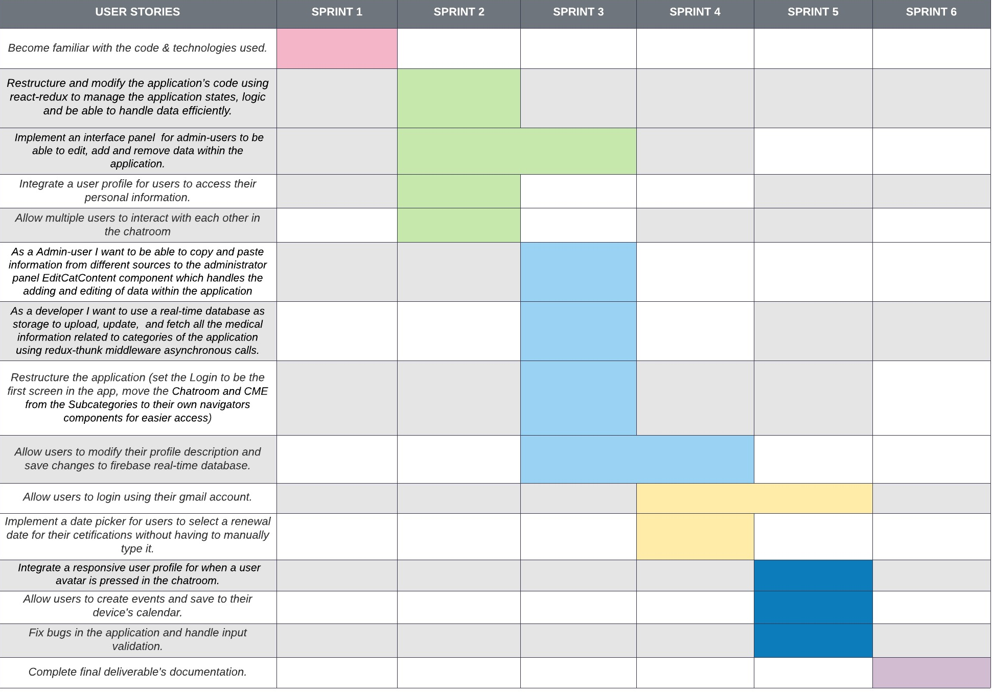
PROJECT MANAGEMENT
Notes:
Introduce the problem that the whole project tackles and stay focused on the parts that you have been working. Indicate if there is an existing previous system, enumerate its problems/limitations, etc.

Slide 8
USER STORIES (SANTIAGO DE IRALA MUT)
I worked on the following user stories:
1-1, 2-1, 3-15, 4-4, 4-8, 5-5
Of these, the most significant/important are:
2-1: As a user of the app, I would like to be able to chat with other users.
3-15: As a user of the app, I would like to be able to see a picture or profile of the person
Notes:
4. Requirements:
4.1. User stories implemented (one or more slides).
4.2. UML use cases and the use case diagram for the implemented use cases (one or more slides).
4.3. UML sequence diagrams for the implemented use cases.

Slide 9
USER STORIES (DIANET CRUZ)
I worked on the following user stories:
1-4,2-8, 2-10, 3-8, 3-9, 3-10, 3-11, 4-5, 4-6, 4-7, 5-7,5-8, 6-3
Of these, the most significant/important are:
2-10: As a user, I would like to sign into my account using other types of
applications such as gmail.
3-8: As a developer, I want to be able to login with my Gmail.
3-10: As a developer, I want to be able to create a landing page where my user can understand what the application is about.
3-11: As a User, I want to have a nice UI once I login into the application.
4-5: As a developer, I would like to create a way for users to log in and sign up with google when opening the application.
4-6: As a user, I would like to see a splash screen when first entering the application before going to the login/signup page.
4-7: As a user, I would like to see a landing page when I open the application.
Notes:
4. Requirements:
4.1. User stories implemented (one or more slides).
4.2. UML use cases and the use case diagram for the implemented use cases (one or more slides).
4.3. UML sequence diagrams for the implemented use cases.

Slide 10
USER STORIES (YEILYS FUNDORA)
I worked on the following user stories:
1-2, 2-2, 2-3, 2-4, 3-5, 3-6, 3-7, 4-1, 4-2, 4-3, 5-1, 5-2, 5-3, 5-6, 6-1
Of these, the most significant/important are:
2-3: As a user, I would like to access my profile, be able to edit my personal information and save it.
2-4: As a user, I would like to have navigation tabs and menus to access the app’s contents easily.
3-5: As a developer, I want to restructure the application, moving the categories Search, Chat and CME to their own navigators’ components for easier access.
3-7: As a developer, I want to be able to save all the user information and future updates to a real-time database.
5-2: As a developer, I want to show a responsive user profile for when a user avatar is pressed in the chatroom.
5-3: As a developer, I want users to create events and be able to add them to their own device calendar.
Notes:
4. Requirements:
4.1. User stories implemented (one or more slides).
4.2. UML use cases and the use case diagram for the implemented use cases (one or more slides).
4.3. UML sequence diagrams for the implemented use cases.

Slide 11
USER STORIES (ABEL GONZALEZ)
I worked on the following user stories:
1-3, 2-5, 2-6, 2-7, 3-1, 3-2, 3-3, 3-4, 4-9, 4-10, 5-4, 5-9, 6-4
Of these, the most significant/important are:
2-5: As a developer I want to work in restructuring and modifying the application’s code using react-redux to manage the application states, logic and be able to handle data efficiently.
2-6: As an admin-user, I would like to have an interface panel to be able to edit, add and remove data within the application.
2-7: As a user I would like to have a drawer navigation to access the admin panel, categories and categories content from the home page of the application
3-1: As a Admin-user I want to be able to copy and paste information from different sources to the administrator panel EditCatContent component which handles the adding and editing of data within the application
3-3: As a developer I want to use a real-time database as storage to upload, update, and fetch all the medical information related to categories of the application using redux-thunk middleware asynchronous calls.
3-4: As a developer I want to redesign the categories content screen to be more user friendly and display data when a tab is pressed
Notes:
4. Requirements:
4.1. User stories implemented (one or more slides).
4.2. UML use cases and the use case diagram for the implemented use cases (one or more slides).
4.3. UML sequence diagrams for the implemented use cases.

Slide 12
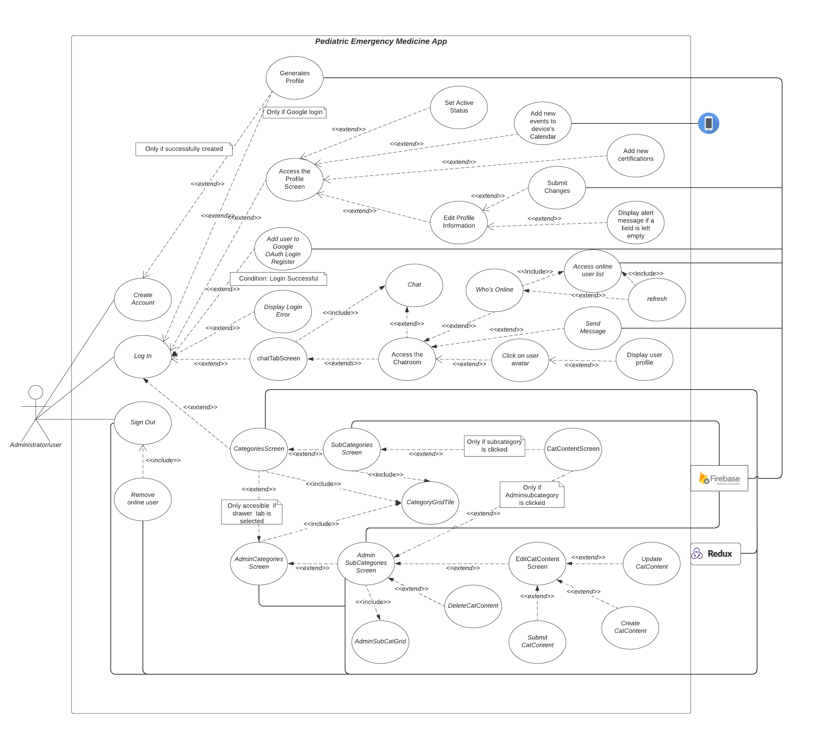
USE CASE DIAGRAM (WHOLE PROJECT)
Notes:
4. Requirements:
4.1. User stories implemented (one or more slides).
4.2. UML use cases and the use case diagram for the implemented use cases (one or more slides).
4.3. UML sequence diagrams for the implemented use cases.

Slide 13
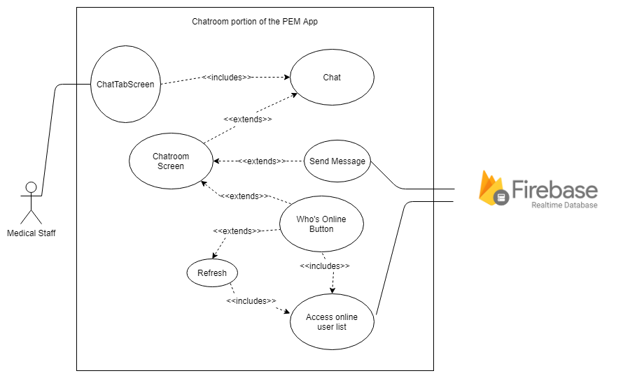
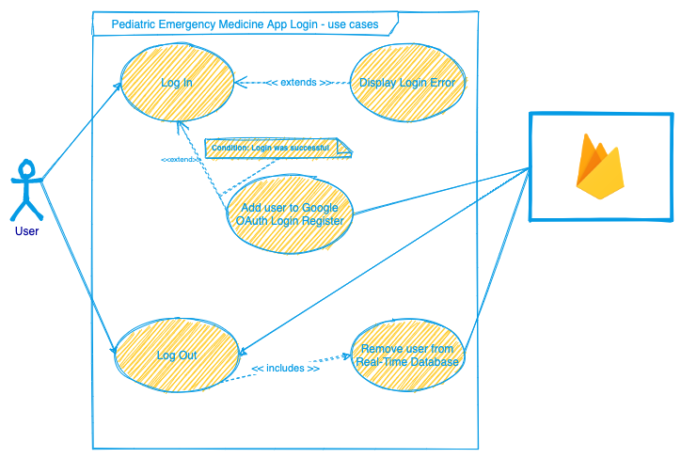
USE CASE DIAGRAM (INDIVIDUAL PARTS)
Use Case Diagram (Santiago de Irala’s Contribution)
Use Case Diagram (Dianet Cruz’s Contribution)
Notes:
4. Requirements:
4.1. User stories implemented (one or more slides).
4.2. UML use cases and the use case diagram for the implemented use cases (one or more slides).
4.3. UML sequence diagrams for the implemented use cases.

Slide 14
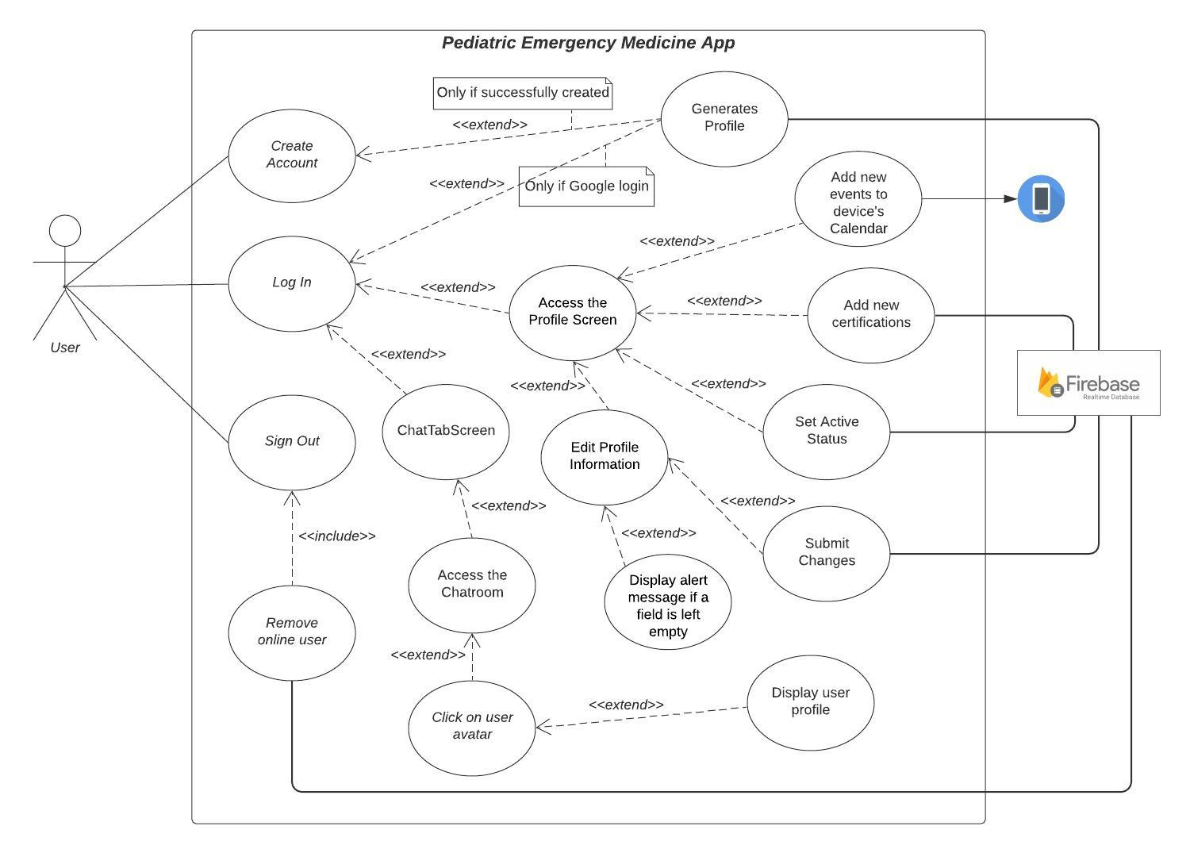
USE CASE DIAGRAM (INDIVIDUAL PARTS)
Use Case Diagram (Yeilys Fundora’s Contribution)
Notes:
4. Requirements:
4.1. User stories implemented (one or more slides).
4.2. UML use cases and the use case diagram for the implemented use cases (one or more slides).
4.3. UML sequence diagrams for the implemented use cases.

Slide 15
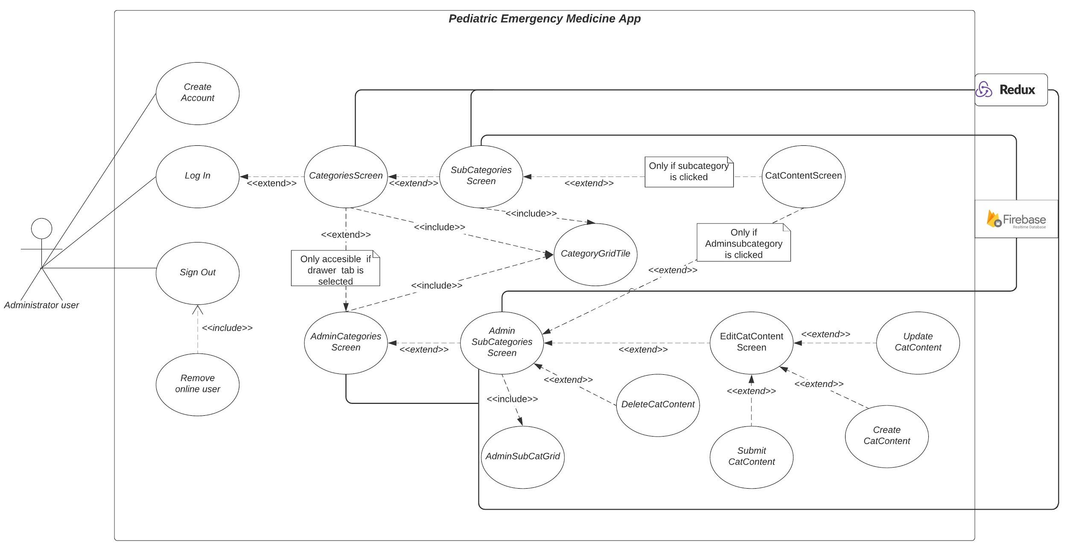
USE CASE DIAGRAM (INDIVIDUAL PARTS)
Use Case Diagram (Abel Gonzalez’s Contribution)
Notes:
4. Requirements:
4.1. User stories implemented (one or more slides).
4.2. UML use cases and the use case diagram for the implemented use cases (one or more slides).
4.3. UML sequence diagrams for the implemented use cases.

Slide 16
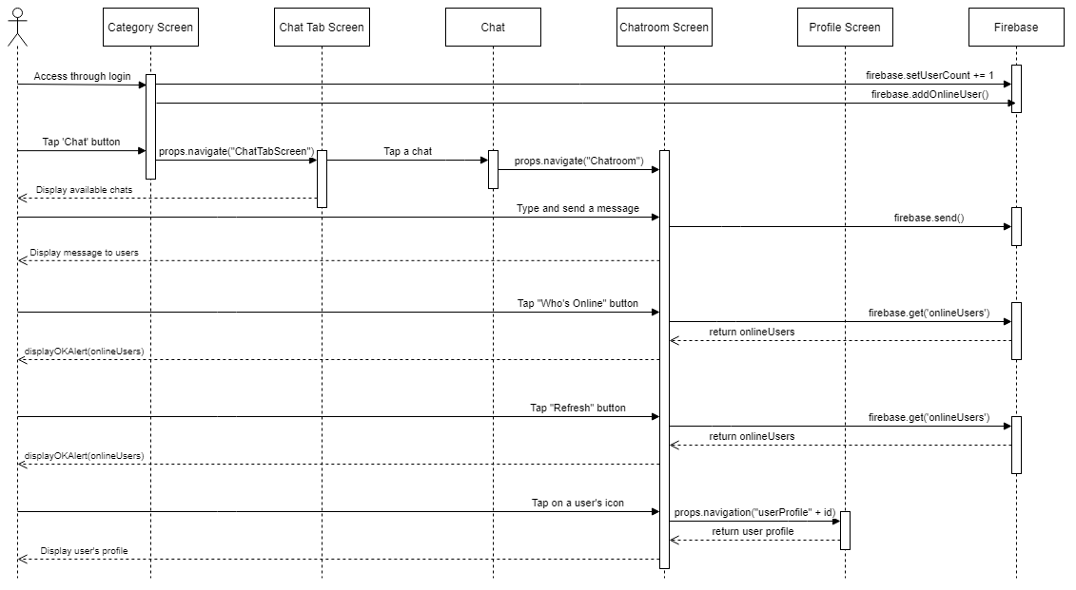
SEQUENCE DIAGRAMS (SANTIAGO DE IRALA MUT)
Notes:
4. Requirements:
4.1. User stories implemented (one or more slides).
4.2. UML use cases and the use case diagram for the implemented use cases (one or more slides).
4.3. UML sequence diagrams for the implemented use cases.

Slide 17
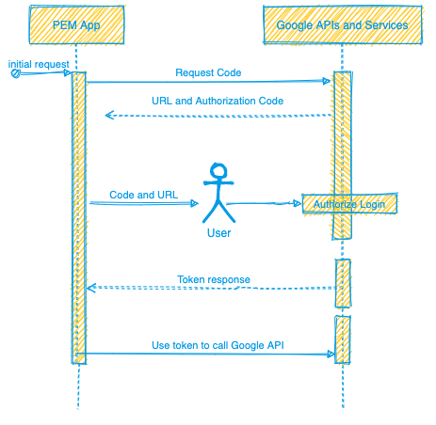
SEQUENCE DIAGRAMS (DIANET CRUZ)
Notes:
4. Requirements:
4.1. User stories implemented (one or more slides).
4.2. UML use cases and the use case diagram for the implemented use cases (one or more slides).
4.3. UML sequence diagrams for the implemented use cases.

Slide 18
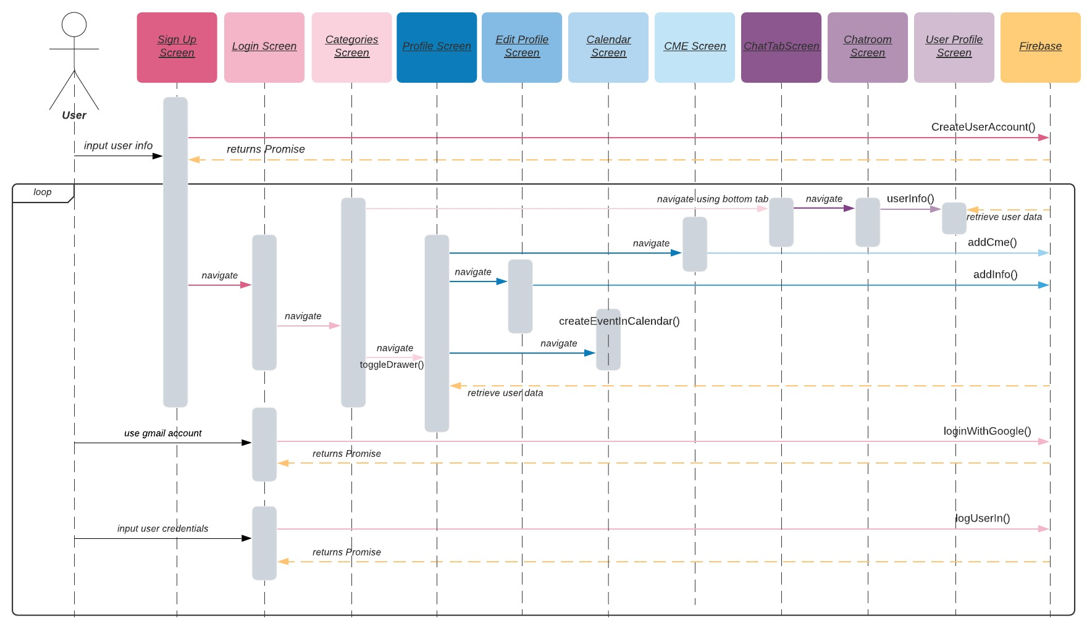
SEQUENCE DIAGRAMS (YEILYS FUNDORA)
Notes:
4. Requirements:
4.1. User stories implemented (one or more slides).
4.2. UML use cases and the use case diagram for the implemented use cases (one or more slides).
4.3. UML sequence diagrams for the implemented use cases.

Slide 19
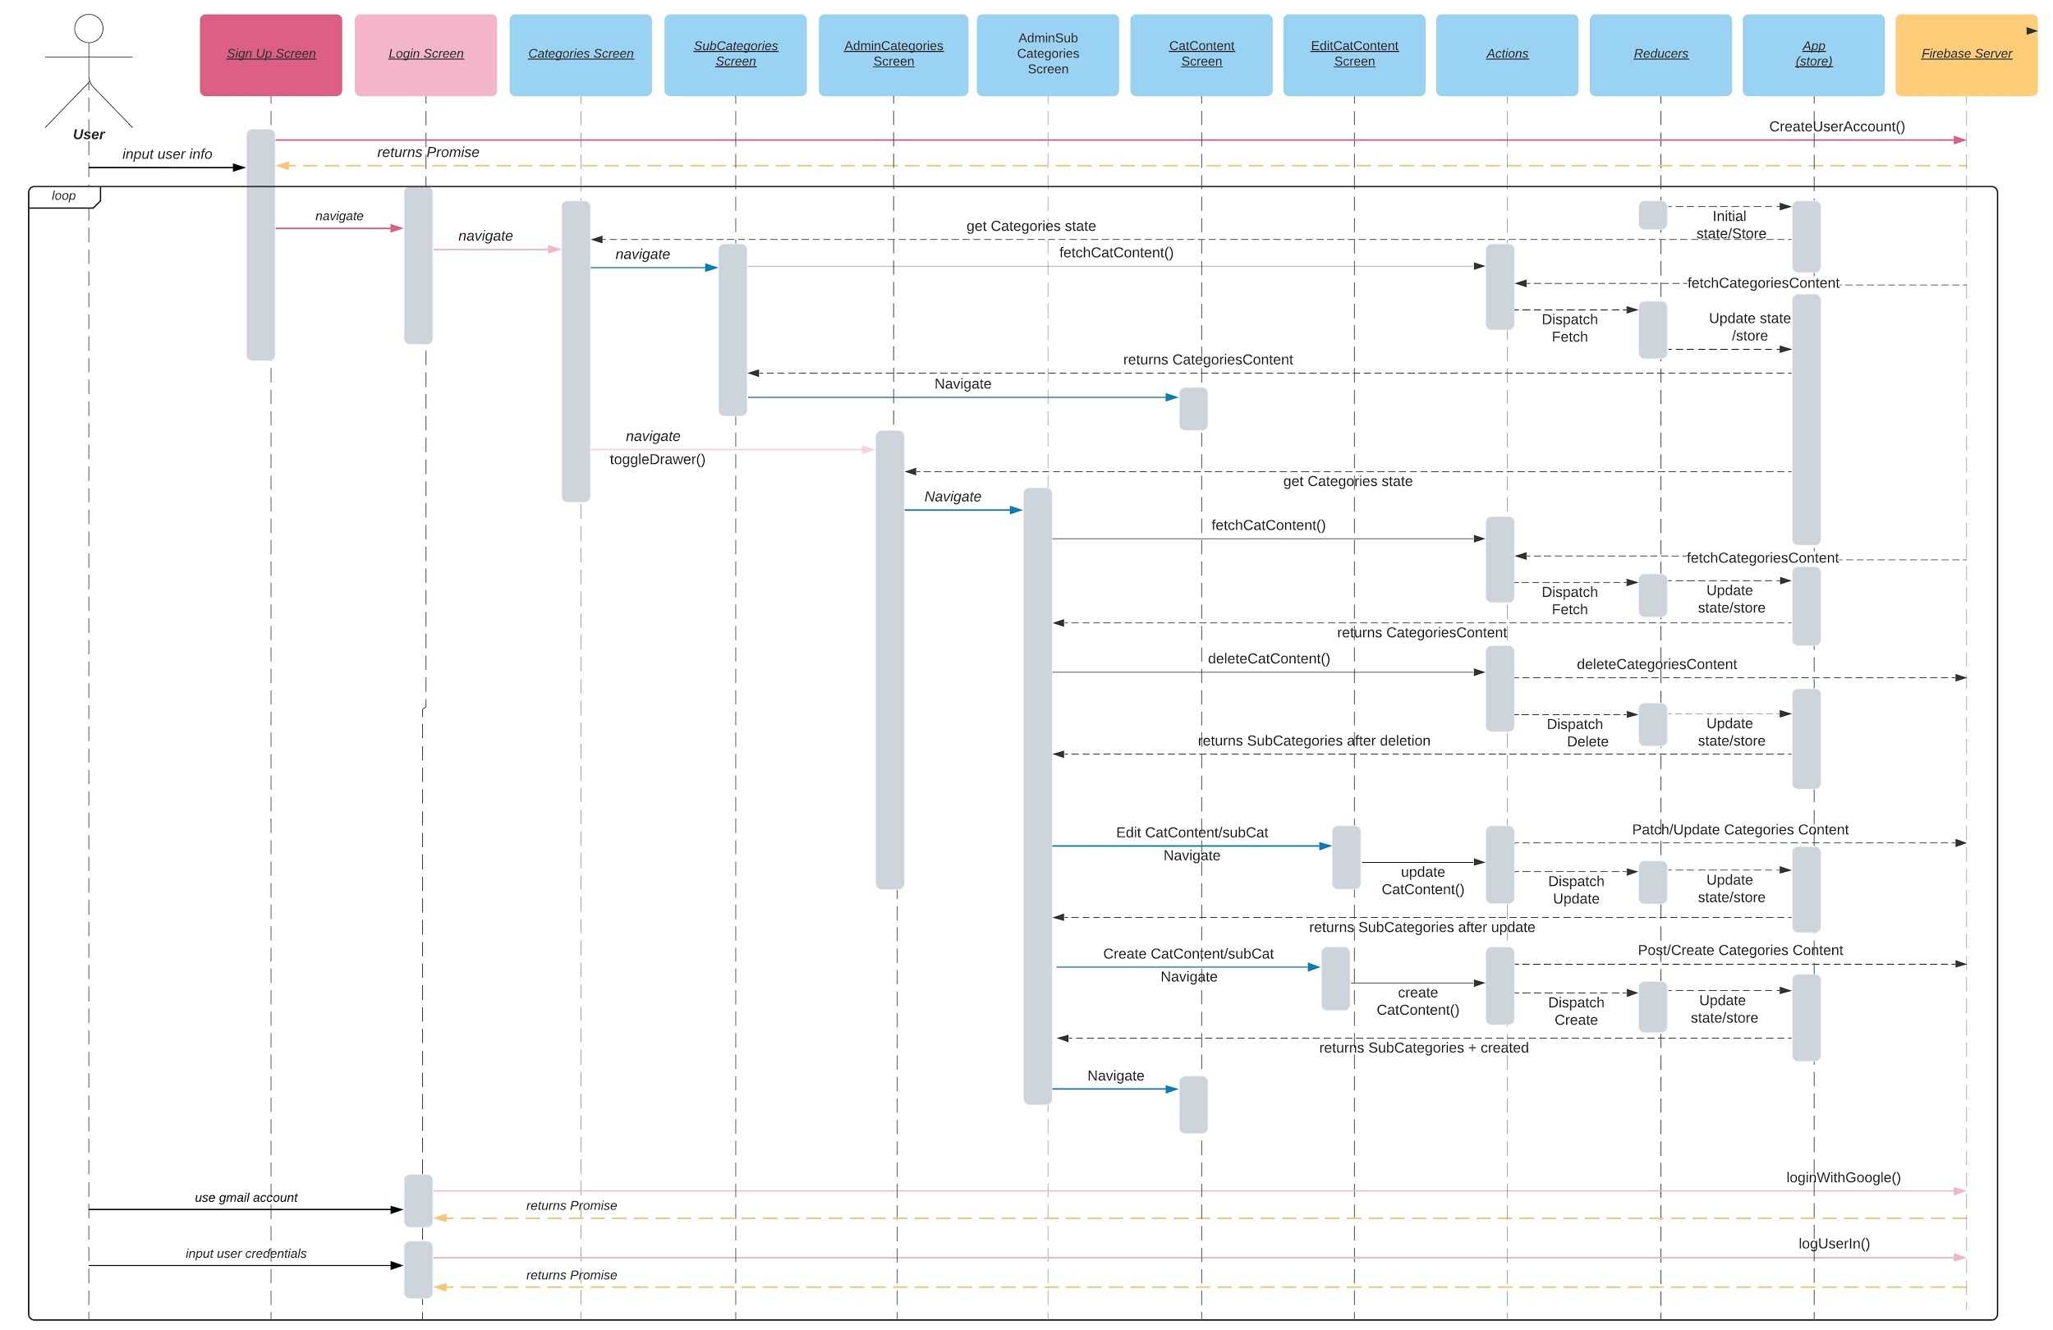
SEQUENCE DIAGRAMS (ABEL GONZALEZ)
Notes:
4. Requirements:
4.1. User stories implemented (one or more slides).
4.2. UML use cases and the use case diagram for the implemented use cases (one or more slides).
4.3. UML sequence diagrams for the implemented use cases.

Slide 20
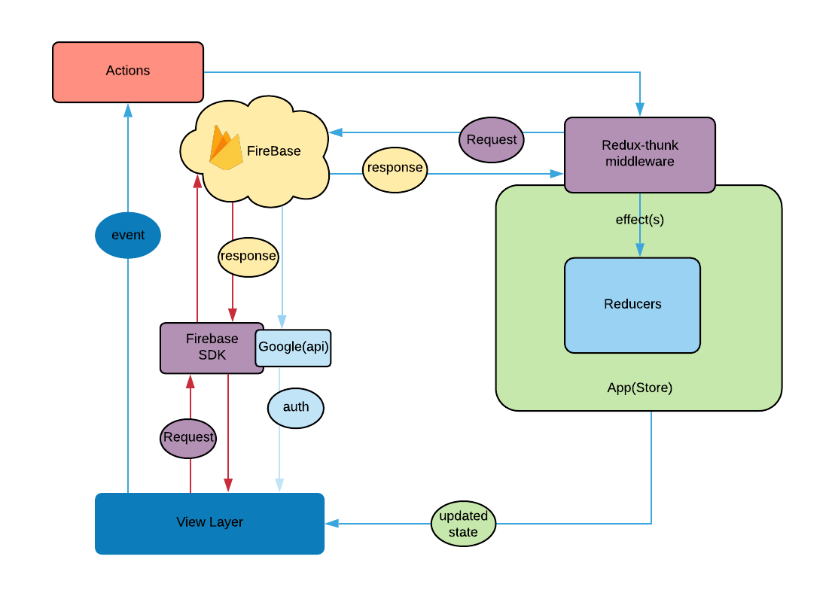
SYSTEM DESIGN: ARCHITECTURE & DEPLOYMENT
Notes:
5. System design:
5.1. System decomposition; identify the architecture patterns used (one slide).
5.2. System deployment – h/w and s/w requirements (one slide).
5.3. Persistent data design (one slide).
5.4. Security/Privacy (one slide).

Slide 21

SYSTEM DATA DESIGN
All data in the application, except authentication-related data (passwords, emails, etc) is stored in Firebase Realtime Database.
Ideal for dynamic data such as messages, CMEs, user profile info and categories content.
Notes:
5. System design:
5.1. System decomposition; identify the architecture patterns used (one slide).
5.2. System deployment – h/w and s/w requirements (one slide).
5.3. Persistent data design (one slide).
5.4. Security/Privacy (one slide).

Slide 22

SYSTEM SECURITY DESIGN
Firebase Authentication used for secure log-in with a variety of different methods like email/password & google login.
User accounts are securely stored by Firebase.
Notes:
5. System design:
5.1. System decomposition; identify the architecture patterns used (one slide).
5.2. System deployment – h/w and s/w requirements (one slide).
5.3. Persistent data design (one slide).
5.4. Security/Privacy (one slide).

Slide 23
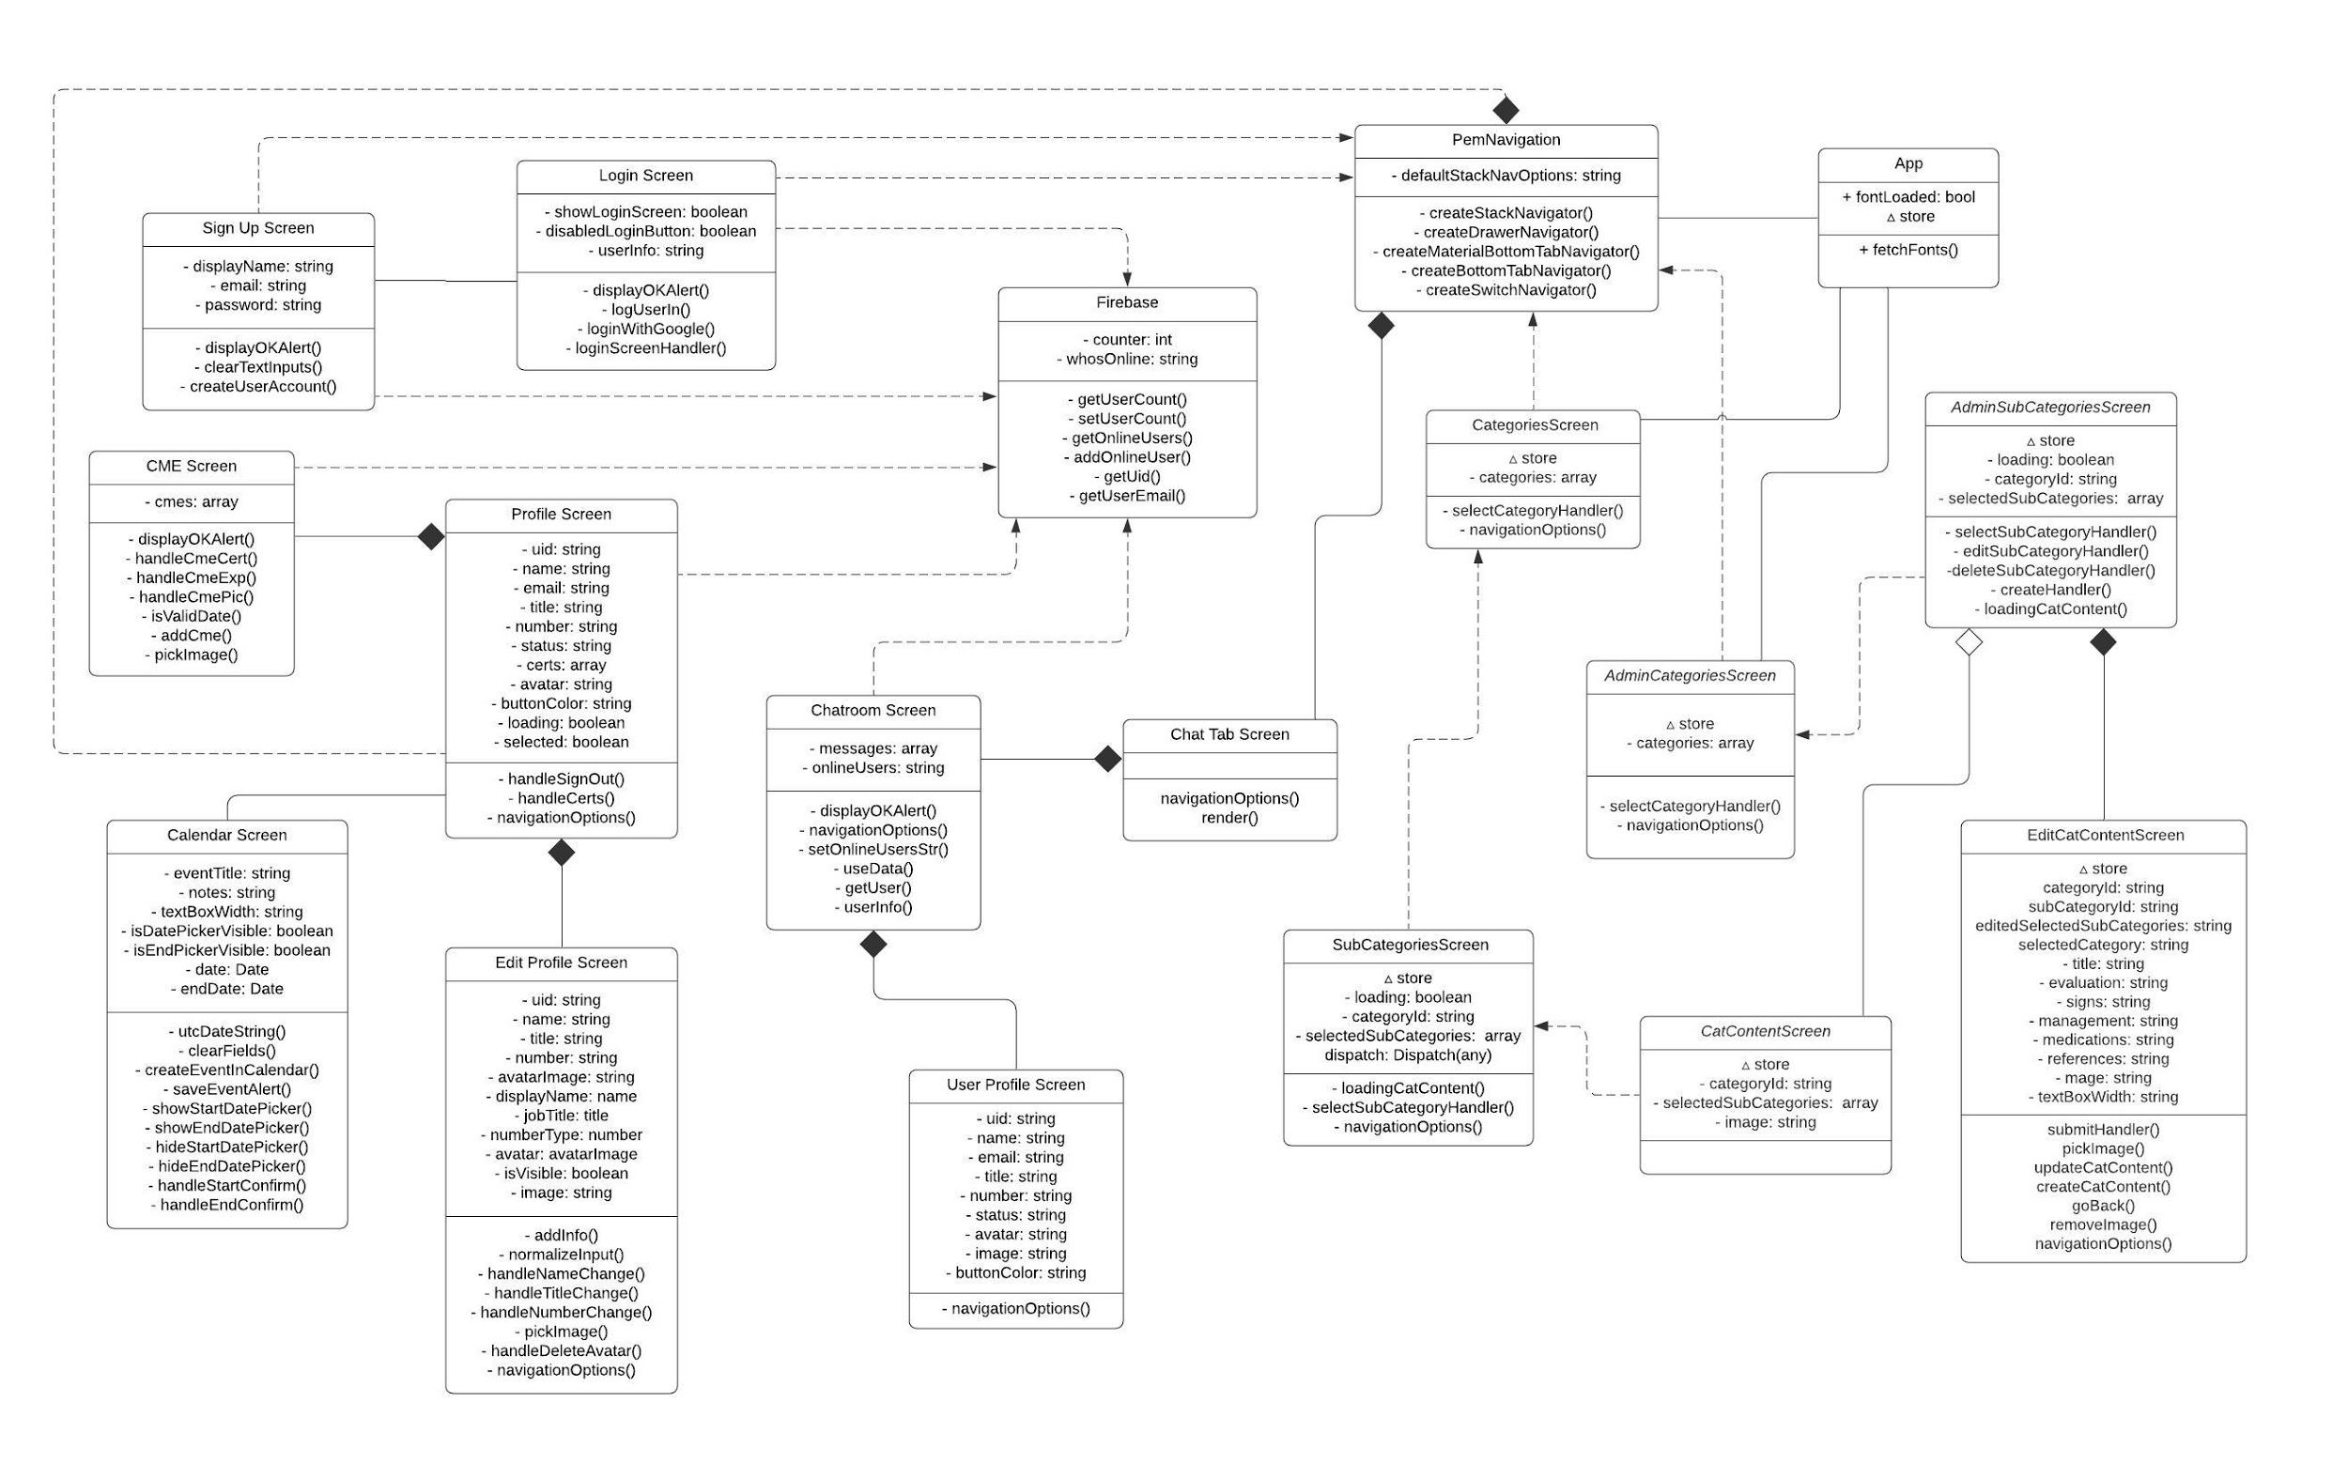
CLASS DIAGRAM (WHOLE PROJECT)
Notes:
6. Detailed design:
6.1. Minimal class diagram. Identify the design patterns used (one or more slides).
6.2. State machine for the main control object or the most important object of the implemented uses cases (one or more slides).
6.3. Main algorithm used related to an implemented use case described above (one or more slides).

Slide 24
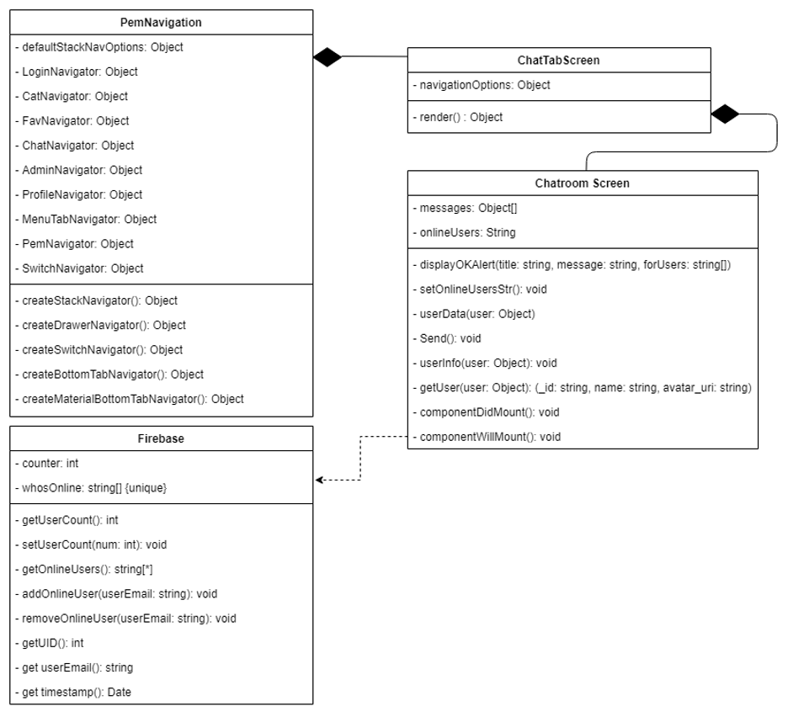
CLASS DIAGRAM (SANTIAGO DE IRALA MUT)
Notes:
6. Detailed design:
6.1. Minimal class diagram. Identify the design patterns used (one or more slides).
6.2. State machine for the main control object or the most important object of the implemented uses cases (one or more slides).
6.3. Main algorithm used related to an implemented use case described above (one or more slides).

Slide 25
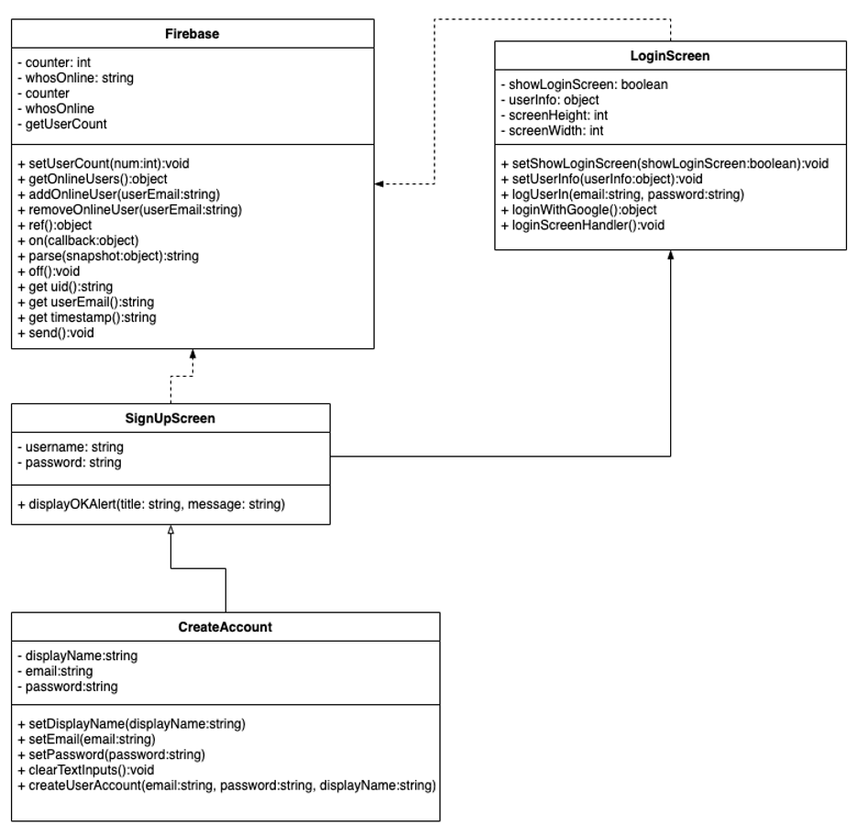
CLASS DIAGRAM (DIANET CRUZ)
Notes:
6. Detailed design:
6.1. Minimal class diagram. Identify the design patterns used (one or more slides).
6.2. State machine for the main control object or the most important object of the implemented uses cases (one or more slides).
6.3. Main algorithm used related to an implemented use case described above (one or more slides).

Slide 26
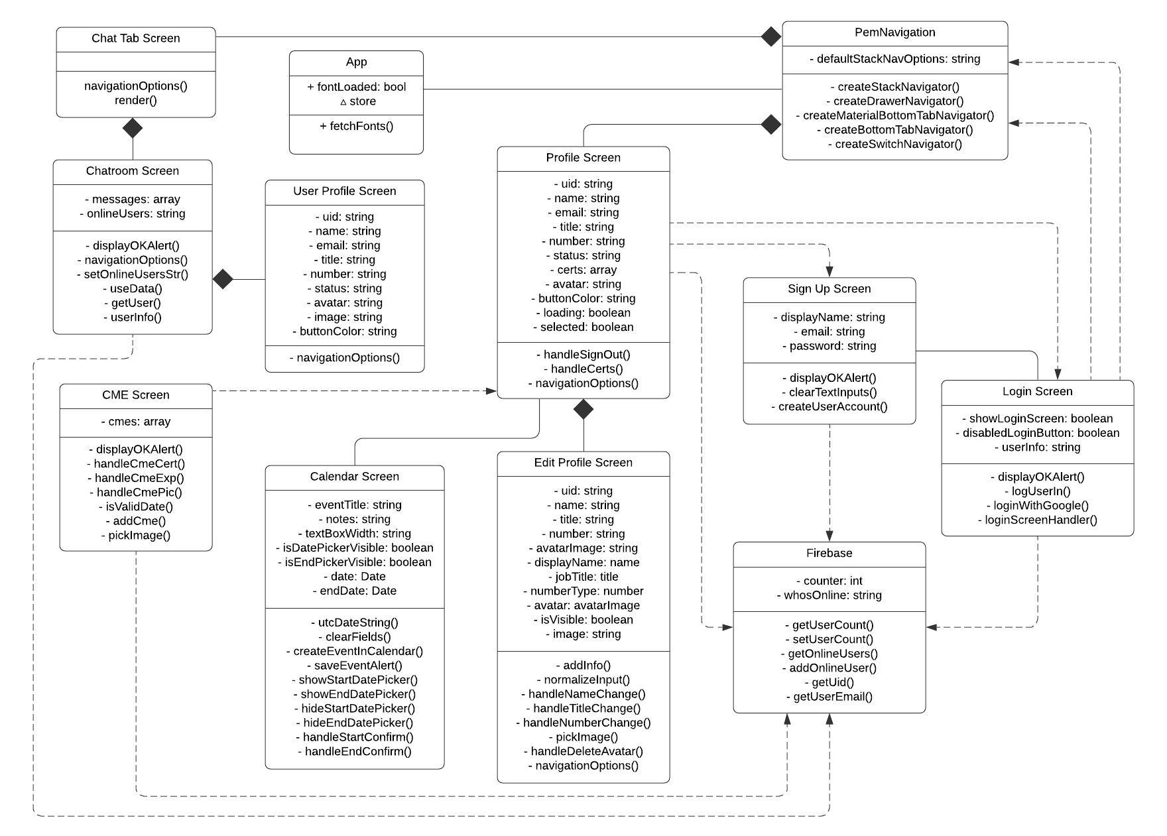
CLASS DIAGRAM (YEILYS FUNDORA)
Notes:
6. Detailed design:
6.1. Minimal class diagram. Identify the design patterns used (one or more slides).
6.2. State machine for the main control object or the most important object of the implemented uses cases (one or more slides).
6.3. Main algorithm used related to an implemented use case described above (one or more slides).

Slide 27
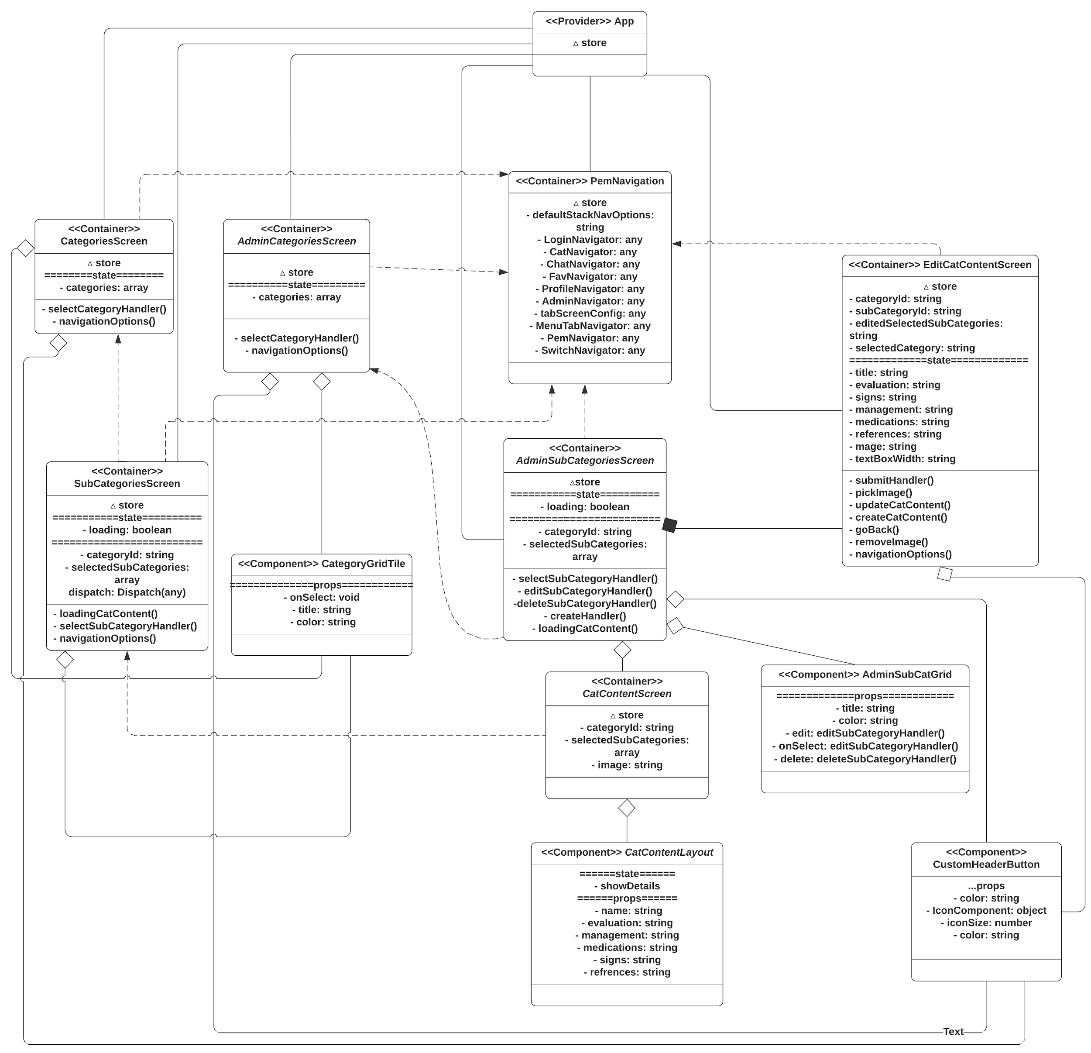
CLASS DIAGRAM (ABEL GONZALEZ)
Notes:
6. Detailed design:
6.1. Minimal class diagram. Identify the design patterns used (one or more slides).
6.2. State machine for the main control object or the most important object of the implemented uses cases (one or more slides).
6.3. Main algorithm used related to an implemented use case described above (one or more slides).

Slide 28
MAIN ALGORITHM
Display search results (subcategories)
let results = []
subcategoriesList.forEach(
subcat => if(subcat.title.contains(userInput)){
results.append(subcat)
}
)
displayResultsList(results)
Note: This main algorithm is from the previous version of the Pediatric Emergency application to search for titles in the categories. It was tested thoroughly with all the new added functionality and changes to the application.
Notes:
6. Detailed design:
6.1. Minimal class diagram. Identify the design patterns used (one or more slides).
6.2. State machine for the main control object or the most important object of the implemented uses cases (one or more slides).
6.3. Main algorithm used related to an implemented use case described above (one or more slides).

Slide 29
TEST SUITES AND TEST CASES
Sunny Day Rainy Day
Purpose | To make sure that the profile of the user is displayed correctly when someone accesses it from the chat.
Preconditions | User being clicked on has set up their profile and it’s connected to the chatroom
Expected Results | User is able to see the profile of the person, including name, CME and similar information, as made available by the other user. The user clicking is NOT able to edit the information.
Actual Results | User is able to see the profile of the person, including name, CME and similar information, as made available by the other user. The user clicking is NOT able to edit the information.
Status | Pass
Purpose | To make sure that the profile of the user is displayed correctly when someone accesses it from the chat.
Preconditions | Two or more users are connected to the chatroom. One user has not set up the profile,
Expected Results | The user sees a default profile fo the other user with just the name and the email, everything else blank or default. The user clicking is NOT able to edit the info.
Actual Results | The user sees a default profile fo the other user with just the name and the email, everything else blank or default. The user clicking is NOT able to edit the info.
Status | Pass
Notes:
7. Test Suites and Test Cases (one sunny day and one rainy day) for the use case represented in part (5) above (2 slides).
7.1 One sunny day and one rainy day for the implemented use cases (one or more slides).
7.2 Automated test scripts for the implemented use cases (one or more slides).

Slide 30
TEST SUITES AND TEST CASES
Sunny Day Rainy Day
Purpose | Guarantee that accounts are created properly with Google Login
Preconditions | Firebase & Google API services are configured correctly and running well
Expected Results | Users successfully Login with Google Account and are welcomed
Actual Results | Users successfully Login with Google Account and are welcomed
Status | Pass
Purpose | Guarantee that accounts are created properly with Google Login
Preconditions | Firebase & Google API services are not configured correctly.
Expected Results | User is unable to login to the app with their Google Account and is shown a relevant error message.
Actual Results | User is unable to login to the app with their Google Account and is shown a relevant error message.
Status | Pass
Notes:
7. Test Suites and Test Cases (one sunny day and one rainy day) for the use case represented in part (5) above (2 slides).
7.1 One sunny day and one rainy day for the implemented use cases (one or more slides).
7.2 Automated test scripts for the implemented use cases (one or more slides).

Slide 31
TEST SUITES AND TEST CASES
Sunny Day Rainy Day
Purpose | Check that a user can successfully set up and edit their profile and save the changes.
Preconditions | Firebase Real-time Database is connected and the user is correctly logged in.
Expected Results | The user is able to change and edit all their information on the app, such as profile picture, full name, email and CMEs.
Actual Results | The user is able to change and edit all their information on the app, such as profile picture, full name, email and CMEs.
Status | Pass
Purpose | Check that a user can successfully set up and edit their profile and save the changes.
Preconditions | Firebase Real-time Database is not connected and the user is correctly logged in.
Expected Results | The user is unable to change and edit all their information on the app, such as profile picture, full name, email and CMEs. They are given a relevant error message.
Actual Results | The user is unable to change and edit all their information on the app, such as profile picture, full name, email and CMEs. They are given a relevant error message.
Status | Pass
Notes:
7. Test Suites and Test Cases (one sunny day and one rainy day) for the use case represented in part (5) above (2 slides).
7.1 One sunny day and one rainy day for the implemented use cases (one or more slides).
7.2 Automated test scripts for the implemented use cases (one or more slides).

Slide 32
TEST SUITES AND TEST CASES
Sunny Day Rainy Day
Purpose | Make sure the admin is able to access the app to add information to the relevant categories and subcategories.
Preconditions | The admin-user’s account has been marked as an admin account.
Expected Results | The admin-user is able to access and edit all the information for each category and sub-category.
Actual Results | The admin-user is able to access and edit all the information for each category and sub-category.
Status | Pass
Purpose | Make sure the admin is able to access the app to add information to the relevant categories and subcategories.
Preconditions | The admin-user’s account has not been marked as an admin account.
Expected Results | The admin-user is unable to access anything further than what a normal user is able to access.
Actual Results | The admin-user is unable to access anything further than what a normal user is able to access.
Status | Pass
Notes:
7. Test Suites and Test Cases (one sunny day and one rainy day) for the use case represented in part (5) above (2 slides).
7.1 One sunny day and one rainy day for the implemented use cases (one or more slides).
7.2 Automated test scripts for the implemented use cases (one or more slides).

Slide 33
SUMMARY
The PEM App will be available, once released, for both Android and iOS devices, allowing a broad spectrum of medical staff to have access to it, worldwide.
Contact:
Santiago de Irala Mut: sdeir001@fiu.edu
Dianet Cruz: dcruz090@fiu.edu
Yeilys Fundora: yfund005@fiu.edu
Abel Gonzalez: agonz943@fiu.edu
Please let us know if you have any questions, suggestions or comments.
Thank You!
Notes:
Summarize your contribution
Include your contact information
Ask if anyone has any questions for you.
Thank your audience

