Slide 1
AI exploration and demo

Slide 2
Agenda
Industry & Scenarios
Data
Industry & Scenarios
Data
Models
Operationalization & Tooling
AI
Models
Operationalization & Tooling

Slide 3
Industry & Scenarios
Speech team is providing TTS/SR capacity to China Mobile(中移动) and state-owned banks, they’re interested in delivering apps on AzS.
Customers interested in AzS:
Supcon(中控 - Leading supplier of automation and information technology, products and solutions),
Uniview(宇视 - Leading public safety and intelligent transportation solutions provider),
Hikvision(海康 - Leading video-centric Internet of Things solutions provider, provides global security, visualization management, and big data services),
Dahua(大华 - Leading Surveillance product and solution provider) .
BingAds team: China + AI.

Slide 4
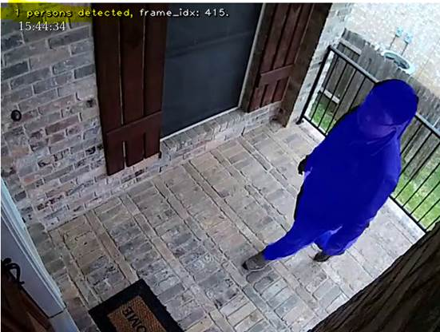
Data
IoT -> connectivity -> Data
Videos + images = 85% data
Demo1:
Bring live video stream to AzS
Human detection & mask.

Slide 5
Models
How do we have enough useful and reusable models that can be deployed on Azure Stack.
Running Deep Learning workloads on AzS.
Training in DLVM or home, inference on AzS.
Aipk
Demo2:
DL models on AzS:
Image:
Facial expression recognition
Car recognition
Chest X-ray
Audio:
TTS (text to speech)
Notes:
Bring AI models to AzS

Slide 6
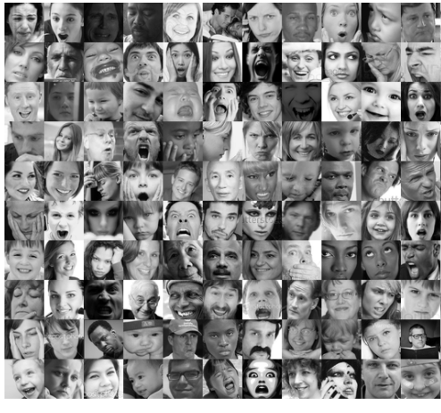
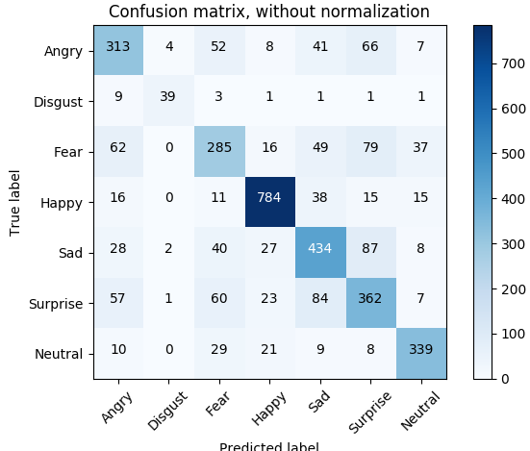
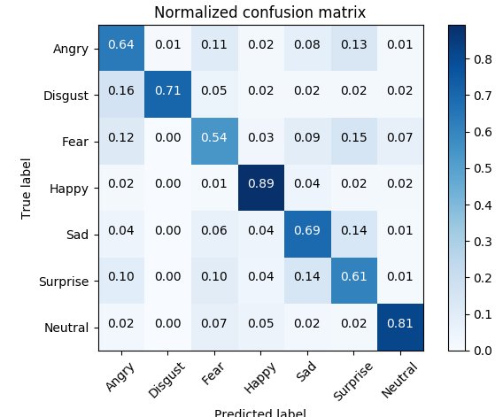
Facial expression recognition
FER-2013 Faces Database
Fine-tune with ResNet-101.
Test acc: 71.22%.
Confusion matrix:

Slide 7
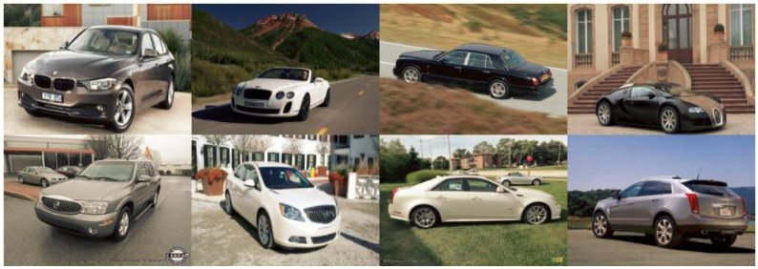
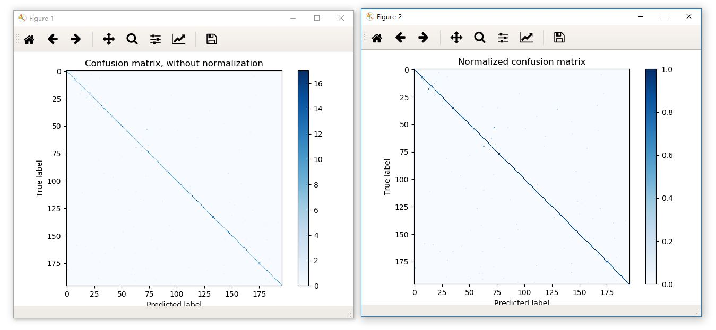
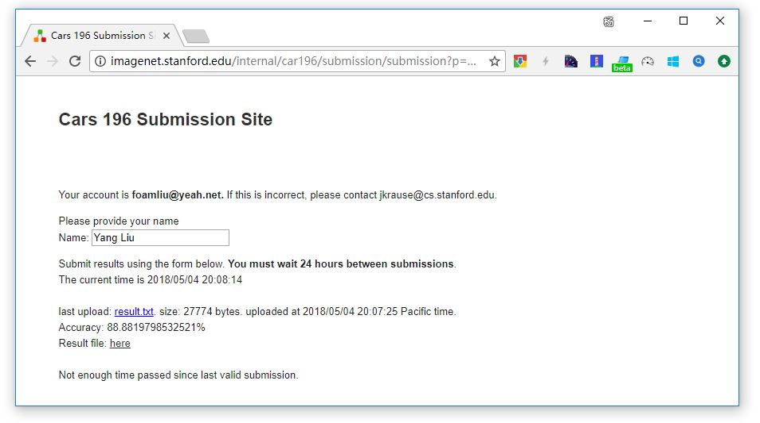
Car recognition
Stanford Cars Dataset
Fine-tune with ResNet-152.
Test acc: 88.88%.
Confusion matrix:

Slide 8
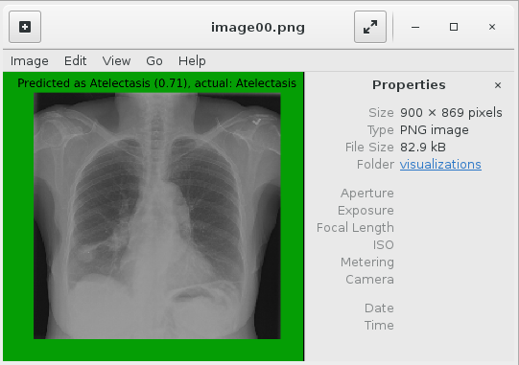
Chest X-ray
AI platform team is exploring a concept of AI packs that allows you to install AI models anywhere (e.g. Azure Stack).
Based on their blob post (link), help packed, can install and run on AzS.

Slide 9
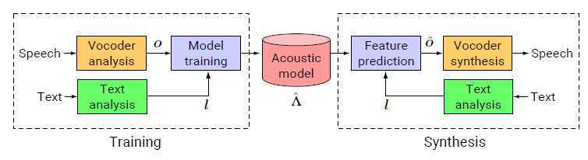
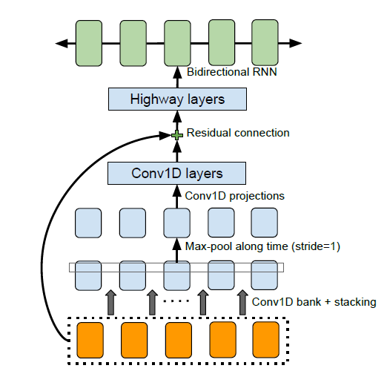
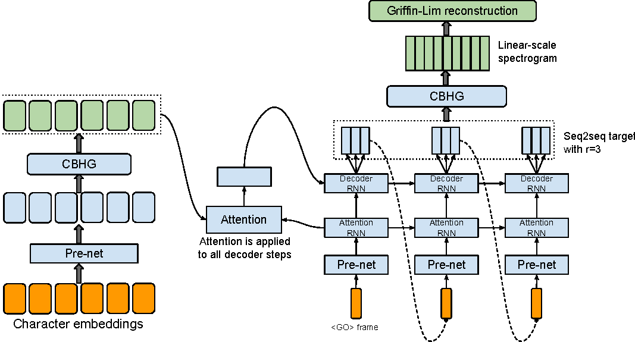
TTS (text to speech)
Statistical parametric model
Tacotron: An end-to-end speech synthesis system by Google. (audio samples)
WaveNet: A Generative Model for Raw Audio by DeepMind.(audio samples)
Tacotron V2. (audio samples)
Tacotron on AzS and DLVM.
This is future, it needs GPU.
End-to-end model

Slide 10
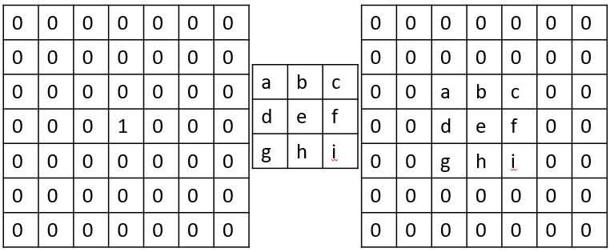
Image classification models
Basic CNN:
Notes:
5*5*32 + 5*5*32*64 + 7*7*64*1024 + 1024 * 10 = 3273504

Slide 11
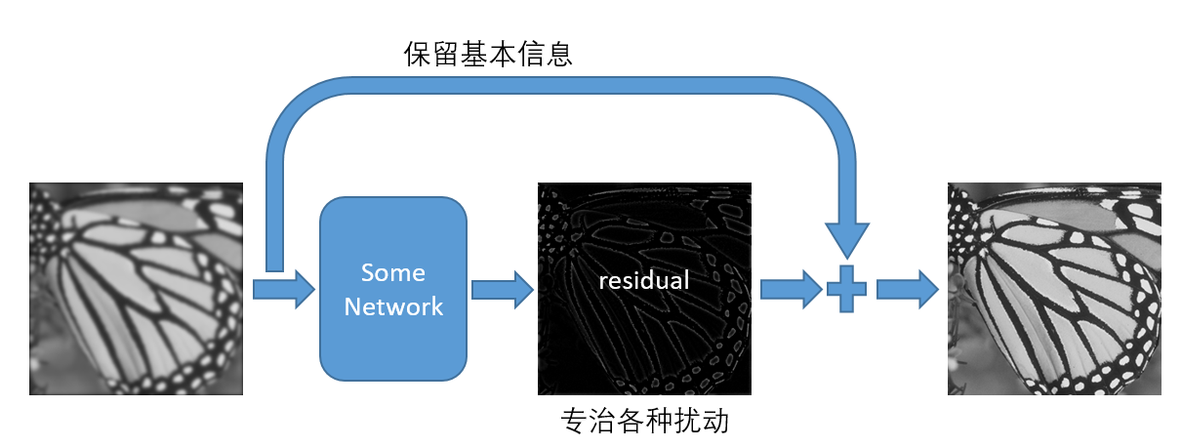
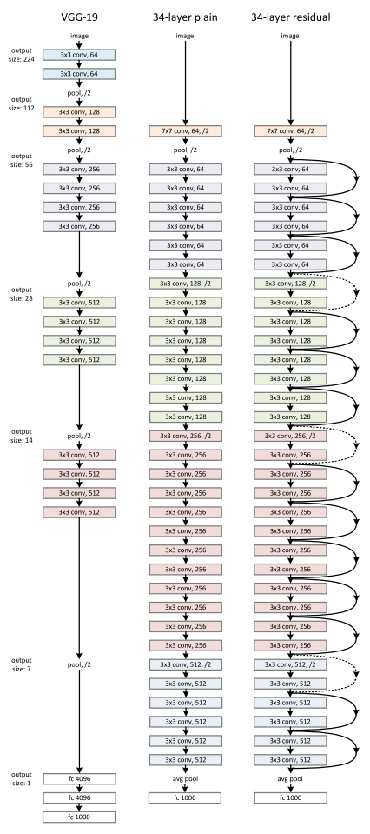
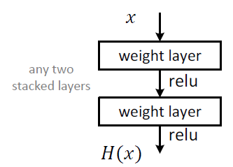
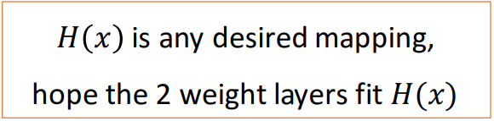
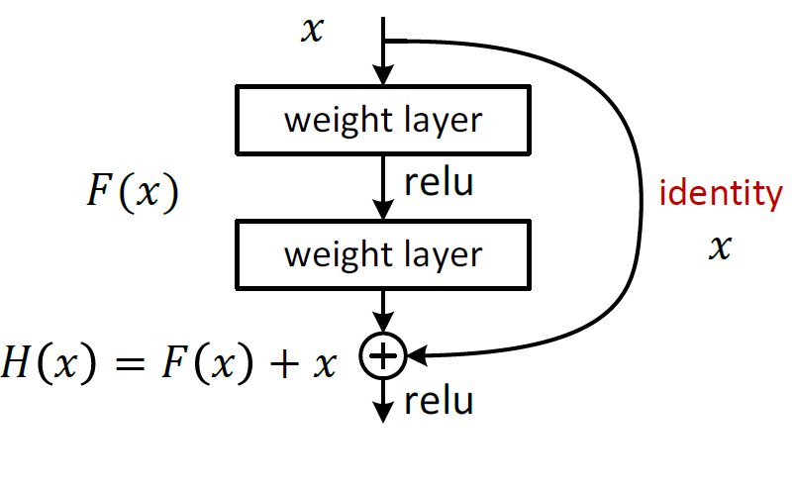
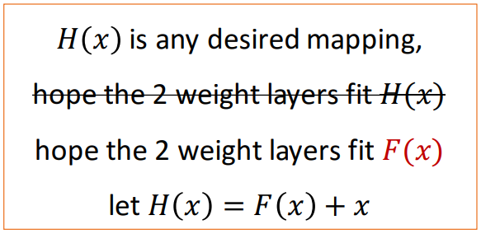
ResNet
基本模块
残差模块

Slide 12
Learning
Training: GPU is key.
Inference:
vary by workloads.
500ms for image recog.
Not necessary for existing speech WL.
Key for complex models or real-time scenarios.
 | CPU | GPU
Environment | Azure Stack DS13_V2 | Azure DLVM NC12
Task1 | CNN model on MNIST (link) - training
Time | 1099.2181s | 201.2000s
Speedup | x5.46
Task2 | RNN model(tacotron) for speech synthesis - inference
Time | 45s | 6s
Speedup | x7.5
Task3 | ResNet-101 on FER-2013 - training
Time | 14:50:26 per epoch | 26:17 per epoch
Speedup | X33.9
Notes:
a highly optimized GPU implementation and an unoptimized, single-core CPU implementation.

Slide 13
Operationalization & Tooling
Speech TTS/SR service deployment is based on Docker/ Kubernetes: (a) create a cluster, b) helm chart deploy Dockers).
Speech recognize/synthesis services today can operate without GPU, but next-gen models are much more computation-intensive.

Slide 14
Conclusion
Time-insensitive inferencing is okay on AzS as of today.
Going forward K8s and GPU are the keys.

Slide 15
Future work
e2e flow about AI on AzS.
Connect to customers and AI services/researches.
Notes:
The blob post outlined e2e flow about AI in Azure,
this should just work in Azure Stack, have a try (especially deployment) to see if any blockers;
Have a better thoughts on: “how models are instrumented and data is collected to calculate their accuracy and precision, we need to have a loop that works like that in Azure Stack, even in offline scenarios.”

