Slide 1
AI exploration and demo

Slide 2
Agenda
Industry & Scenarios
Data
Industry & Scenarios
Data
Models
Operationalization & Tooling
AI
Models
Operationalization & Tooling

Slide 3
Industry & Scenarios
Speech team is providing TTS/SR capacity to China Mobile(中移动) and state-owned banks, they’re interested in delivering apps on AzS.
Customers interested in AzS:
Supcon(中控 - Leading supplier of automation and information technology, products and solutions),
Uniview(宇视 - Leading public safety and intelligent transportation solutions provider),
Hikvision(海康 - Leading video-centric Internet of Things solutions provider, provides global security, visualization management, and big data services),
Dahua(大华 - Leading Surveillance product and solution provider) .

Slide 4
Data
IoT -> connectivity -> Data
Videos + images = 85% data
Demo1:
Bring live video stream to AzS
Pose estimation & recognition

Slide 5
Models
Running Deep Learning workloads on AzS.
Training in DLVM or home, inference on AzS.
Demo2:
DL models on AzS:
Image:
Facial expression recognition
Car recognition
Chest X-ray
Audio:
TTS (text to speech)
Notes:
Bring AI models to AzS

Slide 6
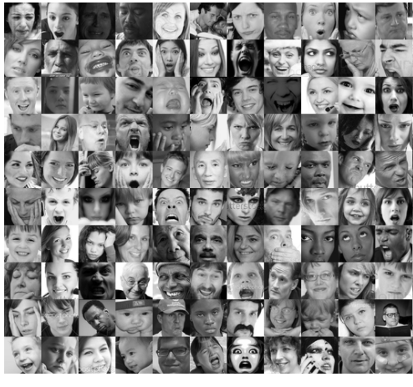
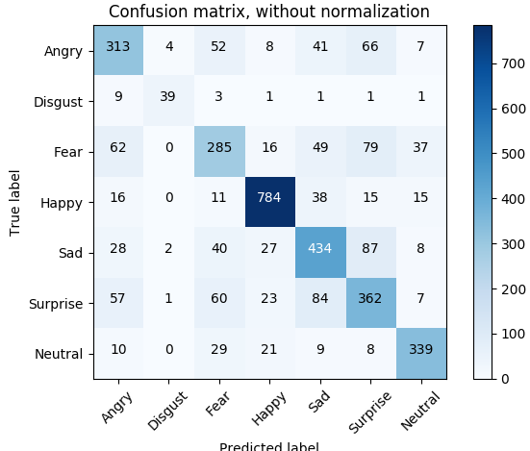
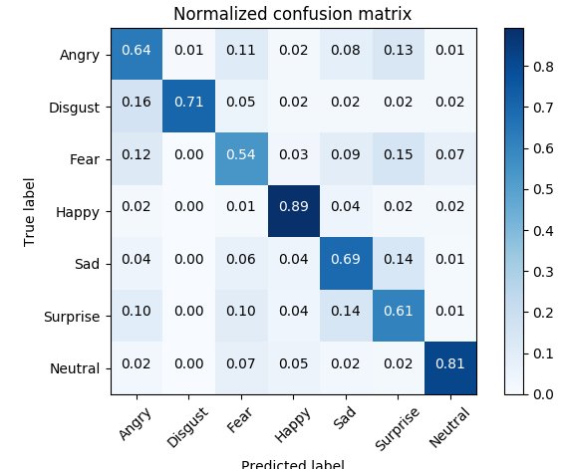
Facial expression recognition
FER-2013 Faces Database
Fine-tune with ResNet-101.
Test acc: 71.22% (state-of-art).
Confusion matrix:

Slide 7
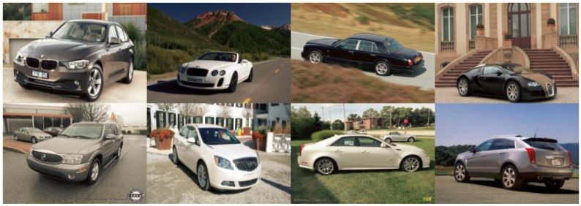
Car recognition
Stanford Cars Dataset

Slide 8
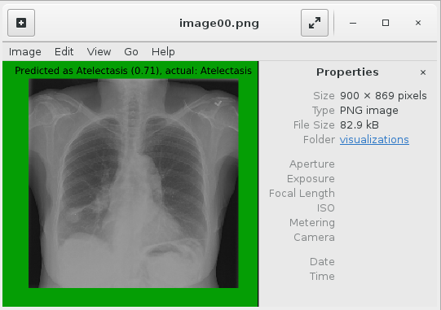
Chest X-ray
AI platform team is exploring a concept of AI packs that allows you to install AI models anywhere (e.g. Azure Stack).
Based on their blob post (link), help packed and install and run on AzS.

Slide 9
TTS (text to speech)

Slide 10
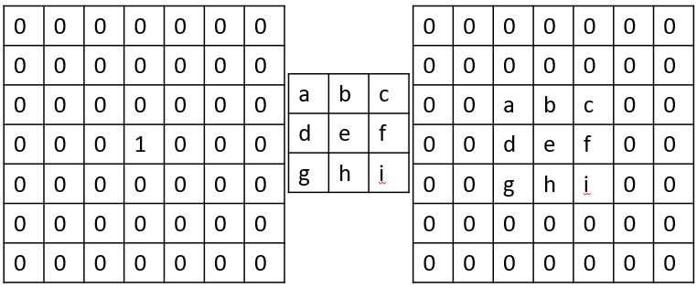
Image classification models
Basic CNN:
Notes:
5*5*32 + 5*5*32*64 + 7*7*64*1024 + 1024 * 10 = 3273504

Slide 11
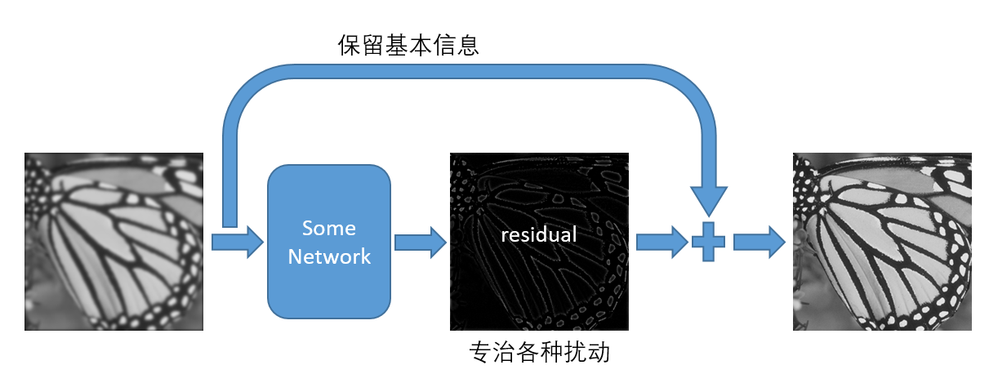
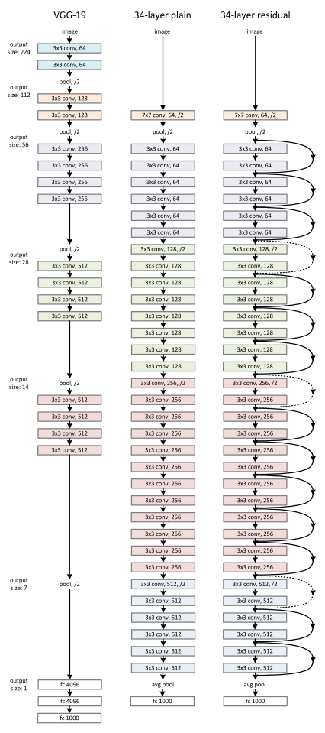
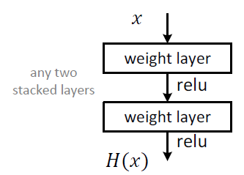
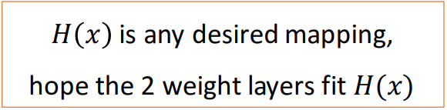
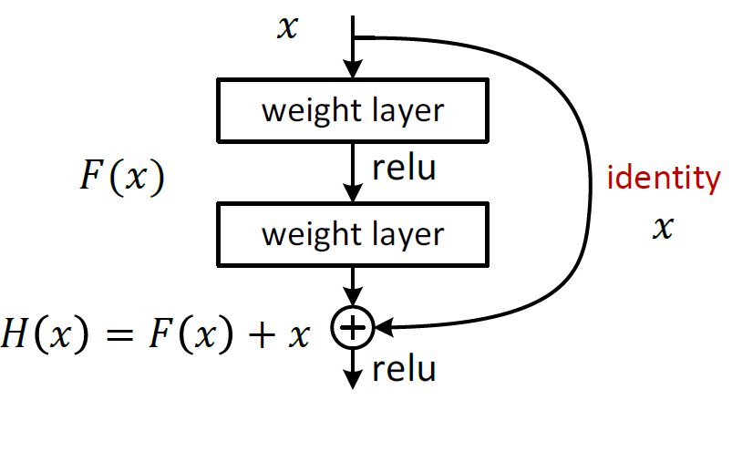
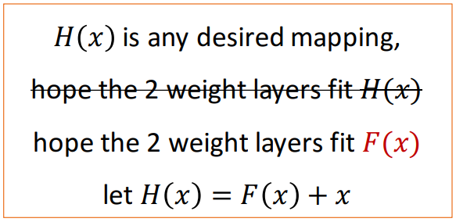
ResNet
基本模块
残差模块

Slide 12
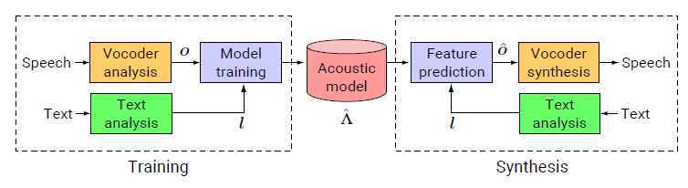
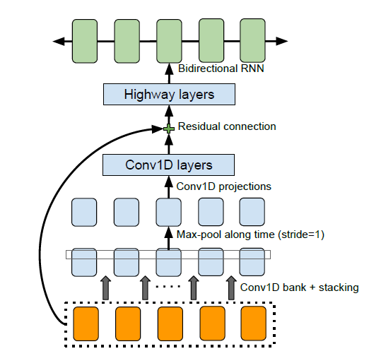
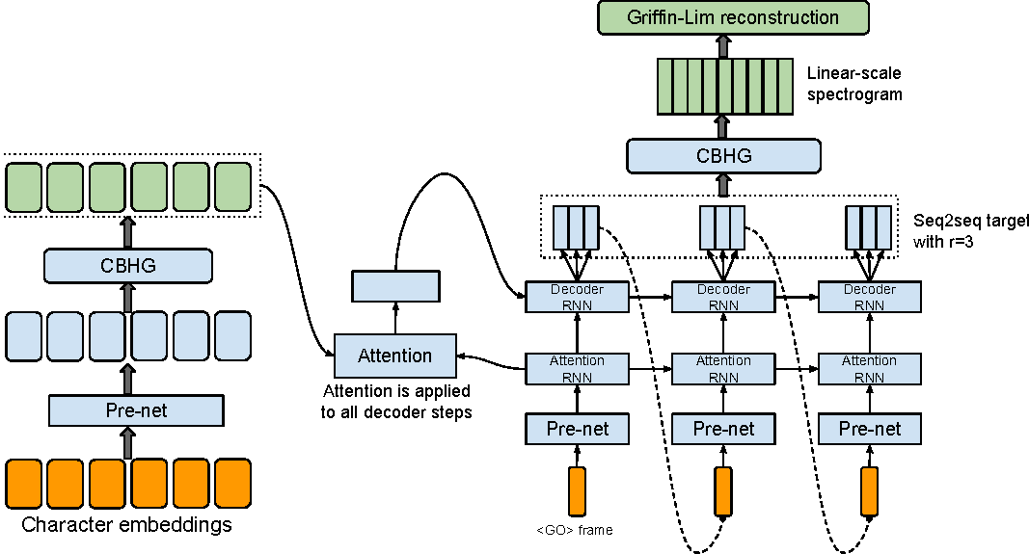
Speech Synthesis Model
Statistical parametric model:
End-to-end model:

Slide 13
Learning
Training: GPU is key.
Inference:
vary by workloads.
500ms for image recog.
Not necessary for existing speech WL.
Key for complex models or real-time scenarios.
 | CPU | GPU
Environment | Azure Stack DS13_V2 | Azure DLVM NC12
Task1 | CNN model on MNIST (link) - training
Time | 1099.2181s | 201.2000s
Speedup | x5.46
Task2 | RNN model(tacotron) for speech synthesis - inference
Time | 45s | 6s
Speedup | x7.5
Task3 | ResNet-101 on FER-2013 - training
Time | 14:50:26 per epoch | 26:17 per epoch
Speedup | X33.9
Notes:
a highly optimized GPU implementation and an unoptimized, single-core CPU implementation.

Slide 14
Operationalization & Tooling
Speech TTS/SR service deployment is based on Docker/ Kubernetes: (a) create a cluster, b) helm chart deploy Dockers).
Speech recognize/synthesis services today can operate without GPU, but next-gen models are much more computation-intensive.

Slide 15
Conclusion
Time-insensitive inferencing is okay on AzS as of today.
Going forward K8s and GPU are the keys.

