Slide 1
AI exploration and demo

Slide 2
Agenda
Industry & Scenarios
Data
Industry & Scenarios
Data
Models
Operationalization & Tooling
AI
Models
Operationalization & Tooling

Slide 3
Data
IoT -> connectivity -> Data
Videos + images = 85% data
Demo1:
Bring live video stream to AzS
Pose estimation & recognition

Slide 4
Models
Run DL models on AzS:
Image:
Chest X-ray
Face recognition
Car recognition
Audio:
TTS (text to speech)
Demo2:
Bring AI models to AzS

Slide 5
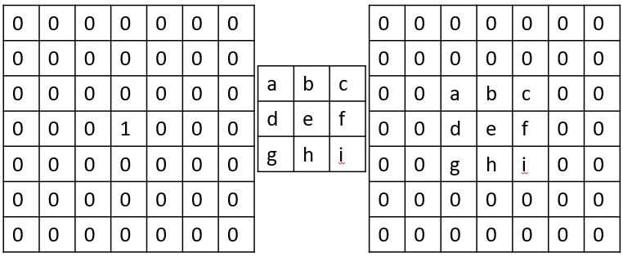
Image classification models
Basic CNN:
Notes:
5*5*32 + 5*5*32*64 + 7*7*64*1024 + 1024 * 10 = 3273504

Slide 6
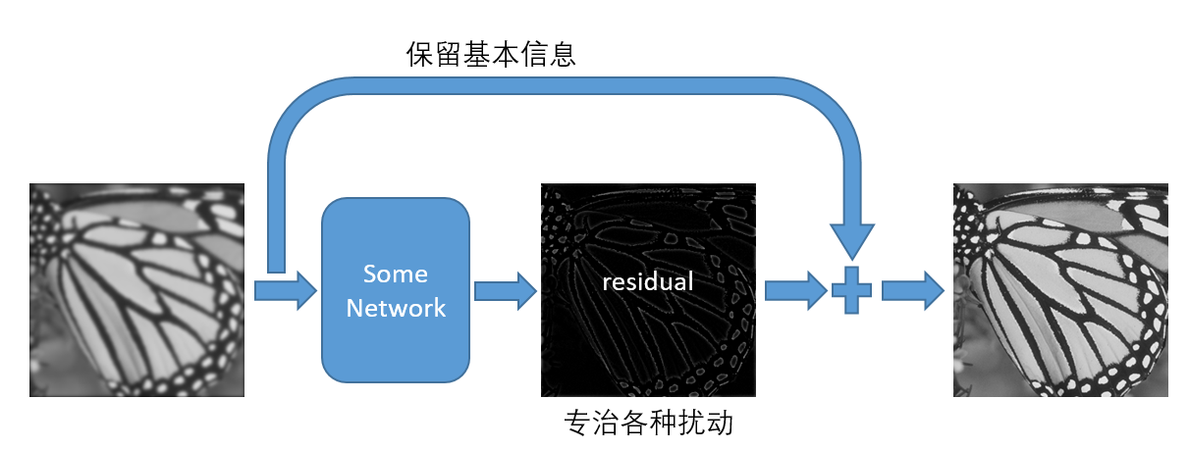
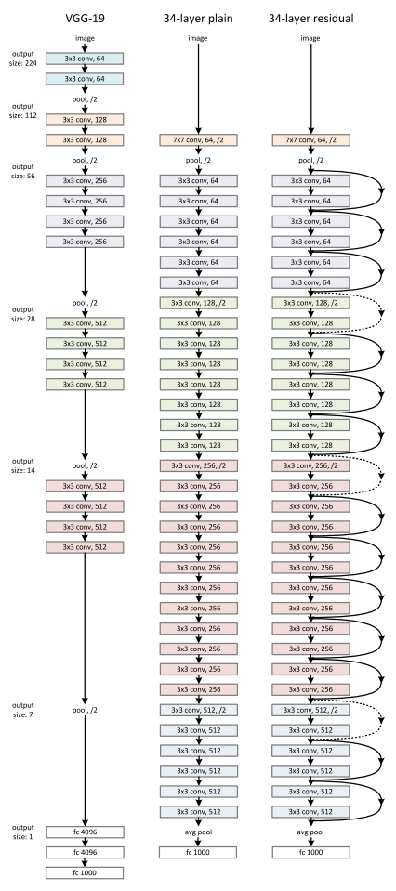
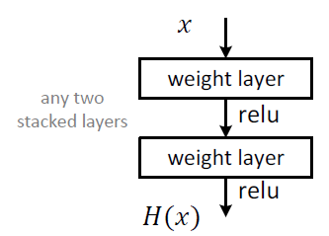
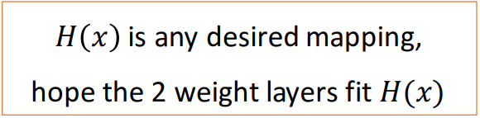
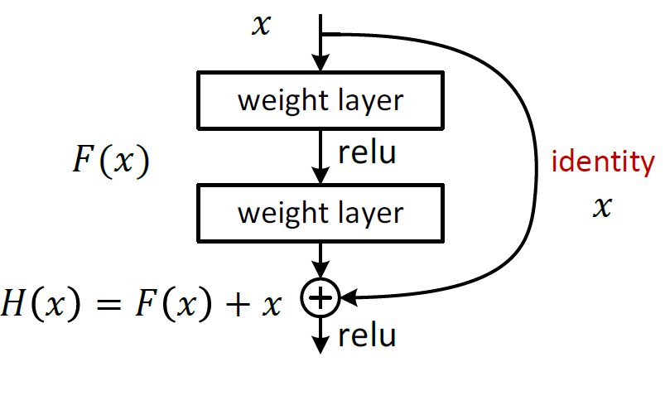
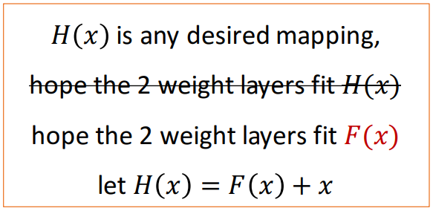
ResNet
基本模块
残差模块

Slide 7
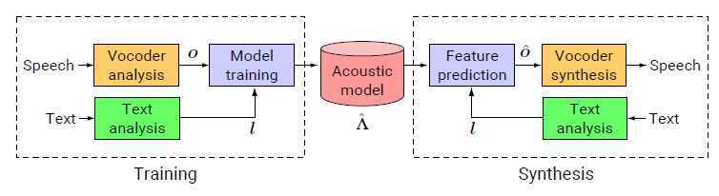
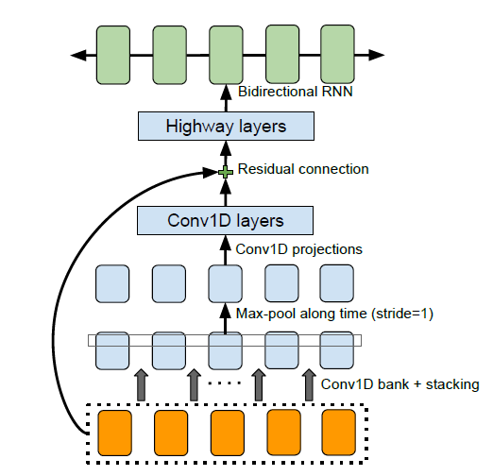
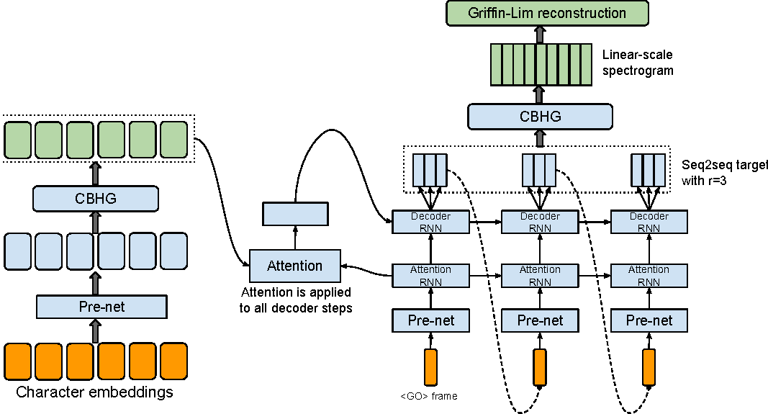
Speech Synthesis Model
Statistical parametric model:
End-to-end model:

Slide 8
Learning
Training: GPU is key.
Inference:
vary by workloads.
500ms for image recog.
Not necessary for existing speech WL.
Key for complex models or real-time scenarios.
 | CPU | GPU
Environment | Azure Stack DS13_V2 | Azure DLVM NC12
Task1 | CNN model on MNIST (link) - training
Time | 1099.2181s | 201.2000s
Speedup | x5.46
Task2 | RNN model(tacotron) for speech synthesis - inference
Time | 45s | 6s
Speedup | x7.5
Task3 | ResNet-101 on FER-2013 - training
Time | 14:50:26 per epoch | 26:17 per epoch
Speedup | X33.9
Notes:
a highly optimized GPU implementation and an unoptimized, single-core CPU implementation.

Slide 9
Operationalization & Tooling
Speech team is providing TTS/SR capacity to local customers.
Speech TTS/SR service deployment is based on Docker/ Kubernetes: (a) create a cluster, b) helm chart deploy Docker).
Speech recognize/synthesis services today can operate without GPU, but next-gen models are much more computation-intensive.

Slide 10
Conclusion
Time-insensitive inferencing is okay in AzS as of today.
Going forward K8s and GPU are the keys.

