Slide 1
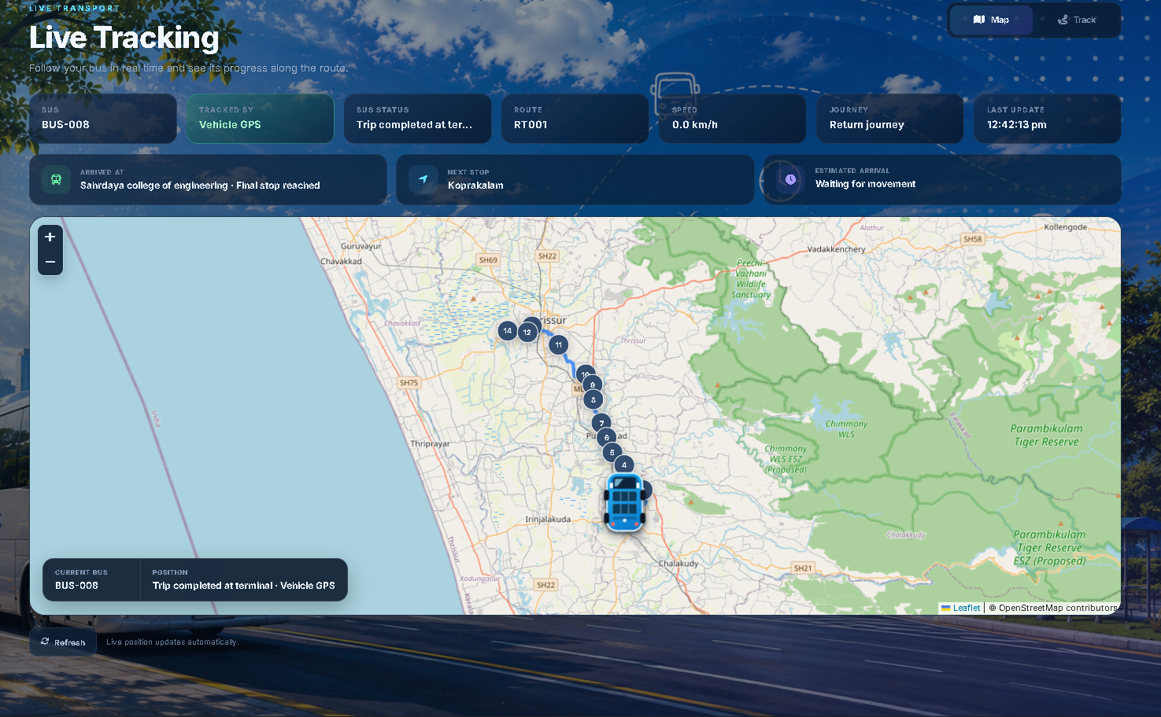
BusTrack
Campus bus tracking and transport operations
A working platform for students, drivers, transport administrators and GPS technicians
ENTREPRENEURSHIP PRESENTATION
From no tracking to a clear, managed campus journey
Notes:
Open with the present situation: the college does not currently use any bus tracking method. Students depend on estimates, calls or informal communication. BusTrack introduces a single system that serves students and the transport team.

Slide 2
02
The current campus experience
There is no live bus tracking system today
0
01
Uncertain waiting
Students may arrive too early or risk missing the bus.
02
Repeated calls
Drivers and transport staff receive location questions during trips.
live tracking tools
Students must estimate where the bus is and when it will reach their stop.
03
No journey record
The college cannot review exact stop arrivals or completed route legs.
04
Limited visibility
Administrators cannot see the whole fleet from one place.
2
Notes:
This slide describes the college's actual starting point. Do not claim that WhatsApp tracking already exists. Explain that any current communication is informal and does not provide a shared operational view.

Slide 3
03
One system, four focused portals
Each person sees the information needed for their role
STUDENT
DRIVER
ADMIN
TECHNICIAN
Live map and stop-by-stop progress
Tools for the assigned journey
Complete transport management
GPS integration and health
Map and Track views
Current and next stop
Outbound and return journey
Digital bus pass
Assigned bus and route
Trip controls
Operational alerts
QR pass verification
Fleet and assignments
Routes and geofences
Trip history
Documents and users
Provider filtering
Delay and timestamp checks
Raw response history
Safe route recovery
The same route state powers every portal
3
Notes:
Describe BusTrack as one transport platform rather than four separate applications. All portals read the same verified journey state, so the student, driver, administrator and technician see consistent information.

Slide 4
04
How BusTrack works
Raw coordinates become route information that students can use
01
02
03
04
05
GPS update
Validate
Route engine
Journey state
Portal update
Vehicle provider or driver phone
Vehicle, timestamp and freshness
Compare with official stop geofences
Current stop, next stop and direction
Student, driver, admin and technician
The map marker and route progress remain separate
BusTrack preserves the real last-known location while showing whether that location is fresh enough to change the route.
4
Notes:
Explain the transformation: a GPS coordinate by itself is only a point. BusTrack validates it, compares it with the saved route, then produces stop progress and journey direction. The final portal refresh does not require the user to reload the page.

Slide 5
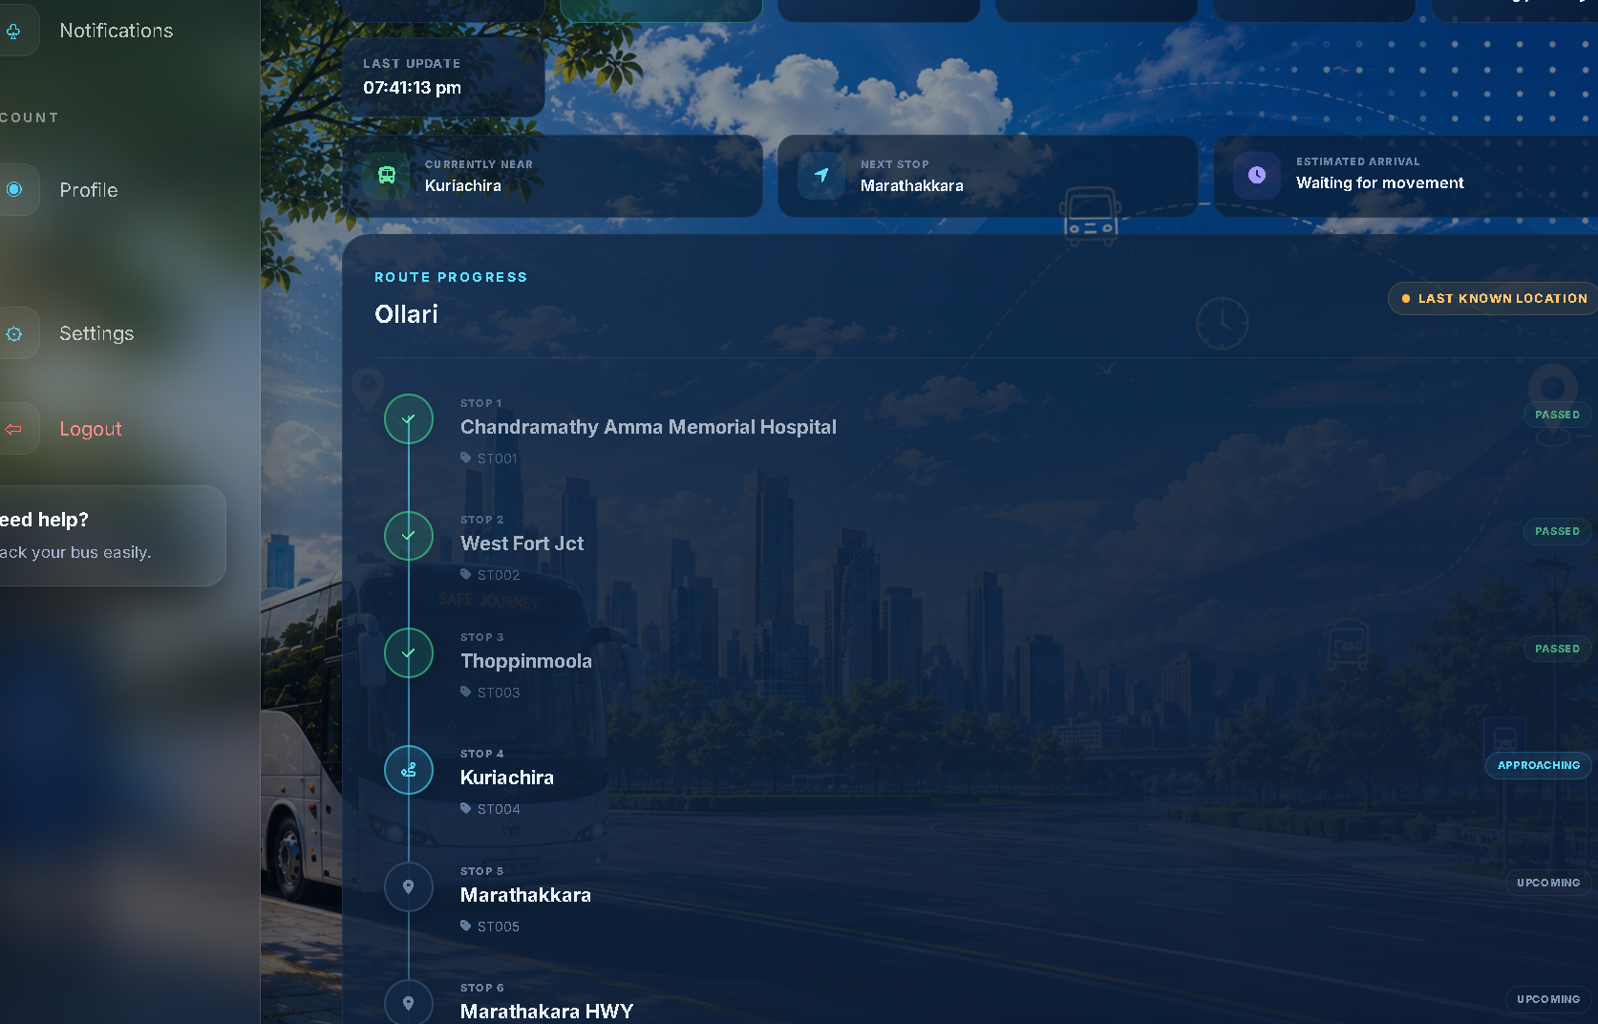
05
Student live tracking
A clear answer to where the bus is and what happens next
Students can see
01
Route progress
Approaching, reached, passed and upcoming stops.
02
Journey direction
Outbound and return routes appear in the correct order.
03
Location confidence
Last-update time and stale warnings prevent false certainty.
5
Notes:
Use the screenshot to show the student's Track view. Point to the current stop, next stop and the passed/upcoming labels. Explain that the Map view uses the same journey state.

Slide 6
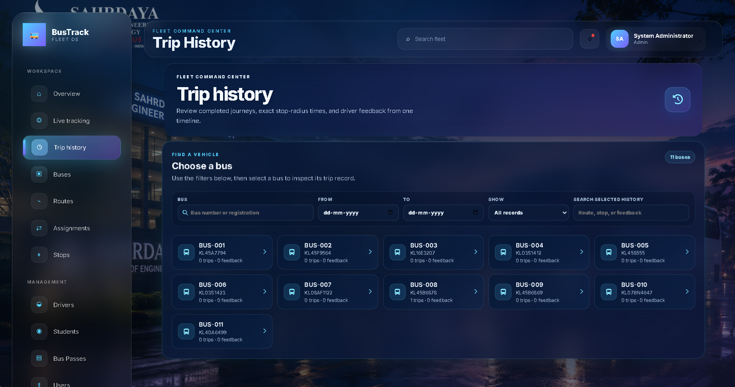
06
Transport administration
One place to manage the fleet and review completed journeys
Operational control
01
Manage the network
Buses, routes, stops, drivers, students and assignments.
02
Review evidence
Stop arrival, departure, dwell time and journey direction.
03
Act on issues
Driver alerts, document reminders, users and active sessions.
6
Notes:
Show how the administrator selects a bus and reviews its trip history. Mention that stop records and driver feedback replace guesswork when someone reports a delay or missed stop.

Slide 7
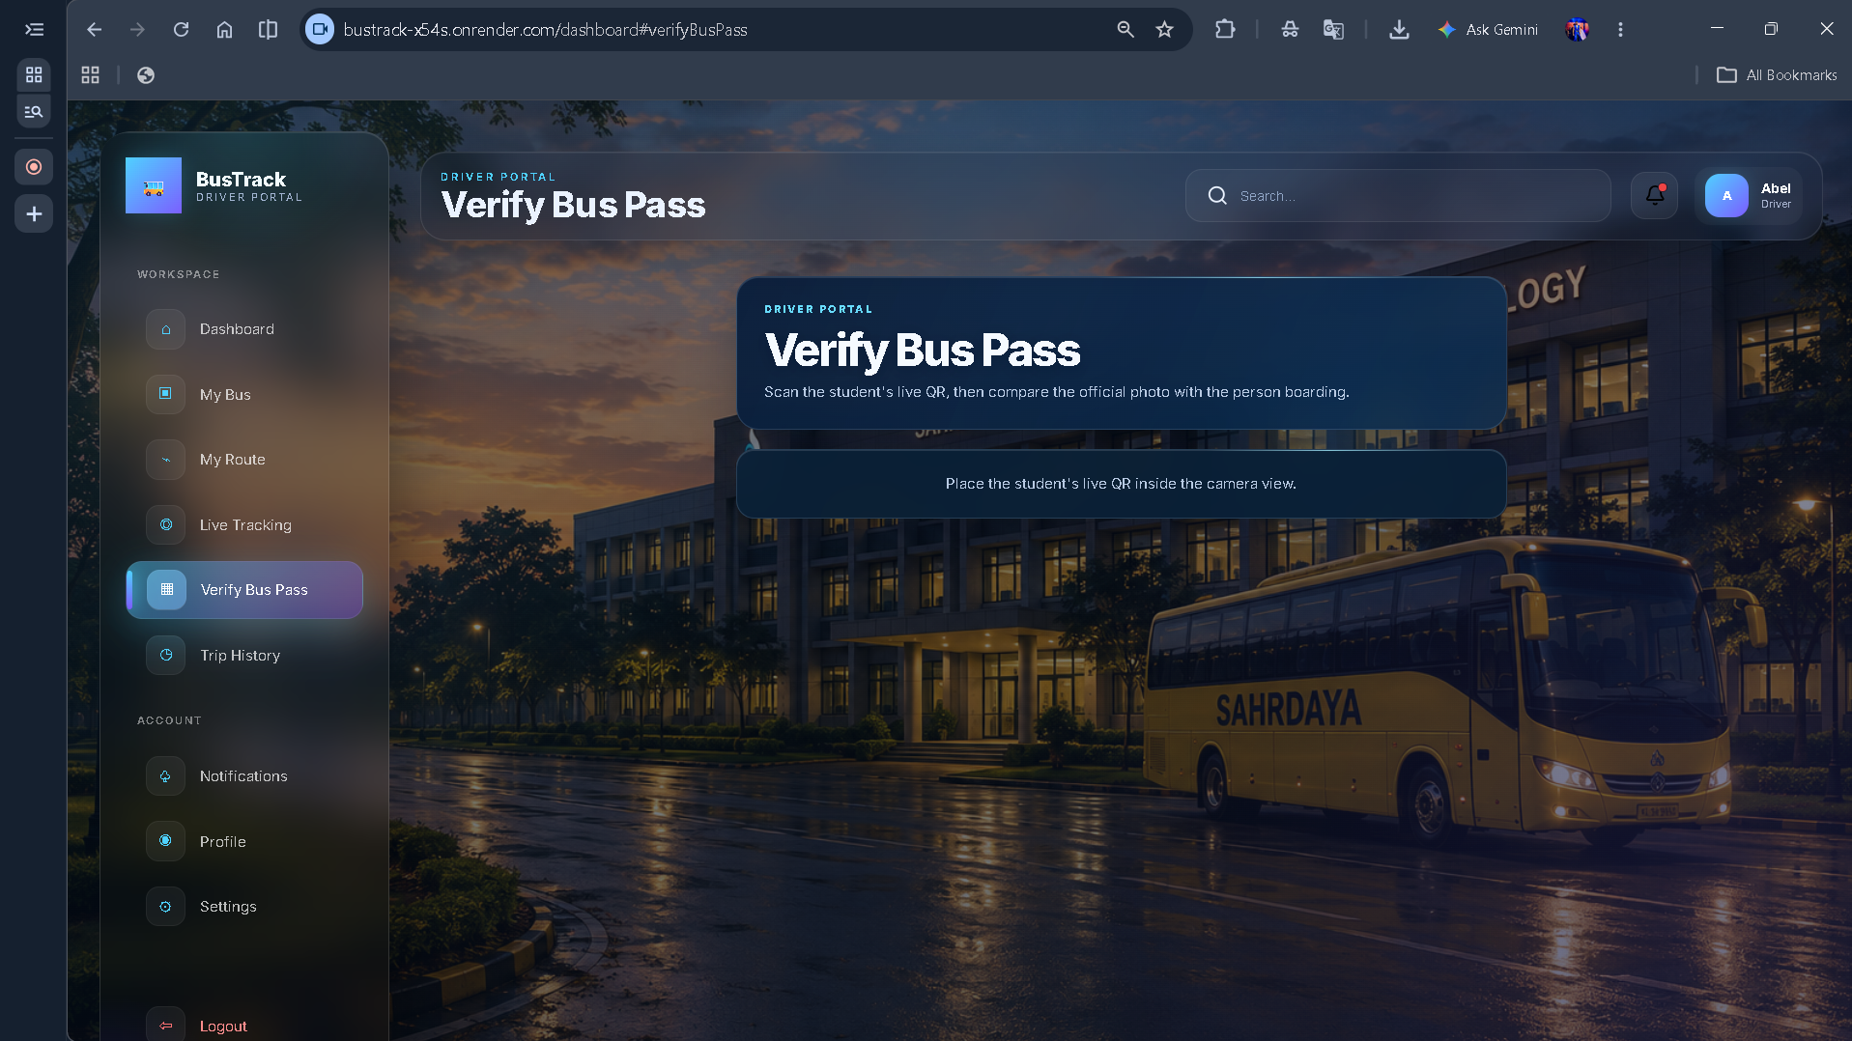
07
Driver tools and secure bus passes
Journey controls and boarding verification on a mobile screen
Driver portal
01
Assigned journey
The driver sees the assigned bus, route and live direction.
02
Operational alerts
Traffic, delay, breakdown and emergency reports reach the administrator.
03
Live pass scan
Camera preview, short-lived QR and official-photo comparison.
The driver confirms the server decision and the student's official photo before boarding.
7
Notes:
Explain that the live QR changes frequently, reducing screenshot reuse. The server checks the pass, active trip, route, bus and student status. The official photograph remains controlled by the transport office.

Slide 8
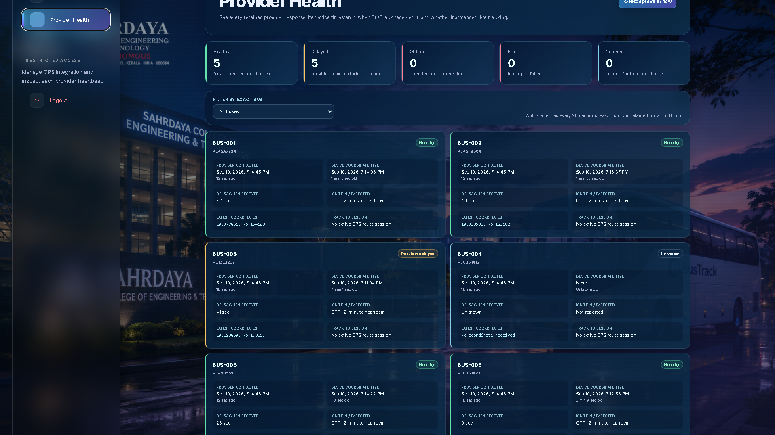
08
GPS reliability and provider health
Airotrack and Kingstrack work through the same route engine
Built for imperfect data
01
Provider separation
Each bus stays assigned to its detected GPS provider.
02
Visible delay
Contact time, device time and update gaps appear separately.
03
Failure isolation
A problem with one provider does not stop the other.
8
Notes:
BusTrack supports the college's mixed GPS fleet. A bus is matched by registration number and retained under its detected provider. Technicians can filter Airotrack and Kingstrack, then inspect the raw response when troubleshooting.

Slide 9
09
Protection from incorrect GPS data
Delayed or misdated packets remain visible without taking control of the journey
01
02
03
04
RECEIVE
CHECK
DECIDE
UPDATE
Keep the original coordinate and device timestamp
Compare device time, receipt time and accepted state
Accept a fresh observation or quarantine an unsafe one
Advance the route only from valid ordered data
Additional safeguards
Older observations cannot move the route backward. A route reset waits for a fresh arrival at its selected first stop. The real bus marker stays at its last-known coordinate.
9
Notes:
This is a key differentiator. Explain that BusTrack does not simply trust the newest response received from a provider. It considers the GPS device time and the already accepted state before changing the journey.

Slide 10
10
Three approaches to campus tracking
The college currently operates without a tracking system
Capability | Current situation | Possible WhatsApp workaround | BusTrack
Live visibility | No shared live view | Someone manually shares phone location | Vehicle GPS with phone continuity
Stop progress | Students estimate | A map pin without route meaning | Approaching, reached, passed and upcoming
Freshness | Unknown | Depends on the sender and phone | Device time, receipt time and stale warning
Fleet records | No structured history | Messages remain scattered in chats | Searchable trips and stop events
Operations | Calls and informal updates | Multiple groups and repeated messages | Role portals, alerts and assignments
Boarding | Manual identification | Separate from tracking | Live QR with official-photo check
WhatsApp remains useful for communication. BusTrack manages the structured transport journey.
10
Notes:
The WhatsApp column describes a possible informal workaround, not the college's current process. Position WhatsApp as a communication tool. BusTrack adds route meaning, reliability controls, history and role-based operations.

Slide 11
11
Why a college would adopt BusTrack
The benefit extends beyond showing a bus marker
STUDENTS
Less uncertainty
See route progress before leaving for the stop.
DRIVERS
Fewer location calls
Use a focused journey screen and send structured alerts.
TRANSPORT OFFICE
Clear operating record
Review routes, assignments, stop times and incidents.
COLLEGE
A platform that can expand
Start with one route and grow across the fleet.
Measure the result
Track location freshness, student usage, driver calls, missed-bus complaints and completed journeys during the pilot.
11
Notes:
Avoid claiming measured reductions before a pilot. Explain that the institution can create a baseline, run BusTrack on one route, and then compare usage, freshness and transport complaints.

Slide 12
12
A practical campus rollout
Begin with one route, verify it and expand with evidence
01
02
03
Prepare
Pilot
Expand
Confirm the bus, driver, route, stop coordinates and GPS registration.
Enroll one route's students and test outbound and return journeys.
Add buses route by route and train the transport office and drivers.
Pilot review
Validate stop detection, location freshness, portal usability and operational response before a full-fleet launch.
12
Notes:
Recommend a limited first deployment. The route must be physically tested in both directions, including the terminal reversal. The pilot also gives the college real evidence for the final entrepreneurship case.

Slide 13
Start with one route
Give students a clear journey and give the college a transport system it can manage.
1
2
3
4
Select the pilot bus and route
Verify every stop in both directions
Enroll the driver and pilot students
Measure the result and expand
BUSTRACK
Campus transport, made visible
Notes:
Close by asking for a one-route campus pilot. The purpose of the pilot is to demonstrate reliability, collect usage evidence and confirm that BusTrack fits the college's daily transport process.

