Slide 1
T-Pot: A Multi-Honeypot
Platform
Abel Melinte – B00137882

Slide 2
Honeypots
Suricata : Network / IP Capturing
Cowrie : SSH / Telnet Capturing
Dionaea : SMB (Server Message Block) and HTTP Capturing
Ddospot : Denial of Service attacks Capturing

Slide 3
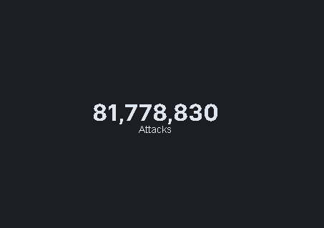
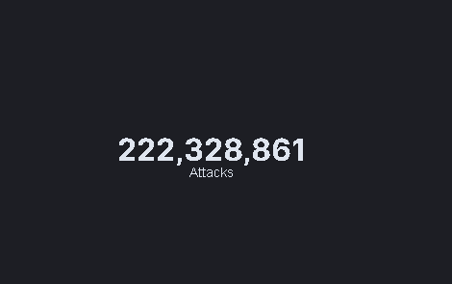
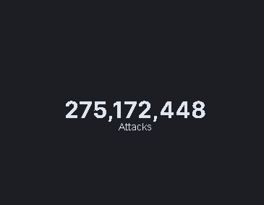
Total Attacks For Each Droplet
Bangalore
New York
Frankfurt
1 Month of gathered data

Slide 4
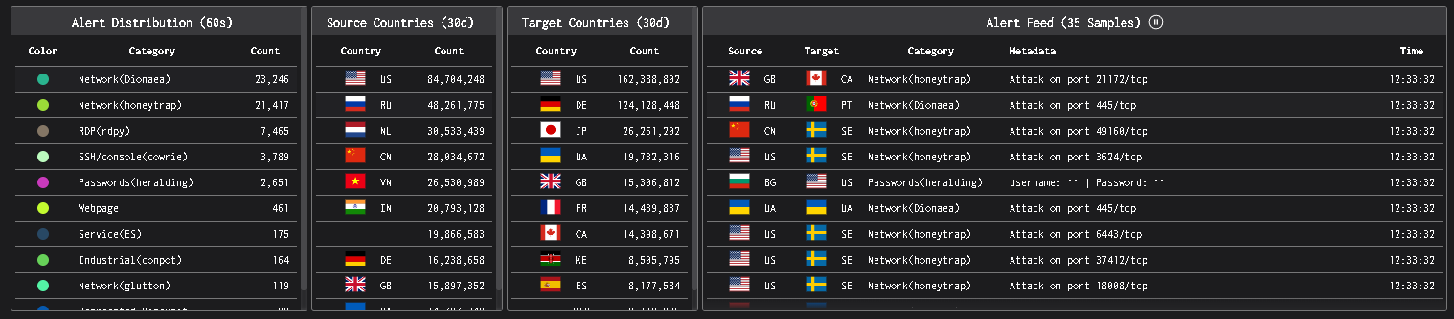
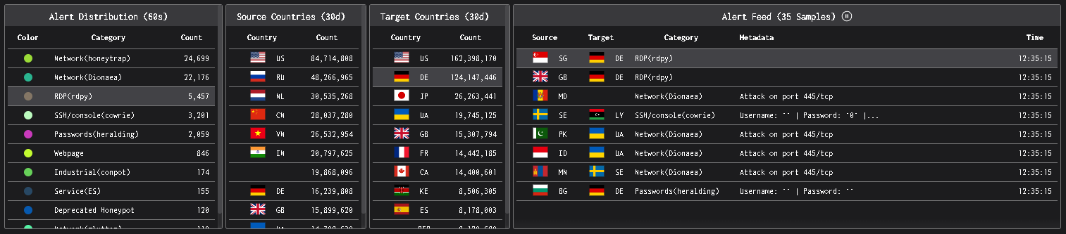
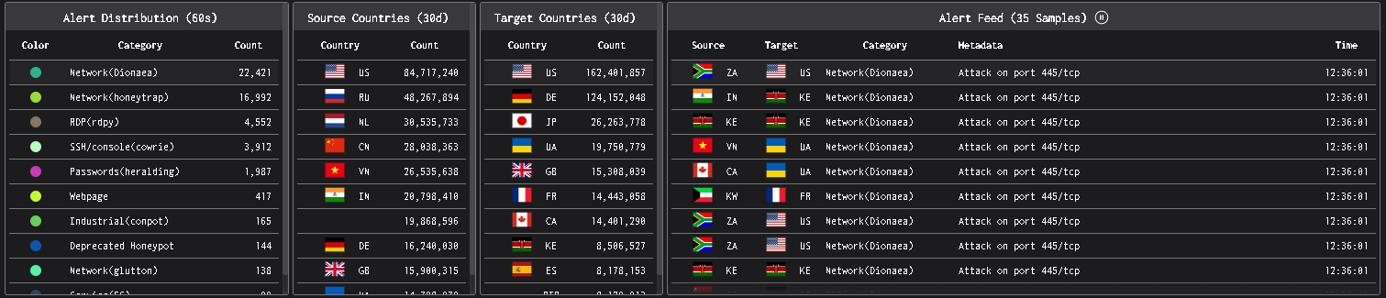
Overview
Bangalore
Frankfurt
New York

Slide 5
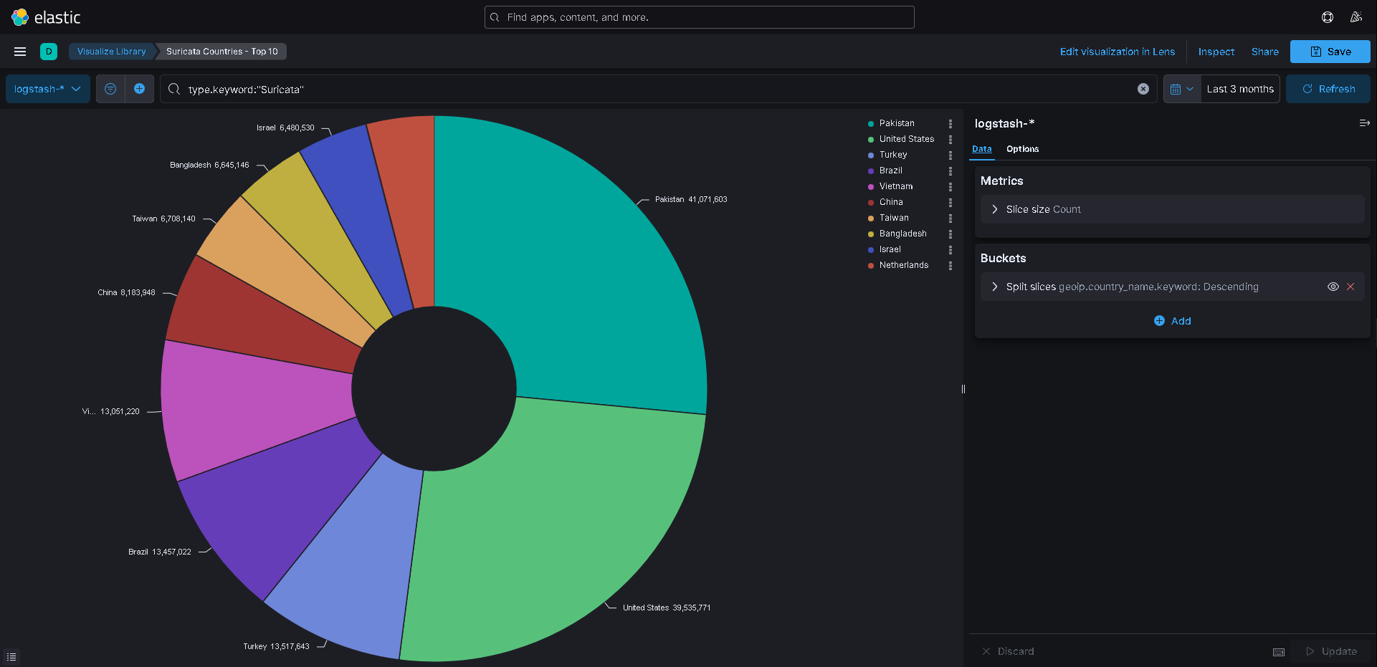
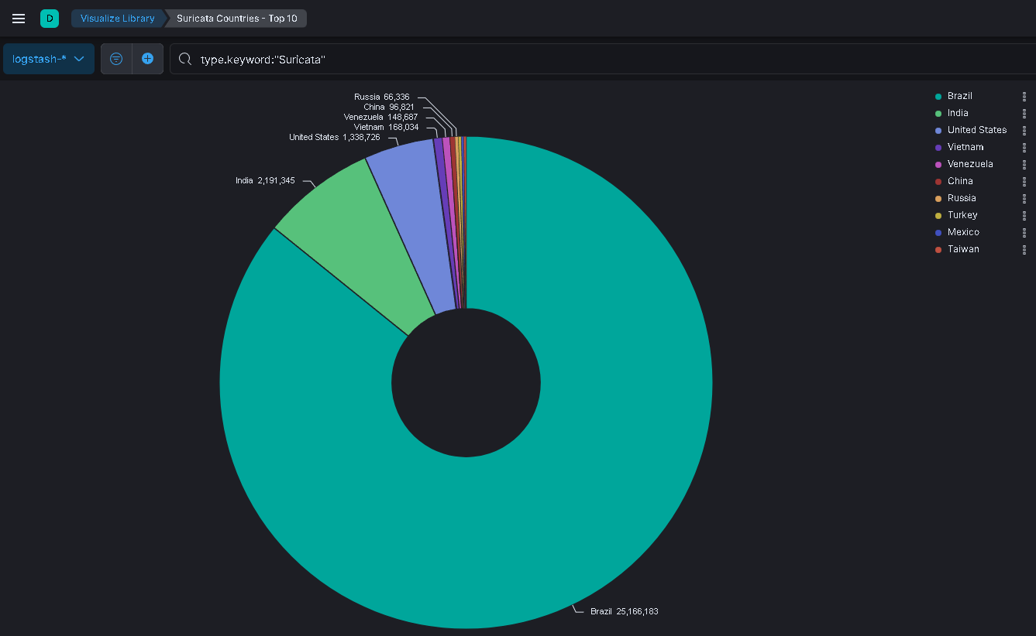
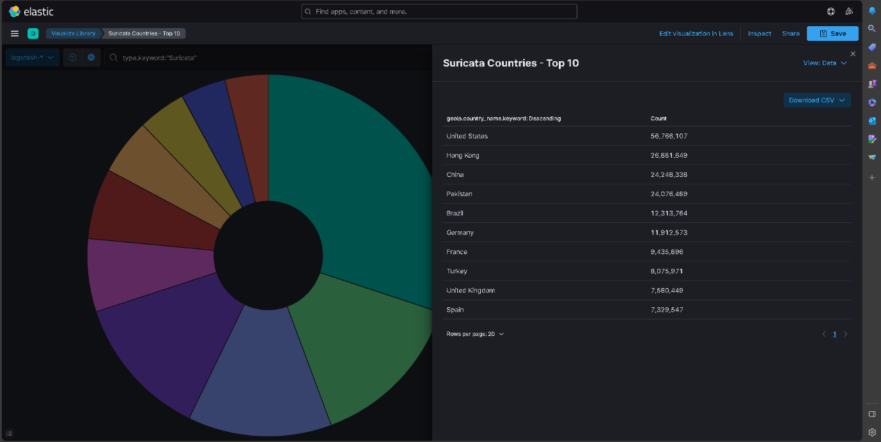
Top Attacking Country
New York
Bangalore
Top 5 Attacking Countries
United States | 97,640,604
Pakistan | 65,148,072
Brazil | 50,754,969
China | 32,527,107
Hong Kong | 26,816,649
Frankfurt

Slide 6
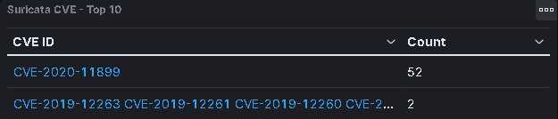
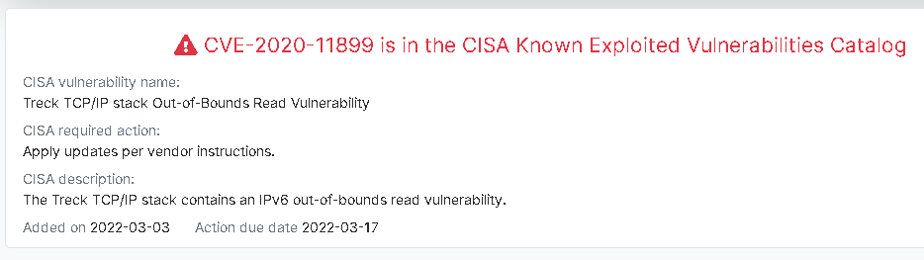

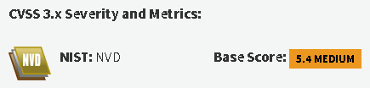
CVE – Top 10
Noted the highest count CVE identifier
Frankfurt
Version: 6.0.1.66
Received Vulnerability Details in relation to the CVE
Received Vulnerability Details in relation to the CVE

Slide 7
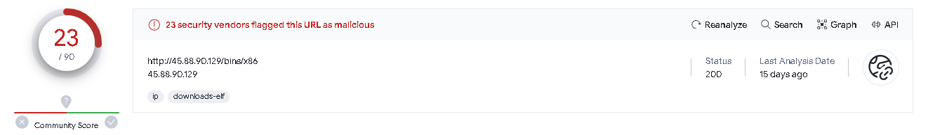
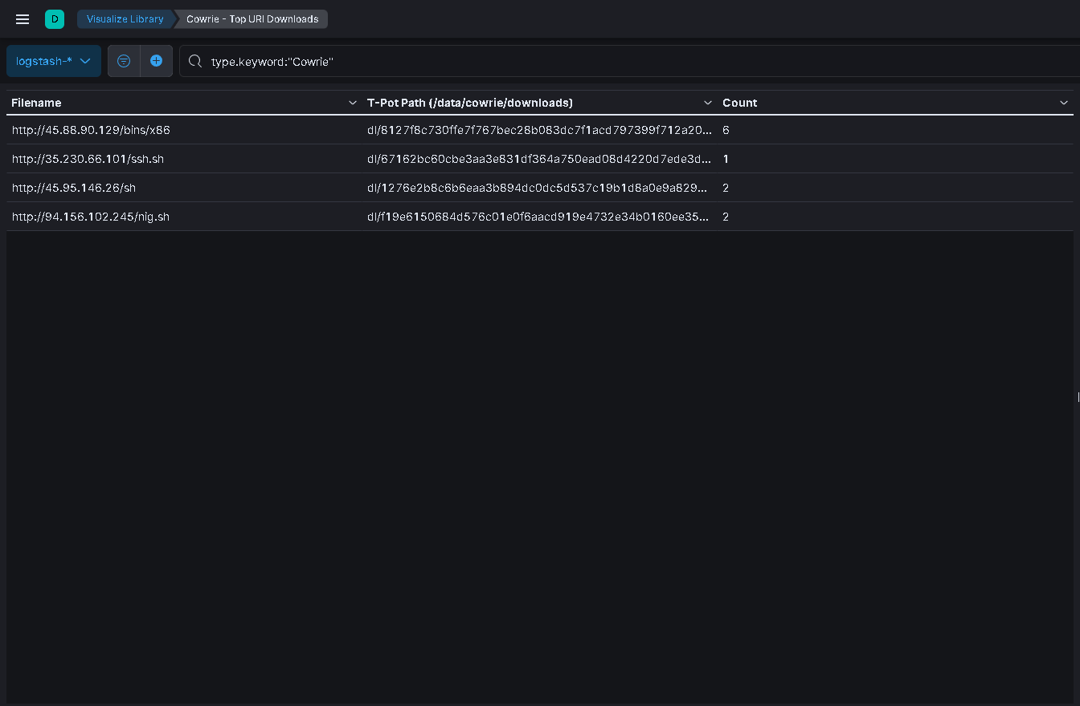
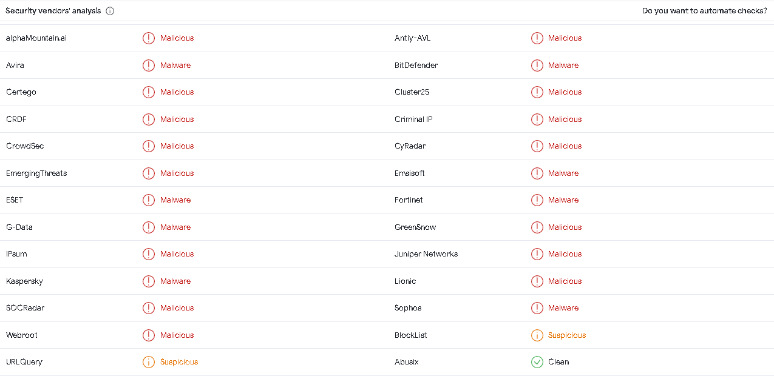
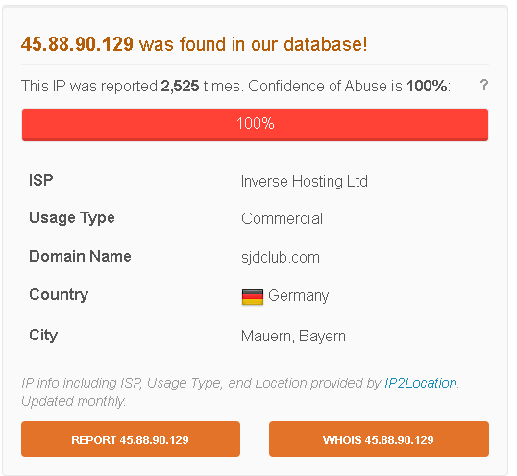
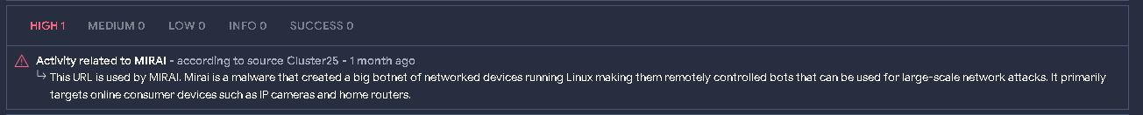
Top URL Downloads
IP related to MIRAI, harmful botnet
Added URL to VirusTotal

Slide 8
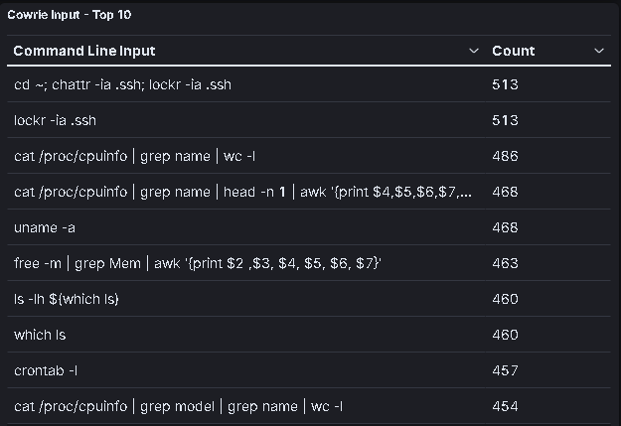
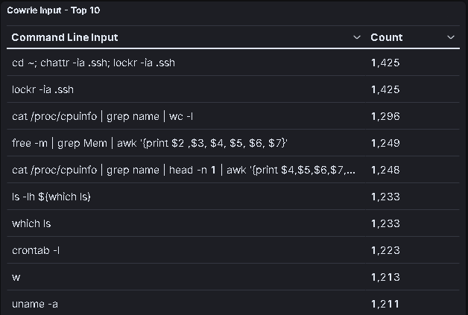
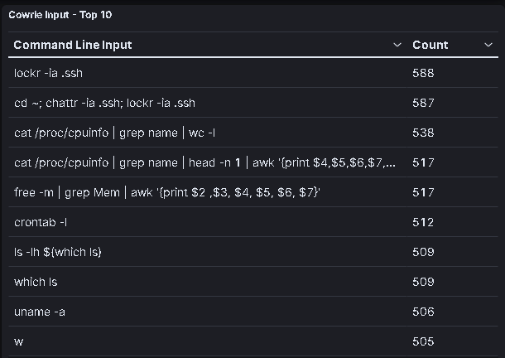
Command Line Inputs
Bangalore
Frankfurt
New York
Commands used above are attackers try to get information from system also trying to gain remotely access through SSH login.

Slide 9
Conclusion
Overall, the T-Pot assignment has been very interesting as I gained a lot of experience on how many different way attackers are able to attack a system by the use of their attacks.
Installing T-Pot was straight forward and it was also extremely UI friendly as navigating through the dashboard to view specific attacks were constantly labelled so you knew what you were navigating through at all times.
If I was to do this assignment again
Do an in-depth research of elastic itself and adjust its settings correctly before making a start (Deletion Phase).
Upgrade the machine to a higher specification as the required system had multiple issues, such as high CPU Usage, Maximum Storage etc.
Constantly monitoring each droplet instead of monitoring it 3-4 times a week.

