Slide 1
RESEARCH DEFENSE · ABEL TEZARE
Do three cost-saving tricks add up?
CG-PED — Curriculum Learning × LoRA × Knowledge Distillation, tested as a full 2³ factorial
48
8
3
2
1
training runs
factorial cells
seeds
benchmarks
CPU core
CG-PED
01
Notes:
~20s. Don't read the title. Say: 'Three well-known tricks make training cheaper. Everybody uses them together. Nobody had checked whether their savings actually add up. I did — 48 training runs, one CPU core.' Then move.

Slide 2
BEFORE THE SCIENCE
Where this project actually came from
Six months ago my world was Python, DSA and web development. Machine learning was a word I had heard.
“This deck is the receipt.”
Everything in this deck — the design, the code, the bugs, the negative result — came out of the training and the projects you gave us.
— and at the end, what I want to build next
I started behind the other trainees. I caught up. And I did not stop at the assignment.
Introduction
02
Notes:
~40s. Deliver this straight, not apologetically. The point is not modesty, it's provenance: this came out of the training programme. Land 'this deck is the receipt' and go. Flag that you will end with a proposal you want their opinion on — it buys attention for 20 minutes.

Slide 3
MOTIVATION
In 2019 a decent model needed a data centre.
In 2025 people fine-tune one on a laptop.
Nothing magic happened in between. A pile of efficiency techniques happened — and almost everyone reports them one at a time.
Motivation
03
Notes:
~30s. Pause after 'on a laptop.' This is the hook for the whole motivation. The one sentence that matters: nothing magic happened, a pile of efficiency techniques happened — and they are almost always reported one at a time.

Slide 4
MOTIVATION
Why I deliberately studied “old” techniques
2009
2015
2021
2024+
Curriculum Bengio et al.
Distillation Hinton et al.
LoRA Hu et al.
today's efficient AI stack
Recent tricks are still unstable. If a combination behaved strangely, I could not tell whether that was the interaction or the technique.
These three have well-characterised solo effects. So any surprise is a finding, not a mystery.
They are the load-bearing beams under today's efficient AI — and practitioners under a budget still stack all three at once.
The contribution is the design. The techniques are just the test subjects.
Motivation
04
Notes:
~60s. Expect a question here: 'why not QLoRA / DoRA / something from this year?' Answer with the timeline: I needed techniques whose solo effects are already well-characterised, so that any surprise in the combination is attributable to the interaction, not to an unstable technique. The design is technique-agnostic — swapping in QLoRA changes flags, not machinery.

Slide 5
THE CAST
Three different ways to spend less
C · Curriculum
L · LoRA
D · Distillation
Teach easy before hard
Sticky notes, not a rewrite
Learn from a senior
You don't open a maths course with calculus. Sort the data by difficulty, start the model on 15% of it, open the pool as it copes. Price: free. Just reorder.
Freeze the book. Write small rank-4 notes in the margin. Only the notes get trained — 4× fewer weights to update. Price: memory saved. Capacity spent.
A bigger teacher already made the mistakes. The student copies its soft answers, not just the labels. Price: you have to pay for the teacher too.
Background
05
Notes:
~70s. Spend the analogies here, they pay off for the rest of the talk. Curriculum = you don't start a maths course with calculus. LoRA = sticky notes in the margin instead of rewriting the book. Distillation = learning from a senior who already made the mistakes. Plant the LoRA one carefully — you cash it in on slide 15.

Slide 6
THE UNTESTED ASSUMPTION
You reach the checkout holding a coupon, a loyalty card, and a cashback offer.
Everyone assumes 10% + 15% + 5% = 30% off.
WHAT THE LITERATURE DOES
CLPD (2026): curriculum + distillation
POCL (2025): curriculum + distillation
TSCL (2026): sequenced KD objectives
Every one of them compares the combination to nothing. That answers “better than nothing?” — not “better than its parts?”
Nobody ran the receipt.
The gap
06
Notes:
~45s. The checkout analogy is the whole motivation in one image. Then hit the right-hand column: CLPD, POCL, TSCL all compare a combination against an uncomposed baseline. That answers 'better than nothing?' — never 'better than its parts?'. This is the gap, in their own literature.

Slide 7
THE IDEA IN ONE LINE
Composition is not combination
f(g(h(x + y + z))) ≠ f(x) + g(y) + h(z)
COMBINATION
Effects sit side by side. You can add them and the arithmetic is honest.
COMPOSITION
Each technique changes the input of the next. The sum is a guess.
The curriculum changes what LoRA sees. LoRA changes how much the student can absorb from the teacher.
Training with all three is composition. Reporting them as a sum assumes combination. That gap is the whole paper.
The research question
07
Notes:
~60s. This is the intellectual core; slow down. Read the formula out loud. Combination = effects side by side, addition is honest. Composition = each technique changes the input of the next, so the sum is a guess. Concretely: the curriculum changes what LoRA sees; LoRA changes how much the student can absorb from the teacher.

Slide 8
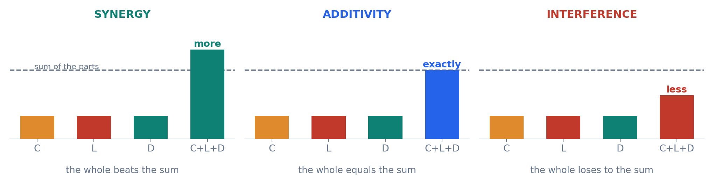
WHY ONE-FACTOR-AT-A-TIME CANNOT ANSWER IT
Three worlds are possible. Four experiments see one.
Run C alone, L alone, D alone and you get three bars — and then you assume the fourth. You have to actually run the combination.
The research question
08
Notes:
~40s. Three worlds — synergy, additivity, interference. Four one-factor experiments produce the first three bars and then assume the fourth. You cannot distinguish these three pictures without running the combination. That is why the design has to be factorial.

Slide 9
DESIGN
A full 2³ factorial — all eight cells
- - -
C - -
- L -
- - D
naive baseline
curriculum
LoRA
distillation
C L -
C - D
- L D
C L D
curr + LoRA
curr + distil
LoRA + distil
full CG-PED
8
×
3
×
2
=
48
Everything else held identical: architecture, learning rate, batch size, step budget, seeds.
cells
seeds
benchmarks
training runs
Design
09
Notes:
~60s. Walk the eight cells left to right; name the naive baseline (blue outline) and the full method (dark, red outline). Then the arithmetic: 8 cells x 3 seeds x 2 benchmarks = 48 runs. Stress the control: everything else identical — architecture, LR, batch, steps, seeds.

Slide 10
DESIGN
Why eight cells, when four would look cheaper
FOUR CELLS
EIGHT CELLS
one-factor-at-a-time
full factorial
each factor's effect vs baseline
every main effect, averaged over 4 pairs
no interaction term
the additive prediction for C+L+D
no independent noise estimate
observed − predicted = the composition gap
seed spread gives the noise floor
Exactly double the cost. It buys the one quantity no cheaper design can produce.
Design
10
Notes:
~45s. Anticipate 'four cells would have been cheaper.' Four gives you main effects and nothing else — no interaction term, and no independent estimate of noise. Eight costs exactly double and produces the composition gap plus the seed-spread noise floor. No cheaper design produces that number.

Slide 11
SETUP
The bench — small enough to run 48 times
Student
2-layer Transformer, d_model 64 — 82K parameters, character-level
35–45
minutes, one CPU core
0
GPUs. No Hugging Face. LoRA written from scratch in ~20 lines.
Teacher
4-layer, 561K parameters — trained from scratch on the same data, then frozen. Not a pretrained model.
Budget
300 steps, LR 4e-3, batch 32, evaluated every 15 steps
Benchmark A
Synthetic SC-LM — difficulty is known by construction, noise-free
Benchmark B
Tiny Shakespeare — difficulty comes from the corpus, not from me
Anyone in this room can reproduce all 48 runs on the laptop they brought.
Setup
11
Notes:
~45s. Keep this brisk — it is setup, not argument. Emphasise two things: the teacher is trained from scratch on the same data and then frozen (it is NOT a pretrained model), and the whole study runs in 35-45 minutes on one CPU core. Anyone in the room can reproduce it.

Slide 12
BEFORE MEASURING ANYTHING
Five checks before a single training step
1
gradients actually reach every LoRA adapter
Check 2 caught a silent aliasing bug.
The adapters existed, the parameter count looked right, the loss curves looked beautiful — and no gradient was flowing.
Those results were fiction. If I had not written verify.py I would be defending them today.
2
adapters sit on the real projections, not on copies
3
base weights are genuinely frozen
4
LoRA is a perfect no-op at initialisation
5
the curriculum really does reorder the data
Setup
12
Notes:
~50s. This slide buys you credibility for every number that follows. Then tell the bug story honestly: the adapters existed, the parameter count was right, the loss curves looked beautiful — and no gradient was flowing. Those results were fiction. verify.py is why I am not defending them today.

Slide 13
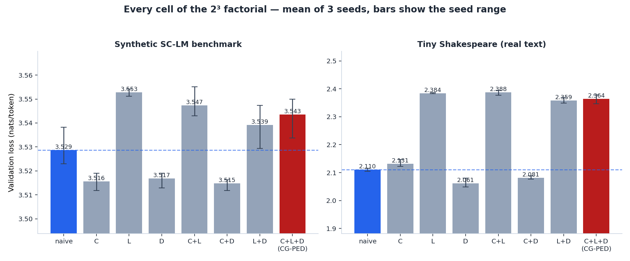
RESULT 1 — ALL EIGHT CELLS
The full method is not at the bottom
Blue = naive baseline. Red = full CG-PED. On real text the composed method is 0.254 nats worse than doing nothing clever at all.
Results
13
Notes:
~45s. Point at blue (naive) and red (full CG-PED). On the synthetic benchmark everything is within a hair. On real text the composed method is 0.254 nats WORSE than doing nothing clever. Do not soften it — the rest of the talk explains it.

Slide 14
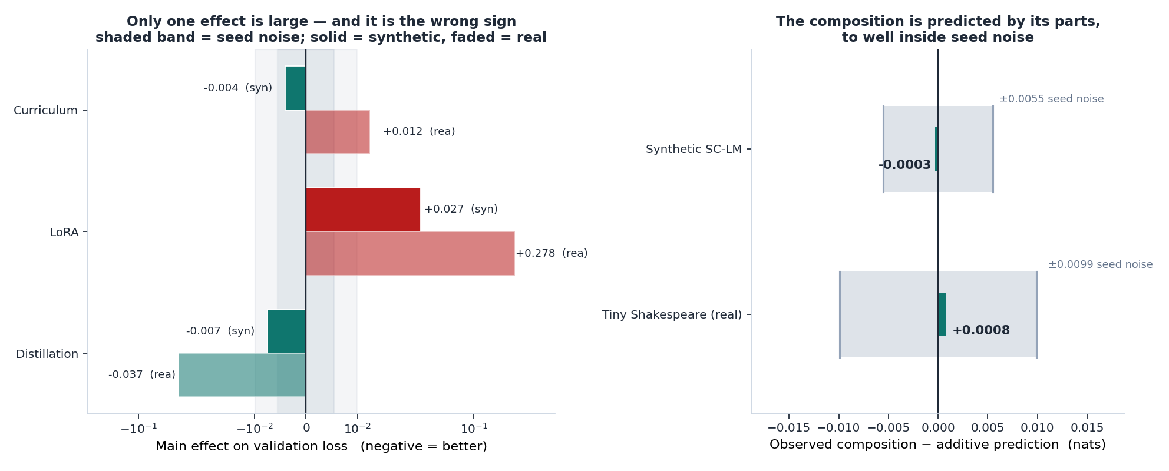
RESULT 2 — THE HEADLINE
They compose — almost perfectly
−0.0003
+0.0008
±0.0055 / ±0.0099
12–18×
composition gap synthetic
composition gap real text
seed noise floor
smaller than the noise that surrounds it
Results
14
Notes:
~75s. The headline. Left panel: only one main effect is large, and it is the wrong sign. Right panel: observed minus additive prediction is -0.0003 and +0.0008, against seed noise of 0.0055 and 0.0099. The interaction is 12-18x smaller than the noise around it. They compose additively — which is exactly why the whole thing loses: nothing compounds, so you get the sum, and the sum is negative.

Slide 15
RESULT 3
Who helps, who costs, who is just noise
TECHNIQUE
SYNTHETIC
REAL TEXT
VERDICT
Curriculum
−0.004
+0.012
Inside the noise, and it flips sign. Free — and worth what you pay.
LoRA
+0.027
+0.278
28× the noise on real text. The dominant term, and it is a cost.
Distillation
−0.007
−0.037
The only effect that helps on both benchmarks. The one thing to keep.
Sticky notes only save time if the book is already written. Training from scratch, the book is blank — and rank 4 has to write all of it.
Results
15
Notes:
~70s. Read the table as a price list. Curriculum: inside the noise and it flips sign between benchmarks — free, and worth what you pay. LoRA: 28x the noise on real text, the dominant term, and it is a cost. Distillation: the only consistent win. Then cash in the analogy: sticky notes only save time if the book is already written. From scratch, the book is blank, and rank 4 has to write all of it.

Slide 16
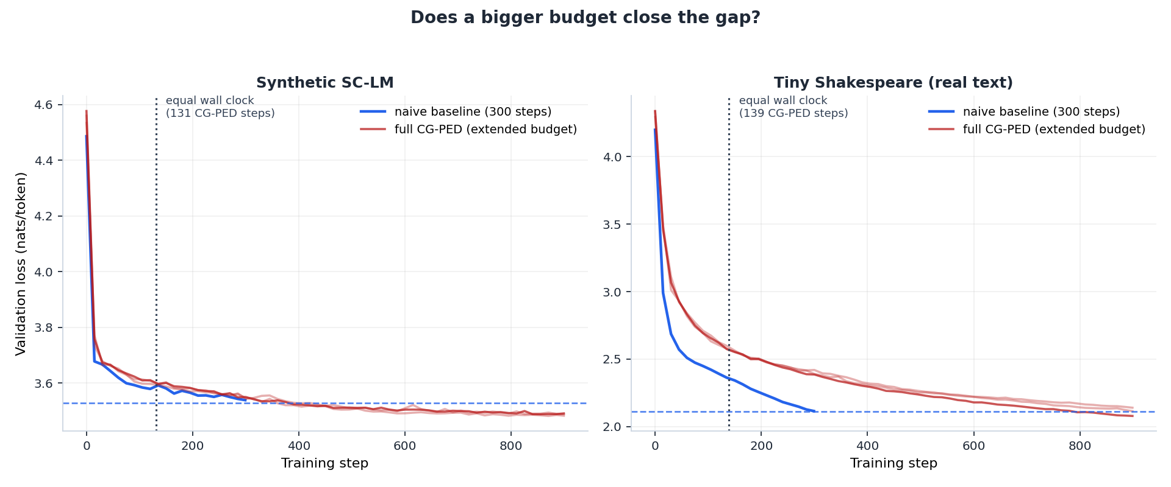
RESULT 4 — THE REALITY CHECK
Equal steps flatters us. Equal wall clock does not.
2.1–2.3×
131 / 139
3 / 3
1 / 3
cost per step vs the naive run
steps CG-PED affords in the naive run's time
synthetic seeds catch up (by ~360–405 steps)
real-text seeds catch up within 900 steps
Results
16
Notes:
~60s. Pre-empt the 'you flattered yourself with equal steps' objection by raising it first. A CG-PED step costs 2.1-2.3x a naive step because the teacher runs too. In the naive run's wall clock, CG-PED affords only 131/139 steps. Synthetic catches up on all three seeds by ~400 steps; real text catches up on one seed out of three by 900.

Slide 17
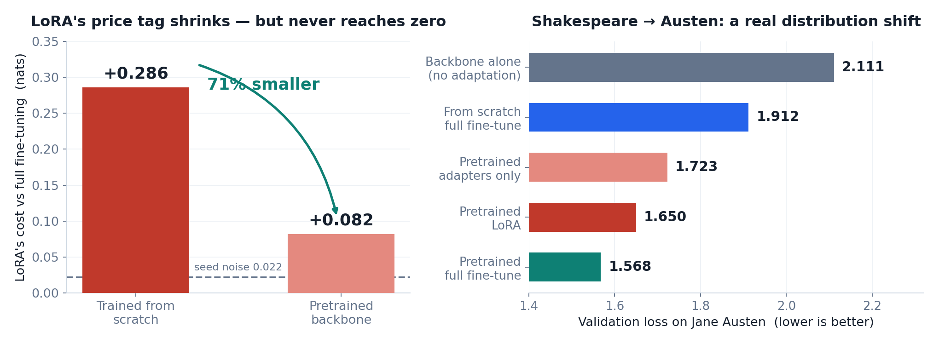
WE ATTACKED OUR OWN RESULT
“LoRA was never meant for training from scratch.”
Pretrain on Shakespeare → adapt to Jane Austen. Same character vocabulary, genuinely different register.
The objection was fair, and it did not save the method. LoRA's cost shrinks by 71% — to +0.082, still 3.7× the noise floor. Better is not free.
Results
17
Notes:
~60s. Frame this as attacking your own result. The fair objection is that LoRA was designed for adapting a pretrained model, not for from-scratch training — so we pretrained on Shakespeare and adapted to Austen. LoRA's cost drops 71%, from +0.286 to +0.082. But 0.082 is still 3.7x the noise floor. Better is not free, and the recommendation does not flip.

Slide 18
CONTRIBUTION
Five things that did not exist before this study
1
The design — the first full 2³ factorial over curriculum × LoRA × distillation — all eight cells exist
2
The number — the composition gap, defined and measured: −0.0003 / +0.0008 nats
3
The price list — each component's effect published against its own noise floor, so you can tell a result from seed luck
4
The reporting — equal-wall-clock alongside equal-step, because that is the budget practitioners actually have
5
A clean negative — with a mechanism — plus assert_lora_live, reusable by any paper that touches LoRA
The machinery is technique-agnostic. Swap in QLoRA, DoRA or data pruning and nothing but the flags changes.
Contribution
18
Notes:
~60s. If you only get one minute in the Q&A, this is the slide. The contribution is the design and the quantity it produces, not a new technique. Close with technique-agnosticism: QLoRA, DoRA, data pruning — the cells change, the machinery does not.

Slide 19
HONEST LIMITATIONS
Where this result stops being true
82K parameters, 300 steps, character-level — a laboratory, not production.
Two benchmarks, one of them synthetic and one of them 1.1 MB of Shakespeare.
Everything trained from scratch. LoRA is measured outside the regime it was designed for.
The curriculum's difficulty score is weak on real text — part of why that effect vanishes.
Three seeds. Enough for a noise floor, not for a p-value.
Additivity is established here. Nobody has shown it holds at scale.
I would rather draw the boundary myself than have you find it. Every one of these is a next experiment, and the codebase already supports them.
Discussion
19
Notes:
~45s. State the limits before the panel does. The two that matter: everything is from scratch, so LoRA is measured outside its home regime; and additivity is established here, at this scale — nobody has shown it holds at 7B. Each limitation maps to a next experiment the codebase already supports.

Slide 20
CONCLUSION
What I'd tell a practitioner on Monday
They add up. So stop running combinations.
If effects are additive you can predict any of the eight cells from three single-factor runs. A combinatorial budget becomes a linear one.
Keep distillation.
The only component that helped on both benchmarks — if you can afford the teacher's compute.
Use LoRA for memory, not for loss.
And only on a pretrained backbone, where its price drops by 71% instead of dominating everything.
Don't pay for a curriculum you can't measure.
Ordering data helped nothing here, and the difficulty score is the prime suspect.
My own data says: do not use my composed method. That is the result, and I am reporting it as one.
Conclusion
20
Notes:
~60s. Land the practical takeaway. The additivity result is genuinely useful: if effects add, three single-factor runs predict all eight cells — a combinatorial budget becomes linear. Then the honest ending: my own data says do not use my composed method. Say it plainly; do not reframe it.

Slide 21
WHAT'S NEXT — AND I WANT YOUR VERDICT
TwinAI
How much of a life is enough?
AFFORDABLE BY DESIGN
Phase 1 — synthetic individuals, known ground truth
Can an AI build a faithful behavioural model of one person from their longitudinal history — and predict decisions they have never faced?
Phase 2 — small consented behavioural study
No foundation model trained: retrieval + episodic memory + light fine-tuning
The same question as this paper, moved from tokens to lifetimes: if 10% of a history buys 70% of the fidelity, most of a life is redundant data. That is data-efficient AI, applied to people.
Classical ML baselines first, LLM agents last
Is it doable? That is my question to you.
Future work
21
Notes:
~75s. Shift energy — this is the ask, not a result. TwinAI is the same data-efficiency question moved from tokens to lifetimes: if 10% of a history buys 70% of the fidelity, most of a life is redundant data. Stress feasibility (synthetic individuals first, no foundation model trained) and ethics (consent, synthetic data first). Then ask them directly whether it is doable.

Slide 22
Six months ago: Python and web development.
Today: 48 training runs and a negative result I can defend line by line.
Thank you.
Questions — and I would genuinely like your verdict on TwinAI.
CG-PED · Abel Tezare
22
Notes:
~20s. Close on the arc, then stop talking. Invite questions and explicitly invite their verdict on TwinAI — it turns Q&A into a conversation rather than an interrogation.

