Slide 1
Site map/Wire frame
Abel Moolakkttu
Esports Nation

Slide 2
goal
The purpose of this site is to introduced esports to new audience and not clutter them with too much information, keeping it simple so that they can get started. This site is also used to bring the community around and to keep the information fresh as well as giving back to them by adding a area where they can submit videos and show off it off in our site. This site provides basic information and recent news about the esports community for each game so that players can choose what gaming community is more suited towards them.

Slide 3
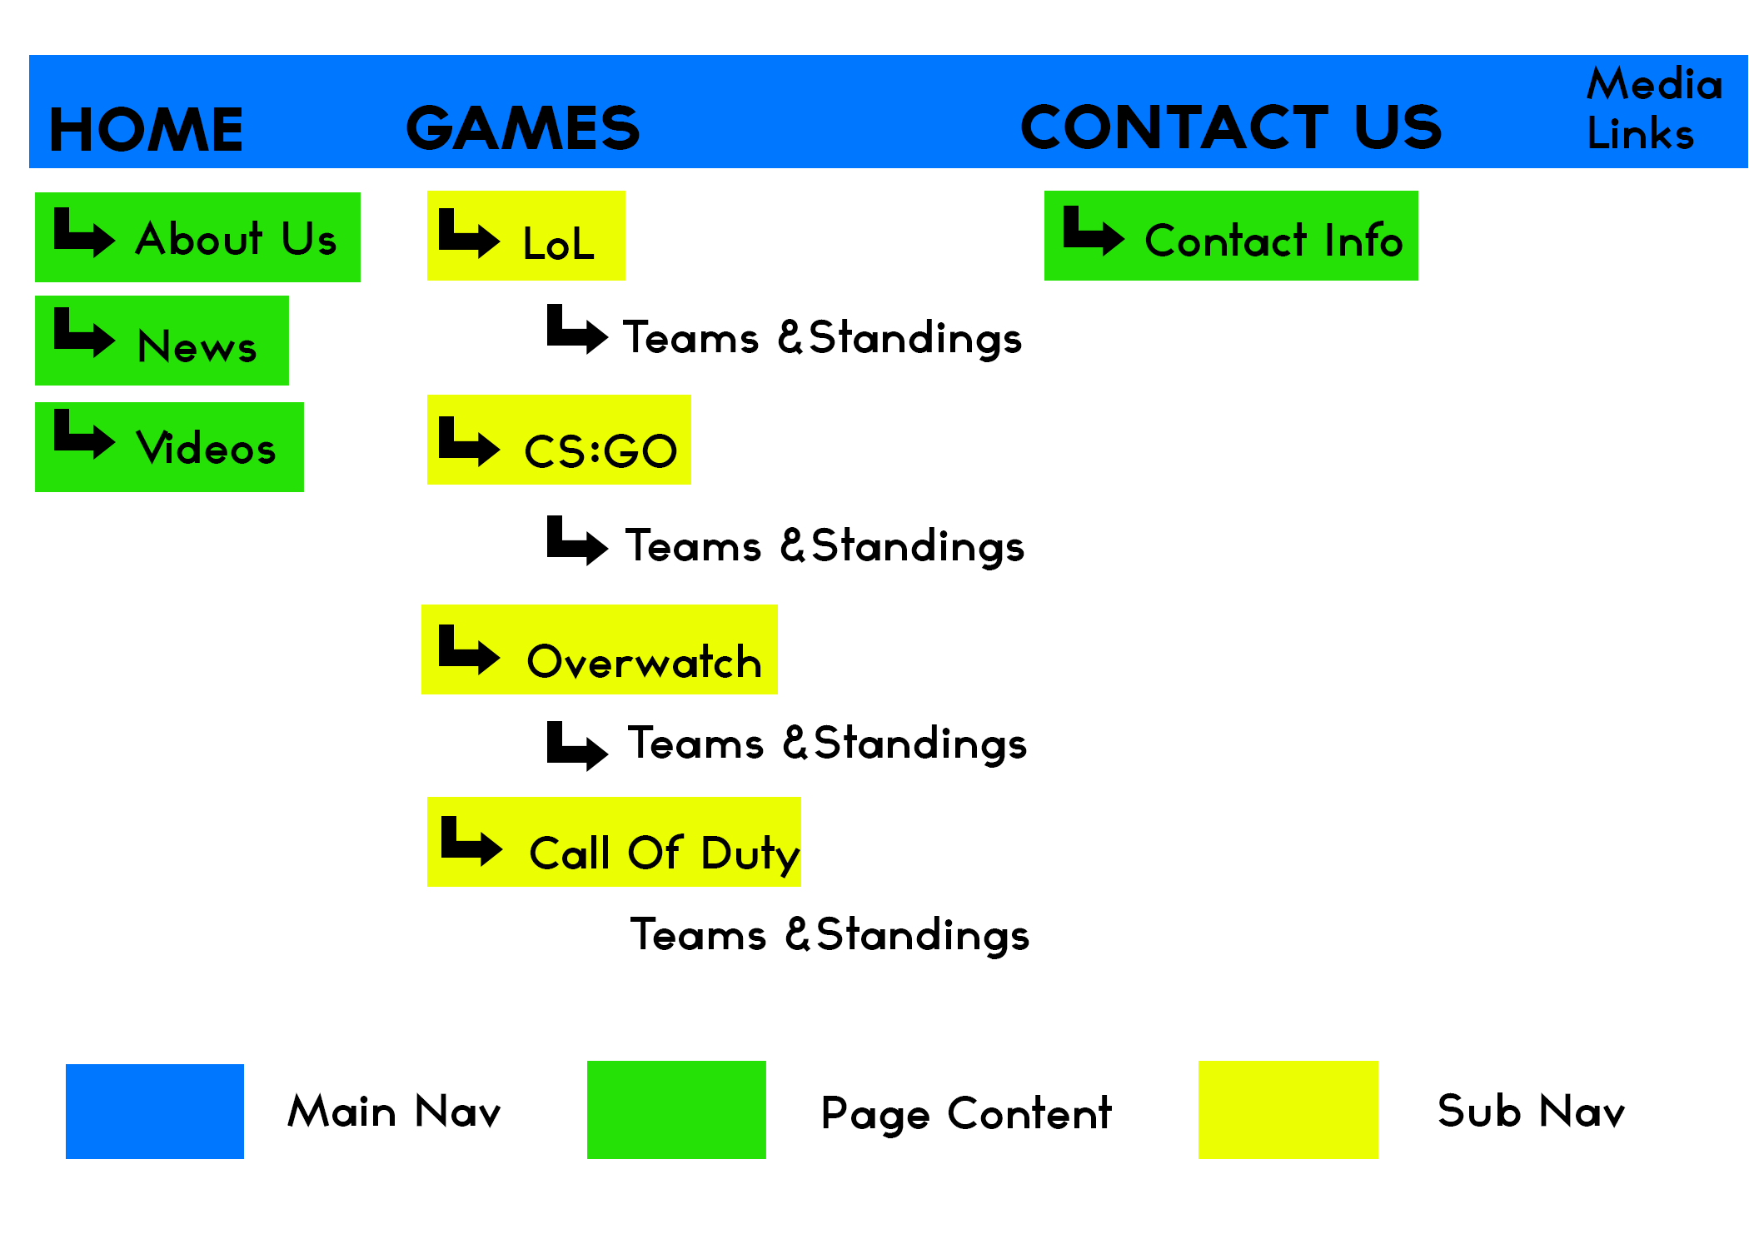
Site Map

Slide 4
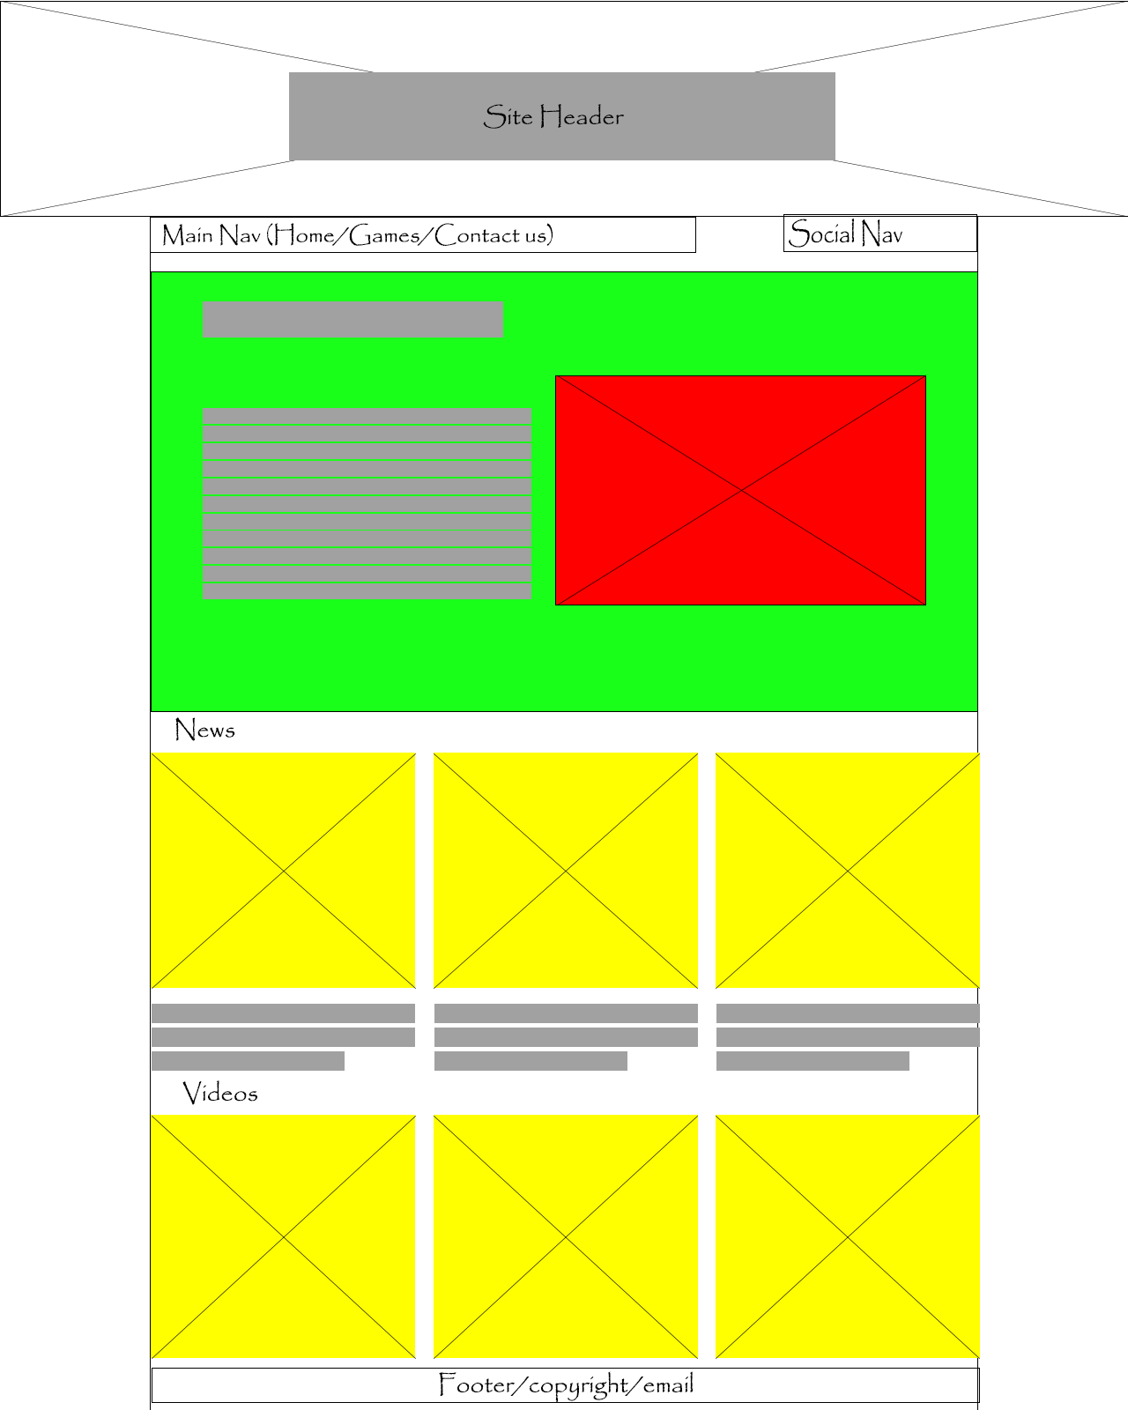
Wire Frame home page

Slide 5
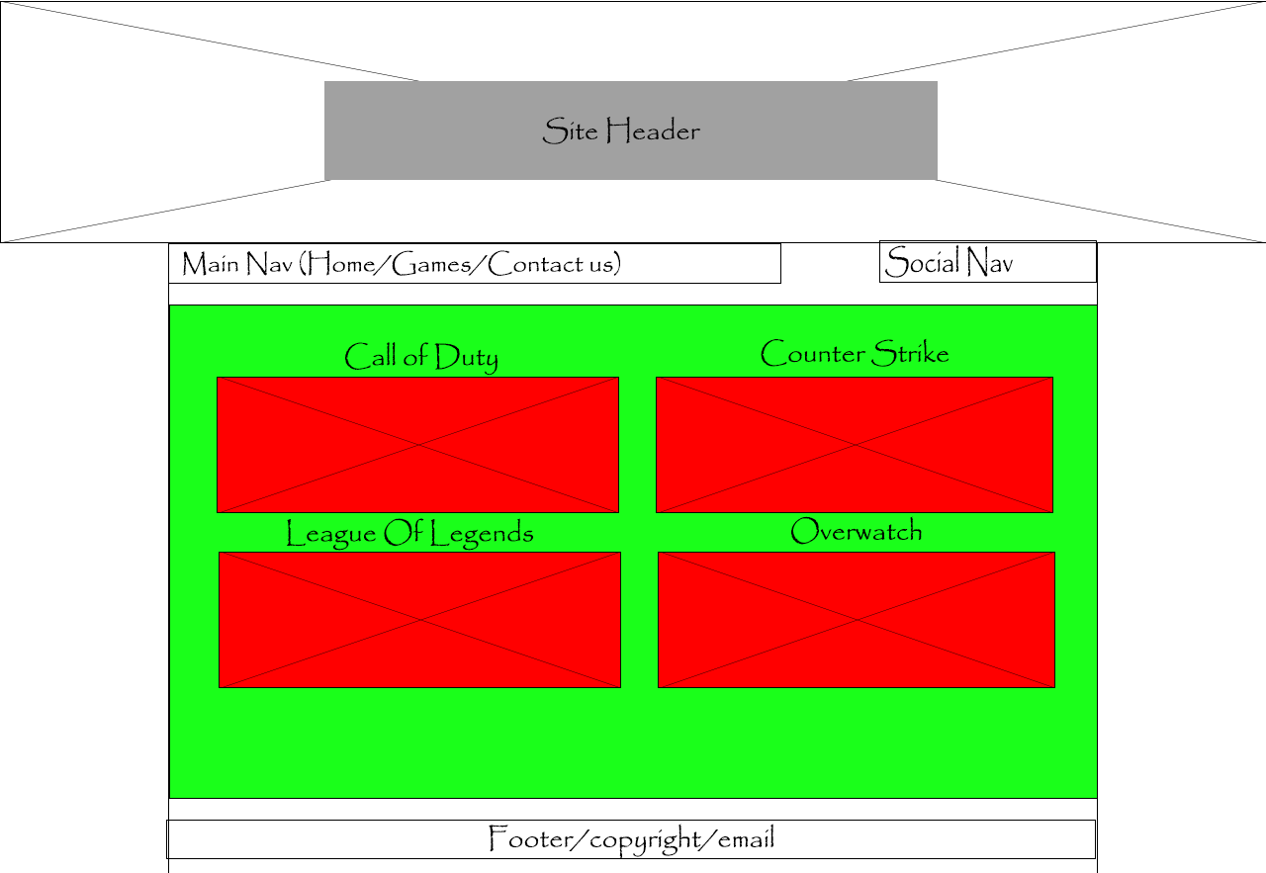
Wire Frame Games page

Slide 6
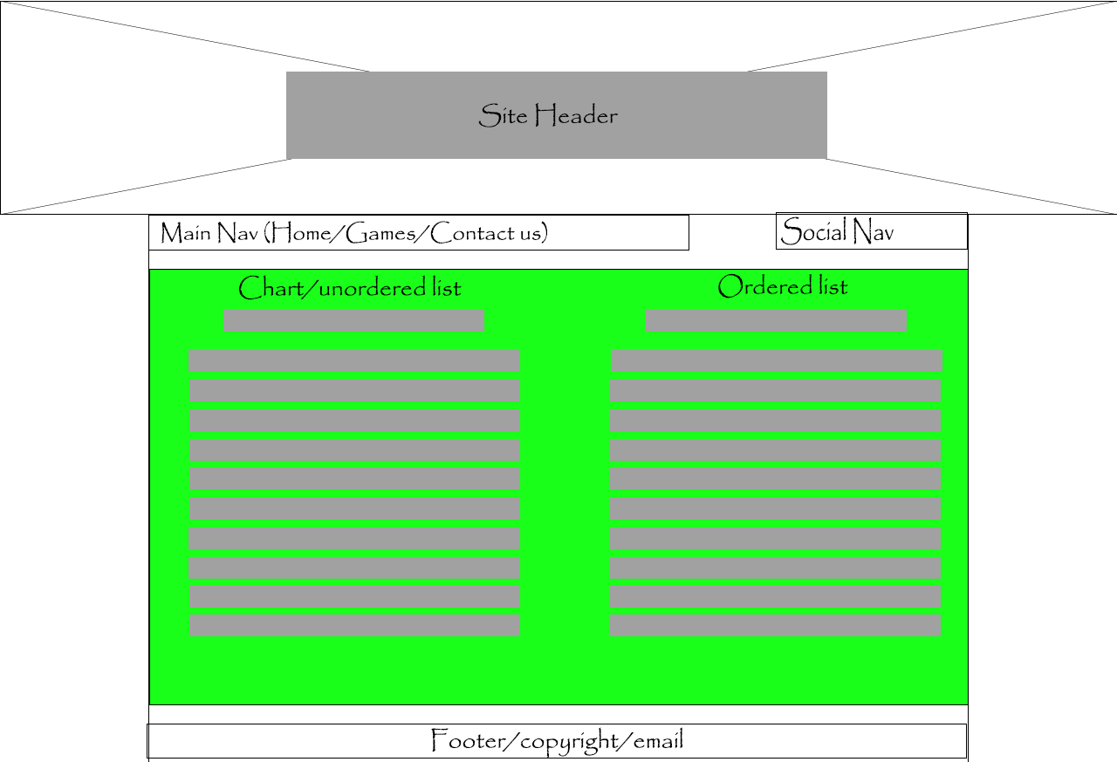
Wire Frame call of duty/league of legends/counter strike/overwatch page

Slide 7
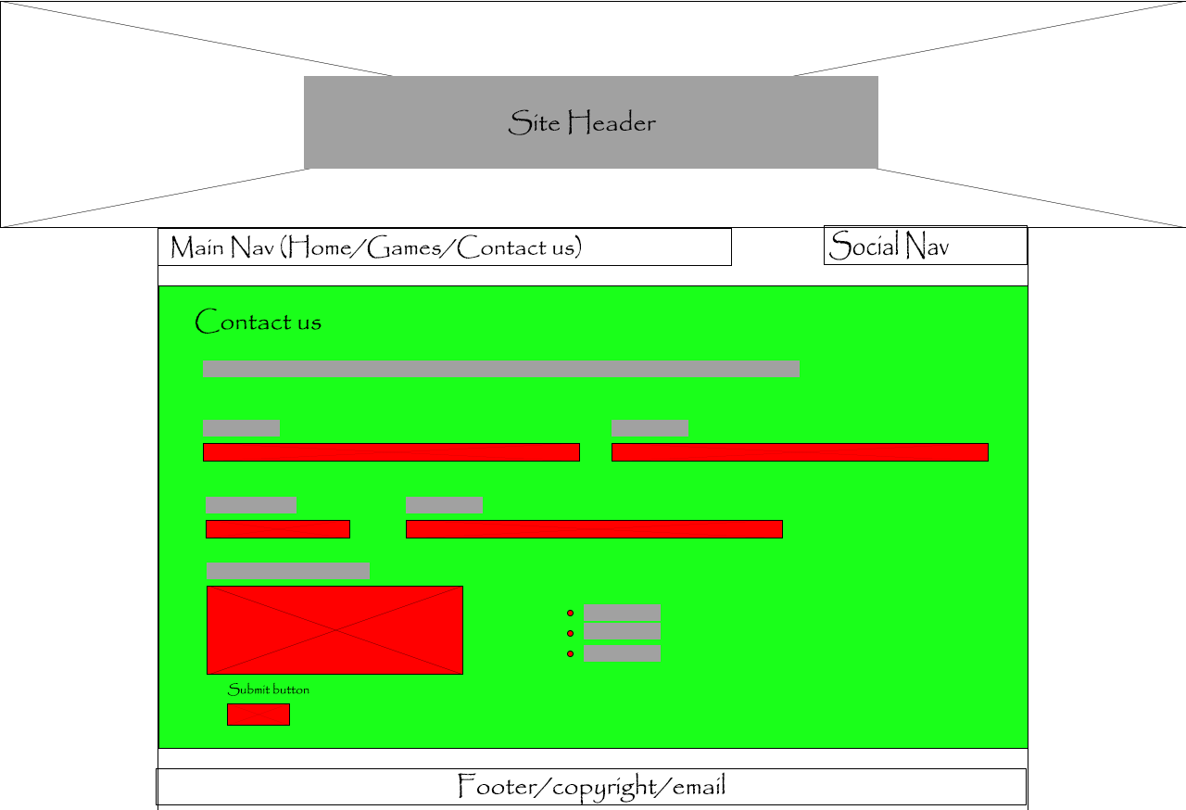
Wire Frame Contacts Page

