Slide 1
eSports
Abel Moolakkattu

Slide 2
Challenging Aspects
Getting the layout in proper adjustments throughout the website so nothing is overlapping and there is enough space between each object
Optimizing the images so it fits well in your website so it doesn’t come out blurry when viewing in different size screens

Slide 3
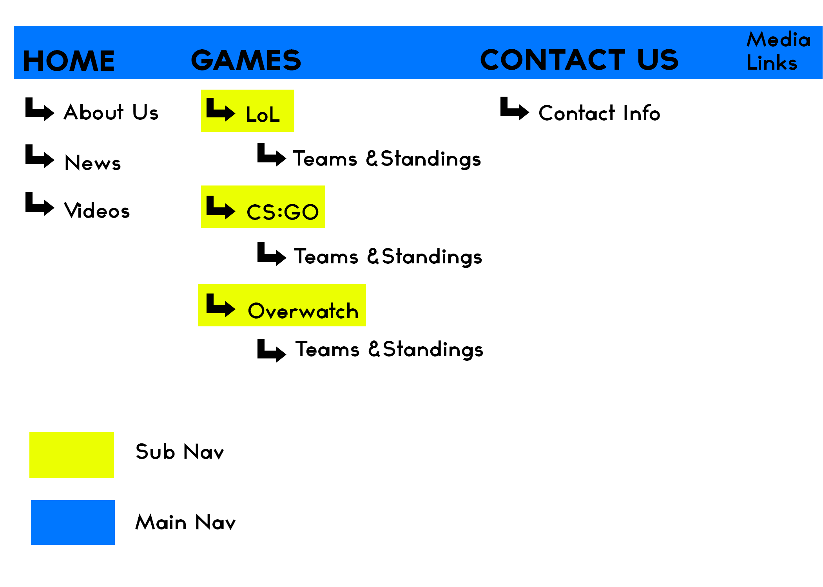
Site Map

Slide 4
Designing the website
I personally enjoy creating the website in which I get to decide what kind of graphics to implement, on how the overall theme of the website is going to be. At the same time appealing to different kinds of audience that there are able to enjoy it on what I have created. Even when the going gets tough with the technicalities, pulling through and learning on how I can make it better. It teaches me things that I have not known before and in doing so making the website better. Overall I enjoy designing all the aspects of the website and making it so that it appeals to most people at least.

