Slide 1



Introducing Master of Social Work
in Psychosocial Software Engineering
Stakeholders’ Validation Workshop
2025
Addis Ababa, Ethiopia
OUR MOTTO
Making Ethiopia the African Hub for
Psychosocial Software Engineering – Advancing together into the 21st century

Slide 2



Menu
Content
Introduction
Partners
Identifying the Problem
Solution and Strategies
Project Overview
Expected outcome and impact
Making Ethiopia the African Hub for
Psychosocial Software Engineering
Conclusion

Slide 3
1. Introducing The Master of Social Work in Psychosocial Software Engineering
Exploring the Transformative Initiative
Back to Menu

Slide 4
The Project Initiation
Title of the project: Establishing a five-year MSW Project in Psychosocial Software Engineering in Ethiopia.
The project is:
Hosted in School of Social Work (SoSW), College of Social Sciences, Arts, and Humanities (CSS-ArtH), AAU
School of Information Technology and Engineering (SITE), Institute of Technology (IT), AAU
Project Supervision: The Project will be implemented jointly by a Joint Committee of Liaison Officers (JCLO) assigned by the two partnering units in SoSW and SITE
Project Coordination: The day-to-day coordination of activities of the Project will be managed by a team of experts.
Back to Menu

Slide 5




Partners
Governmental
Ministry of Education
[FDRE]
Ministry of
Innovation and Technology
[FDRE]
Ethiopian
Artificial Intelligence
Institute [FDRE]
Ethio Telecom
Back to Menu

Slide 6





Partners
International and Regional Organizations
United Nations Educational,
Scientific and Cultural
Organization
United Nations
Children’s Fund
African Union
African
Development Bank
European Union
Back to Menu

Slide 7





Partners
Department for International Development
Multi-lateral and Bilateral Organizations
Norwegian Program for Capacity Development in Higher Education and Research for Development
[DFID]
United Kingdom
Japan International Cooperation Agency
[NORAD]
Norway
Swedish International Development Cooperation Agency
[JICA]
Japan
German Agency for International Cooperation
[SIDA]
Sweden
[GIZ]
Germany
Back to Menu

Slide 8








Partners
Professional Associations
American Psychological Association
International Association of Schools of Social Work
International Union of Psychological Science
International Federation of Social Workers
European Federation of Psychologists’ Association
The Ethiopian Social Work Professionals Association
The Association for Psychological Science
Ethiopian Psychologists’ Association
Back to Menu

Slide 9


Partners
Private Companies
Aha Psychological
Services Plc.
iCog Labs AI Research and Software Development

Slide 10
Partners Technical Advisory Committee
One of the expected output of this workshop is to form a technical advisory group that will assist in the
DESIGN – IMPLEMENTATION – FOLLOW-UP
of the
Master of Social Work
in Psychosocial Software Engineering

Slide 11

3. Identifying the Problem
Challenges
and
Opportunities
Back to Menu

Slide 12

Ethiopia
The Challenges

Slide 13
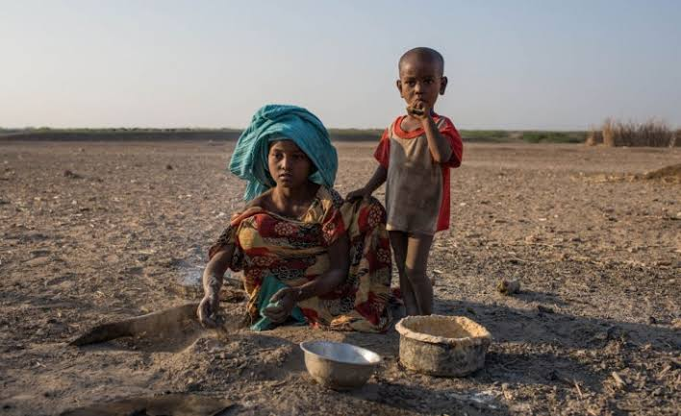
The Challenges
Demographic Challenges
Ethiopia’s population 134 million to ~225 by 2045 and ~268 million by 2053.
Urban population 56 million to ~75 million by 2045, straining urban services.
Youth population ~54 to ~92 million by 2045 increasing demand for employment.
Over 35 under 15 years old to ~90 million by 2045 creating high demand for education and employment.
Arable land 16 million hectares (14.5%) to ~ 12-13 million hectares by 2045, waning feed production.
Shrinking per capita due to decreased arable land and population increased demand.
Back to Menu

Slide 14

The Challenges
Food Security
Crop demand 62 million tonnes (2023) will increase to ~111 million tonnes by 2045
Crop production 32-35 million (Cereals, Teff, pulses, coffee, etc.) ~88 million tonnes by 2045
Currently 20-23% of the total crop demand is covered by import and ~5-6% through foreign aid.
Population with food insecurity 10.2 to 15.8 million (IPC Phase 3+)
More than 14 million children under 5 (>50%) affected due to malnourishment.
IIPC: Integrated Food Security Phase Classification. Phase 1: Minimal; Phase 2: Stressed; Phase 3: Crisis; Phase 4: Emergency; Phase 2: Catastrophe/Famine
Back to Menu

Slide 15
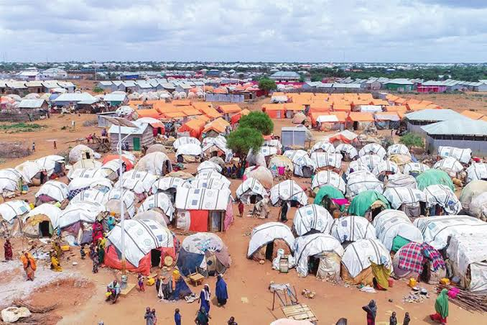
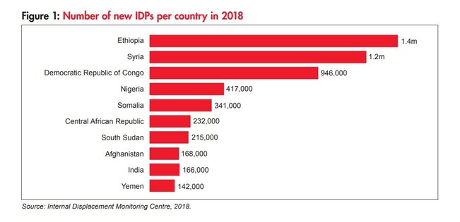
The Challenges
Displacement & Humanitarian Crisis
In 2024 there were 2,739 IDP sites in Ethiopia
Total population (2024) in IDPs stands as 3.3.m following Sudan (9.1m), Syria (6.8m), Colombia (6.8m), DR Congo (6.3m), and Yemen (4.5M)
~ 1.4 million during 2018 unrests.
>3 million due to internal war (2020 - ).
People displaced due to drought:
Internal Conflict 2,267,100 (68.7%)
Drought 2,267,100 (16.5%)
Social tension (8.4%)
Total number of children among IDPs is ~1.09 million
Back to Menu

Slide 16
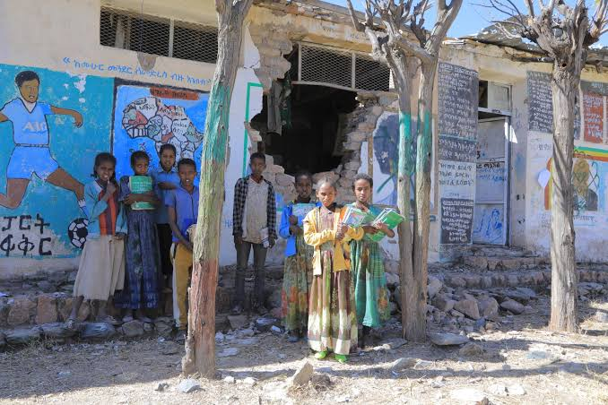
The Challenges
Education
3.1–3.6 million children are out of school due to conflict and drought.
More than 8,000 schools damaged or destroyed since 2021.
In 2023, 96–97% of Grade 12 students failed the national exam; only 3.3% passed. The same pattern was repeated in 2024.
Adult illiteracy stands at 45.4%; average schooling is only 4 years.
Tertiary enrolment rate is ~9.8%, among the lowest in sub-Saharan Africa.
Highest 53.4% (Algeria)
Average of 18 countries (2022) is 23.06%
Lowest 5.43% (Tanzania)
School dropout rates rising sharply in war-affected regions.
Shortages of teachers, books, and safe learning environments.
Back to Menu

Slide 17

The Challenges
Psychosocial & Mental Health Crisis
Researches show PTSD prevalence extremely high in war-affected areas:
59.8% among Maikadra massacre survivors
58.4% among IDPs in Southern Ethiopia
42.4% in North Shewa (Amhara)
40.8% in Northwest Ethiopia
34.5% in Dessie town (post-Tigray conflict)
Estimated 1,551,000 million IDP is high-risk PTSD population.
Nationally, <10% of people with mental illness receive care;
Rural 2.5% of rural residents access biomedical mental health services.
Nationally, <1% receive specialist support.
Psychosocial & Mental Health Services
or
Chains and padlocks
Back to Menu

Slide 18
The Challenges
Psychosocial Services
Only 25% of government health facilities provide MHPSS.
Services are concentrated in Addis Ababa
UNICEF’s mapping of IDP sites showed fewer than 1 in 10 had MHPSS interventions.
Neuropsychiatric disorders account for 5.8%
IN 2016 Depression along contributed 6.2%
The Yearly prevalence of depression is ~5%
Bipolar disorder 0.5%
Childhood disorders range from 12-25%
A meta-analysis (Frontiers in Psychiatry, 2016)found only 42% people seek modern treatment.
There is no national data on psychological and social work services.
0.11 psychiatrists for 100,000 people -------------------------
0.58 psychiatric nurses for 100,000 people --------------------
0.045 clinical psychologists for 100,000 people -------------------------
0.009 social workers for 100,000 people -------------------------
WHO standard for low-income countries – 1/100,000
WHO standard for low-income countries – 2/100,000
WHO standard for low-income countries – 1/100,000
WHO standard for low-income countries – 1/100,000
Back to Menu

Slide 19

Ethiopia
The Opportunities

Slide 20
The Opportunities
~ 2025
Current Status
27 yrs.
15 yrs.
Started
in Eth.
1998
116 yrs.
Started
in Eth.
2010
Started
in Eth.
1909
29 yrs.
95 yrs.
Started
in (ETH)
1996
Started
in (ETH)
1930
Back to Menu

Slide 21
The Opportunities
By 2045
Leveraging Internet Access and Access to Smart Device
Health Services ~82% population covered (mainly via public/CBHI) in 2025 to ~90–95% with expanded UHC and insurance by 2045
Mental Health (National) ~0.045 professionals per 100,000 in 2025) to ~0.5–1 per 100,000 by 2045
Uncrowded Housing ~11–20% of homes with proper sanitation in 2025) to ~81.5% total by 2045
Electricity Access ~54% total to ~81.5% total in 2045
Potable Water (Safely Managed) ~11% in 2025 to 30–40% by 2045
Transport (Rural Roads) 27.5% of rural population within 2 km of all-season roads in 2025 to ~40–50% in 2045
Internet Users ~20% of population (~25M users) in 2025 to ~100% coverage via mobile broadband subscriptions in 2045
Smartphone Ownership ~43% penetration in 2025 to ~90–95%+ by 2045 wearable/implants/ etc. devices in 2045
Internet
Users
Smartphone
Ownership
Sources
Back to Menu

Slide 22
The Opportunities
Leveraging Internet Access and Access to Smart Device
Digital Literacy
Digital Accessibility
Shortage of Professionals
Geographic Concentration
Infrastructure & Facilities
Lack of medication & supplies
Transport
Awareness
Negative attitude
Erroneous beliefs
Digital Inaccessibility
Unavailability
of
Services
Inaccessibility
of
Services
Digital Unavailability
Back to Menu

Slide 23
The Opportunities
Leveraging Internet Access and Access to Smart Device
The Model
Paraprofessionals
Beneficiaries
Educationalists
Social Workers
Psychosocial Software Engineers
Psychologists
Parapsychologists
Back to Menu

Slide 24
The Opportunities
Leveraging Internet Access and Access to Smart Device
Back to Menu

Slide 25
The Opportunities
Leveraging Internet Access and Access to Smart Device
Strategic Advantages
Rapid Digital Expansion
By 2045, 90–100% smart-device penetration and near-universal mobile broadband access is expected.
Digital platforms can reach areas where physical services cannot, especially remote zones.
2. Severe Workforce Shortage
Ethiopia won’t be able to train enough psychologists or social workers to meet demand but can use internet.
Possible to train Guidance officers, Para-counsellors, Social work paraprofessionals but that is even easier to train, deploy, guide and follow-up, supervise, and evaluate service using digital access.

Slide 26
The Opportunities
Leveraging Internet Access and Access to Smart Device
Strategic Advantages
3. Mental Health (psychosocial) Barriers can easily be removed
Awareness creation activities will be customized to the individual level
Negative attitude of individuals will be filtered and treated accordingly
Cultural, Religious, Superstitious, etc., erroneous beliefs will be addressed
Geographic, physical and transport barriers will be completely removed
Rapport, Stigma, discrimination, will not be issues due to complete privacy and confidentiality
4. Severe Workforce Shortage
Train professional psychologists and social workers through distance education
Design and implement in-service and professional development training to increase proficiency.

Slide 27
The Opportunities
Leveraging Internet Access and Access to Smart Device
Strategic Advantages
5. Successful Global Models Exist
Psychosocial (psychological & social work) services through via digital and smart devices
Crisis support chatbots
Remote audio and video therapy
Individually tailored therapeutic interventions using AI assistance, augmented reality and virtual reality
localize solutions using culturally appropriate and real-time customizable content and language.
6. Cost-Effective & Scalable
One-time investment in a robust, secure app is cheaper than building and staffing thousands of clinics.
Scale is virtually unlimited.

Slide 28
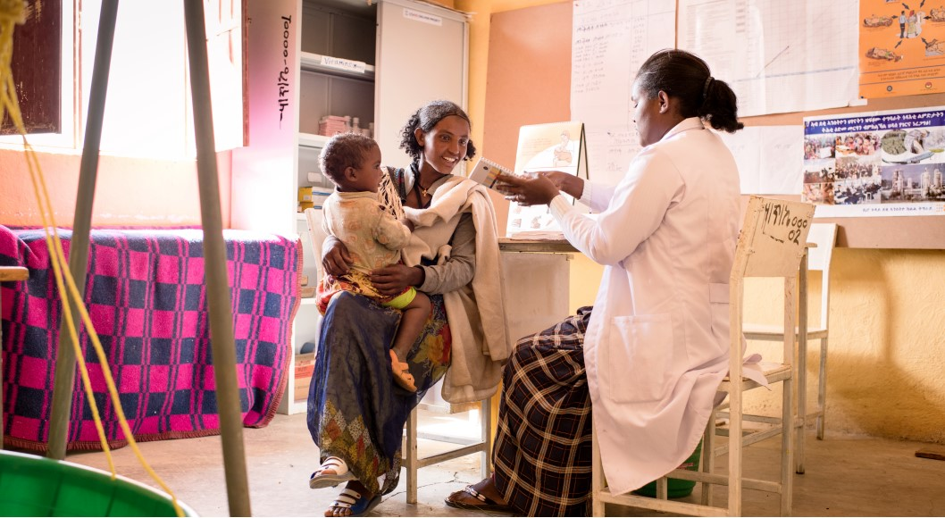
The Opportunities
Leveraging Internet Access and Access to Smart Device
Strategic Advantages
Lessons form
Ethiopia’s Electronic Community Health Information System (eCHIS)
Active in 8,000+ health posts (2024)
Used by 25,000+ health professionals
Covers 22 million people (16.92%)

Slide 29

Proposed Solution and Strategy
Innovative Approach
or
Business as Usual
Addressing Gaps in the
Psychosocial and Mental Health
Intervention
Back to Menu

Slide 30
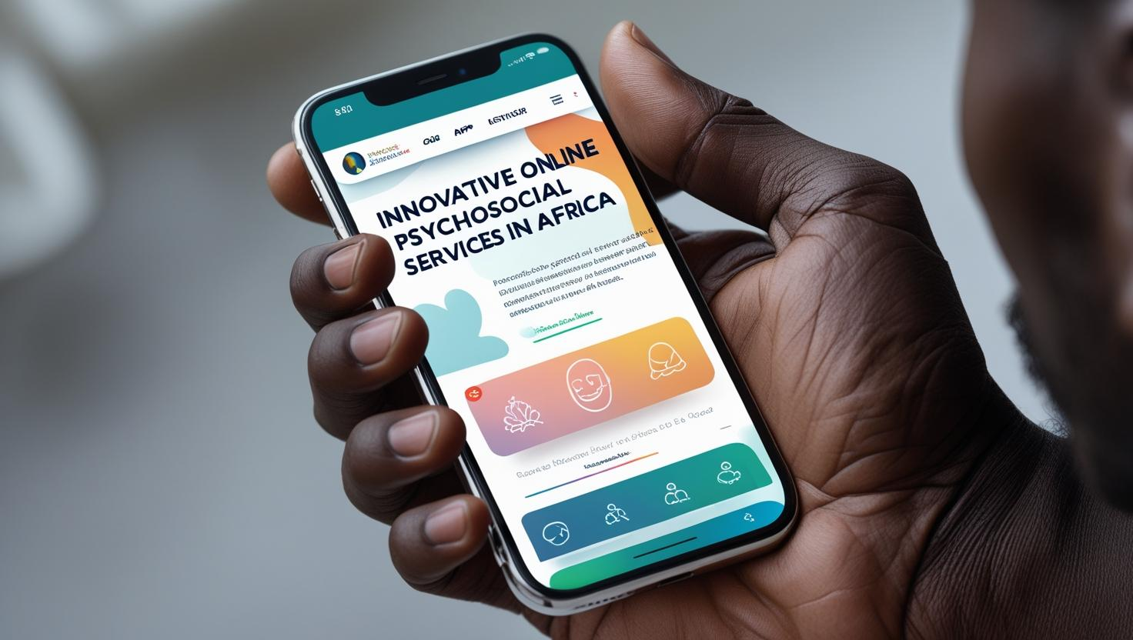
Project Overview
Master of Social Work
in
Psychosocial Software Engineering
Back to Menu

Slide 31
Master of Social Work in Psychosocial Software Engineering
Project Overview
National Policy Directions
Digital Ethiopia 2025 Strategy Envisions transforming Ethiopia into an inclusive digital economy by 2025 emphasizing the role of digital technologies in improving access to services across sectors, including healthcare and education, | National Digital Skills Country Action Plan 2030 Aims to enhance digital skills development in higher education and TVET institutions and encourages the creation of specialized programs in fields like artificial intelligence, software development, and digital resource management. | E-Government Strategy and Enterprise Architecture (2023) Promotes the modernization of public service delivery through secure, citizen-centered digital platforms so as to make quality services available and accessible to all. | The National Social Protection Policy Promotes resilience and social inclusion especially for vulnerable and marginalized populations.
Back to Menu

Slide 32
Master of Social Work in Psychosocial Software Engineering
Project Overview
Project Goal
The goal of this project is to establish a five-year graduate-level program in Psychosocial Software Engineering Program in Addis Ababa University and train 100 students as the first generation of Psychosocial Software Engineers that fosters innovation at the intersection of mental health, social work, and technology.
Back to Menu

Slide 33
Master of Social Work in Psychosocial Software Engineering
Project Overview
Project Objectives
Enhancing Ethiopia’s capacity for digital mental health innovation by training professionals who can leverage AI, machine learning, and mobile technologies to develop scalable interventions;
Strengthening the mental health and social services sectors through the integration of data-driven decision-making and predictive analytics in psychology and social work;
Addressing the shortage of mental health and social work professionals by using technology to expand service accessibility, particularly in underserved and rural areas;
Promoting interdisciplinary collaboration between psychologists, social workers, and software engineers, ensuring that technology is developed with a deep understanding of human behavior and social needs.
Back to Menu

Slide 34
Master of Social Work in Psychosocial Software Engineering
Project Overview
Project Specific Objectives
Enhancing Train at least 100 students in five years in the development of knowledge and skills to:
plan, design, develop and implement digital psychosocial services;
develop digital platforms, such as mobile counseling apps and telehealth services, etc., to improve mental health access in rural and underserved areas;
design digital services to that guarantee equitable access to mental health care through low-cost, AI-assisted digital interventions that reach vulnerable populations; and
ensure the development of a multidisciplinary team with expertise in psychology, social work, and software engineering, ensuring the sustainability of the specialization.
Back to Menu

Slide 35
Master of Social Work in Psychosocial Software Engineering
Project Overview
The evolution of psychology and social was shaped by quantitative methods and statistical models. In the 21st Century computational tools and digital methodologies just as statistical methods became essential a century ago.
The justification for establishing the MSW-PSSE is evident in the ongoing global digitization of mental health and social service practices in the world. Education, research, assessment, diagnosis, prognosis, intervention, follow-up, and MEL have become dependent on digital and computational tools.
Psychometrics and Sociometrics
so shall it be with Psychosocial Software Engineering
Data-driven modeling,
AI-powered diagnostics,
AR/VR virtual therapies,
Biosensors and implants
Biofeedback devices
Back to Menu

Slide 36



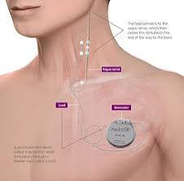
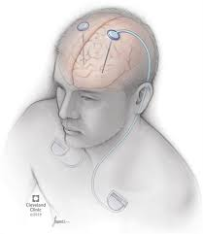
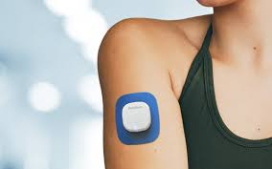
Master of Social Work in Psychosocial Software Engineering
Applications / Devices in Psychology
Mobile Phone Apps (Paired with Wearables) Use: Guided therapy, meditation, CBT exercises, symptom tracking. |  | Tactile Feedback Devices (haptic gloves) Use: stress management, phobia, and touch therapy.
Smartwatches Use: detect panic attacks, sleep tracking, activity monitoring. |  | Vagus Nerve Stimulation (VNS) Implants Use: For treatment-resistant depression or epilepsy; mood-regulation.
Biofeedback Wearables Use: Provide real-time feedback on brain activity, breathing, stress reduction training. |  | Deep Brain Stimulation (DBS) Devices Use: Implanted electrodes used for severe OCD or depression not responsive to therapy or medication.
Back to Menu

Slide 37



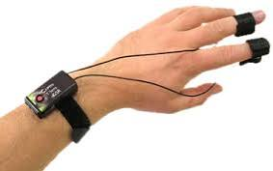

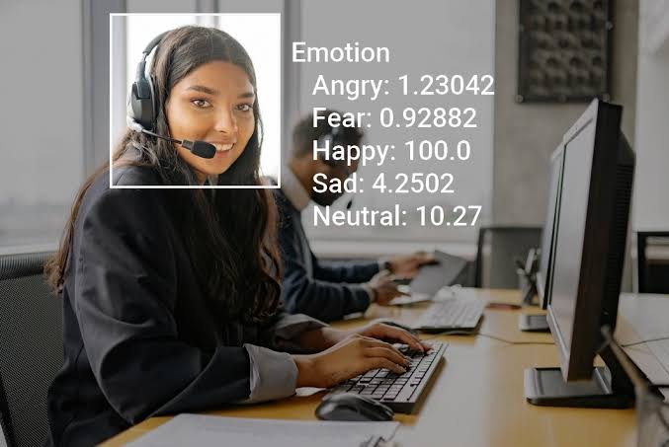
Master of Social Work in Psychosocial Software Engineering
Applications / Devices in Psychology
EEG Headbands Use: Measure brainwaves to support neurofeedback therapy for ADHD, anxiety, PTSD. |  | Virtual Reality (VR) Headsets Use: Exposure therapy, PTSD treatment.
Skin Conductance Sensors (Galvanic Skin Response [GSR]) Use: Detect stress levels through skin response to emotional stimuli. |  | Augmented Reality (AR) Glasses Use: Immersive therapy
Smart Rings Use: Sleep quality, mood tracking and intervention timing. |  | Emotion AI Cameras / Tools Use: Track cues during therapy sessions.
Back to Menu

Slide 38

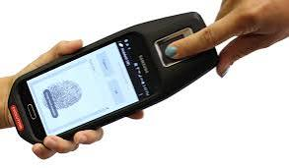

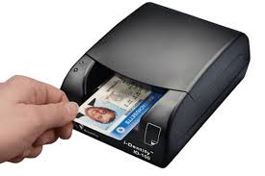
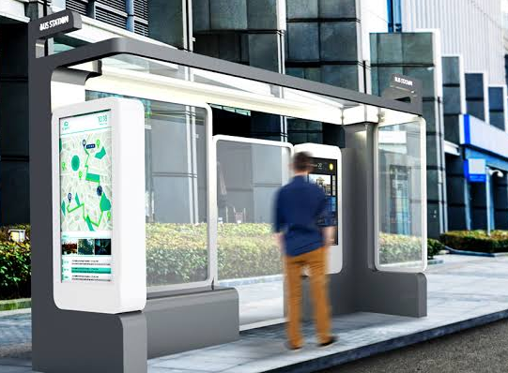

Master of Social Work in Psychosocial Software Engineering
Applications / Devices in Social work
Mobile Case Management Tablet Use: Enables field documentation, referrals, and secure client data access. |  | Mobile Fingerprint Scanner Use: Identifies at-risk individuals in homeless outreach or disaster zones.
Digital ID Scanner Use: Verifies client identity for accessing housing, benefits, or services. |  | Portable Printer Use: Prints consent forms, referrals, or service agreements during field visits.
Wi-Fi Hotspot Device Use: Provides internet access for underserved families during case visits. |  | Smart Shelter Kiosk Use: Allows clients to check bed availability or request shelter spots.
Back to Menu

Slide 39
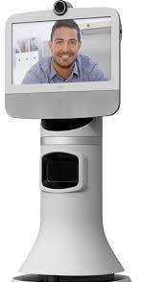



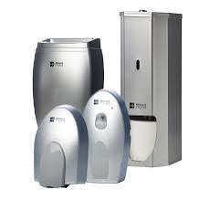

Master of Social Work in Psychosocial Software Engineering
Applications / Devices in Social work
Emergency Alert Pendant Use: Worn by elderly clients to request immediate help when needed. |  | Telepresence Robot Use: Enables remote social workers to interact in care facilities.
Child Location Tracker Use: Monitors movement of children under protective or supervised custody. |  | Medication Lockbox with Timer Use: Prevents overdose or misuse in homes with substance history.
Document Scanner Wand Use: Scans paperwork on-site for housing, immigration, or legal services. |  | Hygiene Kit Dispenser Use: Dispenses essentials (soap, pads, sanitizer) in community outreach settings.
Back to Menu

Slide 40
7. Expected Outcomes and Impact
Short-term and Long-term Outcomes
Employment Opportunities
Impact on National Development
Back to Menu

Slide 41
Expected Outcomes and Impact
Short-term and Long-term Outcomes
Short-term: Training of 100 Qualified Psychologists and Social Workers in Psychosocial Software Engineering
Long-term: The program will enhance the efficiency, accessibility, and reach of psychosocial and mental health services
Employment Opportunities
The program aims to create employment in higher education institutions, research institutes, consultancy, service providers, etc., in mental health and psychosocial services.
Impact on National Development
Improving psychosocial and mental health services leads to a healthier population,
enhanced productivity, and overall societal well-being.
Back to Menu

Slide 42
Conclusion and Call to Action
Urgency of Establishing the Program: The pressing psychosocial and mental health challenges in Ethiopia necessitated action to develop a program that can address needs effectively and sustainably.
Support from Funders and Partners: Engaging support from local and international funders is critical for the successful implementation and sustainability of the program.
Vision for the Future of Psychosocial Services: A forward-thinking perspective aims to establish a vibrant ecosystem of psychosocial services that enhances community well-being and resilience.
Back to Menu

Slide 43
Training the first generation of
Psychosocial Engineers in
Back to Menu

Slide 44
Thank you
Back to Menu

Slide 45
Addenda
Back to Menu

Slide 46
Sources used
African Union Development Agency (AUDA-NEPAD). (2023). Africa Infrastructure Development Index Report 2023. https://www.nepad.org
Central Statistical Agency (CSA) [Ethiopia] & ICF. (2019). Ethiopia Mini Demographic and Health Survey 2019. https://dhsprogram.com/pubs/pdf/FR363/FR363.pdf
DataReportal. (2025). Digital 2025: Ethiopia. https://datareportal.com/reports/digital-2025-ethiopia
International Futures (IFs) Model. (2024). Ethiopia Country Profile and Projections. Pardee Center for International Futures, University of Denver. https://www.ifs.du.edu
ISS Africa. (2023). Ethiopia’s development trajectory: Current Path analysis. Institute for Security Studies. https://futures.issafrica.org/geographic/countries/ethiopia/
Ministry of Health – Ethiopia. (2023). Annual Health Sector Performance Report 2022/23. http://www.moh.gov.et
United Nations Children’s Fund (UNICEF). (2024). Water, Sanitation and Hygiene (WASH) in Ethiopia: Progress and challenges. https://www.unicef.org/ethiopia
United Nations Office for the Coordination of Humanitarian Affairs (UNOCHA). (2024). Ethiopia Humanitarian Needs Overview. https://reliefweb.int/country/eth
World Bank. (2023). Ethiopia Economic Update: Pursuing Shared Prosperity. https://www.worldbank.org/en/country/ethiopia/publication
World Health Organization. (2021). Mental Health Atlas 2020. https://www.who.int/publications/i/item/9789240036703
World Health Organization. (2022). Global Health Observatory (GHO) data repository. https://www.who.int/data/gho
Back to Page
Back to Menu

