Slide 1
CS487-Introduction to competitive programming: A2SV
Lecture #18 Shortest Path, All Shortest Path, Minimum Spanning Tree

Slide 2
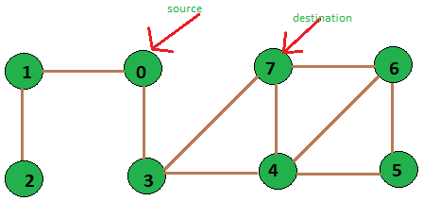
Shortest PAth
Problem: Finding the a path between two vertices in a graph such that the total weight of the edges is minimum
What if all the edge weights are 1?

Slide 3
Shortest PAth
Problem: Finding the a path between two vertices in a graph such that the total weight of the edges is minimum
What if all the edge weights are 1?
BFS

Slide 4
Shortest Path- Dijkstra - I
What if all the edge weights are positive integers?

Slide 5
Shortest Path- Dijkstra - II
What if all the edge weights are positive integers?
BFS with a priority queue

Slide 6
Shortest Path- Dijkstra- III
1 function Dijkstra(Graph, source):
2 dist[source] ← 0
3
4 create vertex priority queue Q
5
6 for each vertex v in Graph:
7 if v ≠ source
8 dist[v] ← INFINITY
9 prev[v] ← UNDEFINED
10
11 Q.add_with_priority(v, dist[v])
12
13
14 while Q is not empty:
15 u ← Q.extract_min()
16 for each neighbor v of u:
17 alt ← dist[u] + length(u, v)
18 if alt < dist[v]
19 dist[v] ← alt
20 prev[v] ← u
21 Q.decrease_priority(v, alt)
22
23 return dist, prev
Time Complexity: O(E + VlgV)
Space Complexity: O(V)

Slide 7
ALL Shortest Path- I
Find the shortest path between all pairs of vertices
Obvious solution?

Slide 8
ALL Shortest Path- II
Find the shortest path between all pairs of vertices
Obvious solution?
Call Dijkstra’s SP for each vertex
Time complexity: O(V*(E+VlgV)) ~ O(V^3)

Slide 9
ALL Shortest Path- III - Floyd Warshall
Find all pair shortest paths that use first K node as intermediate vertices at each iteration of the outer loop
for(int k = 1; k <= n; k++){
for(int i = 1; i <= n; i++){
for(int j = 1; j <= n; j++){
dist[i][j] = min(dist[i][j],dist[i][k]+dist[k][j]);
}
}
}
Time Complexity: O(V^3)
Space Complexity: O(1)
Can we change the order of loops?

Slide 10
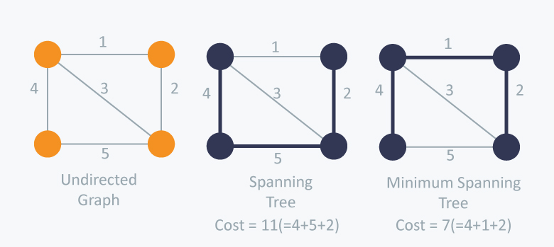
Minimum Spanning Tree
Spanning tree: A tree that connects all the vertices of a graph, with a subset of edges
Minimum spanning tree: A spanning tree such that total sum of edge weights are minimum

Slide 11
Programming Exercises
TODO(Emre): Add problems

Slide 12
Quote of the day
"Judge nothing, you will be happy.
Forgive everything, you will be happier.
Love everything, you will be happiest." — Sri CHINMOY

