Slide 1
CS487-Introduction to competitive programming: A2SV
Lecture #2: Importance of algorithms + Types, Loops, Functions

Slide 2
What’s an Algorithm
In general; step-by-step procedure for solving a problem
In CS; well-defined computational procedure that takes a set of values as input and produces another set of values as output

Slide 3
Algorithm Examples
Fibonacci f(n) = f(n-1)+ f(n-2)
f(1) = f(2) = 1
Summation
Sorting
Shortest path
Compression

Slide 4
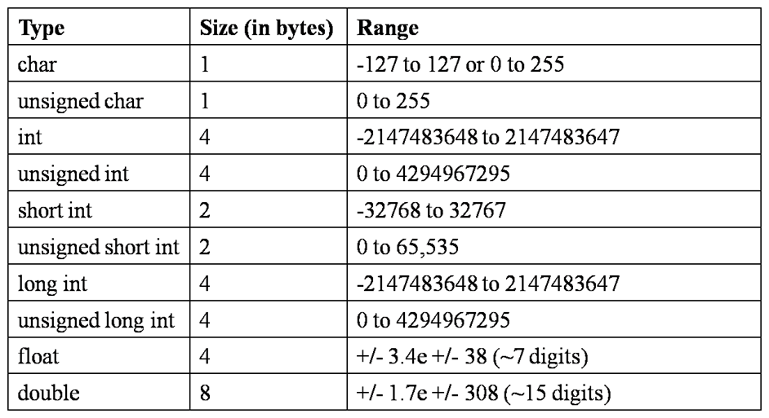
C++ Types
Depends on your environment
Check on your computer

Slide 5
Problem Solving
Calculate a+b for
-10^1000000 <= a,b <= 10^1000000
Sum 2 big numbers

Slide 6
Problem Solving
Calculate a*b for
-10^1000000 <= a,b <= 10^1000000
Multiply 2 big numbers

Slide 7
Environment Practice -Codeforces
Watermelon
Theatre Square

Slide 8
Environment Practice -LEETCODE
Two sum
Add two numbers
Reverse integer

Slide 9
Quote of the day
“Live as if you were to die tomorrow. Learn as if you were to live forever.” - Mahatma Gandhi

