Slide 1
NMSP2024 Error estimation for finite element solutions on meshes that contain thin elements Kenta Kobayashi (小林健太) Hitotsubashi University, Japan (一橋大学) Takuya Tsuchiya (土屋卓也) Osaka University, Japan (大阪大学)

Slide 2
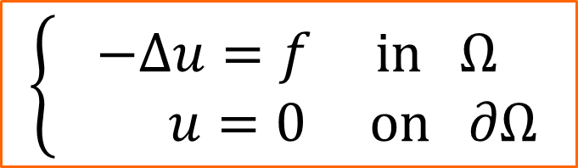


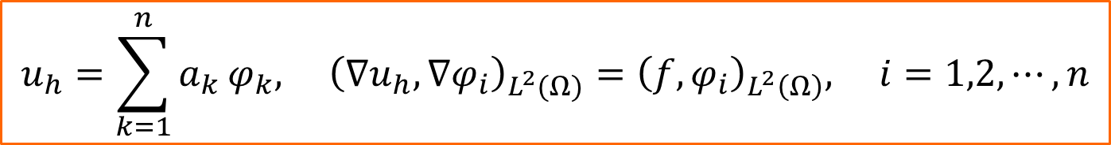
Target equation and its FEM solution
Let $Ω$ be convex polygonal domain. For $f∈L^{2}\left(Ω\right)$, we consider $P^{1}$ FEM solution of the following Poisson equation: It is well known that this equation has weak solution in $H^{2}\left(Ω\right)$.
Now, divide $Ω$ into triangular elements $τ_{j}, j=1,2,⋯,m$ , and we have the FEM solution by the corresponding weak form:
where $φ_{i}, i=1,2,⋯,n$ are the FEM basis.
$$\left\{\begin{aligned}−Δu=f in Ω \\ u=0 on ∂Ω\end{aligned}\right.$$
$$Ω$$
$$u_{h}=\sum_{k=1}^{n}{a_{k}}φ_{k}, {\left(∇u_{h},∇φ_{i}\right)}_{L^{2}(Ω)}={\left(f,φ_{i}\right)}_{L^{2}\left(Ω\right)}, i=1,2,⋯,n$$

Slide 3





Interpolation error constant
For a function $u∈H^{2}(T)$ , let $Π_{T}u$ be linear interpolation which coincides with $u$ at the vertices of triangle $T$. Then, it is known that the following interpolation error estimate holds:
where constant $C(T)$ only depends on $T$.
This constant $C(T)$ is called interpolation error constant.
$u$
$Π_{T}u$
$T$
$${\left|u−Π_{T}u\right|}_{H^{1}\left(T\right)}≤C\left(T\right){\left|u\right|}_{H^{2}\left(T\right)}$$

Slide 4


Céa’s lemma and the error estimation for the FEM solution
For the above situation, it is known that the FEM solution achieves best approximation in $H_{0}^{1}\left(Ω\right)$. This special property is known as Céa’s lemma. Using Céa’s lemma and the interpolation error constant, we have the following error estimation for the FEM solution:
where $Πu$is constructed by connecting $Π_{τ_{j}}$to the whole $Ω$.
$${\left\|u−u_{h}\right\|}_{H_{0}^{1}\left(Ω\right)}^{2}≤{\left\|u−Πu\right\|}_{H_{0}^{1}\left(Ω\right)}^{2}={\left|u−Πu\right|}_{H^{1}\left(Ω\right)}^{2}$$
$$=\sum_{j}{{\left|u−Π_{τ_{j}}u\right|}_{H^{1}\left(τ_{j}\right)}^{2}}≤\sum_{j}{C{\left(τ_{j}\right)}^{2}{\left|u\right|}_{H^{2}\left(τ_{j}\right)}^{2}}≤\max_{j}{C{\left(τ_{j}\right)}^{2}}\sum_{j}{{\left|u\right|}_{H^{2}\left(τ_{j}\right)}^{2}}=\max_{j}{C{\left(τ_{j}\right)}^{2}}{\left|u\right|}_{H^{2}\left(Ω\right)}^{2}$$

Slide 5
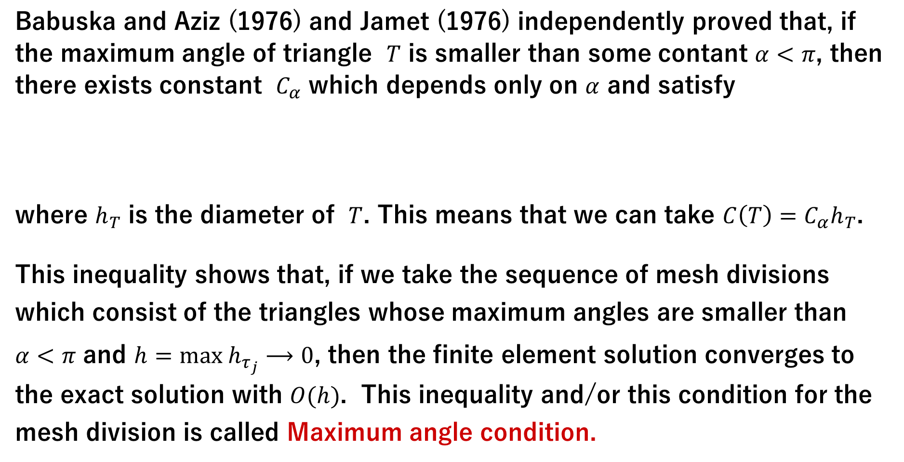
Maximum angle condition
Babuska and Aziz (1976) and Jamet (1976) independently proved that, if the maximum angle of triangle $T$ is smaller than some contant $α<π$, then there exists constant $C_{α}$ which depends only on $α$ and satisfy
where $h_{T}$ is the diameter of $T$. This means that we can take $C\left(T\right)=C_{α}h_{T}$.
This inequality shows that, if we take the sequence of mesh divisions which consist of the triangles whose maximum angles are smaller than $α<π$ and $h=max h_{τ_{j}}⟶0$, then the finite element solution converges to the exact solution with $O(h)$. This inequality and/or this condition for the mesh division is called Maximum angle condition.
${\left|u−Π_{T}u\right|}_{H^{1}\left(T\right)} ≤C_{α}h_{T}{\left|u\right|}_{H^{2}\left(T\right)}$ for $∀u∈H^{2}(T)$

Slide 6
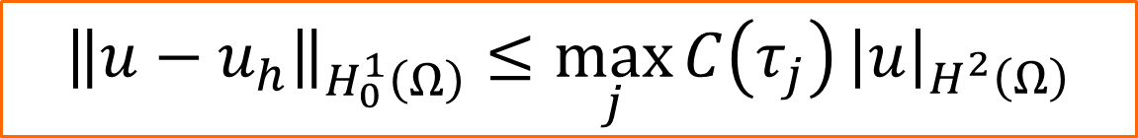
Revisit the error estimation
Let’s look back at the error estimation for the FEM solution.
This error estimation is based on evaluating the worst interpolation error constant of the triangles consisting of the mesh division.
Here, some questions arise about this error estimation.
Question 1: Is this an optimal estimation?
Question 2: Wouldn’t a few badly shaped elements (specifically, elements with maximum angles very close to 𝜋) not worsen the error of the FEM solution?
The answer to the second question is affirmative, with some preceding results.
$${\left\|u−u_{h}\right\|}_{H_{0}^{1}\left(Ω\right)}≤\max_{j}{C\left(τ_{j}\right)}{\left|u\right|}_{H^{2}\left(Ω\right)}$$

Slide 7
Mesh subdivision and Céa’s lemma
We can easily make the examples of mesh division where bad elements do not make the error of the FEM solution worse.
Even if the thin triangles in the left figure degenerate, the error of the FEM solution does not get worse. Since the mesh division of the left figure is a subdivision of the right one, from Céa’s lemma, the error of the FEM solution on the left mesh is bounded by that of the right one.

Slide 8






Preceding result by V. Kucera
v
For thin triangle element $τ$, define $B_{τ}$as follows:
$B_{τ}=\left\{x : \left|x−x_{3}\right|≤r_{τ}\right\}, r_{τ}=\frac{1}{2}min\left(\left|x_{1}−x_{3}\right| , \left|x_{2}−x_{3}\right|\right)$
V. Kucera proved that, if $B_{τ}$is disjoint for all thin elements (Case 1) or all the clusters of thin elements are contained in the ball whose radius is $O(h)$ and each such cluster is sufficiently far from other clusters and the boundary (Case 2), $O(h)$ error estimation can be obtained (Case 1 and 2 can be coexist). Their result is applicable only for 2D.
Only applicable for $u∈W^{2,∞}$ . V. Kucera, On necessary and sufficient conditions for finite element convergence, arxiv:1601.02942.
$$x_{3}$$
$$τ$$
$$x_{1}$$
$$x_{2}$$
v
Case 1
Case 2
$$O(h)$$
v

Slide 9

Preceding result by M. Duprez, V. Lleras and A. Lozinski
M. Duprez, V. Lleras, and A. Lozinski proved that, if all the clusters containing thin elements (the cluster may contain regular elements as well) form a star shape and are completely surrounded by regular elements, and the size of each cluster is $O(h)$, then $O(h)$ error estimation can be obtained. Their result can be extended to 3D cases. The assumption for $u$ is $u∈H^{2}$ .
However, clusters are strictly disjoint each other and should not touch the boundary. M. Duprez, V. Lleras, A. Lozinski, Finite element method with local damage of the mesh, Math. Model. Numer. Anal., 53 (2019) 1871–1891.

Slide 10











Our result: Preliminary
Let $0<θ≤π/3$ be a constant given in advance. And let $T_{θ}$ be a triangle which has angles of $θ, θ, π−2θ$ and maximum edge length is 1.
Classify the triangles that consisting the mesh division as follows:
Group $𝒜$: Minimal angle $≥θ/2$, so-called “good elements”
Group $ℬ$ : Maximum angle $>π−θ$, so-called “bad elements”
Group $𝒞$ : Other
For $τ∈ℬ$ , let $\left[τ\right]$ be the triangle which is similar to $T_{θ}$, the location and length of the longest edge are coincide with that of $τ$ and satisfy $τ⊂\left[τ\right]$ .
For example, if we choose △$ABC$ as $τ$, then $\left[τ\right]$ is △$A′BC$ .
$$T_{θ}$$
$$θ$$
$$θ$$
$$1$$
$$A′$$
$$A$$
$$θ$$
$$θ$$
$$B$$
$$C$$

Slide 11





Main result
Let $h=\max_{j}{h_{τ_{j}}}$ .
For $τ∈ℬ$, let $q_{τ}$ be the vertex of the largest angle of $τ$. Assume that the mesh division satisfies the following conditions.
Condition１：For all $τ∈ℬ$, it holds that $\left[τ\right]⊂Ω$ .
Condition２：For all $τ_{1},τ_{2}∈ℬ,τ_{1}≠τ_{2}$ , it holds that $\left[τ_{1}\right]∩\left[τ_{2}\right]=φ$.
Condition３：For all $τ∈ℬ$, all triangles except $τ$ that share $q_{τ}$ belong to $𝒜$.
Then, there exists constant $C_{θ}$ which depends only on $θ$ and satisfy
$${\left\|u−u_{h}\right\|}_{H_{0}^{1}\left(Ω\right)}≤C_{θ}h{\left|u\right|}_{H^{2}\left(T\right)}.$$
$$𝒜$$
$$𝒜$$
$$𝒜$$
$$ℬ$$

Slide 12

















Outline of the proof: using modified interpolation
For $u$ and every nodal point $p_{i}$, let $w_{i}=\left\{\begin{aligned}\left(Π_{\left[τ\right]}u\right)\left(p_{i}\right), \text{if} \text{there} \text{exists} τ∈ℬ \text{s}\text{.}\text{t}\text{. }q_{τ}=p_{i} \\ \\ u\left(p_{i}\right), \text{otherwise} \end{aligned}\right.$
and define interpolation $Π^{∗}u$ of $u$ by $Π^{∗}u=\sum_{i}{w_{i}φ_{i}}$ . The right figures are the one-dimensional analogue to the interpolation $Πu$ and $Π^{∗}u$ . By using this interpolation and Céa’s lemma, we obtain ${\left\|u−u_{h}\right\|}_{H_{0}^{1}\left(Ω\right)}≤{\left\|u−Π^{∗}u\right\|}_{H_{0}^{1}\left(Ω\right)}$ .
$$q_{τ}$$
$$\left[τ\right]$$
$$τ$$
$$u$$
$$Πu$$
$$u$$
$$Π^{∗}u$$
$$τ$$
$$τ$$
$$\left[τ\right]$$
$$p_{i}$$
$${p_{j}(=q}_{τ})$$
$$p_{k}$$
$$p_{i}$$
$${p_{j}(=q}_{τ})$$
$$p_{k}$$

Slide 13
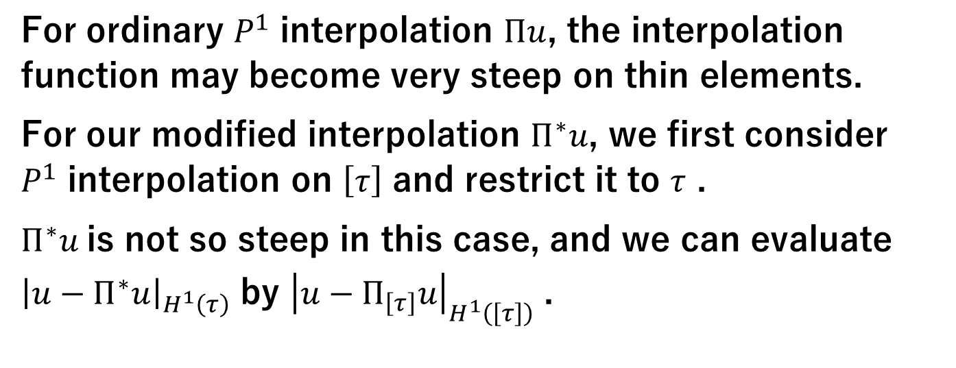


The key idea of our method
For ordinary $P^{1}$ interpolation $Πu$, the interpolation function may become very steep on thin elements.
For our modified interpolation $Π^{∗}u$, we first consider $P^{1}$ interpolation on $\left[τ\right]$ and restrict it to $τ$ .
$Π^{∗}u$is not so steep in this case, and we can evaluate ${\left|u−Π^{∗}u\right|}_{H^{1}\left(τ\right)}$ by ${\left|u−Π_{\left[τ\right]}u\right|}_{H^{1}\left(\left[τ\right]\right)}$ .
$$Πu$$
$$Π^{∗}u$$
$$q_{τ}$$
$$\left[τ\right]$$
$$τ$$

Slide 14
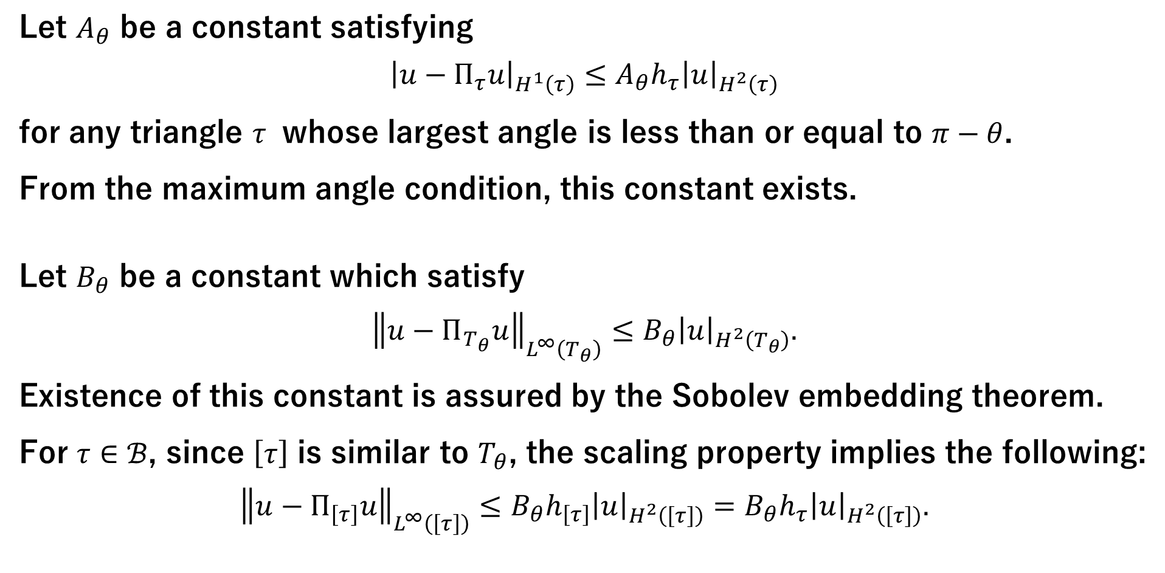
Important constants
Let $A_{θ}$ be a constant satisfying
$${\left|u−Π_{τ}u\right|}_{H^{1}\left(τ\right)}≤A_{θ}h_{τ}{\left|u\right|}_{H^{2}\left(τ\right)}$$
for any triangle $τ$ whose largest angle is less than or equal to $π−θ$.
From the maximum angle condition, this constant exists. Let $B_{θ}$ be a constant which satisfy
$${\left\|u−Π_{T_{θ}}u\right\|}_{L^{∞}\left(T_{θ}\right)}≤B_{θ}{\left|u\right|}_{H^{2}\left(T_{θ}\right)}.$$
Existence of this constant is assured by the Sobolev embedding theorem.
For $τ∈ℬ$, since $\left[τ\right]$ is similar to $T_{θ}$, the scaling property implies the following:
$${\left\|u−Π_{\left[τ\right]}u\right\|}_{L^{∞}\left(\left[τ\right]\right)}≤B_{θ}h_{\left[τ\right]}{\left|u\right|}_{H^{2}\left(\left[τ\right]\right)}=B_{θ}h_{τ}{\left|u\right|}_{H^{2}\left(\left[τ\right]\right)}.$$

Slide 15
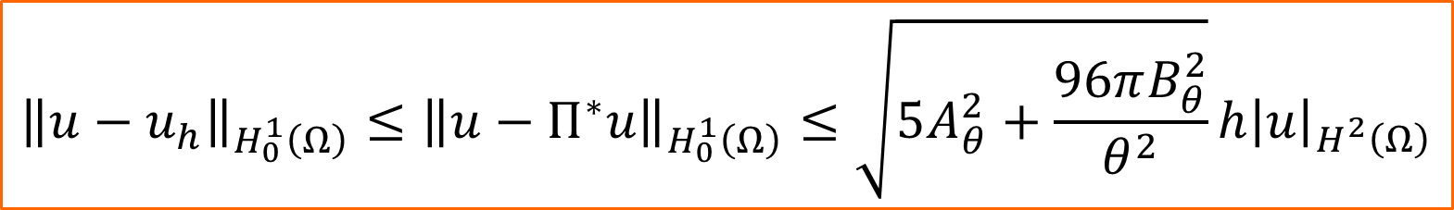
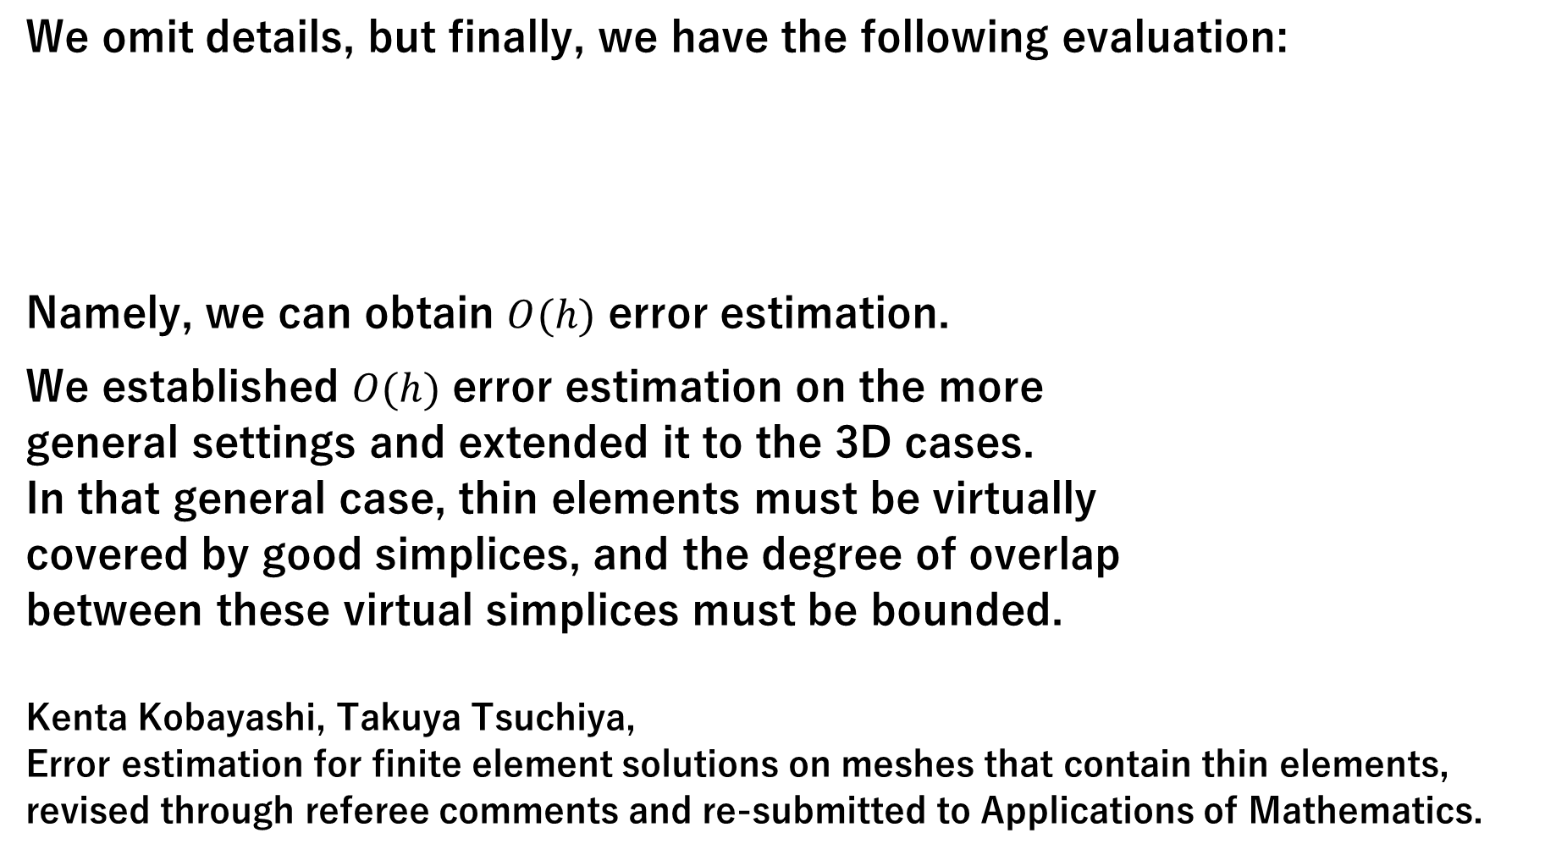
Error estimation
We omit details, but finally, we have the following evaluation:
Namely, we can obtain $O(h)$ error estimation.
We established $O(h)$ error estimation on the more general settings and extended it to the 3D cases. In that general case, thin elements must be virtually covered by good simplices, and the degree of overlap between these virtual simplices must be bounded. Kenta Kobayashi, Takuya Tsuchiya, Error estimation for finite element solutions on meshes that contain thin elements, revised through referee comments and re-submitted to Applications of Mathematics.
$${\left\|u−u_{h}\right\|}_{H_{0}^{1}\left(Ω\right)}≤{\left\|u−Π^{∗}u\right\|}_{H_{0}^{1}\left(Ω\right)}≤\sqrt{5A_{θ}^{2}+\frac{96πB_{θ}^{2}}{θ^{2}}}h{\left|u\right|}_{H^{2}\left(Ω\right)}$$

Slide 16
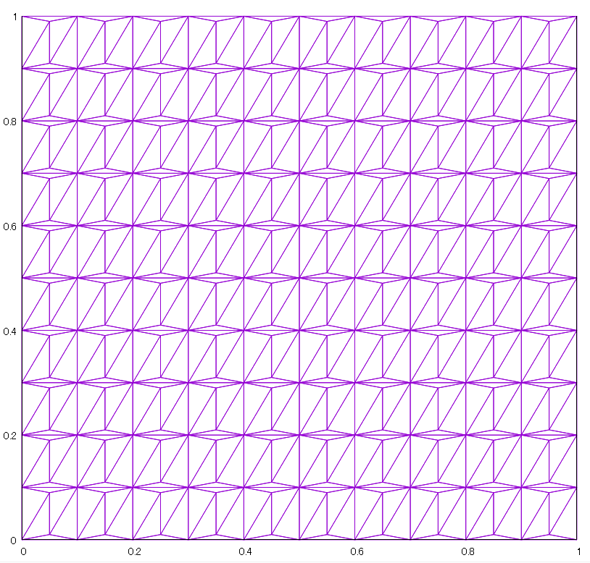







Numerical experiments
Numerical experiments were performed using the following mesh.
This mesh division cannot be dealt with using either V. Kucera’s method or that of M. Duprez, V. Lleras and A. Lozinski.
$$\left(x,y+k\right)$$
$$\left(x+k,y+k\right)$$
$$\left(x+\frac{h}{2}, y+(1−α)k\right)$$
$$\left(x+\frac{h}{2}, y+αk\right)$$
$$\left(x,y\right)$$
$$k=\frac{1}{N}$$
$$\left(x+k,y\right)$$
v

Slide 17
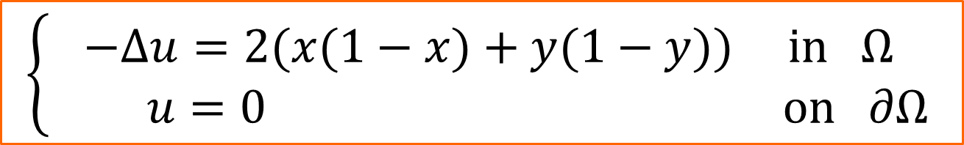
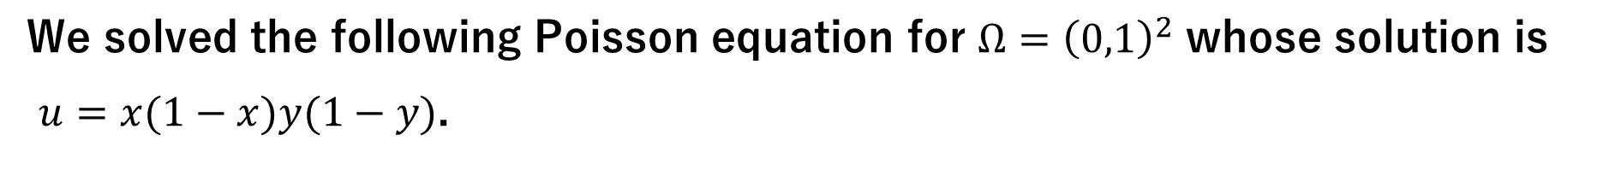
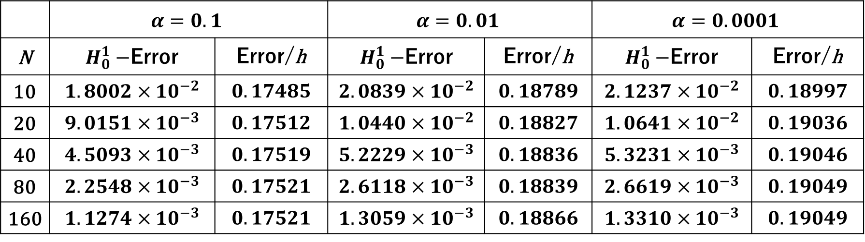
Numerical results
We solved the following Poisson equation for $Ω={\left(0,1\right)}^{2}$ whose solution is
$u=x(1−x)y(1−y)$.
$$\left\{\begin{aligned}−Δu=2(x(1−x)+y(1−y)) in Ω \\ u=0 on ∂Ω\end{aligned}\right.$$
 | $$α=0.1$$ |  | $$α=0.01$$ |  | $$α=0.0001$$
N | $H_{0}^{1}−$Error | Error/h | $H_{0}^{1}−$Error | Error/h | $H_{0}^{1}−$Error | Error/h
10 | $$1.8002×10^{−2}$$ | $$0.17485$$ | $$2.0839×10^{−2}$$ | $$0.18789$$ | $$2.1237×10^{−2}$$ | $$0.18997$$
20 | $$9.0151×10^{−3}$$ | $$0.17512$$ | $$1.0440×10^{−2}$$ | $$0.18827$$ | $$1.0641×10^{−2}$$ | $$0.19036$$
40 | $$4.5093×10^{−3}$$ | $$0.17519$$ | $$5.2229×10^{−3}$$ | $$0.18836$$ | $$5.3231×10^{−3}$$ | $$0.19046$$
80 | $$2.2548×10^{−3}$$ | $$0.17521$$ | $$2.6118×10^{−3}$$ | $$0.18839$$ | $$2.6619×10^{−3}$$ | $$0.19049$$
160 | $$1.1274×10^{−3}$$ | $$0.17521$$ | $$1.3059×10^{−3}$$ | $$0.18866$$ | $$1.3310×10^{−3}$$ | $$0.19049$$

Slide 18
Conclusions
In the conventional error estimation of the FEM solutions, the estimation becomes worse if there exists only one thin element.
In practice, however, the accuracy of the FEM solution often does not get worse, even if there are some thin elements.
In this study, we showed through concrete error estimation that even if there are thin elements, the accuracy of the FEM solution does not get worse if the arrangement of the thin elements satisfies certain conditions.
Even though similar results already exist, our result is more general and applicable to a broader range of arrangements of thin elements than preceding results.
Thank you very much for your attention!

