Slide 1
React.JS
FUNDAMENTALS OF REACT.JS LIBRARY

Slide 2
Title and Content Layout with List
Introduction to React.js
What is React.js
React Features
Pros and Cons
DOM
File and Folder structure
React JSX
React Components
React State
React Props
Events

Slide 3
React.js
React.JS is a declarative, efficient and flexible JavaScript library for building reusable UI components.
Open-Source, free, component based, reusable, free
It is responsible for only the View layer of the application.
It is was first released by Meta (Facebook).

Slide 4
React Features
JSX: stands for JavaScript XML. It is a JS syntax extension. It’s an XML or HTML like syntax used by ReactJS.
Components: React is all about components. React app is made up of multiple components and each component has its own logic and control. These components can be reusable which helps you to maintain the code when working on larger scale projects.
Unidirectional data binding: is designed in such manner that follows unidirectional data flow or one-way data binding. The benefit of one-way data binding gives you better code. You can also implement two-way-data binding.
Virtual DOM: it is a representation/abstraction of the original DOM. It works like a one-way data binding. Whenever any modifications happen in the web application the entire UI is re-rendered in virtual DOM representation and new DOM ones it has done the real DOM will update only the things that have actually changed.

Slide 5
Supports Server-side rendering: content on your webpage is rendered on the server and not on your browser using JavaScript.
Uses reusable UI components: a piece of User Interface that can be used in many parts of an application to build and render different User Interface instances.
Data binding is the coupling and synchronization of two data sources; when data changes in an element, the bound element gets updated to reflect this change. Data binding is used for many reasons, such as linking an application's user interface (UI) to the data it displays, for data entry, etc.

Slide 6
Real DOM | Virtual DOM
It is an abstraction of a page's HTML. | It is an abstraction of an HTML DOM.
It can manipulate on-screen elements. | It cannot manipulate on-screen elements.
Any change updates the entire DOM tree. | Any change only updates the relevant node in the tree.
Updating is slow and inefficient. | Updating is fast and efficient.

Slide 7
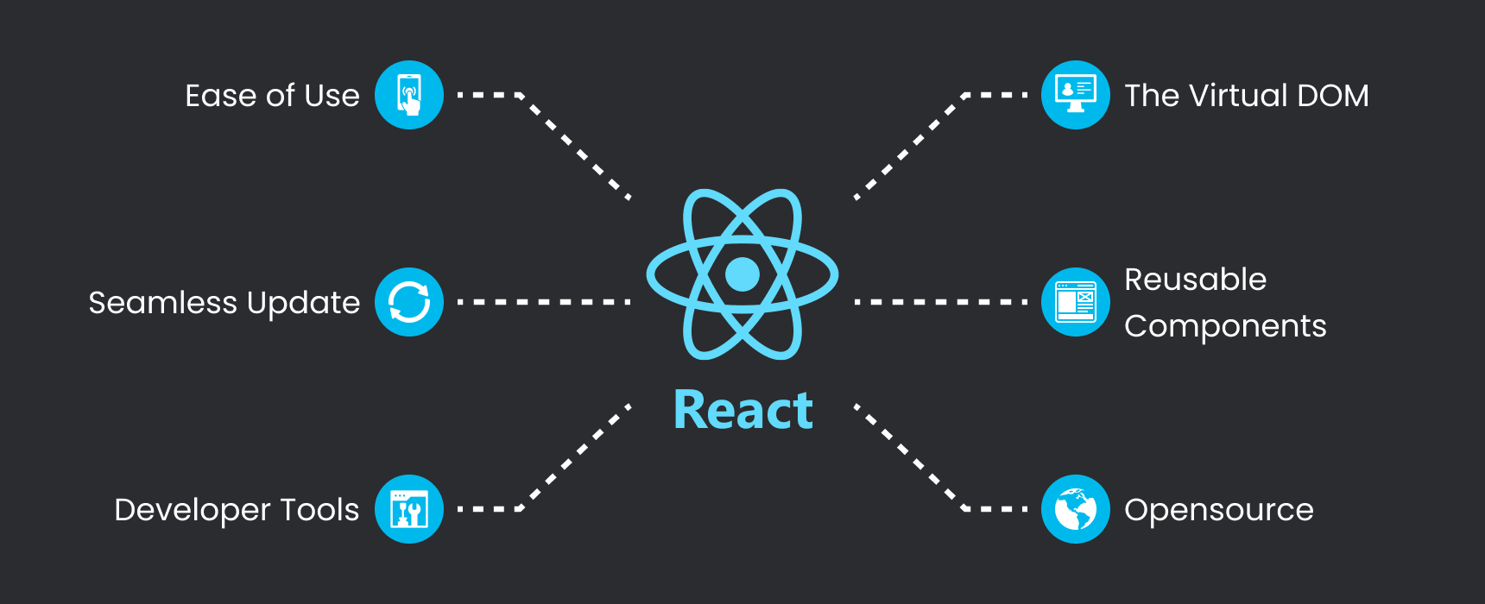
Pros

Slide 8
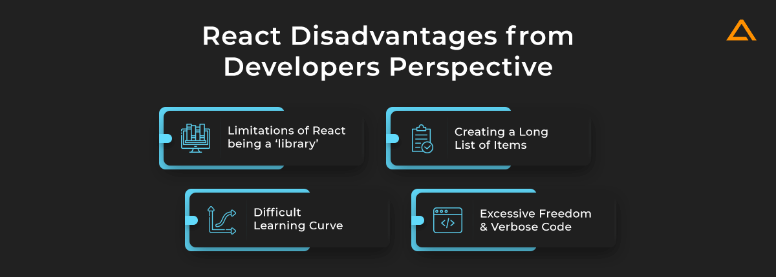
Cons

Slide 9
DOM
Document Object Model
It is a programming interface that allows us to create, change or remove elements from the document.
Events can be added to the document to make it dynamic.
The DOM views an HTML/CSS document as a tree of nodes.
It is an abstraction of the document.
While a Virtual DOM is an abstraction of the abstraction of the document.

Slide 10
Creating a react app
npx create-react-app demo_app1
npx: npm version>5.2
npm start

Slide 12
README.md is a markdown file that includes a lot of helpful tips and links that can help you while learning to use Create React App.
node_modules is a folder that includes all of the dependency-related code that Create React App has installed. You will never need to go into this folder.
package.json that manages our app dependencies and what is included in our node_modules folder for our project, plus the scripts we need to run our app.
.gitignore is a file that is used to exclude files and folders from being tracked by Git. We don't want to include large folders such as the node_modules folder
public is a folder that we can use to store our static assets, such as images, svgs, and fonts for our React app.
src is a folder that contains our source code. It is where all of our React-related code will live and is what we will primarily work in to build our app.

