Slide 1

DLM APP Activites
Bank of Abyssinia
Prepared by : Application Team

Slide 2
Introduction
DLM (Data lifecycle management )is the separation of historical data on live database in to two databse based on a given retention period . The separated data will be accessible through the same enquiries by only adding INCLUDE.DL selection criteria of
.

Slide 3
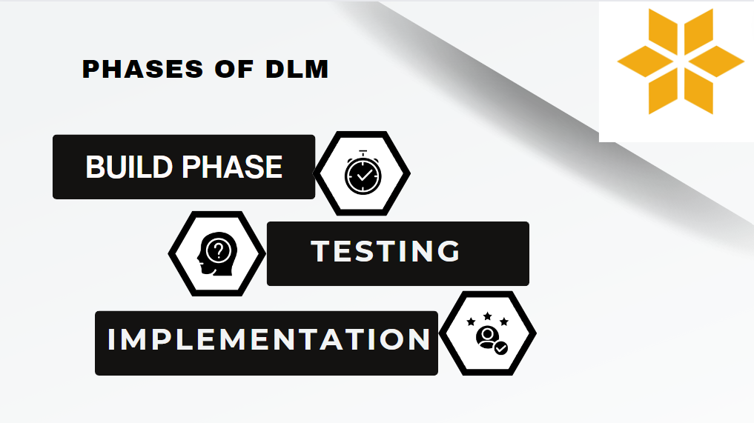

Slide 4
Phases of DLM
1. Build Phase
The following are the major tasks done in the build phase:
Environment preparation
Identifying candidate tables
Creating groups of tables with similar type as Logical groups.
Determining retation period depending on the unique characterstices of each group

Slide 5
2. Testing
In this phase of the project we have done SIT and UAT.
The pre-DLM requirements, TAFJ upgrade and CORE update have been tested in a separate environment.
one Mock environment with five UAT have been done.

Slide 6
3. Live Implementation
The following major tasks was done during Live implementation
6 Core updates
TAFJ upgrade release on 20 application servers
Configuring the TAFJ properties and adding RO credentials to each 20 app servers
Jboss module configuration
Releasing BCON
Applying Correction for the problematic tables

Slide 7
Major activies
T24 environment preparation
Apply correction on problematic Core applications
Update TAFJ from R22(sp5) to R22(sp20)
Update Tafj configurations
Core Update
Correction for some T24 table records
BCON release
DL object installation

Slide 8
Major Activities continued...
Runnning Archival services
----> BNK/ARC.GENERIC
----> BNK/DL.COPY.PROCESS
----> BNK/DL.PURGE.PROCESS
Run COB
To monitor online and COB performance
To Identify issues both during online and COB then resolve in communication with the consultant and Temenos

Slide 9
Corrections
STMT correction -
DE.O.HEADER correction
DLIVERY.IN correction

Slide 10
TAFJ update
update TAFJ on applicaion servers to R22.SP20.0 (release 22 service pack 20 ) to make it compatible for DLM

Slide 11
Core update
update core products

Slide 12
BCON release and DL Object installation
DLM BCON records
configure DL

Slide 13
DL services
ARCHIVE application holds an entry for a logical group
ARC.GENERIC.REQUEST holds LG to be processed by BNK/ARC.GENERIC
BNK/ARC.GENERIC service generates F. RO.COPY.KEYLIST
BNK/DL.COPY.PROCESS updates F.RO.PURGE.KEYLIST
BNK/DL.PURGE.PROCESS
Keys are moved to the F.RO.ERROR.KEYLIST table if the purge/copy fails.
BNK/DL.ERROR.PROCESS processes failed records on F.RO.ERROR.KEYLIST

Slide 14
Activities Summary
 | status | time
STMT printed correction | completed | 2hr 40 mins | pre-DLM
DE.O.HEADER correction | completed | 20 hrs | pre-DLM
DLIVERY.IN correction | completed | 25 mins | pre-DLM
TAFJ update | completed | 1 hr | pre-DLM
BCON release and DL-object installation | completed | 1 hr 40 mins | DLM
DLM services | in progress |  | after-DLM

