Slide 1
Chapter 3
Archival Appraisal

Slide 2
What is Appraisal?
Appraisal is the process of evaluating records to determine how long to keep them, including to decide if the records have sufficient long-term value to warrant the expense of preservation in an archives.
Appraisal is fundamental to the archival endeavor, because appraisal determines what records will be kept and what records can be disposed.

Slide 3
What is Appraisal? Con’t…
An appraisal program is essential for organizations seeking to conform to the international standard for records management, ISO 15489.
Appraisal has been defined as the process of determining the value and thus the disposition of records, based upon their current:
administrative,
legal and fiscal use:
their evidential and informational or research value;
their arrangement and their relationship to other records.

Slide 4
What is Appraisal? Con’t…
Appraisal is a new concept in the archival management process.
An appraisal is an act of determining the worth of records to their creator or user in terms of:
Use
Primary or secondary
Content
evidential or informational
Categories
Administrative value
Fiscal value
Legal value
Historical value/research

Slide 5
What is Appraisal? Con’t…
The process of determining which records are kept, and for how long, which are destroyed based on an established methodology.
In appraisal process many factors take into account:
Needs of creating organization
Needs and expectations of the community
Needs and rules of national archives

Slide 6
What is Appraisal? Con’t…
The Purpose of Appraisal
Appraisal, which is sometimes called ‘evaluation’ or ‘selection’, has two purposes; these are:
Continuing utility:
The finite usefulness that records may have for the continuance of business or as evidence thereof.
Enduring value:
The indefinite value that records may have for any purpose and that justifies their preservation as archives.

Slide 7
What is Appraisal? Con’t…
One of the functions of appraisal is to determine the life expectancy of records by assigning retention periods.
Retention periods must be assigned to all records in an agency, not just those with possible archival value.
Retention is function of preserving and maintaining records for continuing use.
This may be done in the agency of origin, in a records center or in an archival institution.

Slide 8
What is Appraisal? Con’t…
Retention period is length of time, as provided for by legislation, regulation or administrative procedure or based upon an estimate of the frequency of continuing use, that records should be retained in an office or records center before they are transferred to an archival institution or otherwise disposed of.
Disposal is the action taken as a consequence of appraisal decisions.

Slide 9
What is Appraisal? Con’t…
Disposal can only take place when records have reached the non current stage of their life cycle.
The product of the appraisal function is the disposal schedule.
Disposal schedule: The control document recording appraisal decisions and prescribing disposal action.
Also known as disposal list, disposition schedule, records schedule, retention schedule, retention and disposal (or disposition) schedule or transfer schedule.

Slide 10
Appraisal in Practice
When records appraisal is better organized, it is often managed as two distinct operations.
First, current records are appraised in order to destroy those records that do not merit continued retention and to transfer to a records center those semi-current records that still need to be retained.
Second, non-current records are appraised as part of the archival process, to identify records of enduring value.

Slide 11
Appraisal Strategy
Ideally, appraisal and disposal should be a continuing and systematic process undertaken in the context of an agreed strategy.
This strategy should be government or organization-wide with respect to administrative records common to all agencies and agency-wide.
The appraisal and disposal strategy should be at the macro-level (that is, at the series level) not the micro-level (the file or document level.

Slide 12
Appraisal Strategy
There are different types of appraisal strategies
Appraising the functions and activities
produce disposal schedules
‘one-off’ appraisal
used for a specific set of records
produce an appraisal report and list

Slide 13
One-off Appraisal Produces
An appraisal list, that lists each record or each type of record and the disposal action to be applied to the record (archive or destroy).
An appraisal report that sets out the reasons for the appraisal, describes the records, and documents, and provides justification for the disposal actions that have been recommended.
A final approval of the appraisal by the National Archivist signifies that the disposal actions have been agreed upon.

Slide 14
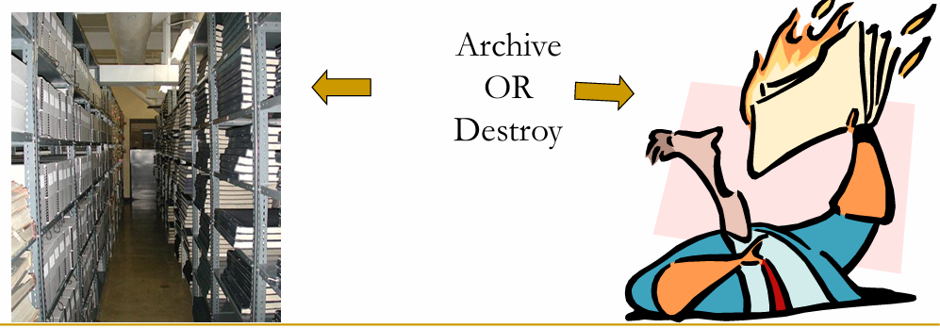
One-off Appraisal Produces…Con’t
The ultimate result of an appraisal is the transfer to the National Archives or to archival storage of records of permanent value and the destruction of records of low or short-term value.

Slide 15
Benefits of using a disposal schedule
Save space
Save money
Save time (retrieval)
Meet legal requirements
Keep the right records
Save records from accidental destruction
Get rid of records you don’t need at the right time

Slide 16
The Process of Appraisal
Step 1: Determine roles and responsibilities
Who performs the appraisal?
Who agrees to the appraisal list and report?
are there different levels required
Who gives final approval?

Slide 17
The Process of Appraisal…Con’t.
Step 2: Research the organization and its functions/records
Helps determine the value of records
What are some of the common sources of this good information?
Step 3: Survey the records
Do the records have some control indexes?
Physical examination of records
Fill out the survey forms

Slide 18
The Process of Appraisal…Con’t.
Step 2: Research the organization and its functions/records
Step 4. Decide which records to appraise
Once all the necessary information is gathered, appraisal decisions may be made
Step 5. List the records

Slide 19
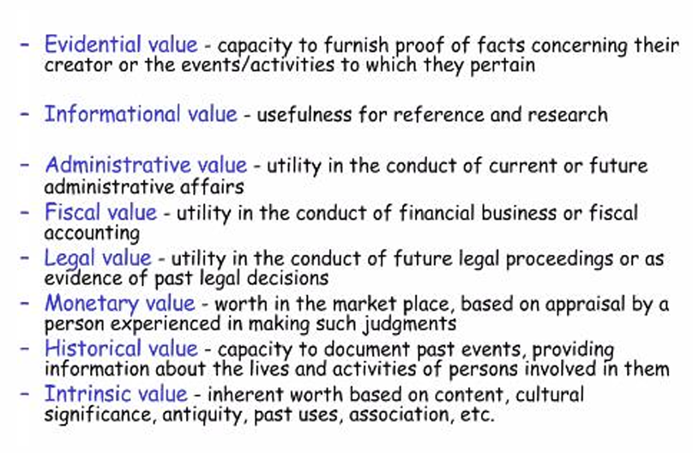
The Process of Appraisal…Con’t.
Step 6. Access the value and mark the list

Slide 20
The Process of Appraisal…Con’t.
Step 7. Consult with stakeholders
Communicate with stakeholders
Remember, you don’t have to listen to them, but they can have some very good ideas.
Step 8. Write the appraisal report
Using the template to document the appraisal decisions.
Incorporate all information you’ve gathered so far

Slide 21
The Process of Appraisal…Con’t.
Step 9. Gain approval
Approved the progress from the assigned bodies.
May be they will be organizational and national.
Finally implement the appraisal decision.

