Slide 1
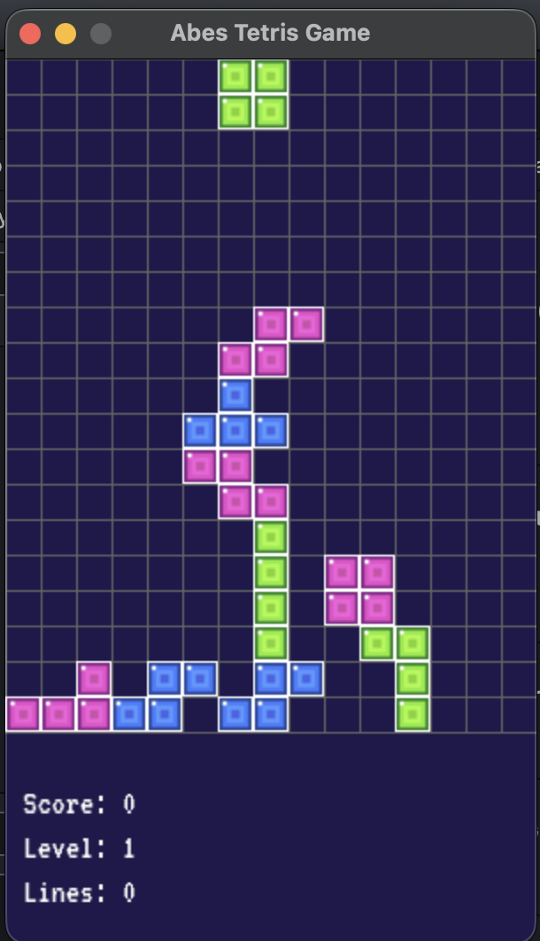
Semester Project
PyGame
Tetris
Githup: https://github.com/Abeoanderson/CS-3080-Final-project
Date Aug 3
Abe Anderson

Slide 2
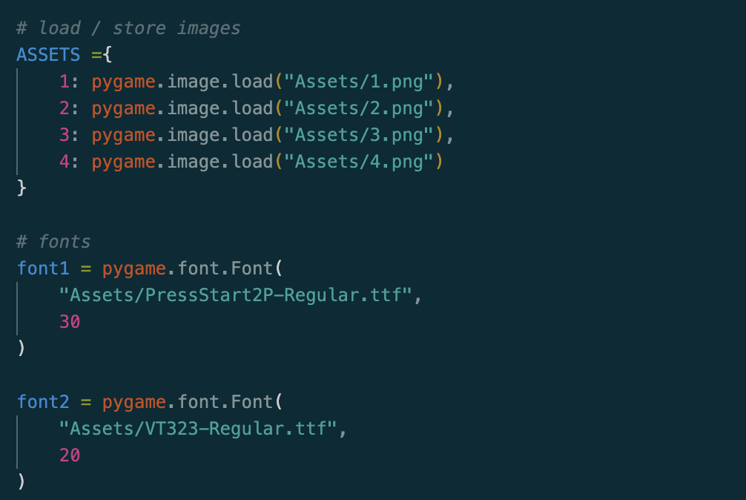
Downloaded resources
Assets contains pictures for blocks and fonts for that old tetris feel

Slide 3
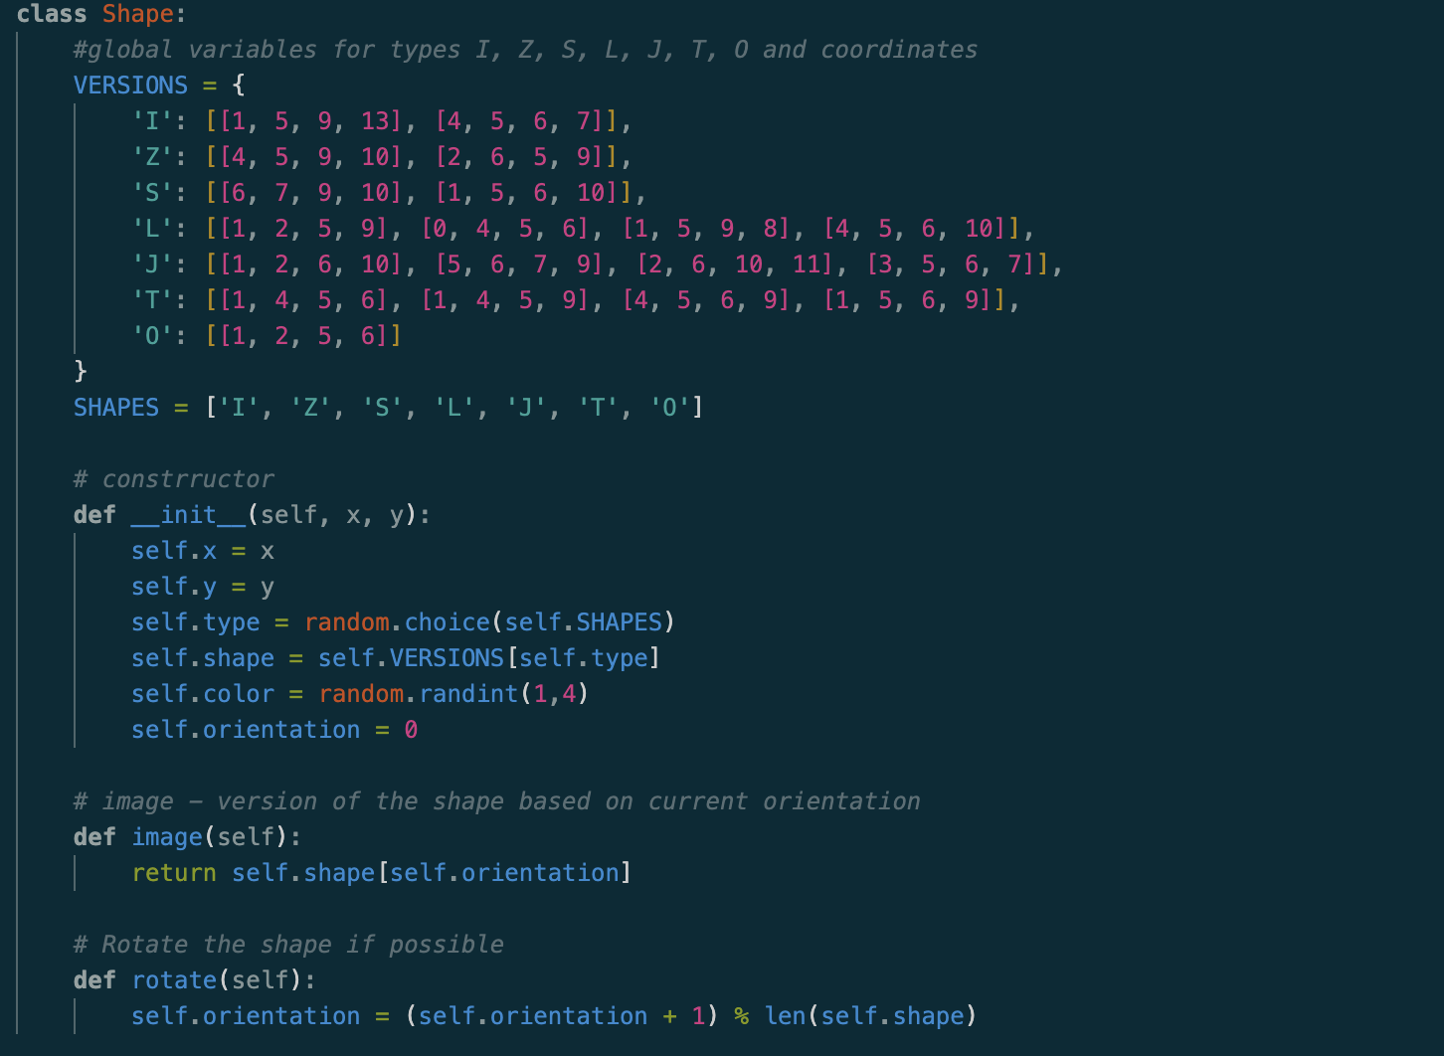
Shape Class:
Versions
All shape orientations
Shape
Reference bak to versions
Init
Location
Type
Shape
Color
Orientation
Image - returns orientation
Rotate - changes orientation if possible

Slide 4
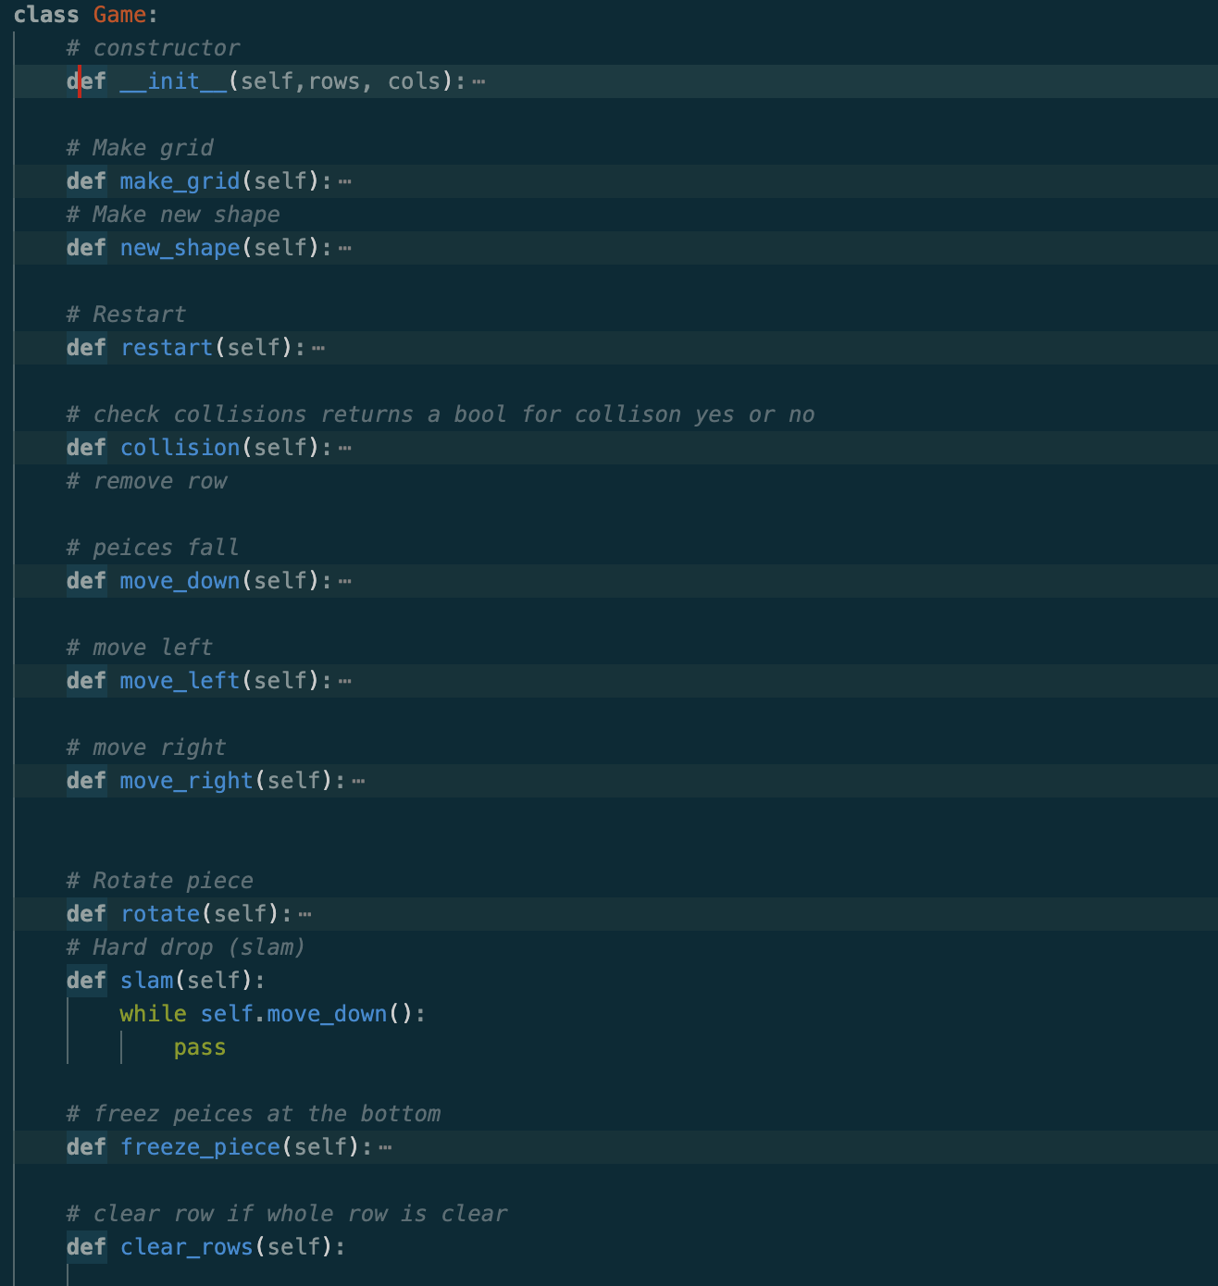
Game class
Handels all main functions of game
Make grid - draw gridlines
New Shape - spawn new piece
Restart - new game and reset stats
Collision - check piece collision with rest of board
Movement - piece movement (called by game loop)
Freeze pieces - stop pieces from falling
Clear row - tetris main scoring mechanism
Update score - self explanatory

Slide 5
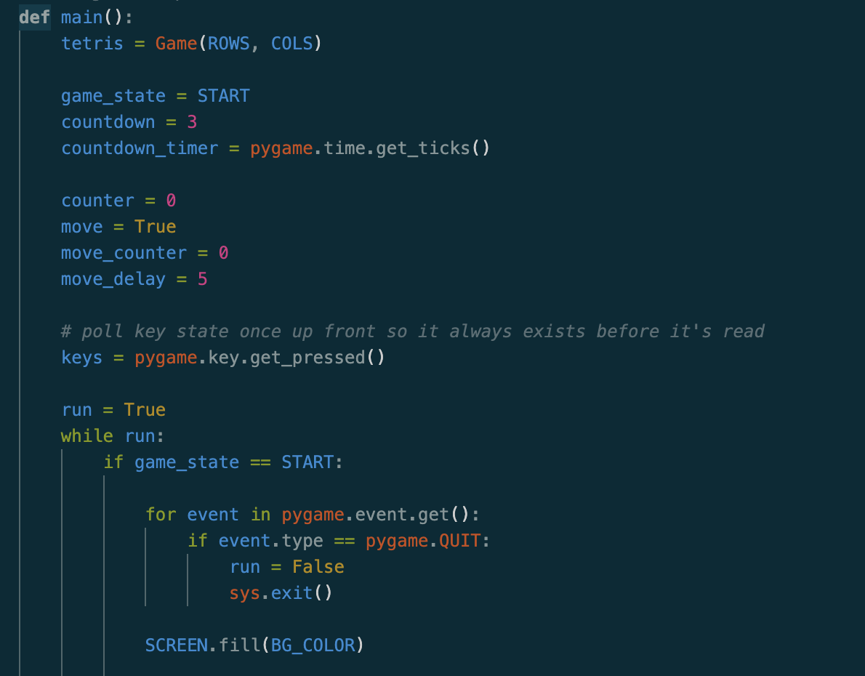
Game Loop:
Make new instance of game class, set countdown and game state,
Main game runs on while run = True to run indefinitely,

Slide 6
DEMO TIME
questions

