Slide 1
Greenfoot

Slide 2
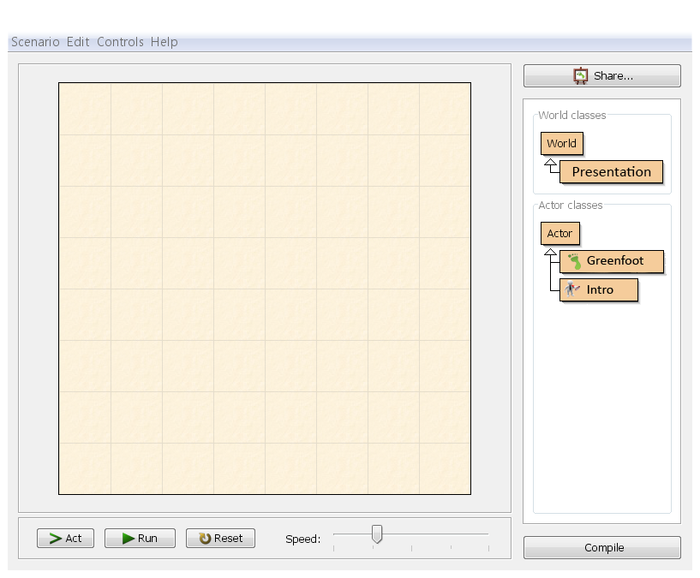

Greenfoot
Greenfoot is an educational integrated development environment targeted at learning and teaching programming to young novices.
Greenfoot combines graphical, integrative output with programming in Java, a standard, text-based object orientated programming language.

Slide 3
