Slide 1
Orbit
team4ever
August 12, 2026
KEEP THE CONVERSATION AT THE CENTER

Slide 2
Agenda
1 | Context | The value of Orbit and the pain points we’re solving
2 | Approach | Translating today’s analog processes into Orbit’s AI-enabled solution
3 | Solution | Key workflows and features for workshop facilitators and their teams
4 | Next Steps | Path to market, reusability, requirements roadmap, risks, success measures

Slide 3
Context: Today, workshop facilitators manage multiple discussion threads and activities without live support
THE CHALLENGE
Develop an AI co-facilitator that creates workshop agenda and materials, synthesizes discussion, surfaces disagreements, suggests follow-up questions, supports interactive exercise, and produces a client-ready readout and action plan. This should support a cross-functional leadership workshop focused on patient intake redesign.
OUR SOLUTION
We’ve developed Orbit to support the workshop lifecycle, allowing facilitators to focus on people, alignment, and outcomes instead of administrative overhead.
CURRENT STATE
FUTURE STATE
Competing perspectives in live discussions
Clear decision and action support, enabled by instant market and subject intelligence
Tedious workshop design from scratch
Accelerated workshop prep with reusable assets
Complex facilitation & simultaneous inputs
Supported facilitation and simplified information
Manual discussion tracking with multiple team members
Comprehensive parking lot, decisions, risks and actions captured live
SOLUTION VALUE
For clients
Faster in-workshop alignment
No more lost discussion
Decisions captured live
Quicker turnaround time to workshop
For Aberdeen
Augmented, intelligent facilitator support
Insights based on live discussion
More thorough preparation
Leaner travel teams

Slide 4
Approach: Orbit facilitates alongside Aberdeen teams preparing for and delivering workshops
OUR APPROACH
Defined the problem and identified current pain points across the workshop flow – plan, develop, facilitate, follow-through
Detailed the inputs and outputs for each workshop phase focused on improving the healthcare patient experience
Aligned on the roles Aberdeen plays in a workshop to be augmented with our AI virtual consulting team
Created agents and designed the live facilitator interface, keeping the human as the lead facilitator with agents supporting to guide live discussion, synthesis, decisions, and deliverables
CONCEPTUAL ARCHITECTURE
HUMAN FACILITATOR | leads the room with objectives, judgment, decisions
PRE-WORKSHOP
Objectives, agenda, exercises and pre-read
IN-WORKSHOP
Timing / flow, themes and disagreement, prompts, decisions and parking lot
POST-WORKSHOP
Readout, summary and action plan
ORCHESTRATOR | routes context between agents and consolidates one unified view
VIRTUAL CONSULTING TEAM (ORBIT AGENTS)
Workshop Planner
Scopes objectives, agenda and exercises
Facilitator
Guides flow, time and transitions
Insight Agent
Surface themes, disagreement and consensus
Decision Agent
Tracks decisions, questions and parking lot
Deliverable Agent
Builds readout, summary and action plan
Subject Matter Expert
Provides swappable domain context

Slide 5
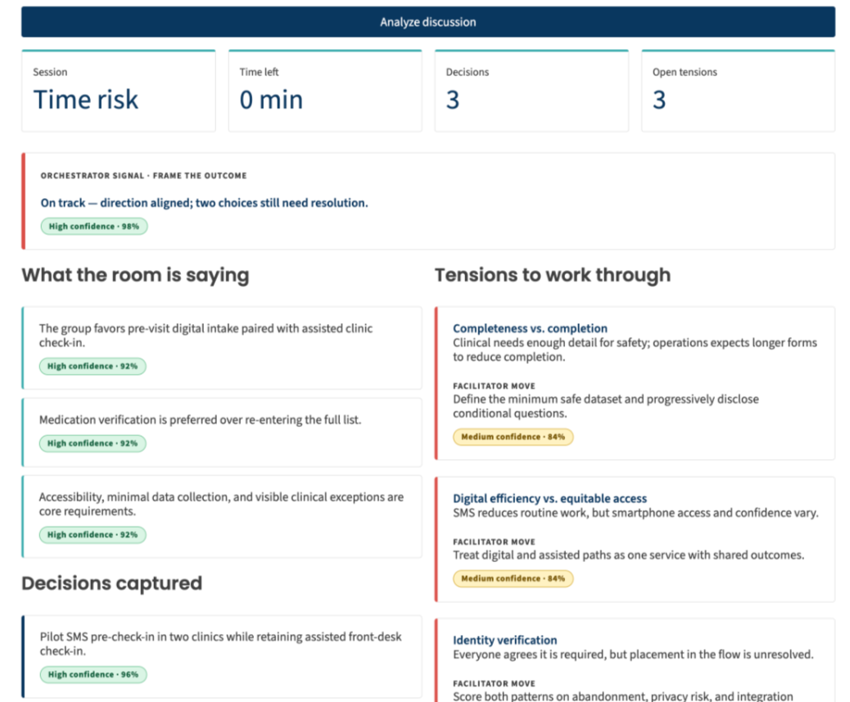
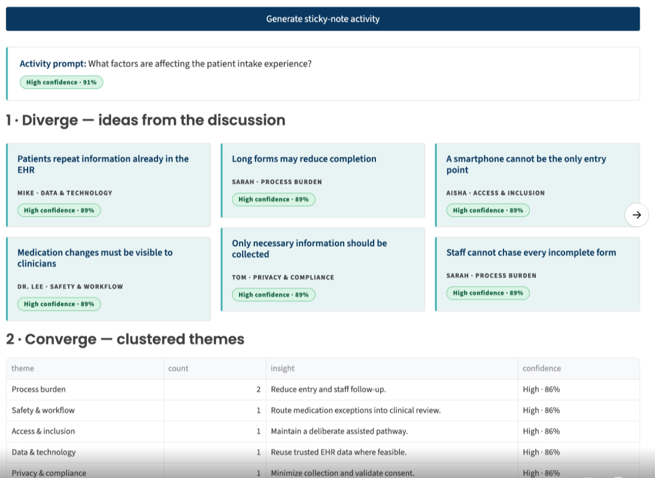
Solution: Orbit reduces facilitator’s cognitive load and parallels workshop flow, including participant activities
Dashboard – letting facilitators focus
Activity Walkthrough – translating discussion into recommendations
LIVE ACTIVITY
What factors impact patient experience?
What key themes are emerging?
What solutions can address pain points & themes?
How should solutions be prioritized?
Analog toolkit: written parking lot, notepad, watch, texts
Analog toolkit: sticky note exercise, Miro, photo of a whiteboard

Slide 6
Next Steps: Orbit can expand features to support more use cases and become reusable across industries
Path to Market
Risks & Assumptions
NEXT 30 DAYS
Pilot internally on one live Aberdeen workshop
Strategize marketing plan
Prepare legal review, consent forms, and data privacy protections
Define success metrics
60-90 DAYS OUT
Package as a repeatable Aberdeen Labs offering, agenda templates included
Codify the playbook
Finalize marketing collateral
Train Product Champions
Script the demo
Pilot on a real client engagement
ONGOING PRODUCT ROADMAP
Workshop Intelligence Engine | Every workshop makes the next one smarter — slides included
Murmur | Captures side conversations and escalate them into meeting outputs
Activity Box | Suggest and prepare workshop exercises like magic wand, sticky notes, voting, kaizen burst, four corners
App Integration | Connect all your productivity and data sources to build central intelligence
Diagramming Integration | Connect Mural, Miro, and Figma to mature virtual interactivity
RISKS
Heavy dependence on transcription and synthesis accuracy
Over-reliance → the tool drafts, the human decides; nothing reaches a client unreviewed
SUCCESS MEASURES
Cycle time improvement per stage: prep, facilitate, synthesize
Action plan comprehensiveness and inclusiveness
Readout in the client's hands same day
Client and facilitator feedback on tool
Expanded Use Cases
eCommerce Transformation | Identifying and solving for user pain points with online shopping for products given various stakeholder priorities
ERP / Core System Selection | Requirements gathering across business and IT stakeholders
Orbit is topic- and industry-agnostic. Swap the domain lens, keep the engine.

Slide 7
Orbit
KEEP THE CONVERSATION AT THE CENTER.

Slide 8
Appendix

Slide 9


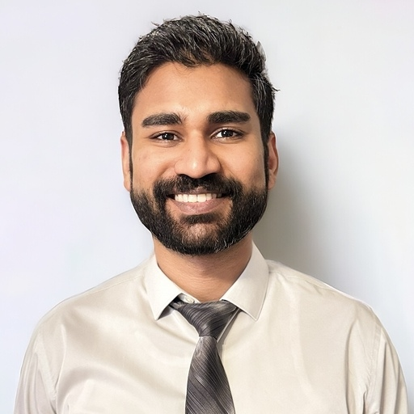


team4ever
Noha Vicars
Managing Director
Leon Pan
Digital Strategy Manager
Gaurav Goyal
AI Data Platform Engineer
Joey Wise
Digital Strategy Consultant
Kate Christian
Customer Strategy Senior Manager

Slide 10
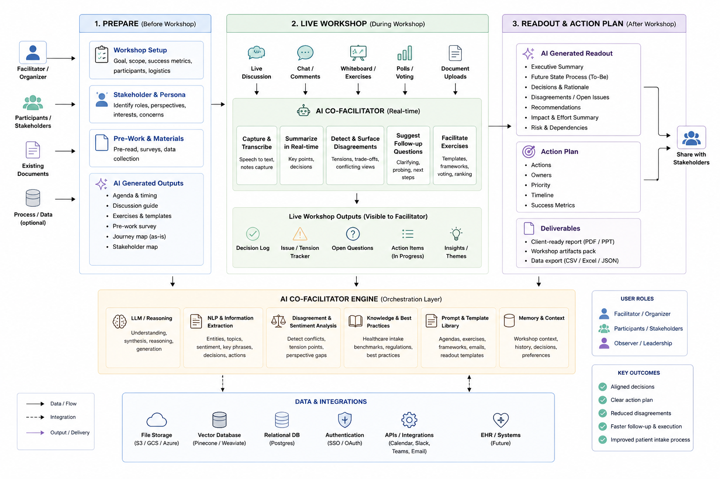
Reference Architecture & Agent Mapping
Planner
Deliverable
Where are the agents working?
Facilitator, Insight, Decision
Deliverable
SME
Planner
Facilitator
Insight
Decision
Deliverable
Deliverable
Deliverable
Facilitator, Insight, Decision

