Slide 1
ABERDEEN HACKATHON · TEAM 05
Pursuit Copilot
Do the thinking that matters. Let AI handle the grind.
One action turns a 30–80 page RFP into a Pursuit Brief and a Proposal Starter — a real point of view on the client, plus the opening sections already drafted.
Seven days to respond. And every bidder sounds the same.
A typical RFP response takes 5–10 people, 1–2 weeks, and 40+ hours each — the BD lead, a partner and the SMEs, all pulled off client work in the same week.
THE CLOCK
The first 48 hours go to structure and boilerplate, not to the client.
THE SAMENESS
Rivals send similar credentials and the same generic approach.
CLIENTS LOVE US
We make things easy — everywhere but the scramble to win the work.
“Most consulting firms market expertise. Beloved brands market experience.”
Wayfarer Market Co.'s RFP explicitly rejects the cut-costs, loyalty-program, more-ads playbook.
Carrie Stout · CJ Johnson · Jordan Cook · Preetish Rath
Notes:
CJ's framing for this pass: judges are not looking for a beautiful deck first. They want a real, tested build with a clear user, a clear workflow, strong business value and a credible path to being useful for Aberdeen or its clients. Read the four slides against that list.
CJ's idea #1 — become the "Least Painful Consulting Firm in America." Most clients quietly dislike consulting projects: too many meetings, too many slides, too much jargon, too much complexity, and consultants who take information but never give any back. The common denominator we are after is not just humour, humanity and quality — remarkably easy, remarkably human, remarkably memorable.
Numbers on this slide (5-10 people, 1-2 weeks, 40+ hours each) are CJ's illustration of a typical pursuit, not a measured Aberdeen baseline. Say so if asked.

Slide 2
THE SOLUTION · PURSUIT COPILOT
Upload the RFP. Get a point of view, not a template.
01 INGEST
The RFP, plus Aberdeen credentials, prior proposals and case studies.
02 ANALYZE
One action: Analyze Opportunity. No forms, no prompt craft.
03 DRAFT
Out comes a Pursuit Brief and a Proposal Starter.
WHAT IT HANDS YOU
Who the client is, in their words — objectives, constraints, red lines.
The three most relevant case studies and credentials, each with a relevance match and a line on why it is relevant.
Three win themes and differentiators, from Aberdeen's own knowledge base.
A seven-section proposal skeleton — Executive Summary, Our Understanding, Approach, Relevant Experience, Team, Timeline, Why Aberdeen — with first-draft copy for the opening two or three.
A Response Action per requirement: what it asks of us.
THE PART NOBODY ELSE BUILT
The draft argues the client's problem back to them, in their language.
Every claim carries the credential, case study or proposal it came from.
“Why Aberdeen” comes from our Culture Charter, in a human voice — not boilerplate.
It lands as a two-page Executive Summary and a one-page Decision Guide, full detail behind them — not 75 slides.
The question behind every output: how do we make each interaction with Aberdeen unexpectedly enjoyable?
2 / 4
Notes:
The output shape is CJ's brand argument turned into product behaviour. Instead of a 75-slide deck, the default deliverable is a two-page Executive Summary, a one-page Decision Guide, and the full analysis behind them. The seven-section skeleton is what gets drafted; this is the shape it comes out in.
CJ's example of the same instinct applied to a meeting — instead of "Attached is the agenda", send: "Good news: we've done the homework. You don't need to prepare anything. We'll bring three recommendations and only need your reaction." The experience we are aiming for is "thank goodness, somebody made this simple."
Culture Charter values behind "Why Aberdeen": low-ego, high-ownership partnership; relationship-driven engagement; agile, growth-minded teams; empowered, multidisciplinary teams.

Slide 3
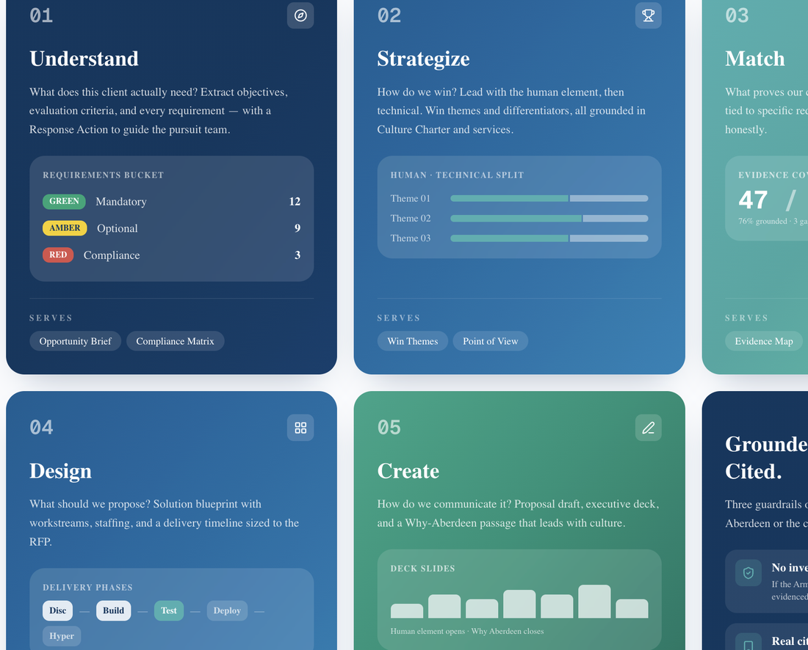
DEMO · WAYFARER MARKET CO.
Upload once. It argues Wayfarer's problem back to them.
Input: specialty grocer, ~500 stores, ~50,000 crew. Grow revenue without eroding crew culture.
1
Copilot reads the RFP: scope, deliverables D1–D5, requirements 5.1–5.7, page limit.
2
It pins the non-negotiable up front: nothing that erodes crew culture.
3
Win themes come back in Wayfarer's language, not ours — crew first, growth second.
4
Three case studies surface with a relevance match and a line on why each one fits.
5
The Proposal Starter assembles against Exhibit B, the client's own required response items, with the opening sections already written.
The pursuit workspace: the five engines — Understand, Strategize, Match, Design, Create — and the requirements bucket they produce.
What the judges see: a first draft that understood the business before it started describing us.
3 / 4
Notes:
Wayfarer Market Co. is one of the three mock RFPs in reference/mock-rfps. Walk the five steps live, then show the Pursuit Brief and the Proposal Starter side by side. Land the contrast CJ is after: the client gets something short and useful up front, with the depth available behind it, rather than a long document they have to mine.
If asked what is not built yet: the credential and case-study library is the main dependency and is empty today. Say that plainly — it is on the pilot plan.

Slide 4
IMPACT · PATH TO MARKET
Faster is nice. Getting your evening back is the point.
BUSINESS VALUE
More pursuits answered, at steadier quality.
The first 48 hours go to the client's problem, not to page setup.
Reusable: the same ingest-and-draft lifts into pitch decks and QBRs.
PILOT PLAN
1 Run in parallel on the next live pursuit, beside the human draft.
2 Stand up the credential and case-study library — the main dependency, empty today.
3 Partner review before send. A rule, not a setting.
WHAT WE WOULD MEASURE
Draft-to-first-review time.
Hours per pursuit, per person.
How much of the draft survives review.
Win rate where it was used.
Baselines get set in the pilot.
RISKS, HONESTLY
Invented credentials or client facts.
One uniform voice across every pursuit.
Confidentiality of client RFP material.
Mitigation: partner sign-off before send, and a cited source per claim.
WHAT WE ARE PLAYING FOR
Want to get home in time for dinner tonight? Or read your kid a bedtime story and tuck them in? Use this tool.
Our target: give back 80% of those 40+ hours — the number the pilot exists to prove, not a result we are claiming today.
Working with Aberdeen should feel easier after every interaction. That includes the week we spend winning the work.
4 / 4
Notes:
The 80% is CJ's target for the pilot to test, not an achieved result. Same for the 5-10 people / 1-2 weeks / 40+ hours figures on slide 1 — they are CJ's illustration of a typical pursuit. Do not present either as measured.
CJ's brand promise, in full: "Working with Aberdeen should feel easier after every interaction." Every touchpoint should reduce stress, not add it. The experience we want is "thank goodness, somebody made this simple." Most firms market expertise; beloved brands market experience — that is the spine of this deck.
Baselines get set during the pilot. Nothing is claimed today.

