Slide 1

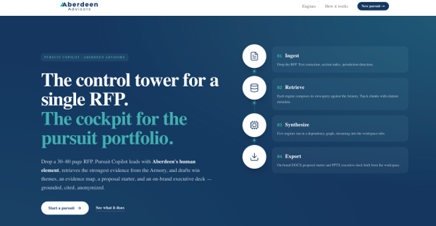
Pursuit
Concierge
An AI-powered business development assistant for the time-sensitive RFP sprint.
Make every proposal feel researched, specific, and easy to say yes to.
Hack Team 05 | Carrie Stout, CJ Johnson, Jordan Cook, Preetish Rath
Notes:
[Sources] - User-provided hackathon prompt and Aberdeen positioning language from this chat. - Visual asset: AI-generated corporate pursuit teamwork image created for this deck.

Slide 2

Less Time Building Proposals. More Time Winning Work.
RFP response teams need a faster way to understand the client, shape the strategy, and make the response feel easy.
Most consulting firms
market expertise.
Beloved brands
market experience.
The Seven-Day RFP Reality
The User
• Attractive opportunity
• Competitors look similar
• Context is scattered
• Generic approaches blur together
Pursuit lead, partner, SME, and proposal manager who need a strong first draft before the clock runs out.
Design Principle
Working with Aberdeen should feel easier after every interaction.
Less prep. Less jargon. Fewer dead-end meetings. More useful thinking in return.
Win condition: show client understanding, not just Aberdeen capabilities.
Notes:
[Sources] - User-provided hackathon prompt and Aberdeen positioning language from this chat.

Slide 3
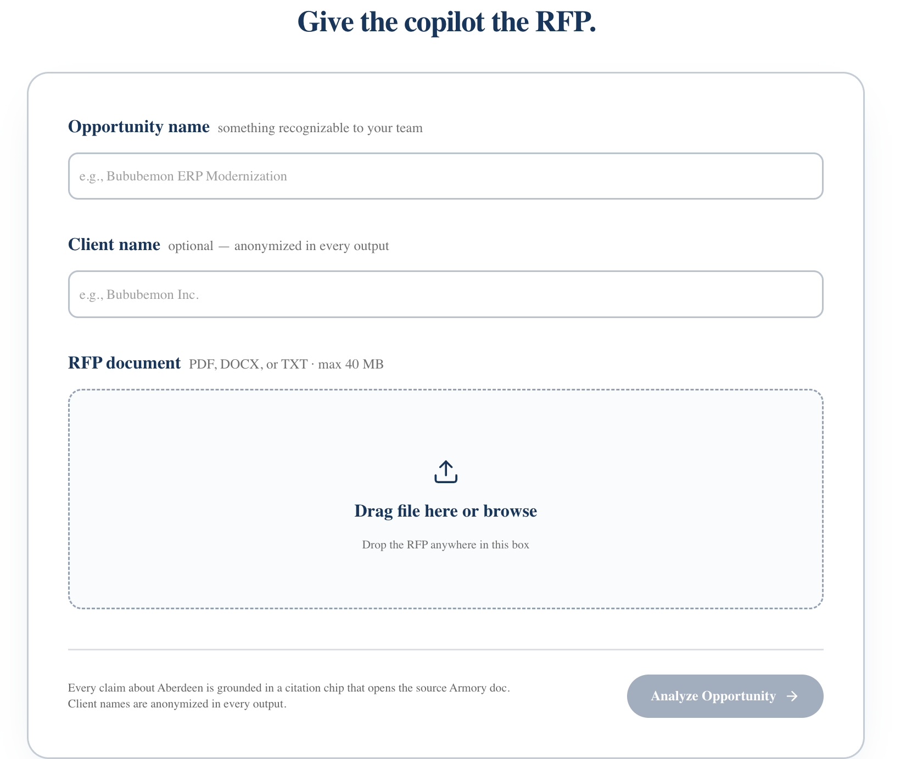
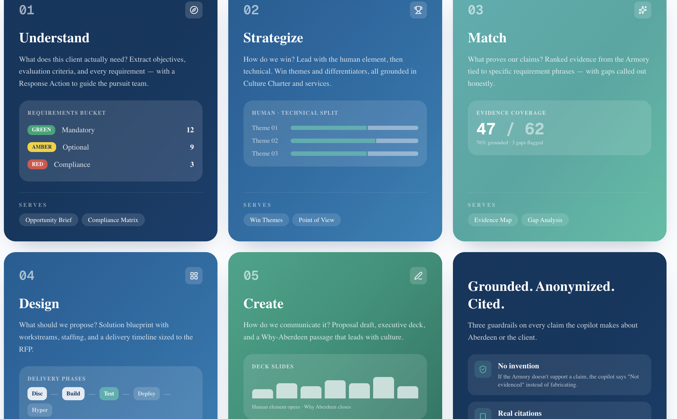
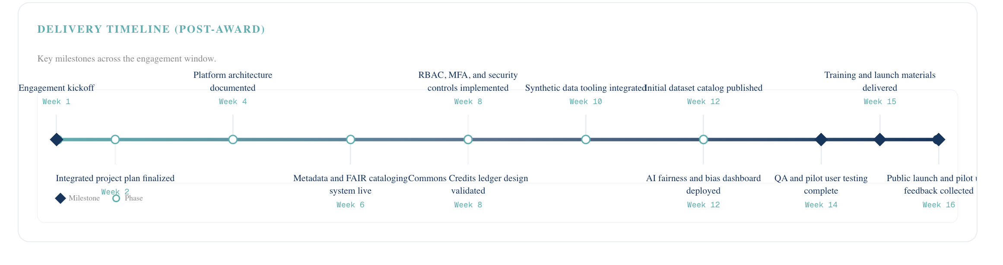
What we built: from messy inputs to first-draft strategy
A grounded assistant that turns RFP context into usable pursuit materials while keeping humans in the review loop.
Inputs it reads
Workflow:
Understand → Strategize → Match -> Design → Create
RFPs, client context, prior proposals, case studies, credentials, service offerings, and market research.
Outputs it drafts
Win themes, solution approach, staffing model, timeline, proposal sections, differentiators, and pitch narrative.
Notes:
[Sources] - User-provided hackathon prompt and Aberdeen positioning language from this chat. - Visual asset: AI-generated workflow infographic created for this deck.

Slide 4
Why? Win the work – Skip the Burnout
The build maps directly to the judging criteria and a credible Aberdeen Labs path.
Problem
understanding
Workflow
fit
Build
quality
Business
value
Path to
market
Client-specific pain, stakes, and buying logic.
Purpose-built for the seven-day pursuit sprint.
Grounded ingestion, structured outputs, reviewable drafts.
Faster first drafts with a more consistent Aberdeen voice.
Internal pilots → Labs accelerator → client-facing BD co-pilot.
Aberdeen differentiator
“Finally, a clear path through an RFP”
Not just a proposal factory. A pursuit experience engine that makes the client feel understood before the project even starts.
Brand promise: make pursuit work remarkably easy, remarkably human, and remarkably memorable.
Notes:
[Sources] - User-provided hackathon prompt and Aberdeen positioning language from this chat.

