Slide 1
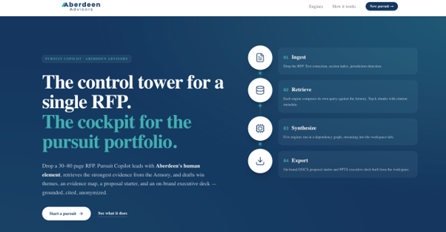

ABERDEEN HACKATHON 2026
Pursuit Concierge
An AI-powered business development assistant for the time-sensitive RFP sprint.
Make every proposal feel researched, specific, and easy to say yes to.
Hack Team 05 | Carrie Stout, CJ Johnson, Jordan Cook, Preetish Rath
Live at pursuit-copilot.vercel.app →

Slide 2

Less Time Building Proposals. More Time Winning Work.
RFP response teams need a faster way to understand the client, shape the strategy, and make the response feel easy.
The Seven-Day RFP Reality
The User
Design Principle
Attractive opportunity
Competitors look similar
Context is scattered
Generic approaches blur together
Pursuit lead, partner, SME, and proposal manager who need a strong first draft before the clock runs out.
Working with Aberdeen should feel easier after every interaction.
Less prep. Less jargon. Fewer dead-end meetings. More useful thinking in return.
Most consulting firms market expertise. Beloved brands market experience.
Win condition: show client understanding, not just Aberdeen capabilities.
2

Slide 3
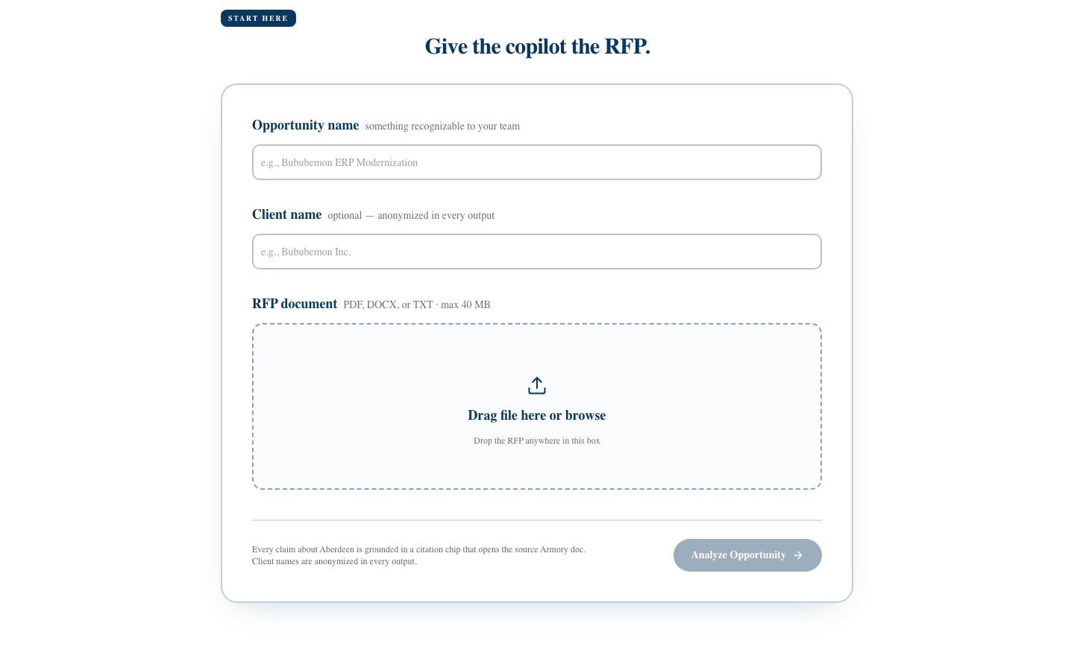
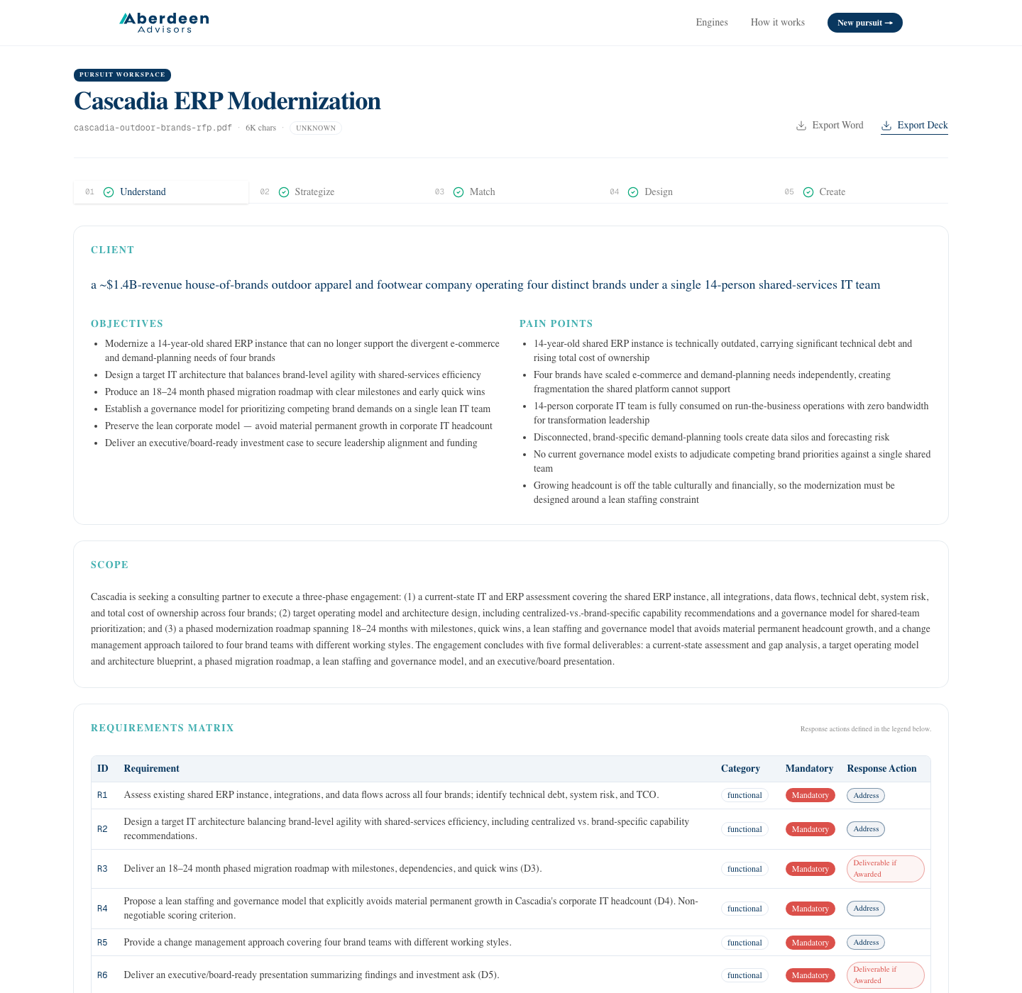
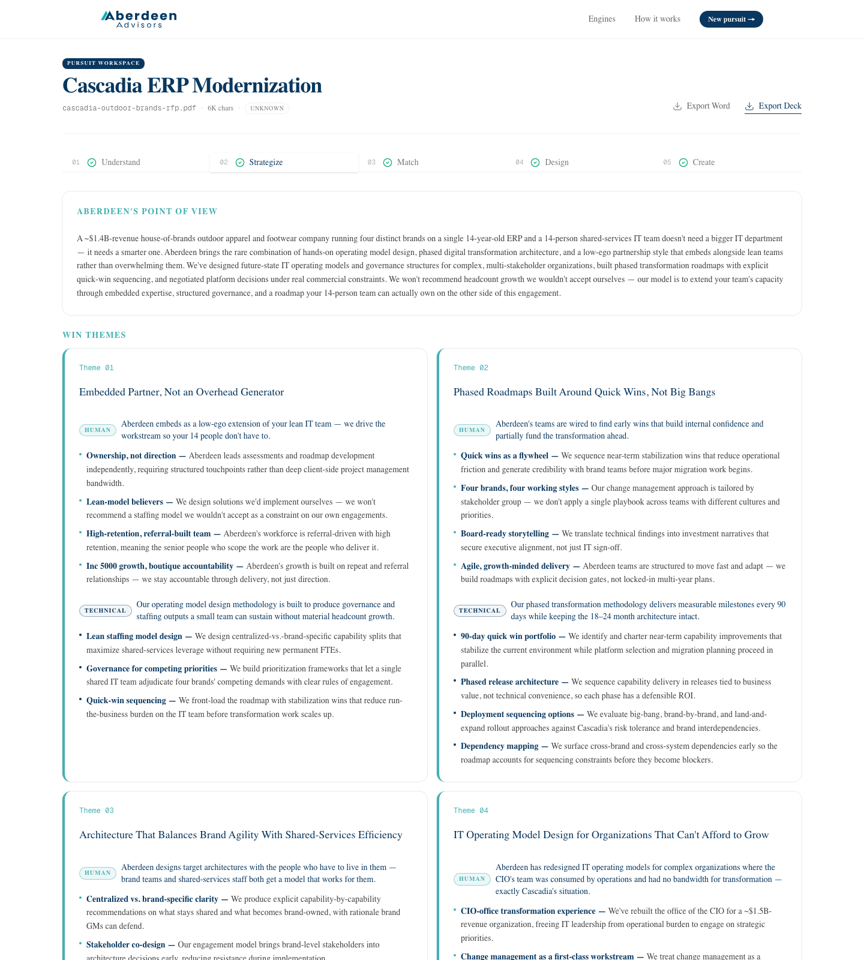
What we built: from messy inputs to first-draft strategy
A grounded assistant that turns RFP context into usable pursuit materials while keeping humans in the review loop.
Inputs it reads
Outputs it drafts
RFPs, client context, prior proposals, case studies, credentials, service offerings, and market research.
Win themes, solution approach, staffing model, timeline, proposal sections, differentiators, and pitch narrative.
WORKFLOW:
Understand
→
Strategize
→
Match
→
Design
→
Create
Drop the RFP
The workspace fills tab-by-tab
Win themes, human element first
Total analysis time: 2–6 minutes from upload to a complete pursuit brief.
3

Slide 4
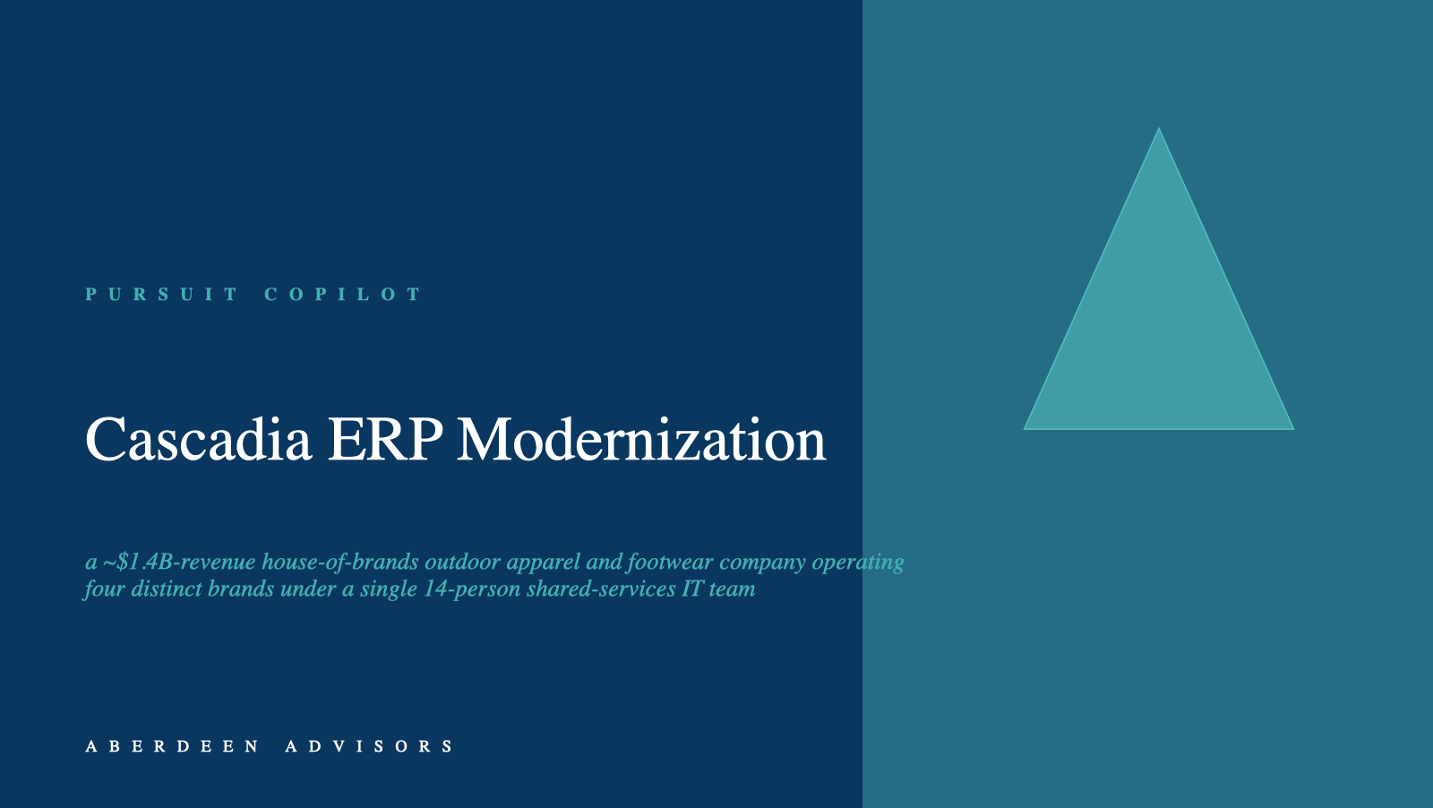
Why? Win the work – Skip the Burnout
The build maps directly to the judging criteria and a credible Aberdeen Labs path.
Problem understanding
Workflow fit
Build quality
Business value
Path to market
Client-specific pain, stakes, and buying logic.
Purpose-built for the seven-day pursuit sprint.
Grounded ingestion, structured outputs, reviewable drafts.
Faster first drafts with a more consistent Aberdeen voice.
Internal pilots → Labs accelerator → client-facing BD co-pilot.
One-click exports: executive deck (.pptx) + proposal starter (.docx)
ABERDEEN DIFFERENTIATOR
Not just a proposal factory. A pursuit experience engine that makes the client feel understood before the project even starts.
“Finally, a clear path through an RFP”
Brand promise: make pursuit work remarkably easy, remarkably human, and remarkably memorable.
4

