Slide 1
The model and the deliverable diverge
Evidence from one completed Aberdeen engagement, not adjectives
What the delivered artefacts show | Why it is structural, not sloppy
Scores held as rubric prose and parsed back out of the display string | The number is inseparable from its justification, so it is never a field
Dimension weights typed into one formula row per sheet | Four registers, four weight rows, one reaching across files to a different range
One initiative tagged to a fifth theme string that exists nowhere else | Theme resolves by string lookup, so grouping and wave order corrupt silently
A column-shifted formula row inside the file marked final | That opportunity has no priority band and its quadrant reads one axis twice
A priority quadrant that the framework can never populate | Nothing warns the team; the empty cell is discovered by the room
Register counts stated four ways: 43, 46, about 50, and a split summing to 56 | Exhibit numbers are typed, not bound, so the deck and the model drift apart
The partner defends numbers on a slide that nothing in the model guarantees.
Notes:
Open on the artefacts, not the theory. This is one completed Aberdeen engagement, and every row here is a defect in the file marked final. Point at the column-shifted formula: that opportunity carries no priority band at all, and its quadrant reads the same axis twice. Nothing in a spreadsheet can detect it. Then the counts — 43, 46, about 50, and a theme split summing to 56 — four artefacts, four answers to one question. Land the consequence: a partner presents numbers the model does not guarantee, and the first challenge from the room is unanswerable. This is the problem Conductor removes by construction, not by care.

Slide 2
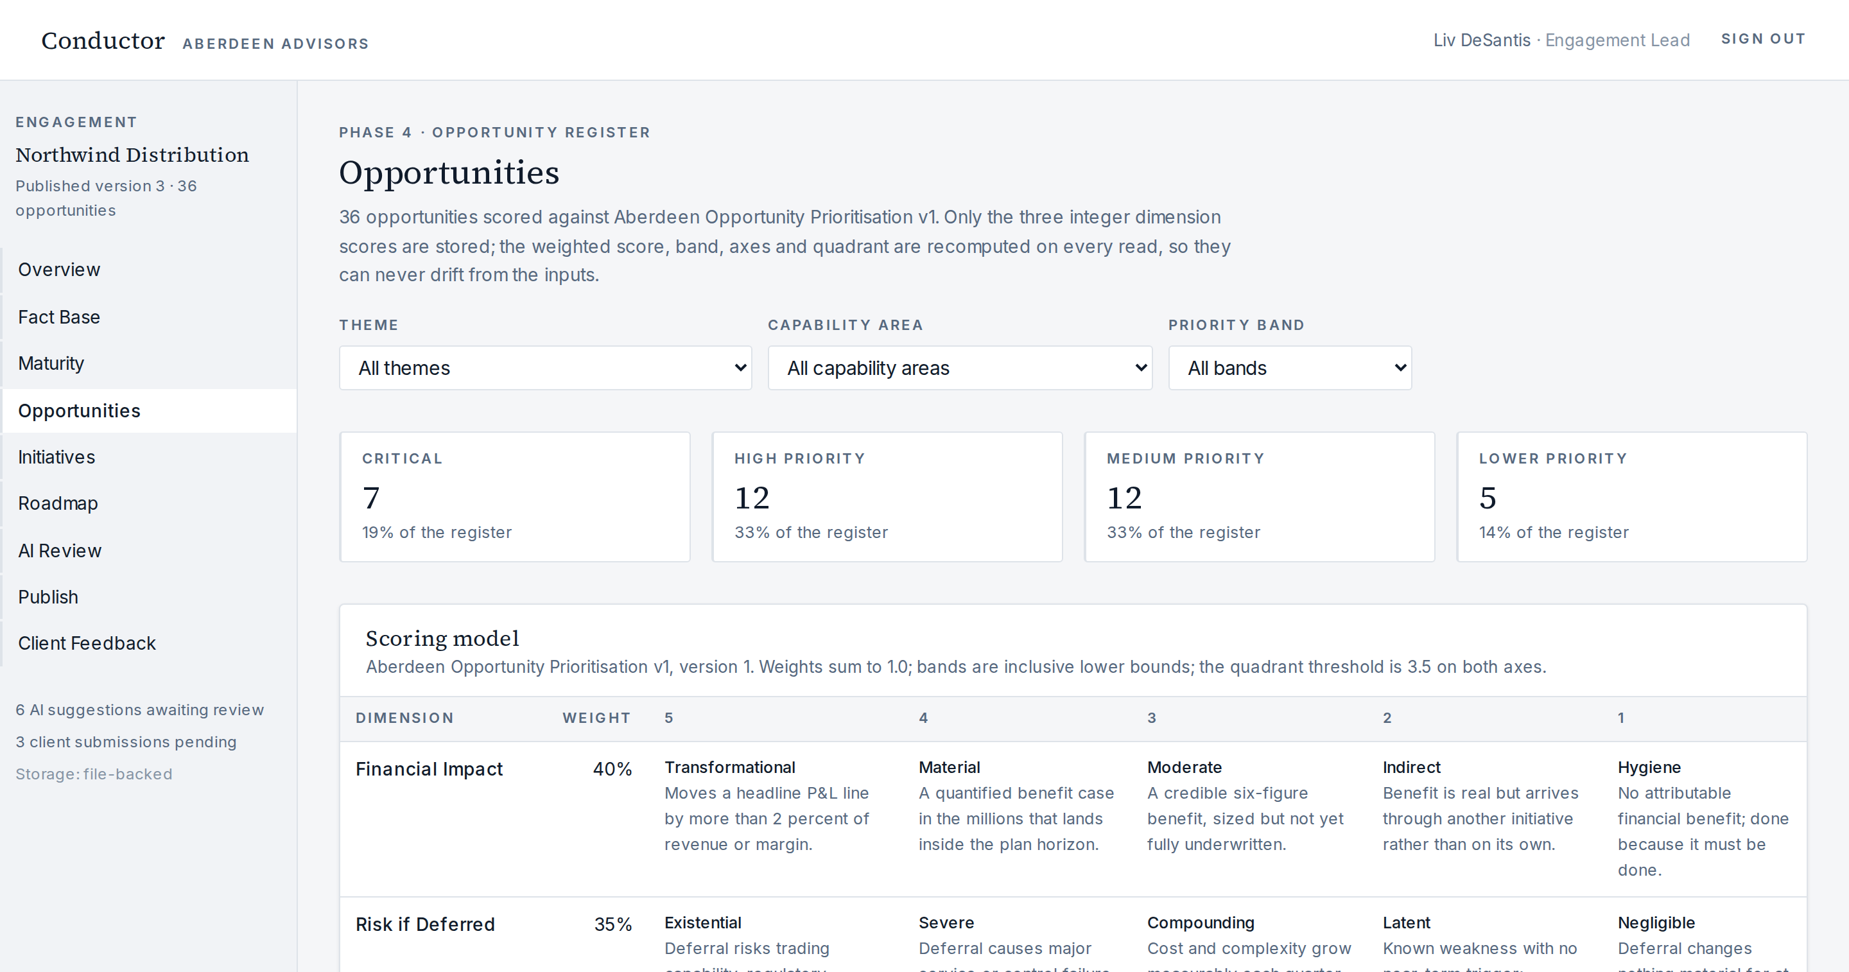
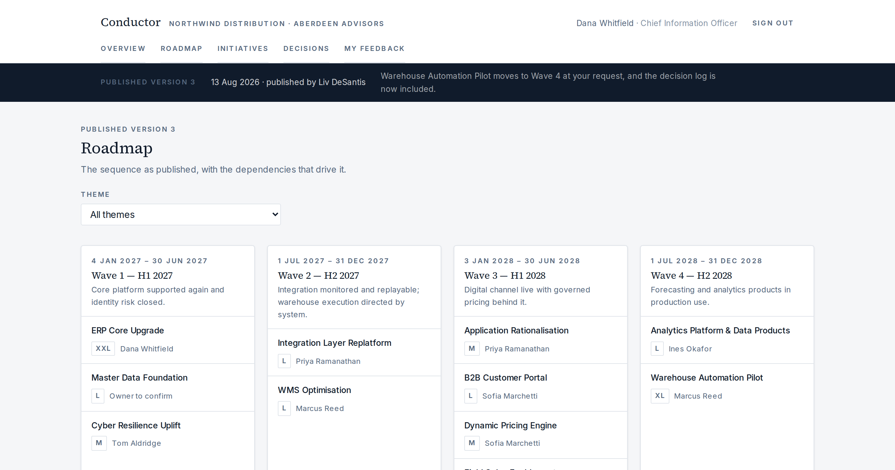
One engagement model, two governed experiences
Conductor runs the eight-phase methodology as one computed model
Aberdeen works one model: 28 maturity focus areas, 36 scored opportunities, 12 initiatives, four waves. Every derived number is recomputed on read, never stored.
Publishing freezes an immutable version; the client portal reads only that snapshot, so a later internal edit cannot change what the client has been shown.
Client input returns as a proposed change for Aberdeen review, never as an overwrite.
Aberdeen workspace: the scored register, with the weights and bands the engine applies
Client portal: the published roadmap the client reads, frozen at version 3
Notes:
Demo path. Sign in as Liv, land on the workspace overview, then Opportunities: only three integer scores are stored, everything else is computed on read. Roadmap shows a real dependency violation — the B2B portal sits in the same wave as the integration work it depends on; move it and the issue clears. Then Publish: version 1 deliberately left out the roadmap and the initiatives, so tick them, publish version 2, and switch to Dana in the portal to watch the content appear. Everything on this slide is working today. Say plainly that the seeded engagement is fictional and persistence is per-instance.

Slide 3
Why a generic tool cannot produce this
AI proposes, code calculates — and the boundary is architectural, not a prompt
What the deliverable requires | Conductor | A generic project tool or AI writer
The firm's method executes | Weights 0.40 / 0.35 / 0.25, bands 4.5 / 3.75 / 2.8, quadrant split 3.5, maturity gap, wave feasibility — one tested engine | Neither carries the firm's scoring method as executable logic; both restate a result computed somewhere else
Every AI output is reviewable | Each proposal carries confidence, evidence and rationale, and no proposal can write a calculated field | An AI writer authors the number and the sentence about it, with no typed field to check either against
The client sees a version, not a live view | Publishing deep-freezes a snapshot of exactly what was selected; the portal reads only that version | A working board the client watches change, or a static export that silently ages
Client input needs a review gate | Feedback returns as a proposal; accepting mutates the model and writes an audit event, rejecting does not | Comments parked beside the artefact, or a client editing the model directly
Honest scope of the demo: the AI proposals in this build are seeded mock outputs (model version mock-v1) — no model is called. What is real is the mechanism: the propose, review and commit flow, the confidence and evidence carried on each proposal, and the rule that a calculated field is not writable from the AI surface.
Notes:
This is the slide to slow down on. Two moves only. First, in AI Review, open a proposal: confidence, evidence and rationale, then accept it and show the audit event — and say clearly that the proposals are seeded mock outputs while the review mechanics are real. Second, in the portal as Dana, rank an opportunity or ask for different timing, then return as Liv to Client Feedback and accept it: the model moves, the change is recorded. Reject one to show nothing moves. The argument to state out loud: a generic tool holds neither the firm's arithmetic nor a client-safe frozen version.

Slide 4
What works today, what comes next
Reviewable now by local run; the commercial case is a target, not a result
Working in the demo today
Future capability, not in this build
Two authenticated role experiences over one engagement model, with the client seeing only what Aberdeen published
36 scored opportunities, 28 maturity focus areas, 12 initiatives, four waves, typed dependencies
Deterministic engine behind every derived number, covered by 22 calculation checks
Publish freezes a version; client ranking and timing feedback return as reviewable proposals
Document and transcript ingestion, with evidence anchored to the source cell or slide
The cost, investment and capacity model
PowerPoint and Excel generation read from the model
Cross-engagement precedent library of playbooks and risks
Execution tracking after board approval
Target case, to be refined — Aberdeen's own underwriting, not an MVP result
Delivery in four weeks against twelve · consultant effort 250 hours against 800 · two to five engagements per consultant a year · $400K to $650K revenue per consultant · RFP win rate 35% to 60%
Repository: github.com/Aberdeen-Advisors/hack-team-06 · There is no deployed instance — the reviewable path is the local run documented in the README: npm install, npm run dev, npm run check:calc. The walkthrough is local and the seeded engagement is fictional.
Notes:
Two lists, deliberately separated. Left is demonstrable in the next five minutes; right is designed but not built, and should be described as future capability every time it comes up — especially ingestion, cost and capacity, and deck generation. On the target block, be explicit: these are the numbers Aberdeen is underwriting for the business case, subject to refinement, and nothing in this build measures them. If asked where the four weeks comes from, say it is Liv's target for the engagement model, not an observed cycle time. Close on the repository and offer the local run; there is no deployed instance to click.

