Slide 1
Application Rationalization Tool
AppWise Insights by Aberdeen Advisors
AI-Powered Application Portfolio Rationalization & Optimization Platform
Team 8 | AI Hackathon | August 2026

Slide 2
Problem Understanding & The Aberdeen Solution
Most companies buying software at scale end up in the same place: spend they cannot see, licenses that are not used, and tools with duplicate functionality. AppWise partners with leadership to recommend tech stack cuts that actualize immediate savings,without disrupting mission-critical systems or data flows.
What we heard…
Global company maintaining 800+ enterprise applications, dozens of SaaS subscriptions, and growing collection of AI tools
CIO tasked to reduce tech spend by 15%+
No disruptions of critical business operations can occur during initiative
What we offer…
Centralized SaaS tool capturing complete application costs
One view of app overlap, usage, and business impact
Rationalization recommendations tied to savings
What the solution provides…
Total technology spend visibility
Invest / consolidate / replace / retire application recommendations with supporting data
Utilization rates and predicted savings, with a time horizon to execute
AN INDUSTRY-WIDE PROBLEM, NOT A ONE-COMPANY PROBLEM
WHAT WE BUILT: AppWise Insights by Aberdeen Advisors
Spend is fragmented: License, cloud and renewal cost sit in different systems, so no one sees the total spend.
Ownership is unclear: apps outlive the sponsor who bought them, and no one is accountable for the spend.
The same capability is bought twice: The business wastes money on competing tools with similar capabilities
Contracts drive the calendar: auto-renewals close before the analysis lands, so savings slip another year.
1
Connect : User fills out an Excel Format to provide key data fields and metrics for AppWise. The tool leverages real vendor contract data and AI to analyze next steps.
2
Categorize : The LLM tags every app, SaaS tool and AI agent against a capability taxonomy.
3
Cluster : Capability overlap surfaces the true redundancy, ranked by dollars saved, utilization, and dependencies.
4
Recommend : Cost, utilization, risk and dependencies resolve each asset into one action:
INVEST · CONSOLIDATE · REPLACE · RETIRE

Slide 3
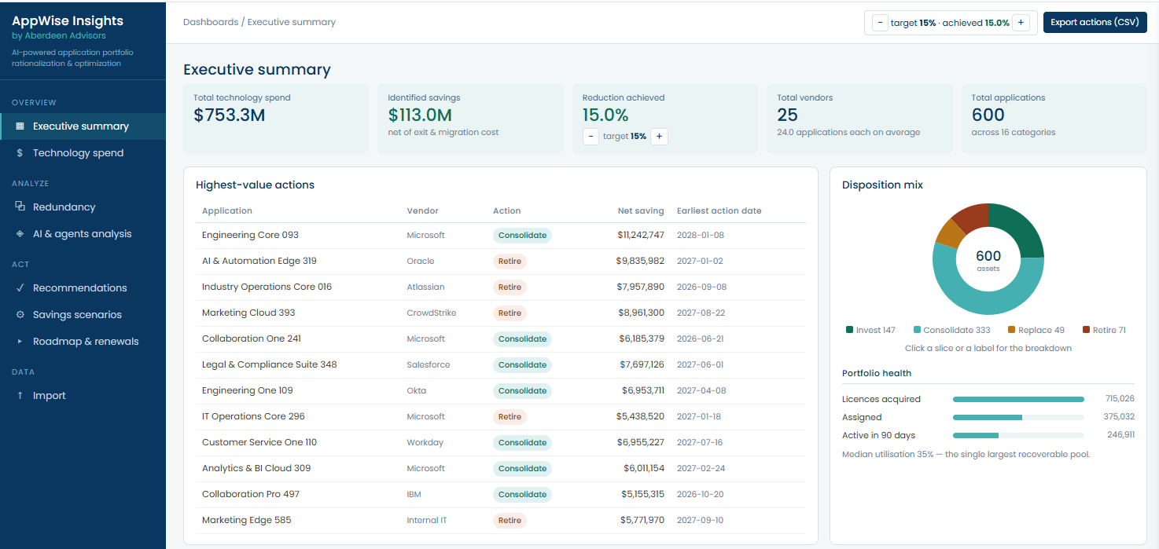
AppWise MVP and its Impact / Business Value
AppWise combines app cost, capability overlap, risk, business criticality, and unused licenses into a customized roadmap with a drillable portfolio view down to individual apps and vendors.
Target Users: The IT Portfolio and Vendor Management lead in the CIO's office, with IT Finance review and app owners validating the Information
Reduce App Spend
Clients can specify the target budget cut percentage for tech spend and the length of time allowed to achieve the cut. Appwise surfaces cost-savings opportunities
Targeted Roadmap
AppWise identifies areas for cuts and provides a quarter-by-quarter roadmap for when cuts can occur, based on contract renewal dates.
Duplicate Spend Exposed
Clusters apps by capability to surface where the same function is bought twice ranked by dollars, utilization, and dependencies.
Most rationalization efforts stall at ”which apps”. AppWise answers which, when, and how much will I save

Slide 4
Path to Market: Prove value, then scale
Harden in 2–4 weeks, validate with 1–2 client pilots, then package the engine as a reusable Aberdeen Labs offering.
WEEKS 0–4
Refine the product
WEEKS 4–8
Pilot at Aberdeen
WEEKS 8–16
Pilot with select clients
WEEK 16 ONWARDS
Scale the offering
Validate workflows, logic and required input fields. Fix bugs, capture lessons learned and plan the capability rollout.
Internal pilot using ServiceNow CMDB extracts and dummy data. Confirm the input template holds against real exports.
One or two clients (e.g. Novant, Hanger). Begin with data discovery, gather user feedback, capture ROI and realized reductions.
Pitch clients and prospects using proven pilot results. Convert feedback into a repeatable, packaged offer.
RISKS AND HOW WE HANDLE THEM
Patchy inventory data: missing fields are flagged, never ignored
Wrong Inputs: Prior to Data intake, we’ll double check metrics with app owners and(or) systems that generated them, including contract review
We will always meet with the App Owners to validate usage data, app data and insights prior to any final recommendation
Prior to full-rollout, we’ll make sure the logic and engine behind the savings and other metrics are correct. We’ll iterate as needed
HOW WE MEASURE SUCCESS
Percentage of the portfolio and app usage data validated by app owners and(or) contractual data
Validating all the data surfaces by the input file is correct and formulas and recommendations are sustainable.
Successfully identifying cost savings opportunities and validating the recommendations with app owners
DATA READINESS
For the hackathon we assume the client has complete data required as initial data intake for the tool
In practice, app owners will source records from ServiceNow CMDB, contracts and sign-on data to fill the intake file
Aberdeen supports the data collection as part of the engagement
Anything missing is defaulted and reported rather than rejected
FUTURE CAPABILITIES
Upload contracts; extract target fields and populate the data into tool
Add guided Q&A chatbot for users to query the portfolio and reach insights
Assess AI tools, agents, token usage and related cost
Establish Weighted Scoring techniques to consolidate decision making
API integration with client ITAM system to push real-time updates to application and license data into AppWise

Slide 5
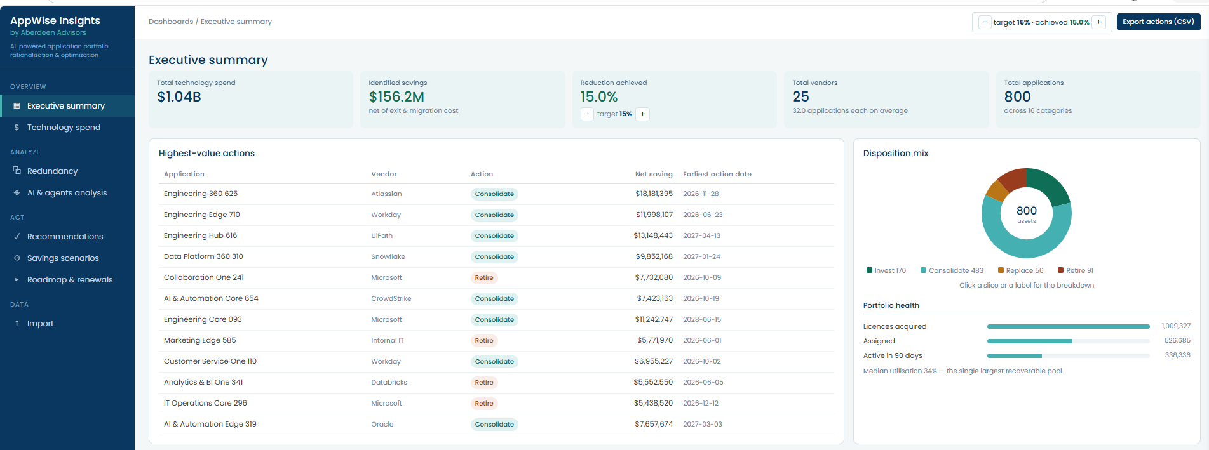
Appendix: AppWise Insights — Tool Screenshots
Executive Summary
The one-page CIO view: total technology spend, savings identified against the 15% target, and the highest-value actions ranked by net saving alongside the disposition mix across all 800 assets and portfolio licence health.

Slide 6
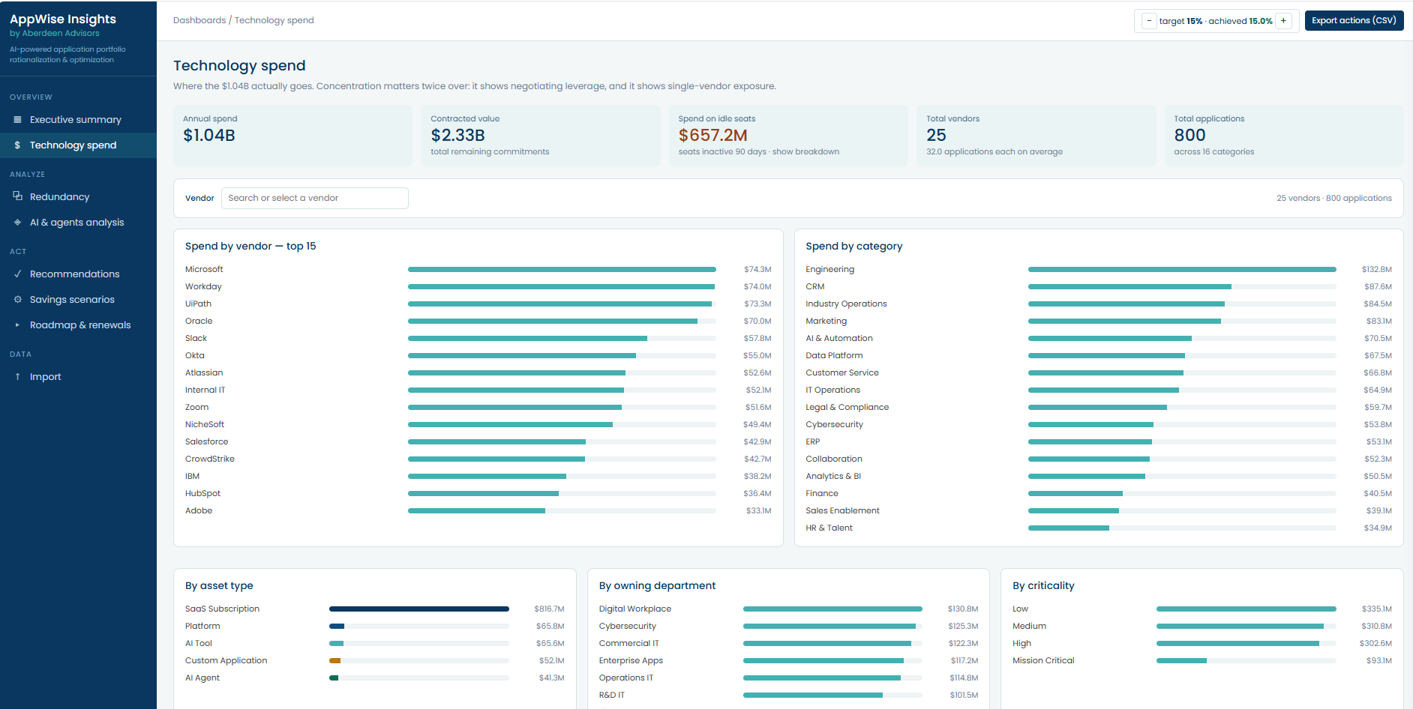
Appendix: AppWise Insights — Tool Screenshots
Technology Spend
Where the $1.04B actually goes: spend by vendor, capability category, asset type, owning department and business criticality — plus contracted value still committed and the spend sitting on idle seats.

Slide 7
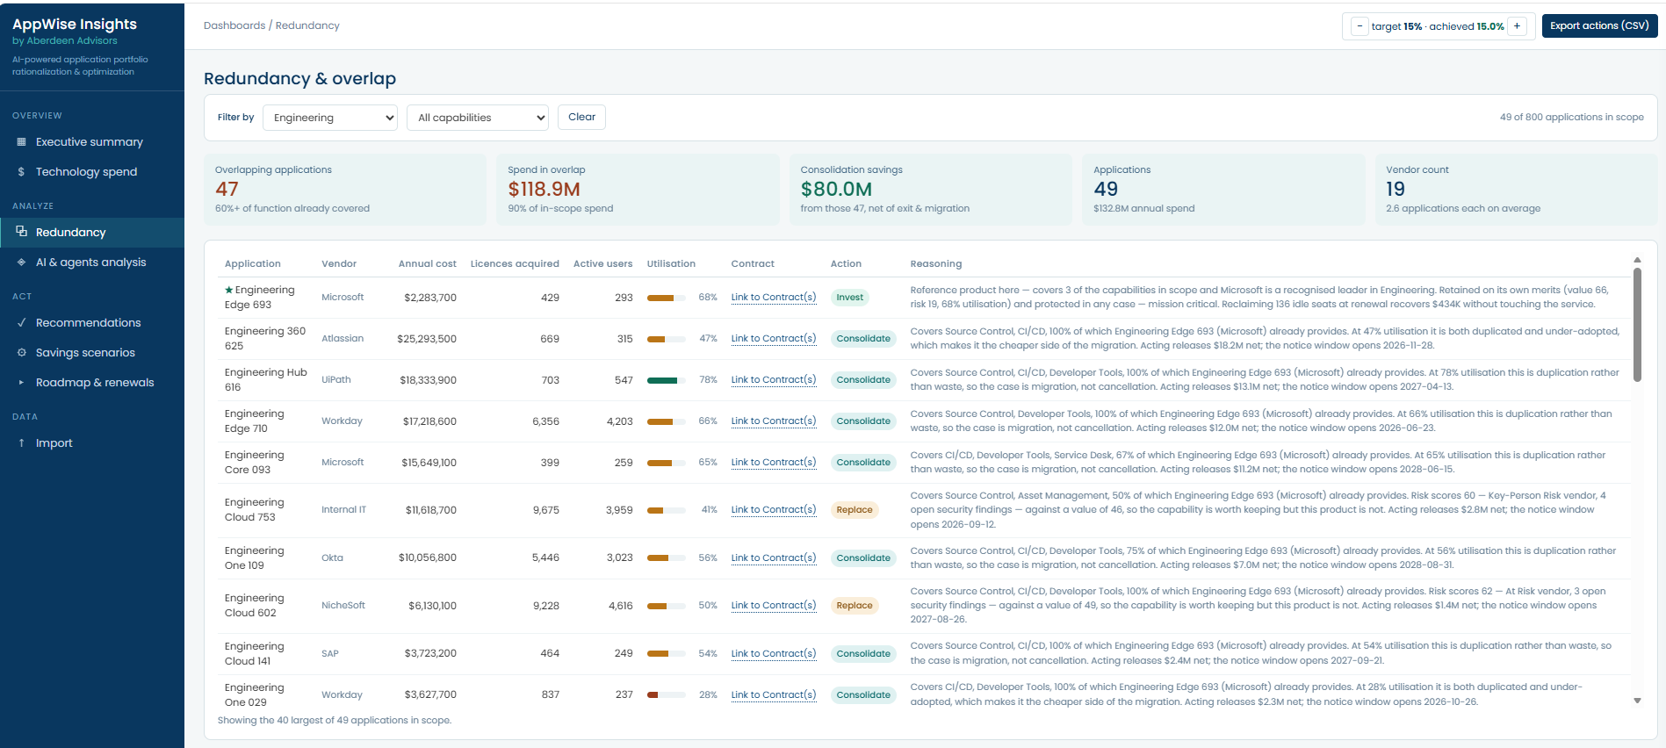
Appendix: AppWise Insights — Tool Screenshots
Redundancy & Overlap
Applications whose capabilities are already covered elsewhere in the portfolio, with cost, licences acquired versus active users, utilization, contract links, the recommended action and the written reasoning behind each call.

Slide 8
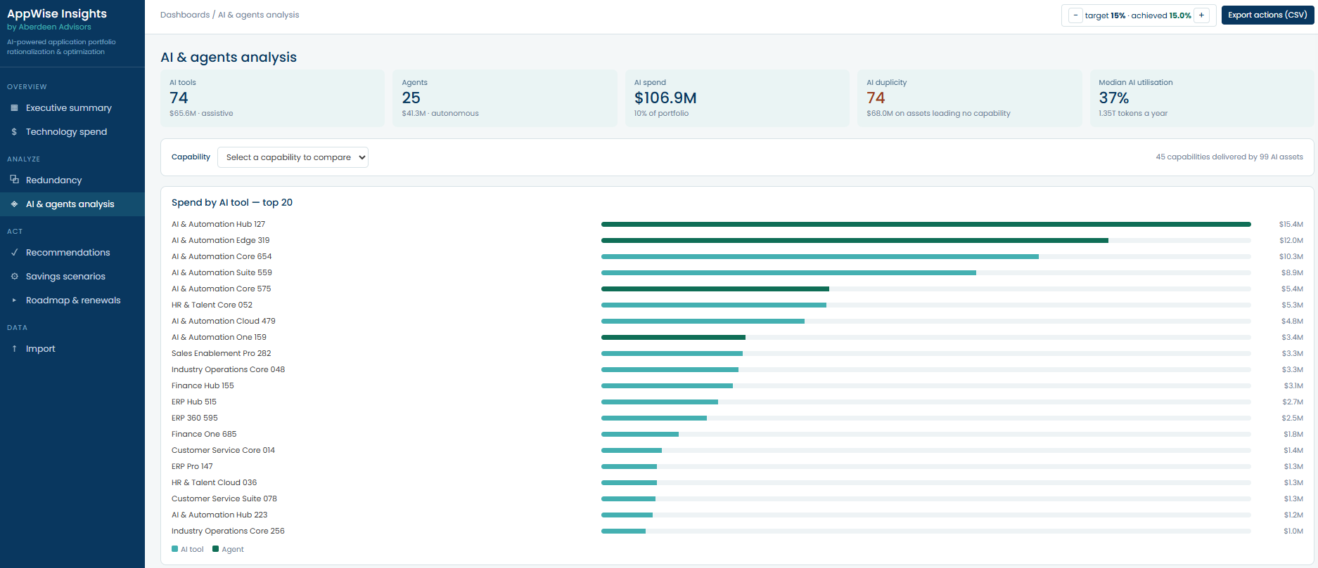
Appendix: AppWise Insights — Tool Screenshots
AI & Agents Analysis
The AI-specific lens: assistive tools versus autonomous agents, AI spend as a share of the portfolio, duplicated AI capability, token consumption and median AI utilization.

Slide 9
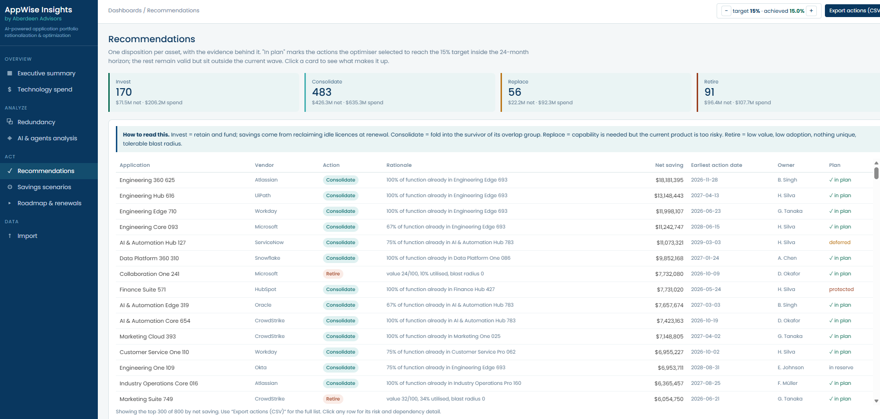
Appendix: AppWise Insights — Tool Screenshots
Recommendations
One disposition per asset — Invest, Consolidate, Replace or Retire — each with its rationale, net saving, earliest action date, named owner and whether it made the current wave or sits in reserve.

Slide 10
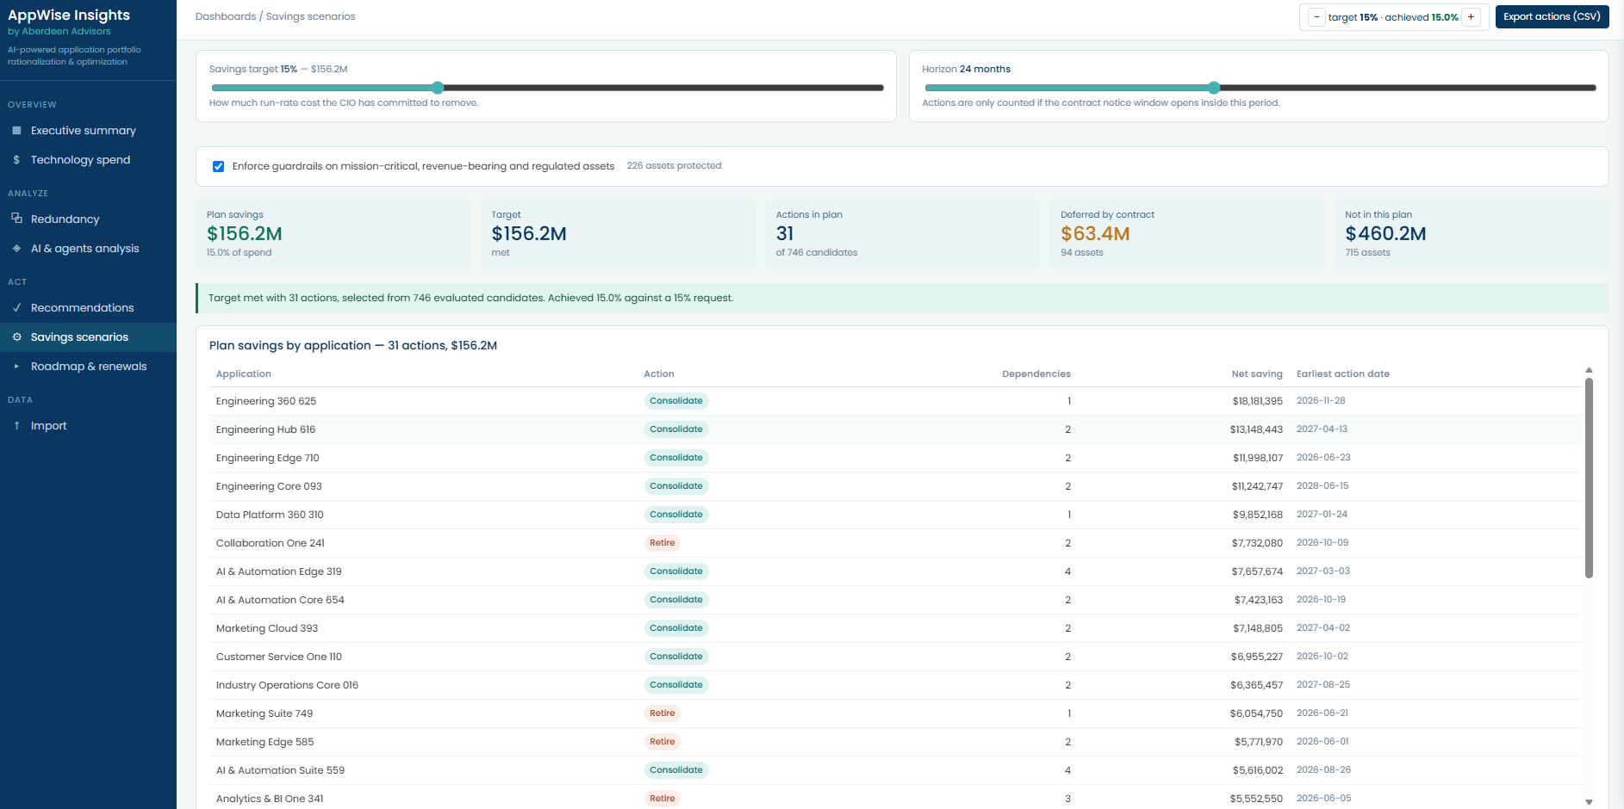
Appendix: AppWise Insights — Tool Screenshots
Savings Scenarios
The planning controls: set the savings target and time horizon, enforce guardrails on mission-critical, revenue-bearing and regulated assets, and see the smallest set of actions that clears the target.

Slide 11
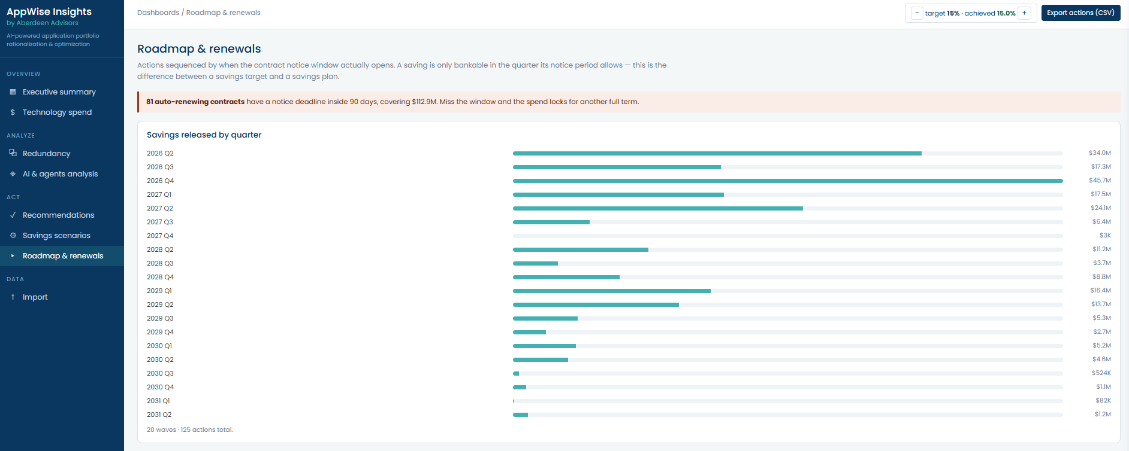
Appendix: AppWise Insights — Tool Screenshots
Roadmap & Renewals
Savings released quarter by quarter, sequenced to when each contract's notice window actually opens — including a warning on auto-renewals with deadlines inside 90 days.

Slide 12
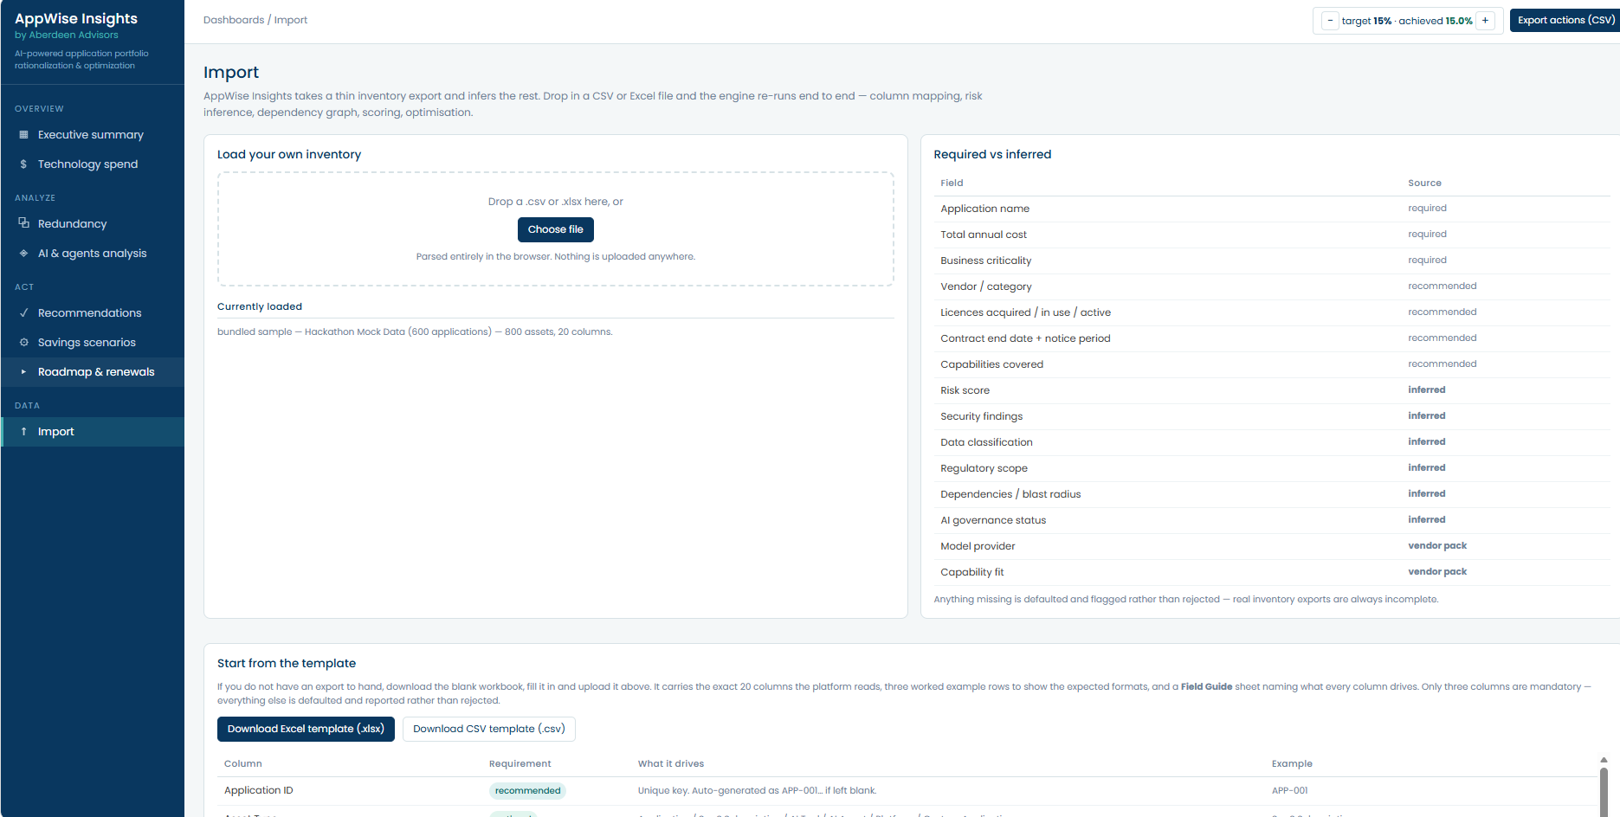
Appendix: AppWise Insights — Tool Screenshots
Data Import
Bring your own inventory: drop in a CSV or Excel export and the engine re-runs end to end. Shows which fields are required, recommended or inferred, with a downloadable template.

