Slide 1
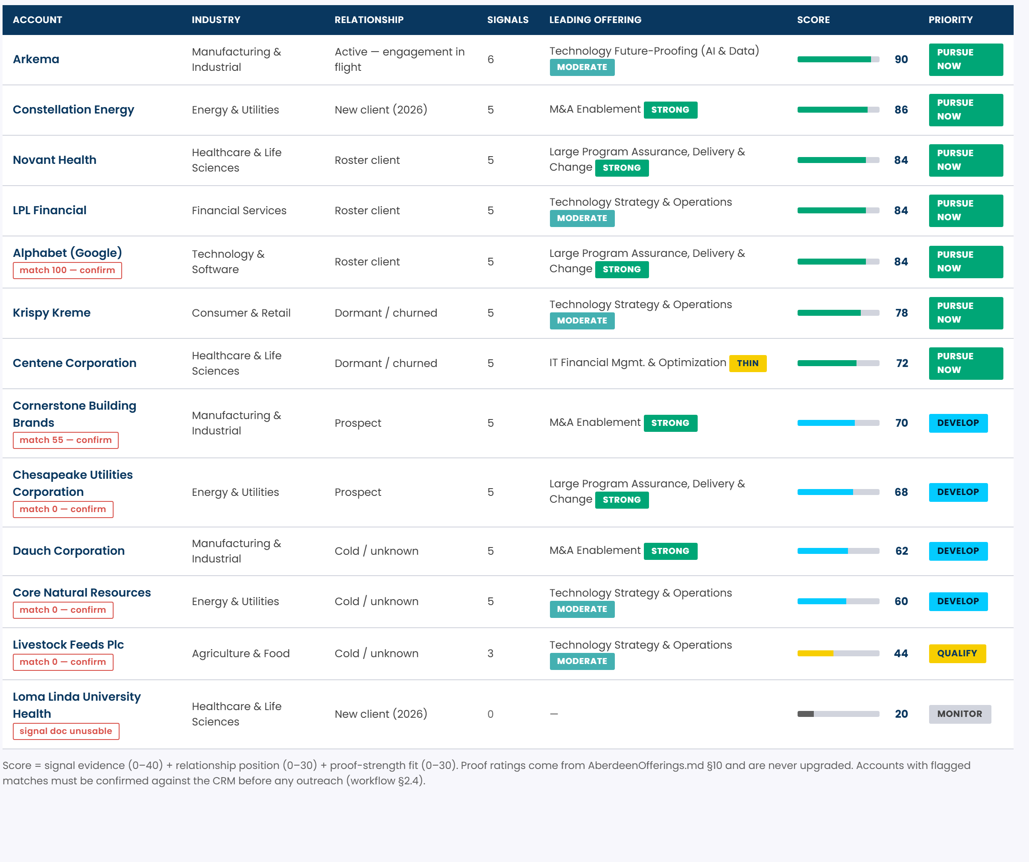

Pursuit Intelligence
Public filings plus Aberdeen's own credentials, as a ranked pursuit list
A working web app, built entirely from what is already in the repo: three agent-instruction files and 13 public company documents. It scores every account, shows why, and never invents a fact it cannot cite.
13
59
33
0
Accounts assessed
Evidenced buying signals
Addressable initiatives
External API calls
HOW IT WORKS
13 public documents
›
59 signals extracted
›
Scored 40/30/30
›
Ranked pipeline
›
Pursuit brief + outreach
WHAT MAKES IT DEFENSIBLE
Every claim cites a page
Signals carry the document and page reference they came from.
Proof ratings are never upgraded
STRONG / MODERATE / THIN come from AberdeenOfferings.md §10.
Gaps are reported, not filled
Missing CRM fields show as gaps; one stale source is excluded.
Nothing leaves the machine
Level 3 compliant: zero network calls anywhere in the app.
All 13 accounts ranked — click any row for the full brief
CONFIDENTIAL · Aberdeen Advisors · 2026
1

Slide 2
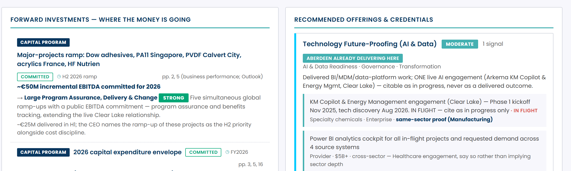
One brief, three sources, one recommendation
What a partner previously assembled by hand over hours — now on one screen, with every figure traceable
WHAT WE ALREADY KNOW
WHAT THE RESEARCH ADDS
WHAT WE CAN SELL
Relationship position and play
Forward investments from filings
Offerings the signals trigger
Live engagement, if any
Committed vs announced vs exploratory
Credentials, same-sector first
Revenue trajectory and bucket
Decision-makers and topic to raise
Honest proof strength badge
Blank CRM fields shown as gaps
Page-level citation on every claim
Draft outreach, partner-editable
Arkema brief — filings research on the left, Aberdeen capability and proof on the right, with the live Clear Lake engagement flagged as in progress, never as a delivered outcome
CONFIDENTIAL · Aberdeen Advisors · 2026
2

Slide 3
Architecture
Static, self-contained, zero egress — the whole app is one HTML file with the data compiled in
1 · SOURCES
client-data/
agent-instructions/
About Aberdeen/
committed to the repo
13 public documents — 9 press releases, 3 filings, 1 digest
AGENT_WORKFLOW · SKILL · AberdeenOfferings
quals master + enhanced credential library
▼
2 · DATA LAYER
data-signals.js
59 signals · evidence, page ref, provenance, category, triggered offering
data-investments.js
33 addressable initiatives · committed / announced / exploratory
hand-extracted, compiled in
data-contacts.js
decision-makers with the topic to raise
data-aberdeen.js
offerings, credentials, §10 proof ratings, account buckets
▼
3 · SCORING
Signal evidence
40
Relationship position
30
Proof-strength fit
30
transparent, arguable
count, weighted for tech / AI / M&A / restructuring
the workflow bucket — live engagement scores highest
mean §10 rating across triggered offerings
▼
4 · SURFACES
Radar
Pipeline
Sources
three views, one file
where capital is going, filtered to Aberdeen-addressable
13 accounts ranked, tiered Pursue / Develop / Qualify
every document, provenance tier and guardrail
GUARDRAILS — ENFORCED, NOT ASPIRATIONAL
Zero network calls · Level 3 stays local
Page-level citation on every figure
Proof ratings never upgraded
Stale source excluded, not mined
Unconfirmed name matches flagged
Blank CRM fields reported as gaps
Deliberate trade-off: the data layer is compiled by hand, so nothing drifts mid-demo and there is no credential to leak — but it does not refresh itself. That is the first thing to change at scale.
CONFIDENTIAL · Aberdeen Advisors · 2026
3

Slide 4
Path to scale
From 13 hand-compiled accounts to the firm's whole book, without giving up the evidence discipline
NOW
30 DAYS
60 DAYS
90 DAYS
Proof of concept
Connect the real book
Automate the intake
Make it the BD operating system
13 accounts, 59 signals, hand-extracted
Read the 30-account CRM and revenue file
Scheduled filing and news collection
Warm-path graph from engagement history
›
›
›
Three views, one self-contained file
Join credentials.py to the quals library
Signal recency decay and expiry
Outreach tracked through to reply
Runs with no install and no credential
Generate the one-page POV from the brief
Sort, filter and search the pipeline
Win/loss written back as new credentials
Brand-correct, Poppins embedded
Fill the 48 missing quantified outcomes
Partner override with an audit trail
Feeds HorizonView, not competes with it
WHAT ACTUALLY GATES THIS
48 blank outcomes
Four of six capabilities have zero quantified proof. One number per qual converts them to sellable.
One source of truth
The data layer duplicates the instruction files. Generate it from them instead.
Local-path dependency
The workflow assumes one machine. Repo-relative paths let anyone run it.
The discipline is the asset: a tool a partner can argue with beats one they have to trust.
CONFIDENTIAL · Aberdeen Advisors · 2026
4

