Slide 1
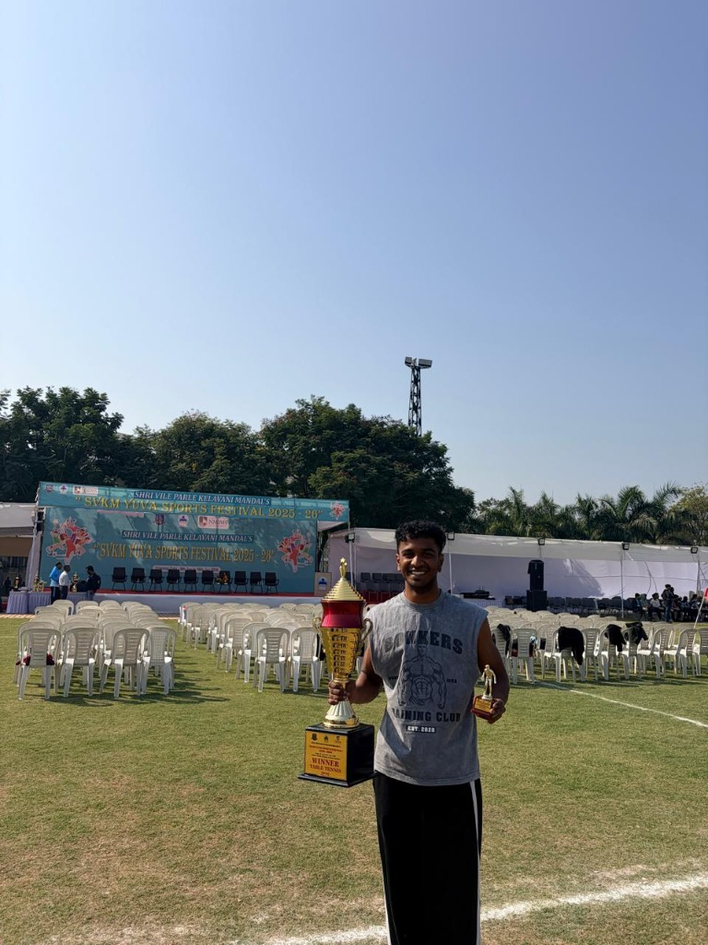
PORTFOLIO ENGINEERING & DESIGN CASE STUDY
ABEER NAIR
The Champion's Realm: Non-Academic Portfolio
Designing a High-Performance, Cinematic Web Platform Showcasing Competitive Athletics, Campus Leadership, and Personal Curiosity.
"A competitive athlete, a reliable organiser, and a curious, people-loving person who enjoys every new challenge."
PRESENTER: Abeer Nair | B.Tech Information Technology
INSTITUTION: SVKM's NMIMS MPSTME, Shirpur Campus
NMIMS Yuva Sports 2026 Winner

Slide 2
STRATEGIC VISION
Portfolio Objectives & Mission
Translating non-academic excellence into a verifiable, high-impact digital identity
01
MULTIDIMENSIONAL PERSONA
02
DOCUMENTED TRACK RECORD
Holistic Human Representation
Evidence-Based Verification
Transcend the rigid limitations of academic transcripts. Present a complete 360° portrait spanning national sports, campus governance, world travel, and culinary creativity.
Provide authentic, documented proof of achievements—including School National Table Tennis, West Zone Inter-University, and the Yuva Sports 2026 championship victory.
03
PROFESSIONAL ALIGNMENT
04
UNFORGETTABLE EXPERIENCE
Transferable Competency Mapping
Cinematic & Engaging Storytelling
Demonstrate how physical conditioning, tournament composure under pressure, and event security crisis management translate directly into high-stakes engineering teamwork.
Employ an immersive visual theme ('If Game of Thrones had a website') with rich obsidian tones, gold gradients, and interactive components that captivate recruiters and evaluators.
Abeer Nair | The Champion's Realm • Non-Academic Portfolio Case Study
2026

Slide 3
PROBLEM & RATIONALE
Why Create a Non-Academic Portfolio?
Addressing the critical blind spots of traditional technical resumes
THE TRADITIONAL RESUME DILEMMA
THE INTERACTIVE PORTFOLIO ADVANTAGE
Flat, Unidimensional & Dry Text
Living Proof of Grit, Charisma & Craft
✖ Reduces multi-year athletic rigor into a single bullet point line.
✔ Authentic Visual Proof: Live match action, trophy ceremonies, and podium addresses.
✖ Fails to communicate pressure management, adrenaline control, and fast reflexes.
✔ Cross-Functional Transferability: Shows how athletic stamina drives 36-hour hackathons.
✖ Leaves organizing leadership (Security Core, SIH 2025) without human context or visual evidence.
✔ Interactive Engagement: Switchable views, responsive filters, and dynamic timelines.
✖ Completely ignores curiosity traits like world exploration and culinary experimentation.
✔ Memorable Personal Brand: The 'Champion's Realm' aesthetic creates an unforgettable impression.
✖ Lacks emotional resonance—recruiters review hundreds of identical monochrome PDFs.
✔ Global Accessibility: Instant web deployment on Netlify & GitHub Pages accessible worldwide.
Abeer Nair | The Champion's Realm • Non-Academic Portfolio Case Study
2026

Slide 4
UX ARCHITECTURE
Heuristic Principles Applied (Part 1)
Implementing Jakob Nielsen's 10 Usability Heuristics for seamless interaction
H01
H02
H03
Visibility of System Status
Match Between System & Real World
User Control and Freedom
Keeping the user informed at all times
Speaking the user's language through intuitive metaphors
Effortless navigation and flexible viewing options
• Sticky Glassmorphic Navbar: Highlights active section in real-time as user scrolls.
• Tournament Scroll Timeline: Physical tournament progression from School to University champion.
• Interactive Athlete Photo Switcher: One-click tabs to switch between Trophy, Match, Gym, Travel.
• Live State Indicators: Pulsing red broadcast dots ('Tournament Action', 'Active 2026').
• Metaphorical Categorization: 'The Arena' (Sport), 'The Forge' (Fitness), 'The Hearth' (Cooking).
• Instant Anchor Jumping: Smooth scroll triggers to leap between sections without lag.
• Interactive Matrix Feedback: Highlighted cells illuminate real-time competency breakdowns.
• Natural Terminology: Everyday conversational phrasing rather than developer jargon.
• Global Return-To-Top Control: Persistent footer and nav shortcuts to reset view instantly.
Abeer Nair | The Champion's Realm • Non-Academic Portfolio Case Study
2026

Slide 5
UX ARCHITECTURE
Heuristic Principles Applied (Part 2)
Consistency, recognition over recall, and minimalist aesthetic design
H04
H06
H08
Consistency & Standards
Recognition Rather Than Recall
Aesthetic & Minimalist Design
Strict Design Token System
Visual Scannability & Clarity
High Signal-to-Noise Ratio
• Universal UI tokens across all 10 sections: 16px card radius, 1px gold border borders, obsidian backgrounds.
• 4 Hero Stat Cards: Instant quantitative anchors above the fold (National, Zonal, Winner, 3 Events).
• Dark obsidian background eliminates screen glare while elevating high-res photos.
• Symmetrical Card Pairs: Mirrored structures in Fitness ('Gym Work' & 'Core Power') and People ('Connecting' & 'Speaking').
• Color-Coded Badges: Red for tournaments, Amber for events, Blue for travel, Green for real-world impact.
• Carefully curated negative space gives breathing room to achievements without clutter.
• Consistent Badge Taxonomy: Standardized pill tags for levels, years, and skill tags.
• Skills Heatmap Matrix: Explicit visual grid connecting every non-academic pursuit to workplace strengths.
• Purposeful Framer Motion scroll triggers—subtle elevations rather than distracting page shifts.
Abeer Nair | The Champion's Realm • Non-Academic Portfolio Case Study
2026

Slide 6
VISUAL IDENTITY
Design System: 'The Champion's Realm'
Cinematic Game of Thrones Obsidian Aesthetic built on Modern React Architecture
Color Palette & Atmosphere
Typography System
Deep Obsidian (#080B11) and Royal Midnight (#0D131F) provide an imposing foundation. Dragonfire Gold (#F59E0B) and Bright Amber (#FBBF24) symbolize victory and regal poise, with Crimson (#DC2626) accents for athletic intensity.
Headings powered by Cinzel & Cinzel Decorative evoke ancient stone inscriptions and championship titles. Body text rendered in clean, legible Inter/Outfit guarantees effortless reading across mobile and desktop displays.
Motion & Micro-Interactions
Tech Stack & Performance
Subtle canvas floating ember sparks, smooth spring card hover elevations (-6px translateY), animated numeric counter tickers on the Hero stats, and smooth-scroll navigation anchors create a tactile, premium feel.
Built with React 19, Vite 6, Tailwind CSS 4, and Framer Motion. Zero UI kit bloat. Lightning-fast build times (2.2s), mobile-first responsive breakpoints, and pre-configured deployment rules for Netlify and Vercel.
Abeer Nair | The Champion's Realm • Non-Academic Portfolio Case Study
2026

Slide 7
LIVE INTERFACE
Portfolio Snapshots: Cross-Device UI Showcase
Dedicated snapshot frames displaying responsive desktop, tablet, and mobile execution
● ● ● http://localhost:5174/ — Abeer Nair | The Champion's Realm
● ● ● Mobile Experience (375px)
Abeer Nair | The Champion's Realm • Non-Academic Portfolio Case Study
2026

Slide 8
CONTENT STRUCTURE
Core Pillars & Non-Academic Architecture
Systematic organization of life pursuits strictly derived from documented achievements
1. Competitive Sports Arena
2. Athletic Conditioning
3. Campus Leadership
DISCIPLINE & HIGH PRESSURE
DAILY PHYSICAL HABITS
BEHIND-THE-SCENES COORDINATION
• School National Table Tennis representation
• Sub-second reaction time & agility footwork drills
• Security Core Member (College Cultural Fest)
• West Zone Inter-University competitor
• Rotational torso & posterior chain power
• Organising Committee Member (SIH 2025)
• Winner, NMIMS Yuva Sports 2026 Champion
• Multi-match tournament cardiovascular stamina
• DSN Team Member (NMMUN 2024)
• Team sports: Football & Cricket on campus
• 100% daily discipline & consistent work ethic
• Calm judgement, crowd awareness & team sync
4. Curiosity: Travel & Hearth
5. People & Communication
6. Synthesized Skill Matrix
EXPLORATION & FLAVOUR CRAFT
EXTROVERTED CONNECTIONS
TRANSFERABLE WORKPLACE SKILLS
• Heritage wonder: Basilica of Bom Jesus, Old Goa
• Starting conversations & building rapid rapport
• Interactive matrix connecting pursuits to skills
• Coastal journeys: Stepping outside routine
• Public speaking at NMIMS MPSTME wooden podium
• Teamwork, Communication, and Pressure Poise
• Home cooking: Slow-simmered chicken curry
• Clear verbal alignment on court and at events
• Planning, Adaptability, and Creativity mapping
• Patience, culinary timing & sharing with others
• Connecting across Sports, Events, and Travel
• Holistic alignment with engineering leadership
Abeer Nair | The Champion's Realm • Non-Academic Portfolio Case Study
2026

Slide 9
SYNTHESIS & IMPACT
Conclusion: The Complete Engineering Athlete
How non-academic excellence shapes extraordinary professional capability
THE SYNTHESIS FORMULA
KEY PORTFOLIO METRICS
Character Forged Beyond Academics
FACTS INVENTED
0% (100% Authentic)
ATHLETIC CALMNESS
Competing in national table tennis teaches composure during match-point pressure—a vital skill when debugging mission-critical production outages.
USER PHOTOS EMBEDDED
10 High-Res Real Photos
OPERATIONAL LEADERSHIP
BUILD & VERIFICATION
Managing festival security and national hackathons proves that great outcomes require meticulous behind-the-scenes planning and proactive communication.
Zero-Error Vite Build
SOURCE CODE MANAGEMENT
CONTINUOUS CURIOSITY
GitHub (AberrNair/portfolio)
Exploring historic world heritage and learning delicate culinary recipes nurture an inventive, lifelong learner mindset.
HOSTING COMPATIBILITY
Netlify & Vercel Ready
EXTROVERTED ALLIANCES
Naturally connecting with diverse people turns cross-functional engineering silos into unified, high-performing teams.
RESPONSIVE VIEWPORTS
Desktop, Tablet & Mobile
Abeer Nair | The Champion's Realm • Non-Academic Portfolio Case Study
2026

