Slide 1
Threat Intelligence 101:
Research, Application and Real-World Impact

Slide 2

Whoami
Threat Intelligence Analyst at The Weir Group
SOC Analyst at The Weir Group
Graduate Abertay BSc Ethical hacking 2023
Interests largely in threat intelligence and OT/ICS
Notes:
Tactics – plan of attack overall from reconnaissance, payload delivery to execution
Techniques- Attack tools used
Procedures – Step by step path threat actors used

Slide 3
What is threat intellgience
01
Notes:
By definition is ‘the process of collecting, analysing and interpreting information about existing or potential cyber threats to help organisations make informed security decisions and mitigate risks’
Threat intelligence MUST be, relevant, accurate, and timely

Slide 4
Threat Intelligence Categories
01
02
03
Tactical
Operational
Strategic
Short term, immediate technical details
(IOCs, TTPs)
Context and insights to short term threats
(Who, What When, How, Why)
High level, long term insights of threat landscapes
(Who, Why, What is next?)

Slide 5
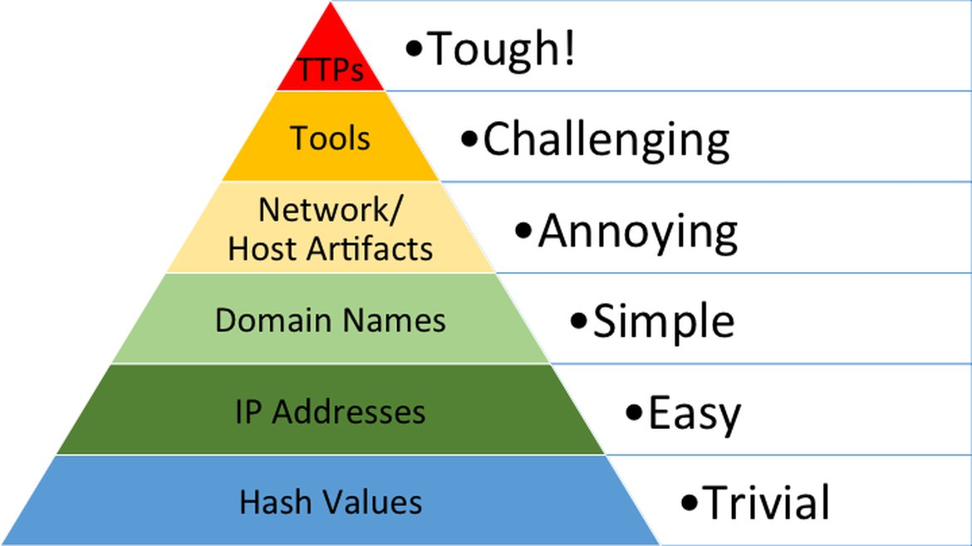
Indicators of Compromise
Tactics
Techniques
Procedures
Notes:
Tactics – plan of attack overall from reconnaissance, payload delivery to execution
Techniques- Attack tools used
Procedures – Step by step path threat actors used

Slide 6

CIA Triad
Notes:
Confidentiality: This principle involves protecting information from unauthorized access and disclosure.
Integrity: This ensures that data remains accurate, complete, and consistent, and is only altered by authorized users. Availability: This principle guarantees that systems and data are accessible to authorized users when they are needed.

Slide 7
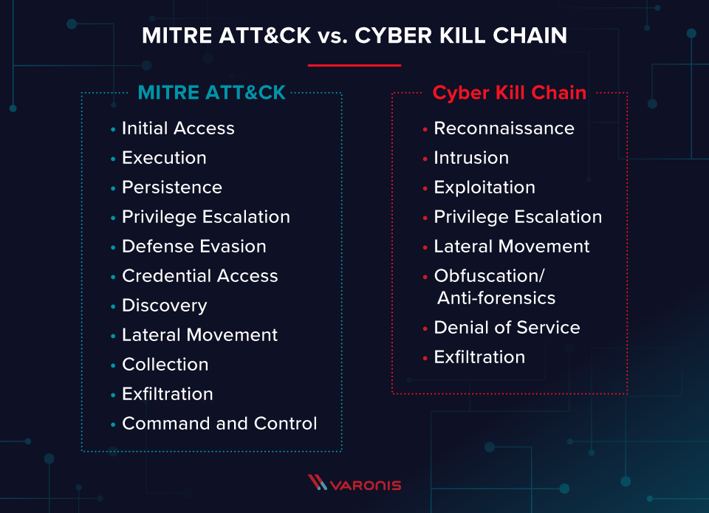
MITRE ATT&CK & Cyber Kill Chain
Detailed matrix of tactics and techniques
Operational threat hunting, detection engineering and mapping
High level model
Strategic understanding of progression
Notes:
Tactics – plan of attack overall from reconnaissance, payload delivery to execution
Techniques- Attack tools used
Procedures – Step by step path threat actors used

Slide 8
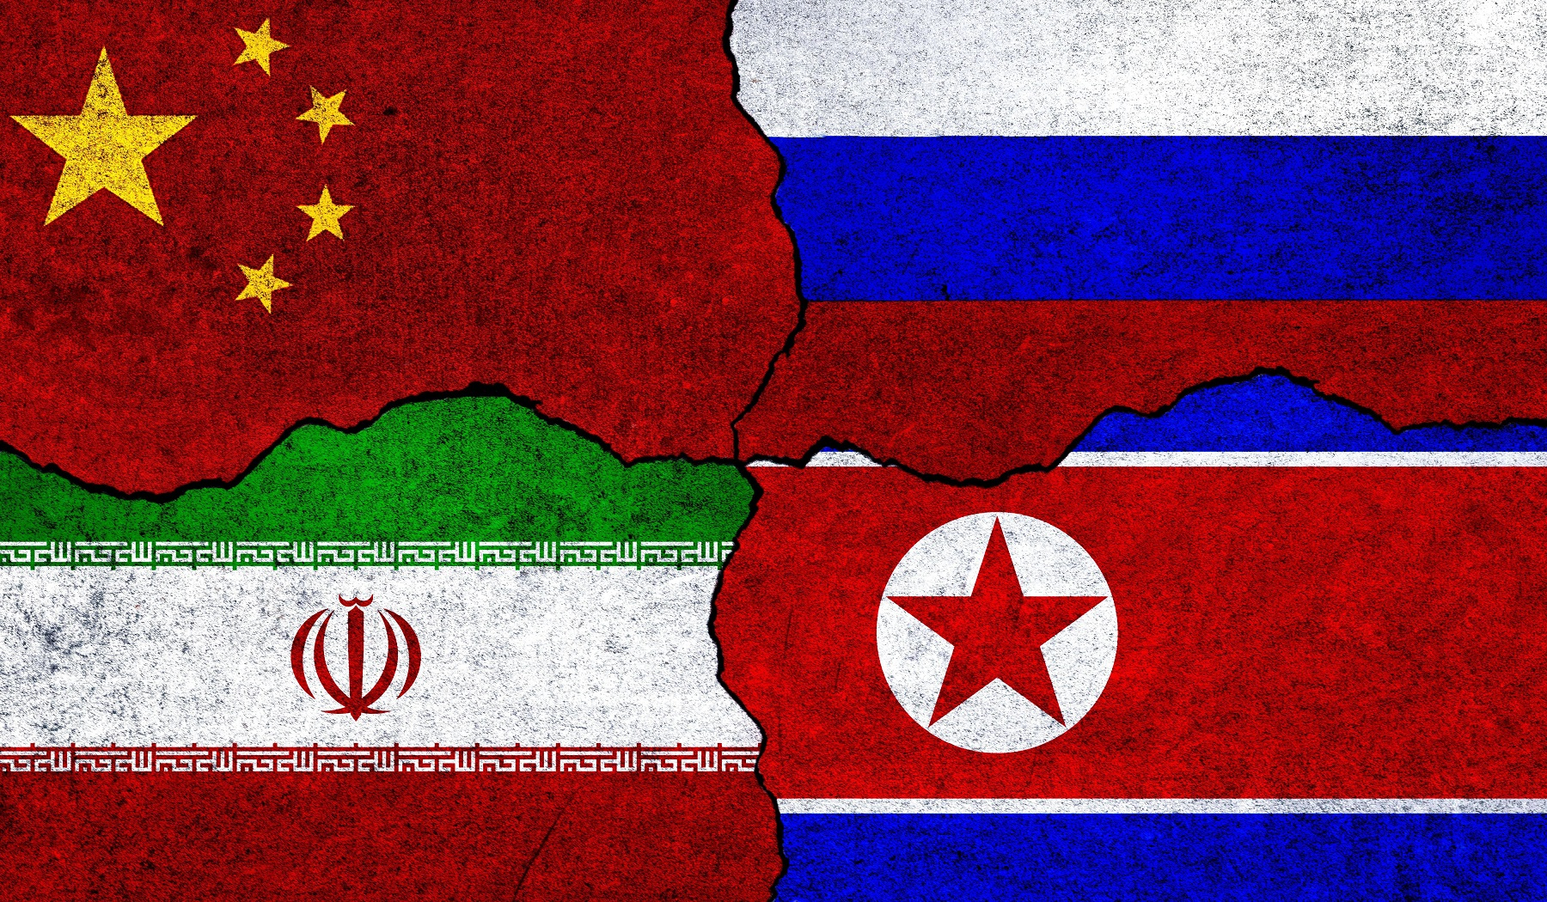
BIG 4, State Sponsored Activity
CHINA
Long term espionage
Intellectual Property, government
Sophisticated
Strategic Objectives
China’s 5 year plan
RUSSIA
Destructive
Financially motivated
Espionage for intelligence
DDOS disruption
IRAN
Espionage, defacement, disruption
Critical infrastructure and/or adjacent
Sophistication in OT environments
NORTH KOREA
Global espionage
Financially motivated, data theft
Impersonation
Notes:
China:
- Sophisticated- custom built malware and exploits

Slide 9
02
Why we use threat intelligence

Slide 10
Proactive Defence
Improve Incident Response
Risk-Based Prioritisation
Why
Understanding Adversary Behaviour
Fraud prevention, Brand Reputation Protection
Operational efficiency, Cost Savings
Informed Stategic Planning
Enhanced threat
detection

Slide 11
03
Researching threat intelligence

Slide 12
Research Methods
OSINT
Counter Intelligence
HUMINT
Internal Intelligence
News!, Web Monitoring
Activities to prevent spying, intelligence gathering
Threat Sharing, SME’s
Telemetry, Incidents

Slide 13
Research Methods
https://docs.google.com/spreadsheets/u/1/d/1H9_xaxQHpWaa4O_Son4Gx0YOIzlcBWMsdvePFX68EKU/pubhtml#gid=361554658
https://github.com/fastfire/deepdarkCTI
https://github.com/jivoi/awesome-osint
https://thehackernews.com/
https://www.securityweek.com/
https://www.bleepingcomputer.com/
https://www.ncsc.gov.uk/section/keep-up-to-date
Vendors annual reporting, Mandiant, Recorded Future, Microsoft, Crowdstrike
CISA

Slide 14
04
Outputs

Slide 15
Outputs of TI
Reports/Briefings
Threat Hunting
Detection Engineering
Informing Processes
Operational or stategic reporting, threat actor profiles, priority information requests
Seeking out assumed threats in an environment
Proactive detections of threats in environments
Threat Modelling
Business decisions
Operational processes

Slide 16

Reporting
What happened?
When did it happen?
Victimology?
Technical details?
CIA?
Profile of threat actor
What does this mean for you?
What can we expect to see
Notes:
Victimology- what region is being targeted, what industry is being targeted, motivations? Ideological? Why might this organisation have been specifically targeted?
Conclusional Analysis:
What does all this information mean?
How is it relevant to Weir?
What should Weir be doing about it all?
Risk based analysis and evaluations?
Is it really all that bad? Are the threat actors that much of a threat? How likely it is?

Slide 17

Profiles
Who is the threat actor/group?
Where are they based?
What kind of group are they? What is their operating model?
When did they first emerge? When did they become prolific?
Any notable movements on the group recently that’s relevant?

Slide 18


Engineering & Hunting
Threat hunting is the proactive manual practice of searching for and identifying advanced cyber threats that have evaded automated tools.
Assumed breach or vulnerability
Hypothesis
Analyse
Indicators of attack
Detection engineering is the service of designing, implementing, testing and refining login to identify and response to malicious activity within an environment.
Threat hunts -> Detection engineering
Tactical intelligence

Slide 19

Engineering & Hunting
Yara Rules: Use for hunting malware artifacts in files, memory dumps or binaries
Example: Searching endpoints for specific malware signature or pattern
KQL: Use for hunting behavioural indicators in logs/telemetry
Example: Querying SIEM data for suspicious process execution or lateral movement
Sigma Rules: Generic, SIEM agnostic detection language that can be converted into queries for multiple SIEMs
SQL-Based queries, EQL (Used in Elastic), FQL (CrowdStrikes Falcon)

Slide 20
06
How you can use threat intelligence now

Slide 21
How to use
Proactive Intelligence & research
Current news – Job interviews
Using MITRE ATT&CK and Cyber Kill Chain to structure analysis
Mapping findings to IOC & TTP collection
Fuel malware analysis & research
Prioritisation in recommendations of reporting in coursework (likelihood, map it to the real world)
Linking found vulnerabilities to real-world exploitations

Slide 22
07
Case Studies

Slide 23
Cl0P Exploiting Oracle-EBS
01
02
03
Threat Profile
Detection Engineering
Extrapolated Technicalities

Slide 24
Threat Profile
RaaS, Extremely prolific
Large enterprises, governments, critical infrastructure
Russian-Speaking
Financial Gain, espionage, geopolitical disruption
Double-Extortion Model
Victim list released (includes Washington Post, Logitech)
CVE-2025-61882 RCE in Oracle, Critical
Network vulnerability, no user interaction required, low complexity
CIA all affected
Notes:
Cl0p is a well-established Ransomware-as-a-Service (RaaS) group known for targeting large
enterprises, government agencies and critical infrastructure. Suspected to be linked to
Russian-speaking advanced persistent threat (APT) groups, Cl0p’s campaigns serve multiple
purposes including financial gain, espionage and geopolitical disruption. The group operates
a double extortion model, combining data theft with data encryption, and frequently
leverages zero-day vulnerabilities and supply chain compromise to achieve mass infiltration.
Cl0p was recorded as the most active ransomware group in Q1 2025, during a period where
overall ransomware activity rose by 46%. Notably, more than half of the 55 reported incidents
involved direct attacks on operational technology systems. Investigations revealed that Cl0p
deployed ransomware kits and USB-based malware to infiltrate and persist in these
environments, taking advantage of legacy vulnerabilities and poor patching practices
common in industrial control systems.
The group’s increasing proficiency in targeting OT environments suggests a strategic shift
towards sectors where disruption will yield high impact. Given the slow pace of
modernisation in many industrial systems, this trend is expected to continue. While Cl0p’s
activity slowed in Q2, this behaviour is consistent with their operational pattern, pausing to
identify new exploitable vulnerabilities before launching renewed campaigns. A resurgence
is likely in the coming months.

Slide 25
Extrapolated Technicalities
First thing would be prioritising patching the vulnerability
Execution: RCE
Persistence: Scheduled Tasks / Service Creation
Exfiltration: Large-Scale theft
Hunts:
Unusual HTTP POST Requests to Oracle EBS endpoints
Access logs with unusual parameters or payloads
New processes by Oracle application services
Sudden spike in outbound traffic from servers

Slide 26
Detection Engineering
IOCs become redundant
Long Term Detections:
Anomalous extracts of data
Generic account name creation of service accounts or scheduled tasks ‘Test’ ‘admin’
Command execution via BI Publisher
Anomalous process trees (Oracle -> bash -> curl)

Slide 27
Questions?

