Slide 1


Tabular Playground Series: State Classification
BY:-
Brittney McKeone
Harshal Varpe
Steven Platt
Zach Fugate

Slide 2
Problem Statement
Our team has been provided twenty-six thousand, 6o-second sequences of 13 biological sensor data for almost one thousand participants.
The participants could have been in two possible states.
The objective was to determine the state of the participants from the given sensor data.
Notes:
Editorial Guidelines on Bullets:
1. Vertical lists are best introduced by a grammatically complete sentence followed by a colon. No periods
are required at the end of entries unless at least one entry is a complete sentence, in which case a period
is necessary at the end of each entry.
Example: A university can be judged by three measures:
· The quality of its students
· The quality of it faculty
· The quality of its infrastructure
2. If a list completes the sentence that introduces it, items begin with lowercase letters, commas or semicolons
(if individual items contain commas) are used to separate each item, and the last item ends with a period.
Note that the introductory clause does not end with a colon.
Example: A university can be judged by
· the quality of its students,
· the quality of its faculty,
· the quality of its infrastructure.
3. Avoid mixing sentence and nonsentence items in a bulleted list.
‹#›

Slide 3
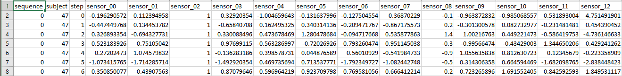
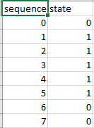
Overview of the Data
The data was already split into train and test sets.
The training data had the training labels separated into different CSV file.
The training data comprised of ~26,000 60-second recordings of thirteen biological sensors.
The training labels file contained only the state for a corresponding data point in training data. The state were 0 for inactive and 1 for active.
Notes:
Editorial Guidelines on Bullets:
1. Vertical lists are best introduced by a grammatically complete sentence followed by a colon. No periods
are required at the end of entries unless at least one entry is a complete sentence, in which case a period
is necessary at the end of each entry.
Example: A university can be judged by three measures:
· The quality of its students
· The quality of it faculty
· The quality of its infrastructure
2. If a list completes the sentence that introduces it, items begin with lowercase letters, commas or semicolons
(if individual items contain commas) are used to separate each item, and the last item ends with a period.
Note that the introductory clause does not end with a colon.
Example: A university can be judged by
· the quality of its students,
· the quality of its faculty,
· the quality of its infrastructure.
3. Avoid mixing sentence and nonsentence items in a bulleted list.
‹#›

Slide 4
Preprocessing
The given dataset had only numerical features in the form of sensor data. So we decided to do the following preprocessing steps:
Missing/Null Values
Heat Map
Outlier Analysis
Missing/Null Values
Important in limiting memory loss/errors within the data set.
Heat Map
To recognize any correlations within the data set.
Important in showing the behaviour of the data.
Outlier Analysis
Important in identifying any outliers within the data set.
Can now get rid of any extreme deviations in the data.
Notes:
Editorial Guidelines on Bullets:
1. Vertical lists are best introduced by a grammatically complete sentence followed by a colon. No periods
are required at the end of entries unless at least one entry is a complete sentence, in which case a period
is necessary at the end of each entry.
Example: A university can be judged by three measures:
· The quality of its students
· The quality of it faculty
· The quality of its infrastructure
2. If a list completes the sentence that introduces it, items begin with lowercase letters, commas or semicolons
(if individual items contain commas) are used to separate each item, and the last item ends with a period.
Note that the introductory clause does not end with a colon.
Example: A university can be judged by
· the quality of its students,
· the quality of its faculty,
· the quality of its infrastructure.
3. Avoid mixing sentence and nonsentence items in a bulleted list.
‹#›

Slide 5
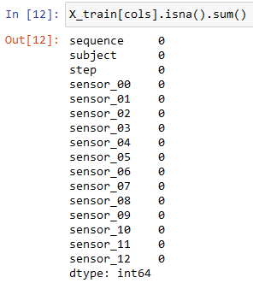
Preprocessing (Missing/Null Values)
Notes:
Editorial Guidelines on Bullets:
1. Vertical lists are best introduced by a grammatically complete sentence followed by a colon. No periods
are required at the end of entries unless at least one entry is a complete sentence, in which case a period
is necessary at the end of each entry.
Example: A university can be judged by three measures:
· The quality of its students
· The quality of it faculty
· The quality of its infrastructure
2. If a list completes the sentence that introduces it, items begin with lowercase letters, commas or semicolons
(if individual items contain commas) are used to separate each item, and the last item ends with a period.
Note that the introductory clause does not end with a colon.
Example: A university can be judged by
· the quality of its students,
· the quality of its faculty,
· the quality of its infrastructure.
3. Avoid mixing sentence and nonsentence items in a bulleted list.
‹#›

Slide 6
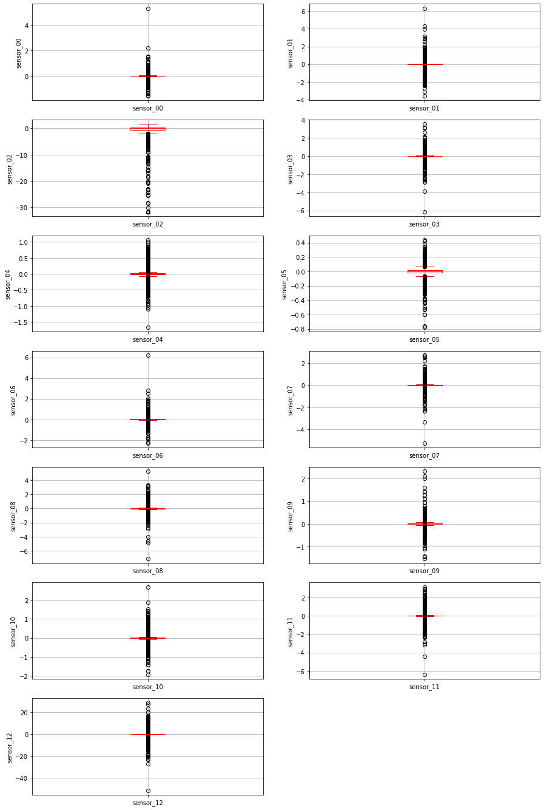
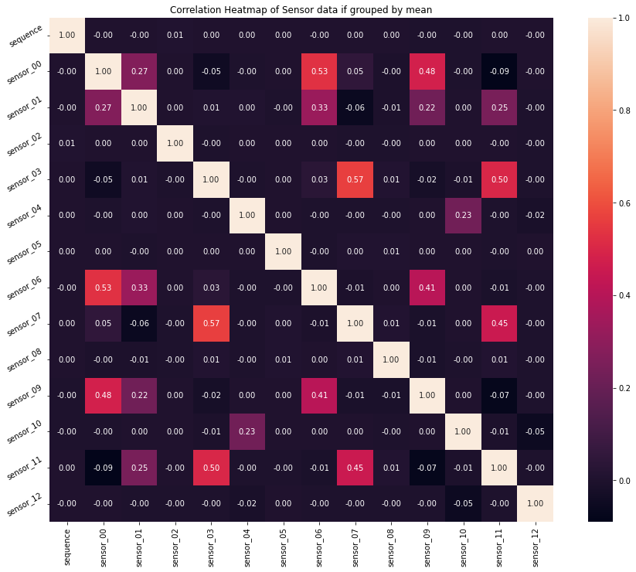
Preprocessing (Heat Map and Outlier Analysis)
Notes:
Editorial Guidelines on Bullets:
1. Vertical lists are best introduced by a grammatically complete sentence followed by a colon. No periods
are required at the end of entries unless at least one entry is a complete sentence, in which case a period
is necessary at the end of each entry.
Example: A university can be judged by three measures:
· The quality of its students
· The quality of it faculty
· The quality of its infrastructure
2. If a list completes the sentence that introduces it, items begin with lowercase letters, commas or semicolons
(if individual items contain commas) are used to separate each item, and the last item ends with a period.
Note that the introductory clause does not end with a colon.
Example: A university can be judged by
· the quality of its students,
· the quality of its faculty,
· the quality of its infrastructure.
3. Avoid mixing sentence and nonsentence items in a bulleted list.
‹#›

Slide 7
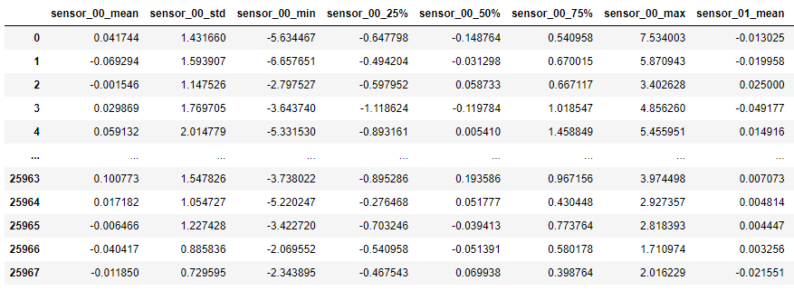
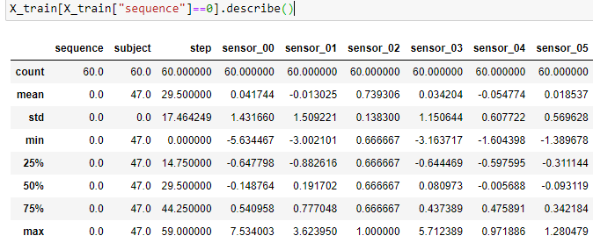
Preprocessing
91 features per sequence
Notes:
Editorial Guidelines on Bullets:
1. Vertical lists are best introduced by a grammatically complete sentence followed by a colon. No periods
are required at the end of entries unless at least one entry is a complete sentence, in which case a period
is necessary at the end of each entry.
Example: A university can be judged by three measures:
· The quality of its students
· The quality of it faculty
· The quality of its infrastructure
2. If a list completes the sentence that introduces it, items begin with lowercase letters, commas or semicolons
(if individual items contain commas) are used to separate each item, and the last item ends with a period.
Note that the introductory clause does not end with a colon.
Example: A university can be judged by
· the quality of its students,
· the quality of its faculty,
· the quality of its infrastructure.
3. Avoid mixing sentence and nonsentence items in a bulleted list.
‹#›

Slide 8
Models
After the preprocessing, we chose the following classifiers:
Decision Tree Classifier - works well with numerical data
Gaussian Naive Bayes - applies Bayes’ theorem with the naive assumption of conditional independence between every pair of features,
Logistic Regression - works well in classification problems / when target variable is categorical
Ensemble Techniques - Random Forest Classifier,Gradient Boosting Classifier,CatBoost Classifier
Notes:
Editorial Guidelines on Bullets:
1. Vertical lists are best introduced by a grammatically complete sentence followed by a colon. No periods
are required at the end of entries unless at least one entry is a complete sentence, in which case a period
is necessary at the end of each entry.
Example: A university can be judged by three measures:
· The quality of its students
· The quality of it faculty
· The quality of its infrastructure
2. If a list completes the sentence that introduces it, items begin with lowercase letters, commas or semicolons
(if individual items contain commas) are used to separate each item, and the last item ends with a period.
Note that the introductory clause does not end with a colon.
Example: A university can be judged by
· the quality of its students,
· the quality of its faculty,
· the quality of its infrastructure.
3. Avoid mixing sentence and nonsentence items in a bulleted list.
‹#›

Slide 9
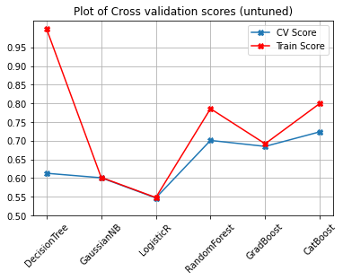
Baseline results
Apart from Decision Tree Classifier, most models did not overfit.
Ensemble techniques performed better than the other techniques.
Notes:
Editorial Guidelines on Bullets:
1. Vertical lists are best introduced by a grammatically complete sentence followed by a colon. No periods
are required at the end of entries unless at least one entry is a complete sentence, in which case a period
is necessary at the end of each entry.
Example: A university can be judged by three measures:
· The quality of its students
· The quality of it faculty
· The quality of its infrastructure
2. If a list completes the sentence that introduces it, items begin with lowercase letters, commas or semicolons
(if individual items contain commas) are used to separate each item, and the last item ends with a period.
Note that the introductory clause does not end with a colon.
Example: A university can be judged by
· the quality of its students,
· the quality of its faculty,
· the quality of its infrastructure.
3. Avoid mixing sentence and nonsentence items in a bulleted list.
‹#›

Slide 10
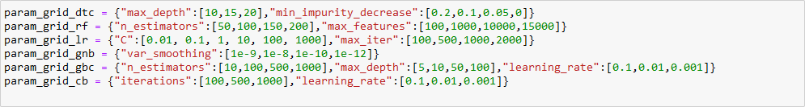
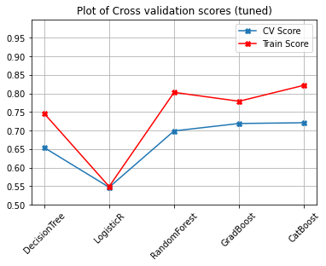
Hyperparameter tuning and Results
Used GridSearchCV
Notes:
Editorial Guidelines on Bullets:
1. Vertical lists are best introduced by a grammatically complete sentence followed by a colon. No periods
are required at the end of entries unless at least one entry is a complete sentence, in which case a period
is necessary at the end of each entry.
Example: A university can be judged by three measures:
· The quality of its students
· The quality of it faculty
· The quality of its infrastructure
2. If a list completes the sentence that introduces it, items begin with lowercase letters, commas or semicolons
(if individual items contain commas) are used to separate each item, and the last item ends with a period.
Note that the introductory clause does not end with a colon.
Example: A university can be judged by
· the quality of its students,
· the quality of its faculty,
· the quality of its infrastructure.
3. Avoid mixing sentence and nonsentence items in a bulleted list.
‹#›

Slide 11
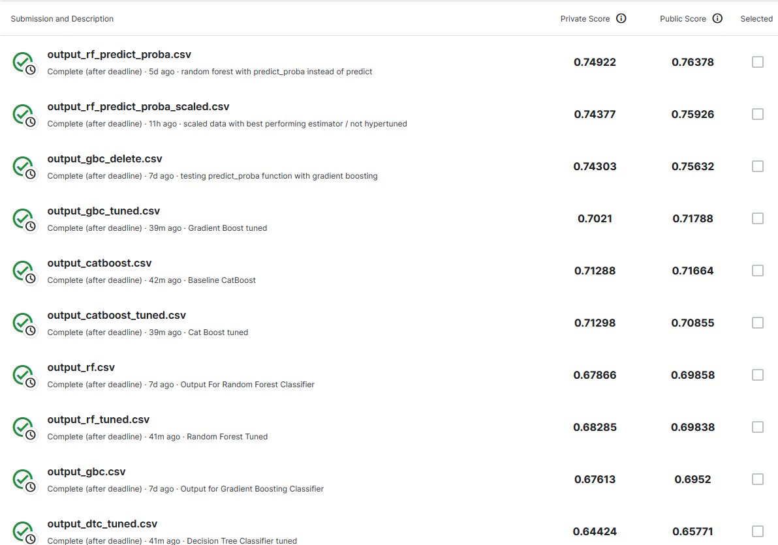
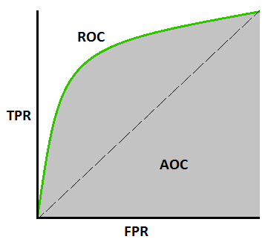
Kaggle Scores
Notes:
Editorial Guidelines on Bullets:
1. Vertical lists are best introduced by a grammatically complete sentence followed by a colon. No periods
are required at the end of entries unless at least one entry is a complete sentence, in which case a period
is necessary at the end of each entry.
Example: A university can be judged by three measures:
· The quality of its students
· The quality of it faculty
· The quality of its infrastructure
2. If a list completes the sentence that introduces it, items begin with lowercase letters, commas or semicolons
(if individual items contain commas) are used to separate each item, and the last item ends with a period.
Note that the introductory clause does not end with a colon.
Example: A university can be judged by
· the quality of its students,
· the quality of its faculty,
· the quality of its infrastructure.
3. Avoid mixing sentence and nonsentence items in a bulleted list.
‹#›

Slide 12
Conclusion and Future Work
Testing different hyperparameters
Experimentation with other libraries (Keras, PyTorch, TensorFlow)
Experiment with different methods to characterize each 60 second sequence
Notes:
Editorial Guidelines on Bullets:
1. Vertical lists are best introduced by a grammatically complete sentence followed by a colon. No periods
are required at the end of entries unless at least one entry is a complete sentence, in which case a period
is necessary at the end of each entry.
Example: A university can be judged by three measures:
· The quality of its students
· The quality of it faculty
· The quality of its infrastructure
2. If a list completes the sentence that introduces it, items begin with lowercase letters, commas or semicolons
(if individual items contain commas) are used to separate each item, and the last item ends with a period.
Note that the introductory clause does not end with a colon.
Example: A university can be judged by
· the quality of its students,
· the quality of its faculty,
· the quality of its infrastructure.
3. Avoid mixing sentence and nonsentence items in a bulleted list.
‹#›

Slide 13
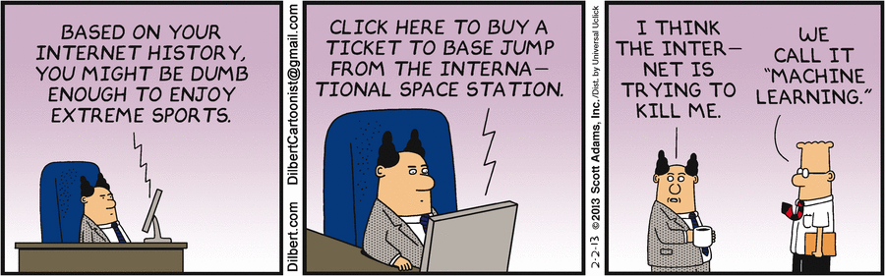
Questions?
Notes:
Editorial Guidelines on Bullets:
1. Vertical lists are best introduced by a grammatically complete sentence followed by a colon. No periods
are required at the end of entries unless at least one entry is a complete sentence, in which case a period
is necessary at the end of each entry.
Example: A university can be judged by three measures:
· The quality of its students
· The quality of it faculty
· The quality of its infrastructure
2. If a list completes the sentence that introduces it, items begin with lowercase letters, commas or semicolons
(if individual items contain commas) are used to separate each item, and the last item ends with a period.
Note that the introductory clause does not end with a colon.
Example: A university can be judged by
· the quality of its students,
· the quality of its faculty,
· the quality of its infrastructure.
3. Avoid mixing sentence and nonsentence items in a bulleted list.
‹#›

