Slide 1
K.Abhichand
CE17B104
LINECRAFT ML TASK PPT

Slide 2
Method of approach
Processed the data by checking for NaN values, removing useless columns.
Explored the data and visualized some interesting insights
Scaled and assigned binary representation to categorical columns
Used the below classification algorithms and took the best model
Logistic Regression
Decision tree classifier
Random Forest classifier
Support Vector Machines (SVM)
K-Nearest Neighbors (KNN)
Naive Bayes
Best accuracy score was achieved by Random Forest Classifier
Now predicted the type of fault for the data which has machine failure

Slide 3
Observations
There is no high correlation between any of the columns in the given data
There are 60% of low quality variants, 30.2% of medium quality, 9.7% high quality variants to be precise.
Rotational speed and torque follows normal distribution, where as other columns weren’t distributed normally
Also there is no good correlation between the types of failure and the input columns. So, no column can be deleted.

Slide 4
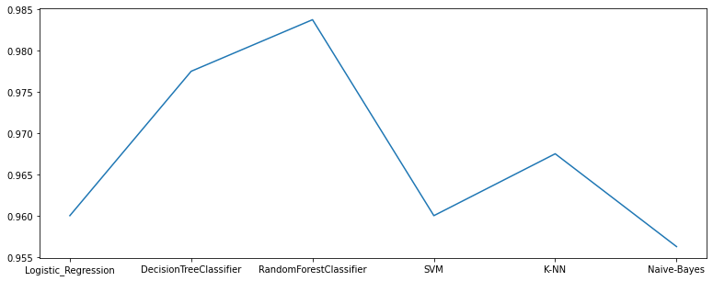
Accuracy
Achieved an accuracy score of 100% for machine failure on the Train data.
As seen from the graph, random forest classifier gave an accuracy score of 98.125% on the test data.(on my own hold out)

Slide 5
Prediction of types of fault.
Achieved an accuracy score of 93% for the type1 faults on the test data
Achieved an accuracy score of 100% for the type1 faults on the test data
Achieved an accuracy score of 96% for the type1 faults on the test data
Achieved an accuracy score of 100% for the type1 faults on the test data
Achieved an accuracy score of 100% for the type1 faults on the test data
Visualised this results through the confusion matrix.

