Slide 1
Bioinformatics BEFRI and Beyond
17.9.2018
Rémy Bruggmann
Universität Bern – Interfaculty Bioinformatics Unit

Slide 2
History
Support
Research
Master program

Slide 3
Interfaculty Bioinformatics Unit (IBU)
Support
Research
Master program
IBU

Slide 4
Bioinformatics Initiative BEFRI
Setup of a bioinformatics service BEFRI
complementary between Bern and Fribourg
synergies
Setup of a MSc program in bioinformatics (2013)

Slide 5
Master program in Bioinformatics & Computational biology
Joint master program between
University of Bern
University of Fribourg
Designed from scratch!
Open to
biology/biochemistry bachelor students
informatics bachelor students
also open for “Fachhochschul/University of Applied Science” bachelors (40-60 ECTS required)
Additional ECTS required depending on background

Slide 6
Master program in Bioinformatics & Computational biology
Statistics
2013: 5 students: 4 biologists (1 from industry), 1 computer scientist
2014: 17 students: mainly biology/biochemistry
2015: 15 students: mainly from biology/biochemistry
2016: 16 students: mainly from biology/biochemistry
2017: 15 Students: mainly from biology/biochemistry
2018: 22 Students: mainly from biology/biochemistry

Slide 7
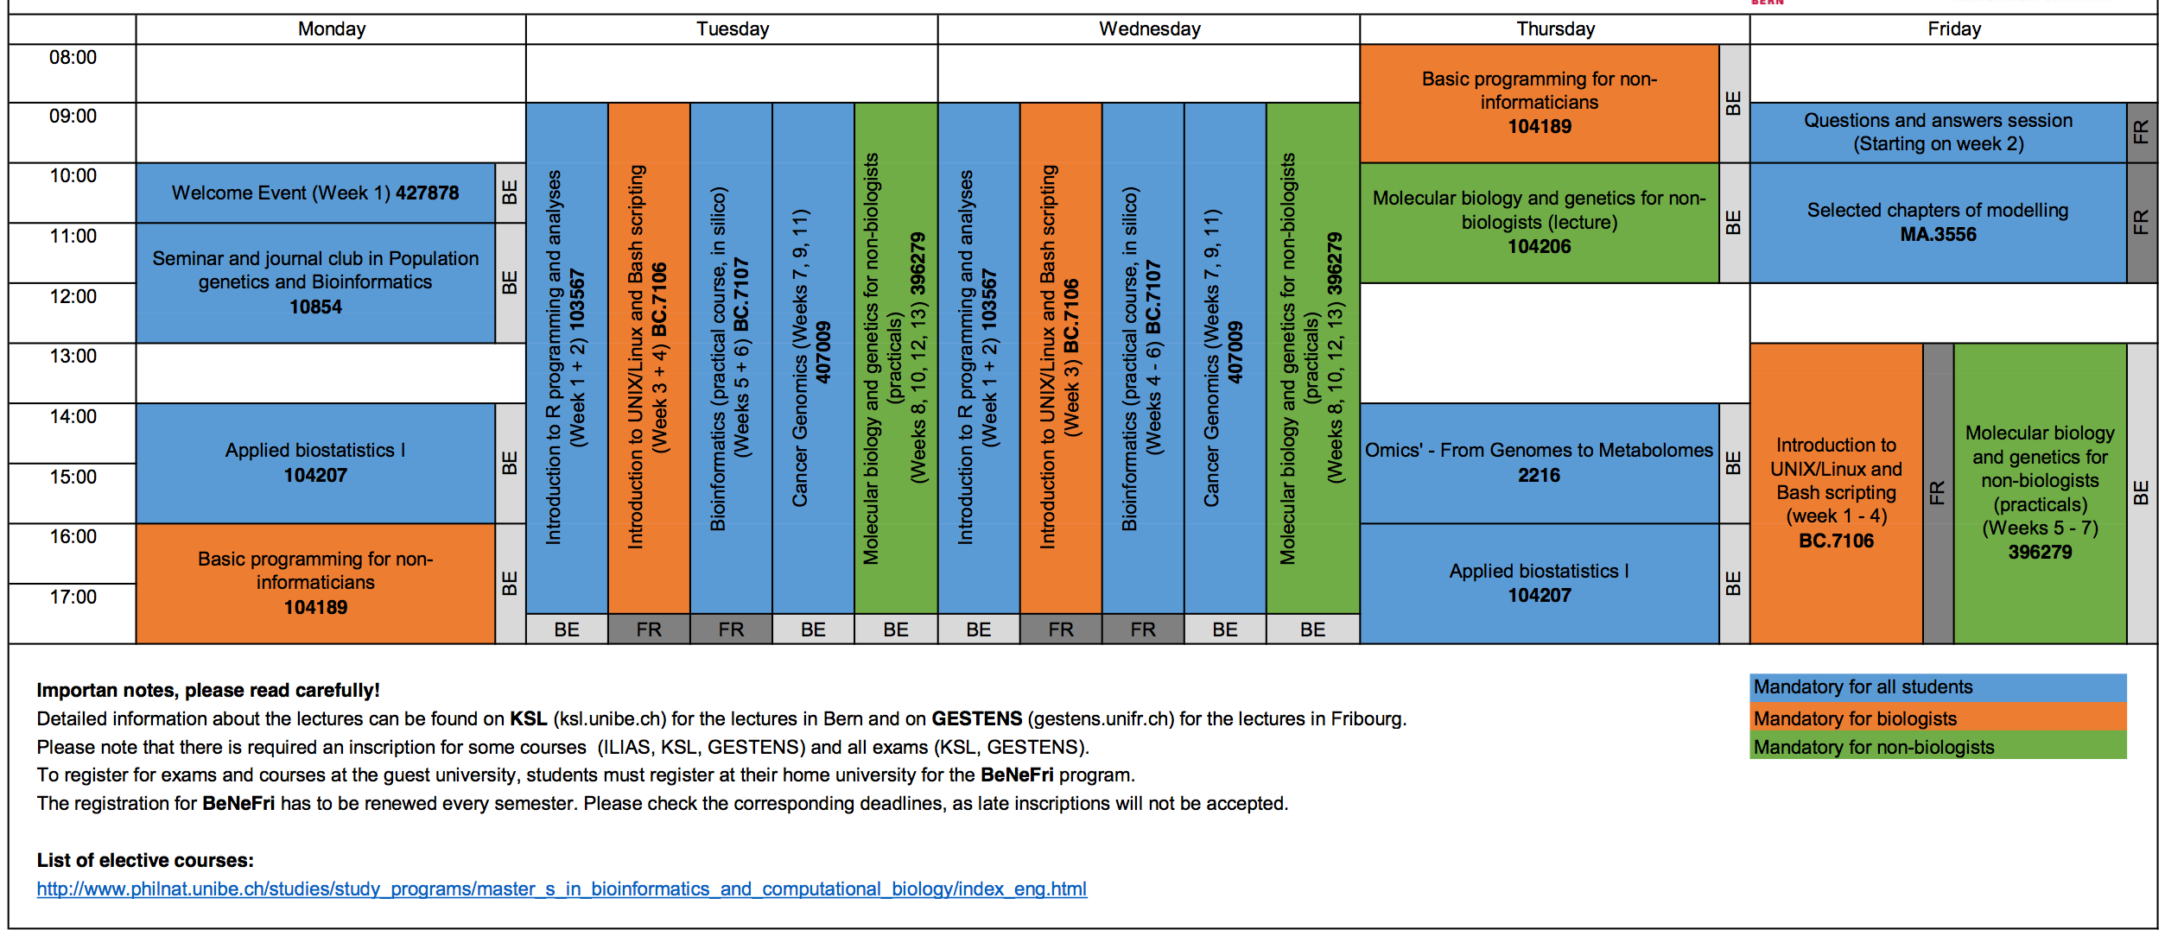
Class Schedule HS18

Slide 8

Courses at SIB and CUSO
Many courses provided by SIB
https://www.sib.swiss/training
Many courses provided by CUSO
Many lectures and courses provided by MSc Bioinformatics
Bioinformatic seminar series will start FS19, organized by IBU

Slide 9

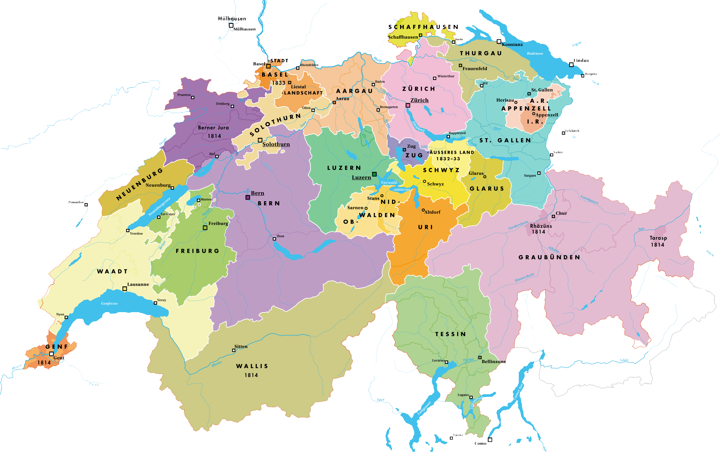
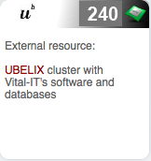
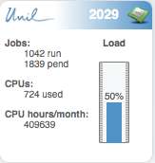
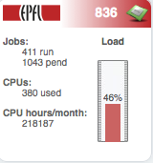
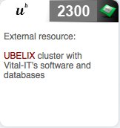
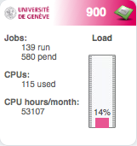
Vital-IT in CH
Interfaculty
Bioinformatics
Unit

Slide 10
HPC – Vital-IT – Bern
Vital–IT Archive Storage
Local Storage
Local Storage
Local Storage
Local Storage
Local Storage
UniL
3380 Cores
EPFL
792
Cores
UniGe
1016
Cores
UniBe (UBELIX)
6600
Cores
IBU UniBe
700
Cores

Slide 11
HPC – Vital-IT – Bern
Vital–IT Archive Storage
comprehensive software repository
daily synchronization
Local Storage
Local Storage
Local Storage
Local Storage
Local Storage
UniL
3380 Cores
EPFL
792
Cores
UniGe
1016
Cores
UniBe (UBELIX)
6600
Cores
IBU UniBe
700
Cores

Slide 12
HPC Ubelix and IBU in Bern
UniBE
Archive
comprehensive software repository
Local Storage
Local Storage
UniBe (UBELIX)
6600
Cores
IBU UniBe
700
Cores

Slide 13
Software and Hardware Resources
Comprehensive software library
UniBern and Bioinf Bern will have (almost) the same installation as Vital-IT
code/pipelines should work on all clusters
different job schedulers
different Linux distributions and different architecture
commercial software not available at all sites
Requests for software installations: charged by the hour (CHF69)
Use of Vital-IT
archive: CHF 368/TB per year
storage: CHF 186/TB per year
CPU: CHF 0.025 per CPU hour

Slide 14
UniBE future software (and Hardware) Resources
Software installation efforts shared between SIB corefacilties?
Since 1.1.2018 SNSF; will be enforced as of 1.1.2019
Use of IBU and Ubelix:
SNSF requires a cost model from every core facility
IBU (and Ubelix) currently work with UniBe to establish a cost model
Changes will take effect 1.1.2019, i.e. bills will be sent to all users of IBU

Slide 15
NGS - Facility
1 Illumina HiSeq3000
1 Illumina NovaSeq6000
1 MiSeq
1 PacBio Sequel

