Slide 1
Low Level Parking System
by Eeshan Chanpura
Pre Final Year Student
Language : Python

Slide 2
Introduction.
This repository gives an overview of how we can design a basic parking lot in Python. It creates parking lot with given number of slots. The cars follow Greedy approach while being parked in the slots.
Github Link: https://github.com/Eeshan2001/Low-Level-Parking-Lot-System

Slide 3
Admin can use following command to control the Parking System
LowLevel_ParkingSystem.py script defines the following functions -
create_parking_lot n - Given n number of slots, create a parking lot
park car_number car_color - Parks a vehicle with given registration number and color in the nearest empty slot possible. If there are no more empty slots available, it shows a message "Sorry, parking lot is full".
status - Prints the slot number, registration number and color of the parked vehicles.
leave x - Removes vehicle from slot number x
check_car_number_with_carcolor car_color - this will display All car number with same color
check_slot_number_with_carcolor car_color - this will display All filled slots with same color
check_slot_number_with_carno car_no - this will display slot alloted to car_number

Slide 4
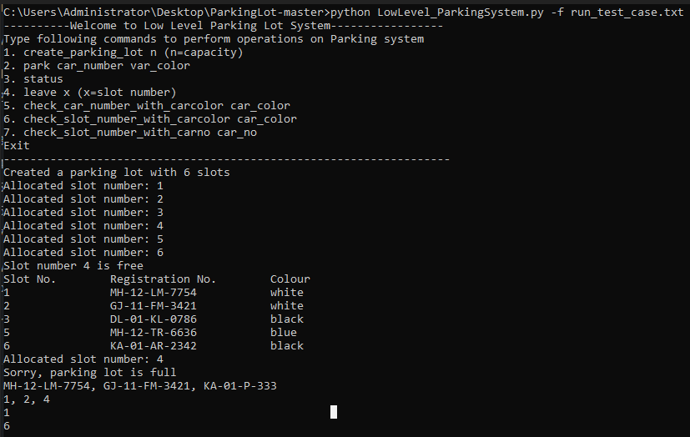
LowLevel_ParkingSystem.py can be run through shell or through file containing test cases. Vehicle.py is a separate class where we can define the type of vehicles that can be parked. it only contains class Car.
An example file run_test_case.txt has been provided in repo.
To run with a file execute python LowLevel_ParkingSystem.py -f run_test_case.txt‘

Slide 5
Thank You

