Slide 1
Analysis & Design of Algorithms
BCS401

Slide 2
Module-3
TRANSFORM-AND-CONQUER,
SPACE-TIME TRADEOFFS

Slide 3
TRANSFORM & CONQUER
Introduction
A group of design methods that are based on the idea of transformation.
We call this general technique transform-and-conquer because these methods work as two-stage procedures.
First, in the transformation stage, the problem’s instance is modified to be, for one reason or another, more amenable to solution.
Then, in the second or conquering stage, it is solved.
There are three major variations of this idea that differ by what we transform a given instance to (Figure 6.1):

Slide 4
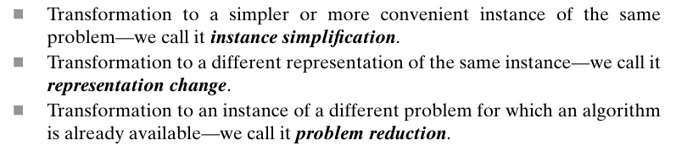
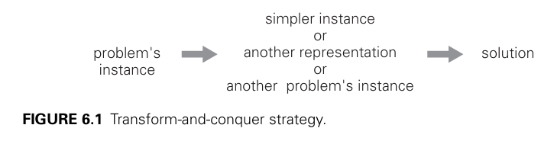
TRANSFORM & CONQUER

Slide 5
TRANSFORM & CONQUER
Introduction
The ideas of instance simplification and representation change are applied to search trees.
The results are AVL trees and multiway balanced search trees
The heaps and heapsort.
Even if you are already familiar with this important data structure and its application to sorting, you can still benefit from looking at them in this new light of transform-and-conquer design.

Slide 6
TRANSFORM & CONQUER
Balanced Search Trees
The binary search tree—one of the principal data structures for implementing dictionaries.
It is a binary tree whose nodes contain elements of a set of orderable items, one element per node, so that all elements in the left subtree are smaller than the element in the subtree’s root, and all the elements in the right subtree are greater than it.
Note that this transformation from a set to a binary search tree is an example of the representation – change technique.

Slide 7
TRANSFORM & CONQUER
Balanced Search Trees
Computer scientists have expended a lot of effort in trying to find a structure that preserves the good properties of the classical binary search tree—principally, the logarithmic efficiency of the dictionary operations and having the set’s elements sorted—but avoids its worst-case degeneracy.
They have come up with two approaches.
The first approach is of the instance-simplification variety: an unbalanced binary search tree is transformed into a balanced one.
Because of this, such trees are called self-balancing
An AVL tree requires the difference between the heights of the left and right subtrees of every node to never exceed 1.

Slide 8
TRANSFORM & CONQUER
Balanced Search Trees
An AVL tree requires the difference between the heights of the left and right subtrees of every node to never exceed 1.
A red-black tree tolerates the height of one subtree being twice as large as the other subtree of the same node.
If an insertion or deletion of a new node creates a tree with a violated balance requirement, the tree is restructured by one of a family of special transformations called rotations that restore the balance required.

Slide 9
TRANSFORM & CONQUER
Balanced Search Trees
The second approach is of the representation-change variety: allow more than one element in a node of a search tree.
Specific cases of such trees are 2-3 trees, 2-3-4 trees, and more general and important B-trees.
They differ in the number of elements admissible in a single node of a search tree, but all are perfectly balanced.

Slide 10
TRANSFORM & CONQUER
AVL Trees
An AVL tree is a binary search tree in which the balance factor of every node, which is defined as the difference between the heights of the node’s left and right subtrees, is either 0 or +1 or −1.
The height of the empty tree is defined as −1.
Of course, the balance factor can also be computed as the difference between the number of levels rather than the height difference of the node’s left and right subtrees.
Consider the figure.

Slide 11
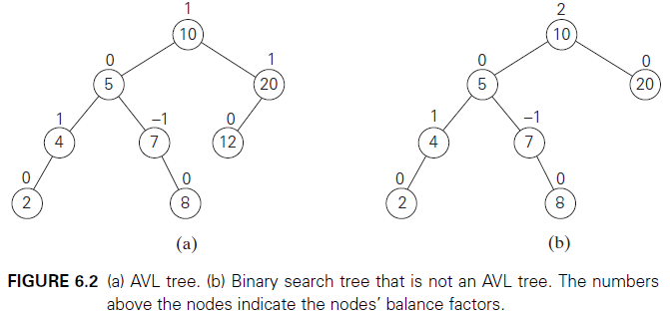
TRANSFORM & CONQUER
AVL Trees
For example, the binary search tree in Figure 6.2a is an AVL tree but the one in Figure 6.2b is not.

Slide 12
TRANSFORM & CONQUER
AVL Trees
If an insertion of a new node makes an AVL tree unbalanced, we transform the tree by a rotation.
A rotation in an AVL tree is a local transformation of its subtree rooted at a node whose balance has become either +2 or −2.
If there are several such nodes, we rotate the tree rooted at the unbalanced node that is the closest to the newly inserted leaf.
There are only four types of rotations; in fact, two of them are mirror images of the other two. In their simplest form, the four rotations are shown in Figure 6.3.

Slide 13
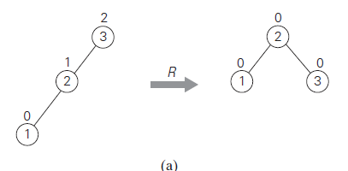
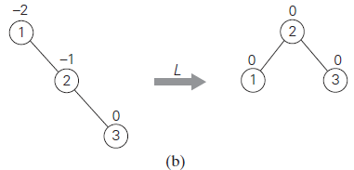
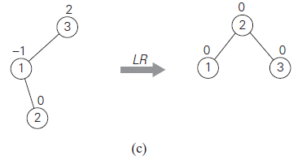
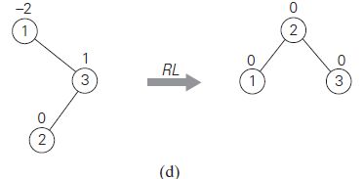
TRANSFORM & CONQUER
AVL Trees
FIGURE 6.3 Four rotation types for AVL trees with three nodes. (a) Single R-rotation. (b) Single L- rotation. (c) Double LR-rotation. (d) Double RL-rotation.

Slide 14
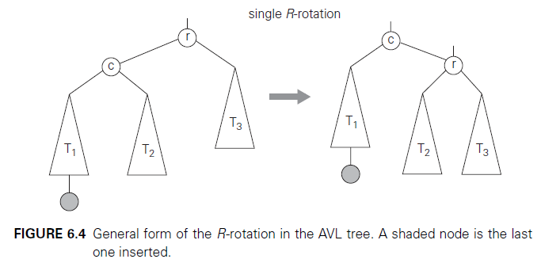
TRANSFORM & CONQUER
AVL Trees
The first rotation type is called the single right rotation, or R-rotation.
Imagine rotating the edge connecting the root and its left child in the binary tree in
Figure 6.3a to the right. Figure 6.4 presents the single R-rotation in its most general form.

Slide 15
TRANSFORM & CONQUER
AVL Trees
Note that this rotation is performed after a new key is inserted into the left subtree of the left child of a tree whose root had the balance of +1 before the insertion.
The symmetric single left rotation, or L-rotation, is the mirror image of the single R-rotation.
It is performed after a new key is inserted into the right subtree of the right child of a tree whose root had the balance of −1 before the insertion.
Note that this rotation is performed after a new key is inserted into the left subtree of the left child of a tree whose root had the balance of +1 before the insertion.

Slide 16
TRANSFORM & CONQUER
AVL Trees
The second rotation type is called the double left-right rotation (LR - rotation).
It is, in fact, a combination of two rotations: we perform the L-rotation of the left subtree of root r followed by the R-rotation of the new tree rooted at r (Figure 6.5).
It is performed after a new key is inserted into the right subtree of the left child of a tree whose root had the balance of +1 before the insertion.

Slide 17
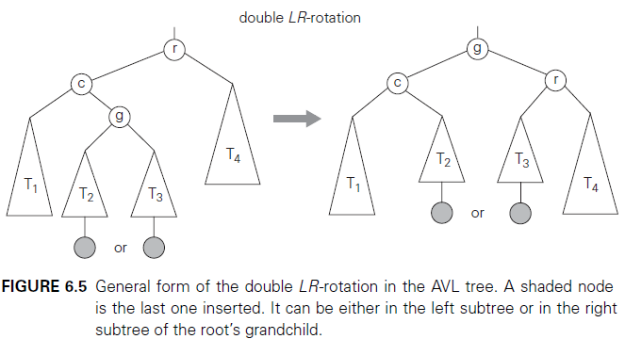
TRANSFORM & CONQUER
AVL Trees
The double right-left rotation (RL-rotation) is the mirror image of the double LR-rotation and is left for the exercises. Note that the rotations are not trivial transformations, though fortunately they can be done in constant time.

Slide 18
TRANSFORM & CONQUER
AVL Trees
Not only should they guarantee that a resulting tree is balanced, but they should also preserve the basic requirements of a binary search tree.
For example, in the initial tree of Figure 6.4, all the keys of subtree T1 are smaller than c, which is smaller than all the keys of subtree T2, which are smaller than r, which is smaller than all the keys of subtree T3. And the same relationships among the key values hold, as they must, for the balanced tree after the rotation.
An example of constructing an AVL tree for a given list of numbers is shown in Figure 6.6.

Slide 19
TRANSFORM & CONQUER
AVL Trees
An example of constructing an AVL tree for a given list of numbers is shown in Figure 6.6.
As you trace the algorithm’s operations, keep in mind that if there are several nodes with the ±2 balance, the rotation is done for the tree rooted at the unbalanced node that is the closest to the newly inserted leaf.

Slide 20
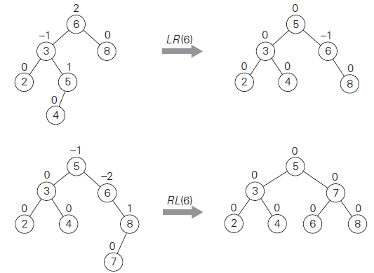
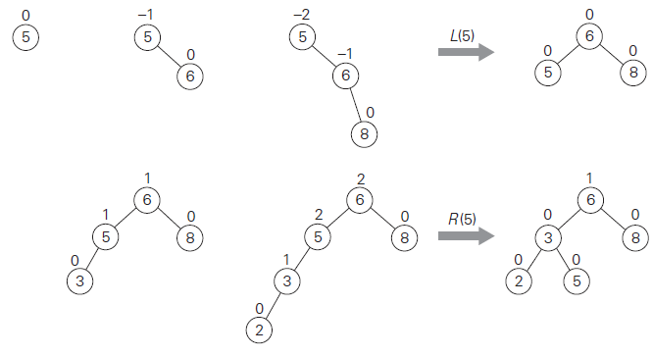

TRANSFORM & CONQUER
AVL Trees

Slide 21
TRANSFORM & CONQUER
AVL Trees
Construct AVL tree for B, C, G, E, F, D, A by successive iterations.

Slide 22
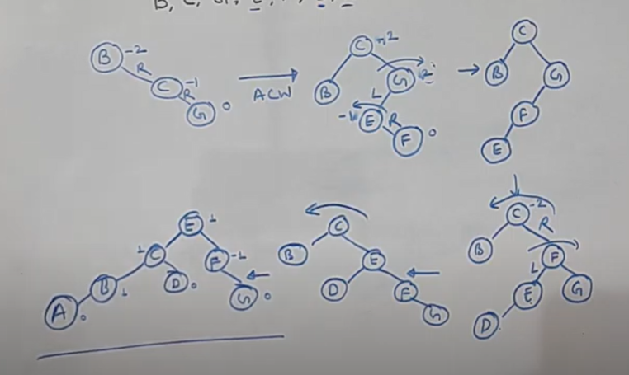
TRANSFORM & CONQUER
AVL Trees
Construct AVL tree for B, C, G, E, F, D, A successively.

Slide 23
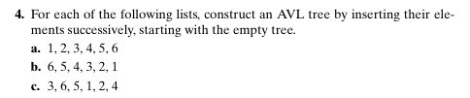
TRANSFORM & CONQUER
AVL Trees

Slide 24
TRANSFORM & CONQUER
AVL Trees
How efficient are AVL trees?
As with any search tree, the critical characteristic is the tree’s height.
It turns out that it is bounded both above and below by logarithmic functions.
Specifically, the height h of any AVL tree with n nodes satisfies the inequalities.

Slide 25
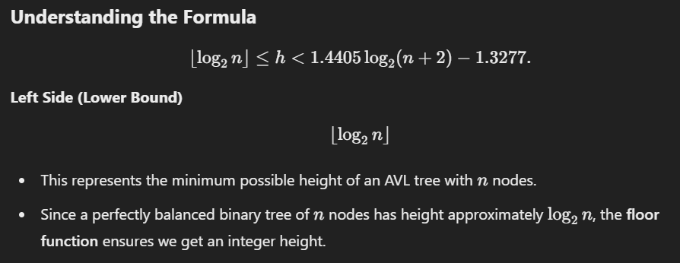
TRANSFORM & CONQUER

Slide 26
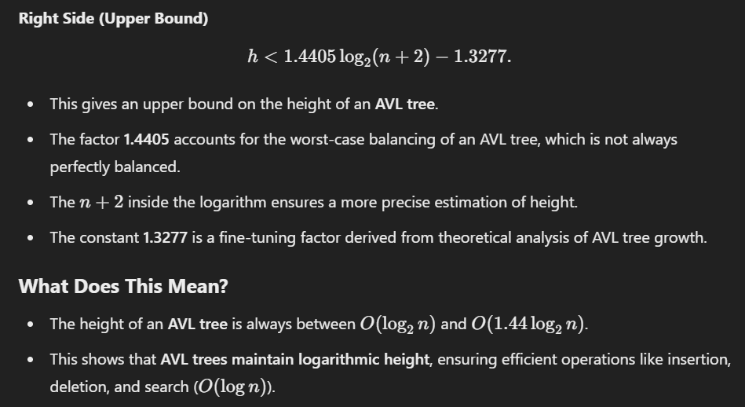
TRANSFORM & CONQUER

Slide 27
TRANSFORM & CONQUER
AVL Trees
The inequalities immediately imply that the operations of searching and insertion are in the worst case.
Searching in an AVL tree requires, on average, almost the same number of comparisons as searching in a sorted array by binary search.

Slide 28
TRANSFORM & CONQUER
AVL Trees
The operation of key deletion in an AVL tree is considerably more difficult than insertion, but fortunately it turns out to be in the same efficiency class as insertion, i.e., logarithmic.
The drawbacks of AVL trees are frequent rotations and the need to maintain balances for its nodes.
These drawbacks have prevented AVL trees from becoming the standard structure for implementing dictionaries.
At the same time, their underlying idea — that of rebalancing a binary search tree via rotations—has proved to be very fruitful and has led to discoveries of other interesting variations of the classical binary search tree.

Slide 29
TRANSFORM & CONQUER
2-3 Trees
The second idea of balancing a search tree is to allow more than one key in the same node of such a tree
A 2-3 tree is a tree that can have nodes of two kinds: 2-nodes and 3-nodes.
A 2-node contains a single key K and has two children: the left child serves as the root of a subtree whose keys are less than K, and the right child serves as the root of a subtree whose keys are greater than K.
A 3-node contains two ordered keys K1 and K2 (K1<K2) and has three children.
The leftmost child serves as the root of a subtree with keys less than K1, the middle child serves as the root of a subtree with keys between K1 and K2, and the rightmost child serves as the root of a subtree with keys greater than K2 (Figure 6.7).

Slide 30
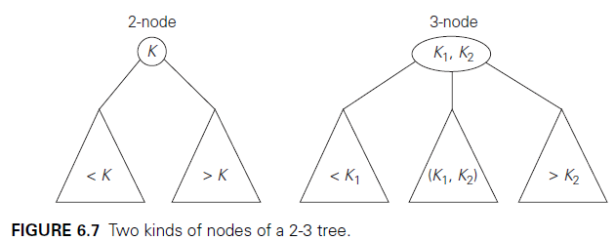
TRANSFORM & CONQUER
2-3 Trees
The last requirement of the 2-3 tree is that all its leaves must be on the same level.
In other words, a 2-3 tree is always perfectly height-balanced: the length of a path from the root to a leaf is the same for every leaf. We “ buy “ this property by allowing more than one key in the same node of a search tree.
Searching for a given key K in a 2-3 tree is quite straightforward. We start at the root.
If the root is a 2-node, we act as if it were a binary search tree: we either stop if K is equal to the root’s key or continue the search in the left or right subtree if K is, respectively, smaller or larger than the root’s key.

Slide 31
TRANSFORM & CONQUER
2-3 Trees
If the root is a 2-node, we either stop if K is equal to the root’s key or continue the search in the left or right subtree if K is, respectively, smaller or larger than the root’s key.
If the root is a 3-node, we know after no more than two key comparisons whether the search can be stopped (if K is equal to one of the root’s keys) or in which of the root’s three subtrees it needs to be continued.

Slide 32
TRANSFORM & CONQUER
2-3 Trees
Inserting a new key in a 2-3 tree is done as follows.
First of all, we always insert a new key K in a leaf, except for the empty tree.
The appropriate leaf is found by performing a search for K.
If the leaf in question is a 2-node, we insert K there as either the first or the second key, depending on whether K is smaller or larger than the node’s old key.
If the leaf is a 3-node, we split the leaf in two: the smallest of the three keys (two old ones and the new key) is put in the first leaf, the largest key is put in the second leaf, and the middle key is promoted to the old leaf’s parent.

Slide 33
TRANSFORM & CONQUER
2-3 Trees
If the leaf happens to be the tree’s root, a new root is created to accept the middle key.
Note that promotion of a middle key to its parent can cause the parent’s overflow (if it was a 3-node) and hence can lead to several node splits along the chain of the leaf’s ancestors.
An example of a 2-3 tree construction is given in Figure 6.8.

Slide 34
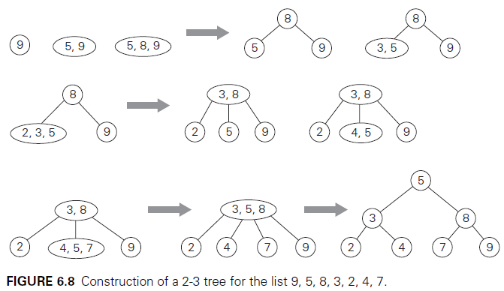
TRANSFORM & CONQUER
2-3 Trees

Slide 35
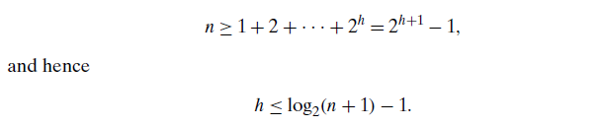
TRANSFORM & CONQUER
2-3 Trees
As for any search tree, the efficiency of the dictionary operations depends on the tree’s height. So let us first find an upper bound for it.
A 2-3 tree of height h with the smallest number of keys is a full tree of 2-nodes (such as the final tree in Figure 6.8 for h = 2). Therefore, for any 2-3 tree of height h with n nodes, we get the inequality

Slide 36

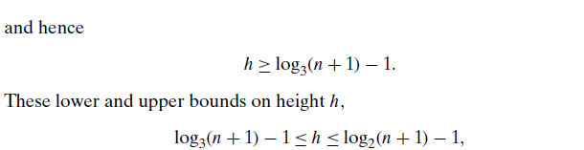
TRANSFORM & CONQUER
2-3 Trees
On the other hand, a 2-3 tree of height h with the largest number of keys is a full tree of 3-nodes, each with two keys and three children. Therefore, for any 2-3 tree with n nodes,
imply that the time efficiencies of searching, insertion, and deletion are all in
in both the worst and average case.

Slide 37
TRANSFORM & CONQUER
Heaps
The data structure called the “heap” is a partially ordered data structure that is especially suitable for implementing priority queues.
Recall that a priority queue is a multiset of items with an orderable characteristic called an item’s priority, with the following operations:
            finding an item with the highest (i.e., largest) priority
            deleting an item with the highest priority
            adding a new item to the multiset

Slide 38
TRANSFORM & CONQUER
Heaps
It is primarily an efficient implementation of these operations that makes the heap both interesting and useful.
The heap is also the data structure that serves as a cornerstone of a theoretically important sorting algorithm called heapsort.

Slide 39
TRANSFORM & CONQUER
Heaps
A heap can be defined as a binary tree with keys assigned to its nodes, one key per node, provided the following two conditions are met:
The shape property—the binary tree is essentially complete (or simply complete), i.e., all its levels are full except possibly the last level, where only some rightmost leaves may be missing.
The parental dominance or heap property—the key in each node is greater than or equal to the keys in its children. (This condition is considered automatically satisfied for all leaves.)

Slide 40
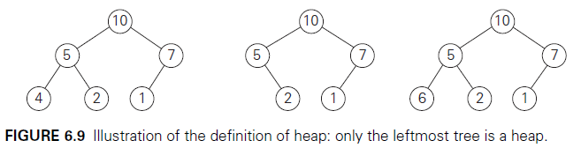
TRANSFORM & CONQUER
Heaps
For example, consider the trees of Figure 6.9.
The first tree is a heap.
The second one is not a heap, because the tree’s shape property is violated.
And the third one is not a heap, because the parental dominance fails for the node with key 5.

Slide 41
TRANSFORM & CONQUER
Heaps
Note that key values in a heap are ordered top down; i.e., a sequence of values on any path from the root to a leaf is decreasing (non-increasing, if equal keys are allowed).
However, there is no left-to-right order in key values; i.e., there is no relationship among key values for nodes either on the same level of the tree or, more generally, in the left and right subtrees of the same node.
Here is a list of important properties of heaps, which are not difficult to prove (check these properties for the heap of Figure 6.10, as an example).

Slide 42
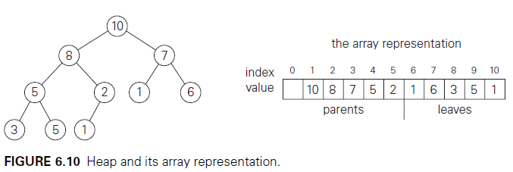
TRANSFORM & CONQUER
Heaps
There exists exactly one essentially complete binary tree with n nodes.
Its height is equal to log₂ n.
3. The root of a heap always contains its largest element.
4. A node of a heap considered with all its descendants is also a heap.

Slide 43
TRANSFORM & CONQUER
Heaps
4. A heap can be implemented as an array by recording its elements in the top-down, left-to-right fashion.
It is convenient to store the heap’s elements in positions 1 through n of such an array, leaving H[0] either unused or putting there a sentinel whose value is greater than every element in the heap. In such a representation,
    a. the parental node keys will be in the first n/2 positions of the array, while the leaf keys will occupy the last n/2 positions;
    b. the children of a key in the array’s parental position i (1≤ i ≤ n/2) will be in positions 2i and 2i + 1, and, correspondingly, the parent of a key in position i (2 ≤ i ≤ n) will be in position i/2.

Slide 44
TRANSFORM & CONQUER
Heaps
Thus, we could also define a heap as an array H[1..n] in which every element in position i in the first half of the array is greater than or equal to the elements in positions 2i and 2i + 1, i.e.,
How can we construct a heap for a given list of keys? There are two principal alternatives for doing this.
The first is the bottom-up heap construction algorithm illustrated in Figure 6.11.

Slide 45
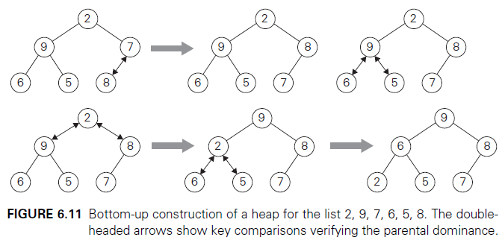
TRANSFORM & CONQUER
Heaps
It initializes the essentially complete binary tree with n nodes by placing keys in the order given and then “heapifies” the tree as follows.

Slide 46
TRANSFORM & CONQUER
Heaps
Starting with the last parental node, the algorithm checks whether the parental dominance holds for the key in this node.
This process continues until the parental dominance for K is satisfied. (Eventually, it has to because it holds automatically for any key in a leaf.)
After completing the “heapification” of the subtree rooted at the current parental node, the algorithm proceeds to do the same for the node’s immediate predecessor.
The algorithm stops after this is done for the root of the tree.

Slide 47
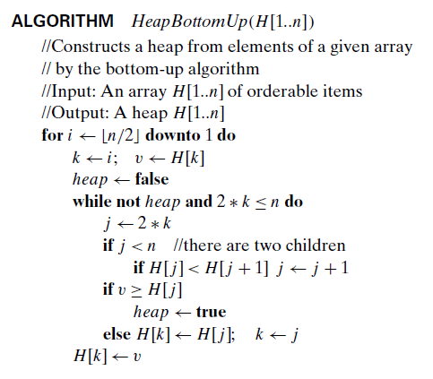
TRANSFORM & CONQUER
Heaps

Slide 48
TRANSFORM & CONQUER
Heaps
How efficient is this algorithm in the worst case?
Assume, for simplicity, that n = 2^{k} − 1 so that a heap’s tree is full, i.e., the largest possible number of nodes occurs on each level.
Let h be the height of the tree.
According to the first property of heaps in the list at the beginning of the section,
for the specific values of n we are considering.
Each key on level i of the tree will travel to the leaf level h in the worst case of the heap construction algorithm.

Slide 49

TRANSFORM & CONQUER
Heaps
Since moving to the next level down requires two comparisons—one to find the larger child and the other to determine whether the exchange is required—the total number of key comparisons involving a key on level i will be 2(h − i).
Therefore, the total number of key comparisons in the worst case will be
where the validity of the last equality can be proved either by using the closed-form formula for the sum or by mathematical induction on h.
Thus, with this bottom-up algorithm, a heap of size n can be constructed with fewer than 2n comparisons.

Slide 50
TRANSFORM & CONQUER
Heaps
The alternative (and less efficient) algorithm constructs a heap by successive insertions of a new key into a previously constructed heap; some people call it the top-down heap construction algorithm.
So how can we insert a new key K into a heap?
First, attach a new node with key K in it after the last leaf of the existing heap.
Then shift K up to its appropriate place in the new heap as follows.
Compare K with its parent’s key: if the latter is greater than or equal to K, stop (the structure is a heap); otherwise, swap these two keys and compare K with its new parent.

Slide 51
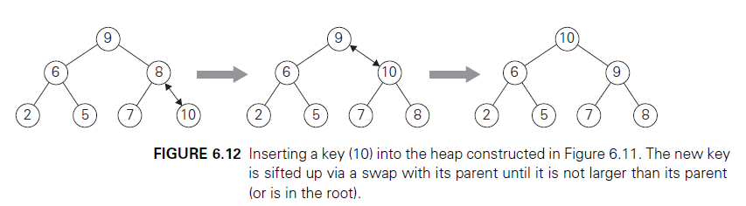
TRANSFORM & CONQUER
Heaps
This swapping continues until K is not greater than its last parent or it reaches the root (illustrated in Figure 6.12).
The insertion operation cannot require more key comparisons than the heap’s height.
Since the height of a heap with n nodes is about log₂n, the time efficiency of insertion is in O(log n).

Slide 52
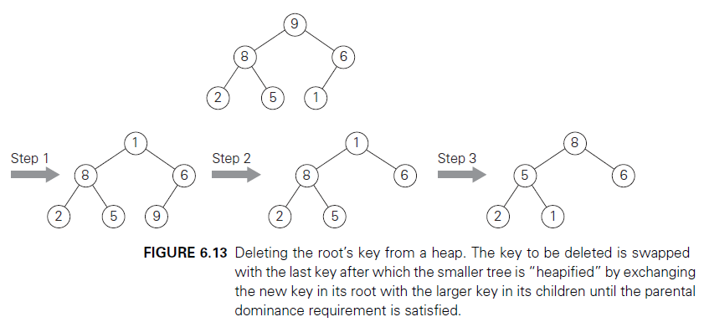
TRANSFORM & CONQUER
Heaps
How can we delete an item from a heap? (only deleting the root’s key considered)
Deleting the root’s key from a heap can be done with the following algorithm, illustrated in Figure 6.13.

Slide 53
TRANSFORM & CONQUER
Heaps
Maximum Key Deletion from a heap
Step 1 Exchange the root’s key with the last key K of the heap.
Step 2 Decrease the heap’s size by 1.
Step 3 “Heapify” the smaller tree by sifting K down the tree exactly in the same way we did it in the bottom-up heap construction algorithm. That is, verify the parental dominance for K: if it holds, we are done; if not, swap K with the larger of its children and repeat this operation until the parental dominance condition holds for K in its new position.

Slide 54
TRANSFORM & CONQUER
Heaps
The efficiency of deletion is determined by the number of key comparisons needed to “heapify” the tree after the swap has been made and the size of the tree is decreased by 1.
Since this cannot require more key comparisons than twice the heap’s height, the time efficiency of deletion is in O(log n) as well.

Slide 55
TRANSFORM & CONQUER
Heapsort
Heapsort—an interesting sorting algorithm discovered by J. W. J. Williams [Wil64]. This is a two-stage algorithm that works as follows.
Stage 1 (heap construction): Construct a heap for a given array.
Stage 2 (maximum deletions): Apply the root-deletion operation n − 1 times to the remaining heap.
As a result, the array elements are eliminated in decreasing order.
But since under the array implementation of heaps an element being deleted is placed last, the resulting array will be exactly the original array sorted in increasing order.

Slide 56
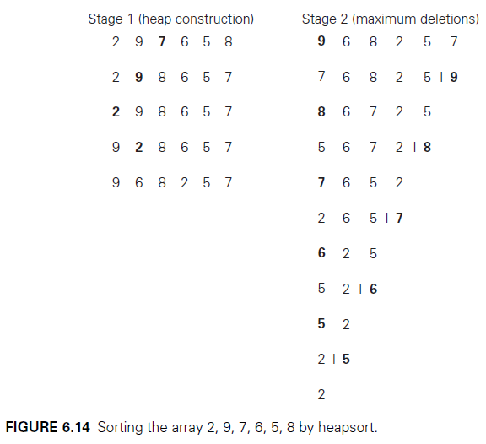
TRANSFORM & CONQUER
Heapsort
Heapsort is traced on a specific input in Figure 6.14.

Slide 57
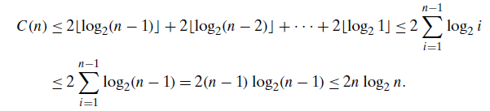
TRANSFORM & CONQUER
Heapsort
Since we already know that the heap construction stage of the algorithm is in O(n), we have to investigate just the time efficiency of the second stage.
For the number of key comparisons, C(n), needed for eliminating the root keys from the heaps of diminishing sizes from n to 2, we get the following inequality:
This means that C(n) ∈ O(n log n) for the second stage of heapsort. For both stages, we get O(n) + O(n log n) = O(n log n).

Slide 58
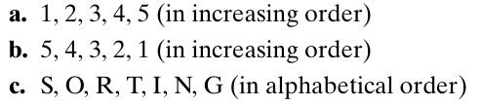
Questions for practice
Construct a heap for the list 1, 8, 6, 5, 3, 7, 4 by the bottom-up algorithm.
Construct a heap for the list 1, 8, 6, 5, 3, 7, 4 by successive key insertions (top-down algorithm)
Sort the following lists by heap sort by using the array representation of heaps.

Slide 59
Space and Time Trade-Offs

Slide 60
Space and Time Trade-Offs
Space and time trade-offs in algorithm design are a well-known issue for both
theoreticians and practitioners of computing.
Consider, as an example, the problem of computing values of a function at many points in its domain.
If it is time that is at a premium, we can precompute the function’s values and store them in a table.

Slide 61
Space and Time Trade-Offs
The idea is to preprocess the problem’s input, in whole or in part, and store the additional information obtained to accelerate solving the problem afterward.
We call this approach input enhancement and discuss the following algorithms based on it:
Counting methods for sorting
Boyer-Moore algorithm for string matching and its simplified version suggested by Horspool

Slide 62
Space and Time Trade-Offs
The other type of technique that exploits space-for-time trade-offs simply uses extra space to facilitate faster and/or more flexible access to the data.
We call this approach prestructuring.
There is one more algorithm design technique related to the space-for-time
trade-off idea: dynamic programming.
This strategy is based on recording solutions to overlapping sub problems of a given problem in a table from which a solution to the problem in question is then obtained.

Slide 63
Space and Time Trade-Offs
Two final comments about the interplay between time and space in algorithm design need to be made.
First, the two resources—time and space—do not have to compete with each other in all design situations.
In fact, they can align to bring an algorithmic solution that minimizes both the running time and the space consumed.
Such a situation arises, in particular, when an algorithm uses a space efficient data structure to represent a problem’s input, which leads, in turn, to a faster algorithm.
Consider, as an example, the problem of traversing graphs.

Slide 64


Space and Time Trade-Offs
Recall that the time efficiency of the two principal traversal algorithms—depth-first search and breadth-first search—depends on the data structure used for representing graphs: it is for the adjacency matrix representation and for the adjacency list representation, where n and m are the numbers of vertices and edges, respectively.
If input graphs are sparse, i.e., have few edges relative to the number of vertices (say, m ∈ O(n)), the adjacency list representation may well be more efficient from both the space and the running-time points of view.

Slide 65
Space and Time Trade-Offs
Second, one cannot discuss space-time trade-offs without mentioning the hugely important area of data compression.
Note, however, that in data compression, size reduction is the goal rather than a technique for solving another problem.

Slide 66
Space and Time Trade-Offs
Sorting by Counting
As a first example of applying the input-enhancement technique, we discuss its application to the sorting problem.
One rather obvious idea is to count, for each element of a list to be sorted, the total number of elements smaller than this element and record the results in a table.
These numbers will indicate the positions of the elements in the sorted list: e.g., if the count is 10 for some element, it should be in the 11th position (with index 10, if we start counting with 0) in the sorted array.

Slide 67
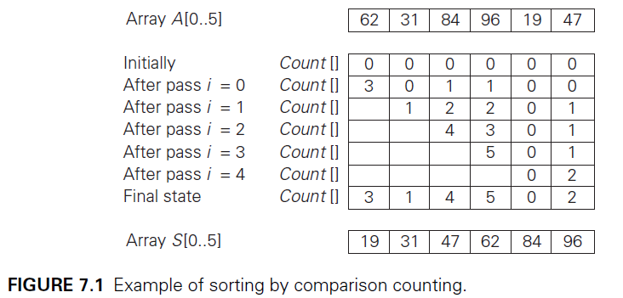
Space and Time Trade-Offs
Sorting by Counting
Thus, we will be able to sort the list by simply copying its elements to their appropriate positions in a new, sorted list.
This algorithm is called comparison counting sort (Figure 7.1).

Slide 68
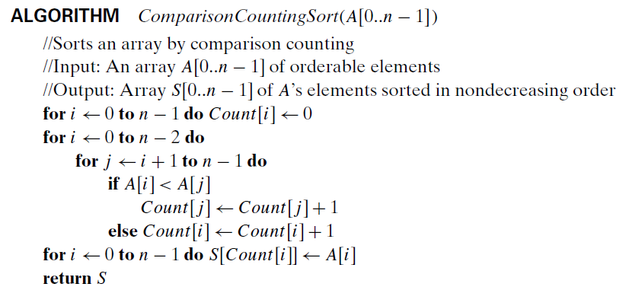
Space and Time Trade-Offs
Sorting by Counting

Slide 69

Space and Time Trade-Offs
Sorting by Counting
What is the time efficiency of this algorithm?
It should be quadratic because the algorithm considers all the different pairs of an n-element array.
More formally, the number of times its basic operation, the comparison A[i]<A[j ], is executed is equal to the sum we have encountered several times already:

Slide 70
Space and Time Trade-Offs
Sorting by Counting
Thus, the algorithm makes the same number of key comparisons as selection sort and in addition uses a linear amount of extra space.
On the positive side, the algorithm makes the minimum number of key moves possible, placing each of them directly in their final position in a sorted array.
The counting idea does work productively in a situation in which elements to be sorted belong to a known small set of values.
Assume, for example, that we have to sort a list whose values can be either 1 or 2.

Slide 71
Space and Time Trade-Offs
Sorting by Counting
Rather than applying a general sorting algorithm, we should be able to take advantage of this additional information about values to be sorted.
We can scan the list to compute the number of 1’s and the number of 2’s in it and then, on the second pass, simply make the appropriate number of the first elements equal to 1 and the remaining elements equal to 2.
More generally, if element values are integers between some lower bound l and upper bound u, we can compute the frequency of each of those values and store them in array F[0..u − l].

Slide 72
Space and Time Trade-Offs
Sorting by Counting
Then the first F[0] positions in the sorted list must be filled with l, the next F[1] positions with l + 1, and so on.
All this can be done, of course, only if we can overwrite the given elements.
Let us consider a more realistic situation of sorting a list of items with some other information associated with their keys so that we cannot overwrite the list’s elements.
Then we can copy elements into a new array S[0..n−1]to hold the sorted list as follows.

Slide 73
Space and Time Trade-Offs
Sorting by Counting
The elements of A whose values are equal to the lowest possible value l are copied into the first F[0]elements of S, i.e., positions 0 through F[0]− 1; the elements of value l + 1 are copied to positions from F[0] to (F[0]+ F[1]) − 1; and so on.
Since such accumulated sums of frequencies are called a distribution in statistics, the method itself is known as distribution counting.

Slide 74
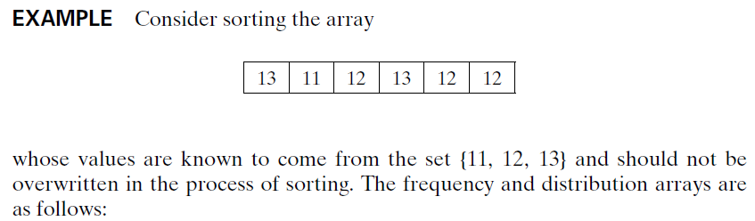
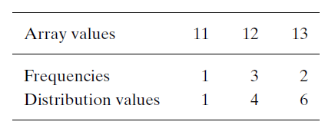
Space and Time Trade-Offs
Sorting by Counting

Slide 75
Space and Time Trade-Offs
Sorting by Counting
Note that the distribution values indicate the proper positions for the last occurrences of their elements in the final sorted array.
If we index array positions from 0 to n − 1, the distribution values must be reduced by 1 to get corresponding element positions.
It is more convenient to process the input array right to left.
For the example, the last element is 12, and, since its distribution value is 4, we place this 12 in position 4 − 1= 3 of the array S that will hold the sorted list.

Slide 76
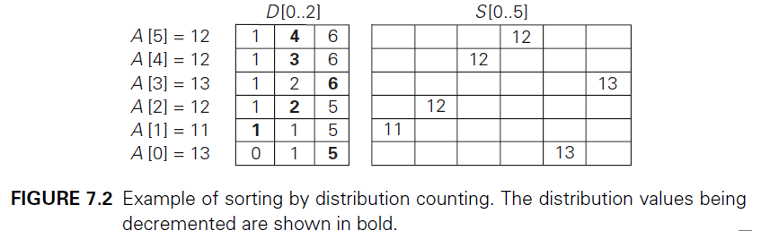
Space and Time Trade-Offs
Sorting by Counting
Then we decrease the 12’s distribution value by 1 and proceed to the next (from the right) element in the given array.
The entire processing of this example is depicted in Figure 7.2.

Slide 77
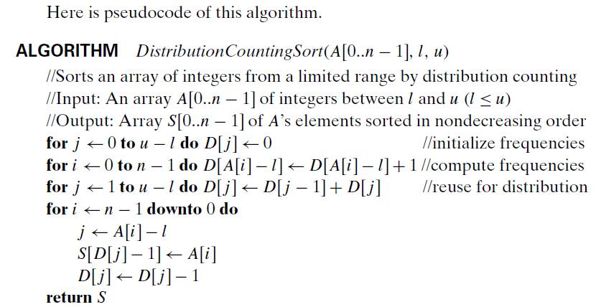
Space and Time Trade-Offs
Sorting by Counting

Slide 78
Space and Time Trade-Offs
Sorting by Counting
Assuming that the range of array values is fixed, this is obviously a linear algorithm because it makes just two consecutive passes through its input array A.
This is a better time-efficiency class than that of the most efficient sorting algorithms—merge sort, quicksort, and heapsort—we have encountered.
It is important to remember, however, that this efficiency is obtained by exploiting the specific nature of inputs for which sorting by distribution counting works, in addition to trading space for time.

Slide 79
Space and Time Trade-Offs
Space and time trade-offs in algorithm design are a well-known issue for both
theoreticians and practitioners of computing.
Consider, as an example, the problem of computing values of a function at many points in its domain.
If it is time that is at a premium, we can precompute the function’s values and store them in a table.

Slide 80
Space and Time Trade-Offs
The idea is to preprocess the problem’s input, in whole or in part, and store the additional information obtained to accelerate solving the problem afterward.
We call this approach input enhancement and discuss the following algorithms based on it:
Counting methods for sorting
Boyer-Moore algorithm for string matching and its simplified version suggested by Horspool

Slide 81
Space and Time Trade-Offs
The other type of technique that exploits space-for-time trade-offs simply uses extra space to facilitate faster and/or more flexible access to the data.
We call this approach prestructuring.
There is one more algorithm design technique related to the space-for-time
trade-off idea: dynamic programming.
This strategy is based on recording solutions to overlapping sub problems of a given problem in a table from which a solution to the problem in question is then obtained.

Slide 82
Space and Time Trade-Offs
Two final comments about the interplay between time and space in algorithm design need to be made.
First, the two resources—time and space—do not have to compete with each other in all design situations.
In fact, they can align to bring an algorithmic solution that minimizes both the running time and the space consumed.
Such a situation arises, in particular, when an algorithm uses a space efficient data structure to represent a problem’s input, which leads, in turn, to a faster algorithm.
Consider, as an example, the problem of traversing graphs.

Slide 83
Space and Time Trade-Offs
Recall that the time efficiency of the two principal traversal algorithms—depth-first search and breadth-first search—depends on the data structure used for representing graphs: it is for the adjacency matrix representation and for the adjacency list representation, where n and m are the numbers of vertices and edges, respectively.
If input graphs are sparse, i.e., have few edges relative to the number of vertices (say, m ∈ O(n)), the adjacency list representation may well be more efficient from both the space and the running-time points of view.

Slide 84
Space and Time Trade-Offs
Second, one cannot discuss space-time trade-offs without mentioning the hugely important area of data compression.
Note, however, that in data compression, size reduction is the goal rather than a technique for solving another problem.

Slide 85
Space and Time Trade-Offs
Sorting by Counting
As a first example of applying the input-enhancement technique, we discuss its application to the sorting problem.
One rather obvious idea is to count, for each element of a list to be sorted, the total number of elements smaller than this element and record the results in a table.
These numbers will indicate the positions of the elements in the sorted list: e.g., if the count is 10 for some element, it should be in the 11th position (with index 10, if we start counting with 0) in the sorted array.

Slide 86
Space and Time Trade-Offs
Sorting by Counting
Thus, we will be able to sort the list by simply copying its elements to their appropriate positions in a new, sorted list.
This algorithm is called comparison counting sort (Figure 7.1).

Slide 87
Space and Time Trade-Offs
Sorting by Counting

Slide 88
Space and Time Trade-Offs
Sorting by Counting
What is the time efficiency of this algorithm?
It should be quadratic because the algorithm considers all the different pairs of an n-element array.
More formally, the number of times its basic operation, the comparison A[i]<A[j ], is executed is equal to the sum we have encountered several times already:

Slide 89
Space and Time Trade-Offs
Sorting by Counting
Thus, the algorithm makes the same number of key comparisons as selection sort and in addition uses a linear amount of extra space.
On the positive side, the algorithm makes the minimum number of key moves possible, placing each of them directly in their final position in a sorted array.
The counting idea does work productively in a situation in which elements to be sorted belong to a known small set of values.
Assume, for example, that we have to sort a list whose values can be either 1 or 2.

Slide 90
Space and Time Trade-Offs
Sorting by Counting
Rather than applying a general sorting algorithm, we should be able to take advantage of this additional information about values to be sorted.
We can scan the list to compute the number of 1’s and the number of 2’s in it and then, on the second pass, simply make the appropriate number of the first elements equal to 1 and the remaining elements equal to 2.
More generally, if element values are integers between some lower bound l and upper bound u, we can compute the frequency of each of those values and store them in array F[0..u − l].

Slide 91
Space and Time Trade-Offs
Sorting by Counting
Then the first F[0] positions in the sorted list must be filled with l, the next F[1] positions with l + 1, and so on.
All this can be done, of course, only if we can overwrite the given elements.
Let us consider a more realistic situation of sorting a list of items with some other information associated with their keys so that we cannot overwrite the list’s elements.
Then we can copy elements into a new array S[0..n−1]to hold the sorted list as follows.

Slide 92
Space and Time Trade-Offs
Sorting by Counting
The elements of A whose values are equal to the lowest possible value l are copied into the first F[0]elements of S, i.e., positions 0 through F[0]− 1; the elements of value l + 1 are copied to positions from F[0] to (F[0]+ F[1]) − 1; and so on.
Since such accumulated sums of frequencies are called a distribution in statistics, the method itself is known as distribution counting.

Slide 93
Space and Time Trade-Offs
Sorting by Counting

Slide 94
Space and Time Trade-Offs
Sorting by Counting
Note that the distribution values indicate the proper positions for the last occurrences of their elements in the final sorted array.
If we index array positions from 0 to n − 1, the distribution values must be reduced by 1 to get corresponding element positions.
It is more convenient to process the input array right to left.
For the example, the last element is 12, and, since its distribution value is 4, we place this 12 in position 4 − 1= 3 of the array S that will hold the sorted list.

Slide 95
Space and Time Trade-Offs
Sorting by Counting
Then we decrease the 12’s distribution value by 1 and proceed to the next (from the right) element in the given array.
The entire processing of this example is depicted in Figure 7.2.

Slide 96
Space and Time Trade-Offs
Sorting by Counting

Slide 97
Space and Time Trade-Offs
Sorting by Counting
Assuming that the range of array values is fixed, this is obviously a linear algorithm because it makes just two consecutive passes through its input array A.
This is a better time-efficiency class than that of the most efficient sorting algorithms—merge sort, quicksort, and heapsort—we have encountered.
It is important to remember, however, that this efficiency is obtained by exploiting the specific nature of inputs for which sorting by distribution counting works, in addition to trading space for time.

Slide 98
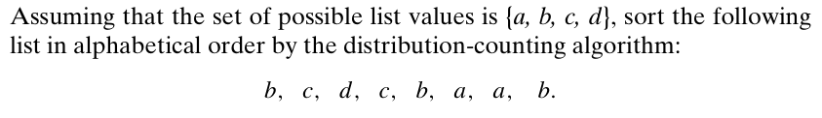
Questions for practice

Slide 99
Space and Time Trade-Offs

Slide 100
Space and Time Trade-Offs
Input Enhancement in String Matching
In this section, we see how the technique of input enhancement can be applied to the problem of string matching.
Recall that the problem of string matching requires finding an occurrence of a given string of m characters called the pattern in a longer string of n characters called the text.
We discussed the brute-force algorithm for this problem earlier: it simply matches corresponding pairs of characters in the pattern and the text left to right and, if a mismatch occurs, shifts the pattern one position to the right for the next trial.

Slide 101
Space and Time Trade-Offs
Input Enhancement in String Matching
Since the maximum number of such trials is n − m + 1 and, in the worst case, m comparisons need to be made on each of them, the worst-case efficiency of the brute-force algorithm is in the O(nm) class.
On average, however, we should expect just a few comparisons before a pattern’s shift, and for random natural-language texts, the average-case efficiency indeed turns out to be in O(n + m).
Several faster algorithms exploit the input-enhancement idea: preprocess the pattern to get some information about it, store this information in a table, and then use this information during an actual search for the pattern in a given text.

Slide 102
Space and Time Trade-Offs
Input Enhancement in String Matching
This is exactly the idea behind the two best-known algorithms of this type: the Knuth-Morris-Pratt algorithm and the Boyer-Moore algorithm.
The principal difference between these two algorithms lies in the way they compare characters of a pattern with their counterparts in a text: the Knuth-Morris-Pratt algorithm does it left to right, whereas the Boyer-Moore algorithm does it right to left.
Since the latter idea leads to simpler algorithms, it is the only one that we will pursue here.

Slide 103
Space and Time Trade-Offs
Input Enhancement in String Matching
Note that the Boyer-Moore algorithm starts by aligning the pattern against the beginning characters of the text; if the first trial fails, it shifts the pattern to the right.
It is comparisons within a trial that the algorithm does right to left, starting with the last character in the pattern.
Although the underlying idea of the Boyer-Moore algorithm is simple, its actual implementation in a working method is less so.

Slide 104
Space and Time Trade-Offs
Input Enhancement in String Matching
Therefore, we start our discussion with a simplified version of the Boyer-Moore algorithm suggested by R. Horspool.
In addition to being simpler, Horspool’s algorithm is not necessarily less efficient than the Boyer-Moore algorithm on random strings.

Slide 105

Space and Time Trade-Offs
Horspool’s Algorithm
Consider, as an example, searching for the pattern BARBER in some text:
Starting with the last R of the pattern and moving right to left, we compare the corresponding pairs of characters in the pattern and the text.
If all the pattern’s characters match successfully, a matching substring is found.
Then the search can be either stopped altogether or continued if another occurrence of the same pattern is desired.

Slide 106
Space and Time Trade-Offs
Horspool’s Algorithm
If a mismatch occurs, we need to shift the pattern to the right.
Clearly, we would like to make as large a shift as possible without risking the possibility of missing a matching substring in the text.
Horspool’s algorithm determines the size of such a shift by looking at the character c of the text that is aligned against the last character of the pattern.
This is the case even if character c itself matches its counterpart in the pattern.
In general, the following four possibilities can occur.

Slide 107
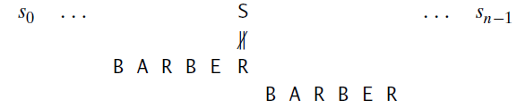
Space and Time Trade-Offs
Horspool’s Algorithm
Case 1 If there are no c’s in the pattern—e.g., c is letter S in our example—we can safely shift the pattern by its entire length (if we shift less, some character of the pattern would be aligned against the text’s character c that is known not to be in the pattern):

Slide 108
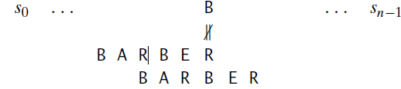
Space and Time Trade-Offs
Horspool’s Algorithm
Case 2 If there are occurrences of character c in the pattern but it is not the last one there—e.g., c is letter B in our example—the shift should align the rightmost occurrence of c in the pattern with the c in the text:

Slide 109
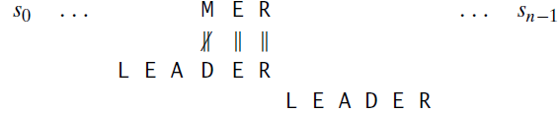
Space and Time Trade-Offs
Horspool’s Algorithm
Case 3 If c happens to be the last character in the pattern but there are no c’s among its other m − 1 characters—e.g., c is letter R in our example—the situation is similar to that of Case 1 and the pattern should be shifted by the entire pattern’s length m:

Slide 110
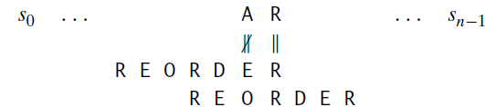
Space and Time Trade-Offs
Horspool’s Algorithm
Case 4 Finally, if c happens to be the last character in the pattern and there are other c’s among its first m − 1 characters—e.g., c is letter R in our example—the situation is similar to that of Case 2 and the rightmost occurrence of c among the first m − 1 characters in the pattern should be aligned with the text’s c:
These examples clearly demonstrate that right-to-left character comparisons can lead to farther shifts of the pattern than the shifts by only one position always made by the brute-force algorithm.

Slide 111
Space and Time Trade-Offs
Horspool’s Algorithm
Fortunately, the idea of input enhancement makes repetitive comparisons unnecessary.
We can precompute shift sizes and store them in a table.
The table will be indexed by all possible characters that can be encountered in a text, including, for natural language texts, the space, punctuation symbols, and other special characters.
The table’s entries will indicate the shift sizes computed by the formula.

Slide 112
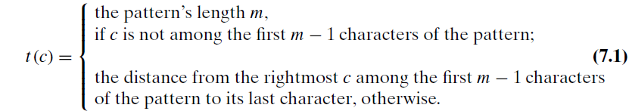
Space and Time Trade-Offs
Horspool’s Algorithm

Slide 113
Space and Time Trade-Offs
Horspool’s Algorithm
For example, for the pattern BARBER, all the table’s entries will be equal to 6, except for the entries for E, B, R, and A, which will be 1, 2, 3, and 4, respectively.
Here is a simple algorithm for computing the shift table entries.
Initialize all the entries to the pattern’s length m and scan the pattern left to right repeating the following step m − 1 times: for the jth character of the pattern (0 ≤ j ≤ m − 2), overwrite its entry in the table with m − 1− j , which is the character’s distance to the last character of the pattern.
Note that since the algorithm scans the pattern from left to right, the last overwrite will happen for the character’s rightmost occurrence—exactly as we would like it to be.

Slide 114
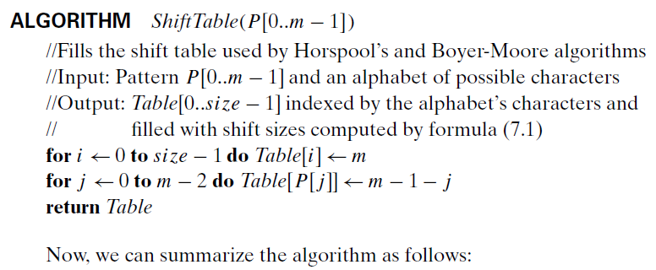
Space and Time Trade-Offs
Horspool’s Algorithm

Slide 115
Space and Time Trade-Offs
Horspool’s Algorithm
Now, we can summarize the algorithm as follows:
Step 1 For a given pattern of length m and the alphabet used in both the pattern and text, construct the shift table as described above.
Step 2 Align the pattern against the beginning of the text.
Step 3 Repeat the following until either a matching substring is found or the pattern reaches beyond the last character of the text.
Starting with the last character in the pattern, compare the corresponding characters in the pattern and text until either all m characters are matched (then stop) or a mismatching pair is encountered.

Slide 116
Space and Time Trade-Offs
Horspool’s Algorithm
In the latter case, retrieve the entry t (c) from the c’s column of the shift table where c is the text’s character currently aligned against the last character of the pattern, and shift the pattern by t (c) characters to the right along the text.

Slide 117
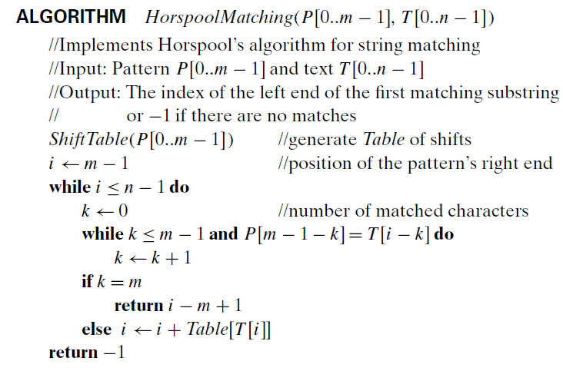
Space and Time Trade-Offs
Horspool’s Algorithm Here is pseudocode of Horspool’s algorithm.

Slide 118
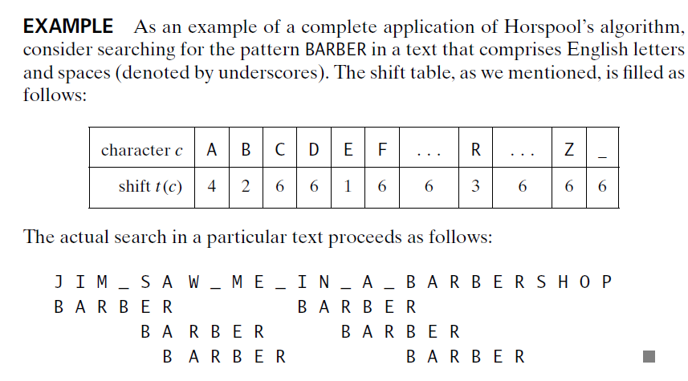
Space and Time Trade-Offs
Horspool’s Algorithm

Slide 119
Space and Time Trade-Offs
Horspool’s Algorithm
A simple example can demonstrate that the worst-case efficiency of Horspool’s algorithm is in O(nm).
But for random texts, it is in (n), and, although in the same efficiency class, Horspool’s algorithm is obviously faster on average than the brute-force algorithm.
In fact, as mentioned, it is often at least as efficient as its more sophisticated predecessor discovered by R. Boyer and J. Moore.

Slide 120
Space and Time Trade-Offs
Boyer-Moore Algorithm
Now we outline the Boyer-Moore algorithm itself.
If the first comparison of the rightmost character in the pattern with the corresponding character c in the text fails, the algorithm does exactly the same thing as Horspool’s algorithm.
Namely, it shifts the pattern to the right by the number of characters retrieved from the table precomputed as explained earlier.
The two algorithms act differently, however, after some positive number k (0<k<m) of the pattern’s characters are matched successfully before a mismatch is encountered:

Slide 121

Space and Time Trade-Offs
Boyer-Moore Algorithm
In this situation, the Boyer-Moore algorithm determines the shift size by considering two quantities.
The first one is guided by the text’s character c that caused a mismatch with its counterpart in the pattern. Accordingly, it is called the bad symbol shift.

Slide 122
Space and Time Trade-Offs
Boyer-Moore Algorithm
The reasoning behind this shift is the reasoning we used in Horspool’s algorithm.
If c is not in the pattern, we shift the pattern to just pass this c in the text.
Conveniently, the size of this shift can be computed by the formula t1(c) − k where t1(c) is the entry in the precomputed table used by Horspool’s algorithm and k is the number of matched characters:

Slide 123
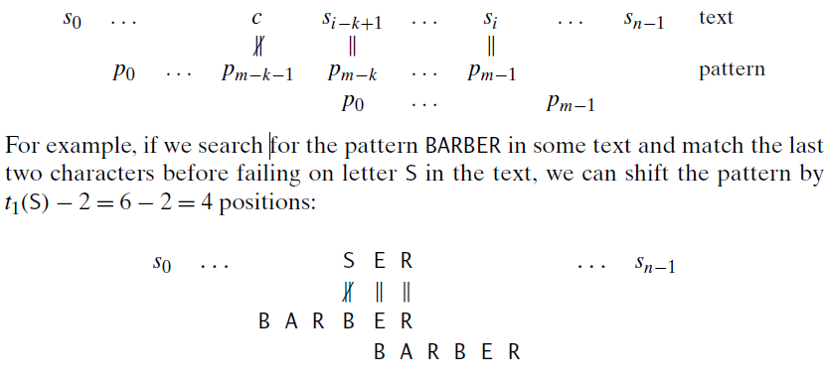
Space and Time Trade-Offs
Boyer-Moore Algorithm

Slide 124
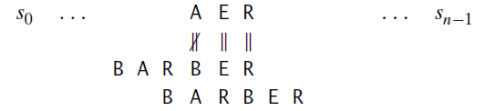
Space and Time Trade-Offs
Boyer-Moore Algorithm
The same formula can also be used when the mismatching character c of the text occurs in the pattern, provided t1(c) −k >0.
For example, if we search for the pattern BARBER in some text and match the last two characters before failing on letter A, we can shift the pattern by t1(A) − 2 = 4 − 2 = 2 positions:

Slide 125
Space and Time Trade-Offs
Boyer-Moore Algorithm
If t1(c) − k ≤ 0, we obviously do not want to shift the pattern by 0 or a negative number of positions.
Rather, we can fall back on the brute-force thinking and simply shift the pattern by one position to the right.
To summarize, the bad-symbol shift d1 is computed by the Boyer-Moore algorithm either as t1(c) − k if this quantity is positive and as 1 if it is negative or zero.

Slide 126
Space and Time Trade-Offs
Boyer-Moore Algorithm
This can be expressed by the following compact formula:
The second type of shift is guided by a successful match of the last k > 0 characters of the pattern.
We refer to the ending portion of the pattern as its suffix of size k and denote it suff (k).
Accordingly, we call this type of shift the good-suffix shift.

Slide 127
Space and Time Trade-Offs
Boyer-Moore Algorithm
We now apply the reasoning that guided us in filling the bad-symbol shift table, which was based on a single alphabet character c, to the pattern’s suffixes of sizes 1, . . . , m − 1 to fill in the good-suffix shift table.
Let us first consider the case when there is another occurrence of suff (k) in the pattern or, to be more accurate, there is another occurrence of suff (k) not preceded by the same character as in its rightmost occurrence. (It would be useless to shift the pattern to match another occurrence of suff (k) preceded by the same character because this would simply repeat a failed trial.)

Slide 128
Space and Time Trade-Offs
Boyer-Moore Algorithm
In this case, we can shift the pattern by the distance d2 between such a second rightmost occurrence (not preceded by the same character as in the rightmost occurrence) of suff (k) and its rightmost occurrence.
For example, for the pattern ABCBAB, these distances for k = 1 and 2 will be 2 and 4, respectively:

Slide 129
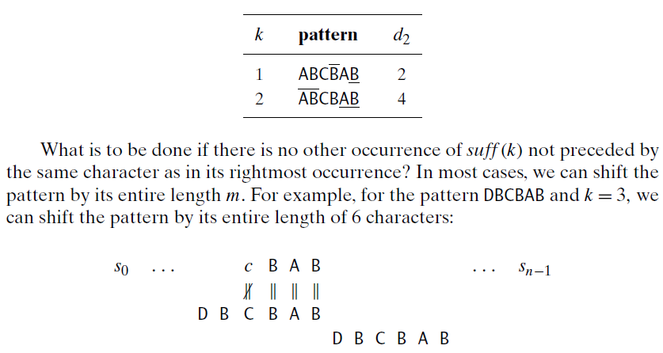
Space and Time Trade-Offs
Boyer-Moore Algorithm

Slide 130
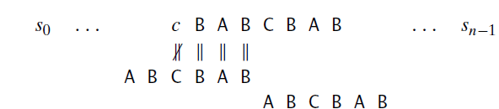
Space and Time Trade-Offs
Boyer-Moore Algorithm
Unfortunately, shifting the pattern by its entire length when there is no other occurrence of suff (k) not preceded by the same character as in its rightmost occurrence is not always correct.
For example, for the pattern ABCBAB and k = 3, shifting by 6 could miss a matching substring that starts with the text’s AB aligned with the last two characters of the pattern:

Slide 131
Space and Time Trade-Offs
Boyer-Moore Algorithm
Note that the shift by 6 is correct for the pattern DBCBAB but not for ABCBAB, because the latter pattern has the same substring AB as its prefix (beginning part of the pattern) and as its suffix (ending part of the pattern).
To avoid such an erroneous shift based on a suffix of size k, for which there is no other occurrence in the pattern not preceded by the same character as in its rightmost occurrence, we need to find the longest prefix of size l < k that matches the suffix of the same size l.

Slide 132
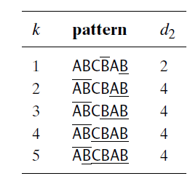
Space and Time Trade-Offs
Boyer-Moore Algorithm
If such a prefix exists, the shift size d₂ is computed as the distance between this prefix and the corresponding suffix; otherwise, d₂ is set to the pattern’s length m.
As an example, here is the complete list of the d₂ values—the good-suffix table of the Boyer-Moore algorithm—for the pattern ABCBAB:

Slide 133
Space and Time Trade-Offs
Boyer-Moore Algorithm
Let’s summarize the Boyer-Moore algorithm in its entirety
Step 1 For a given pattern and the alphabet used in both the pattern and the text, construct the bad-symbol shift table as described earlier.
Step 2 Using the pattern, construct the good-suffix shift table as described earlier.
Step 3 Align the pattern against the beginning of the text.
Step 4 Repeat the following step until either a matching substring is found or the pattern reaches beyond the last character of the text. Starting with the last character in the pattern, compare the corresponding characters in the pattern and the text until either all m character pairs are matched (then stop) or a mismatching pair is encountered after k ≥ 0 character pairs are matched successfully.

Slide 134
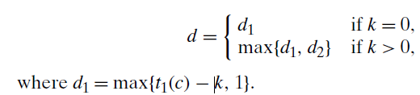
Space and Time Trade-Offs
Boyer-Moore Algorithm
(Step 4 continued)
In the latter case, retrieve the entry t1(c) from the c’s column of the bad-symbol table where c is the text’s mismatched character. If k > 0, also retrieve the corresponding d2 entry from the good-suffix table.
Shift the pattern to the right by the number of positions computed by the formula.

Slide 135
Space and Time Trade-Offs
Boyer-Moore Algorithm
Shifting by the maximum of the two available shifts when k > 0 is quite logical.
The two shifts are based on the observations—the first one about a text’s mismatched character, and the second one about a matched group of the pattern’s rightmost characters—that imply that shifting by less than d1 and d2 characters, respectively, cannot lead to aligning the pattern with a matching substring in the text.
Since we are interested in shifting the pattern as far as possible without missing a possible matching substring, we take the maximum of these two numbers.

Slide 136
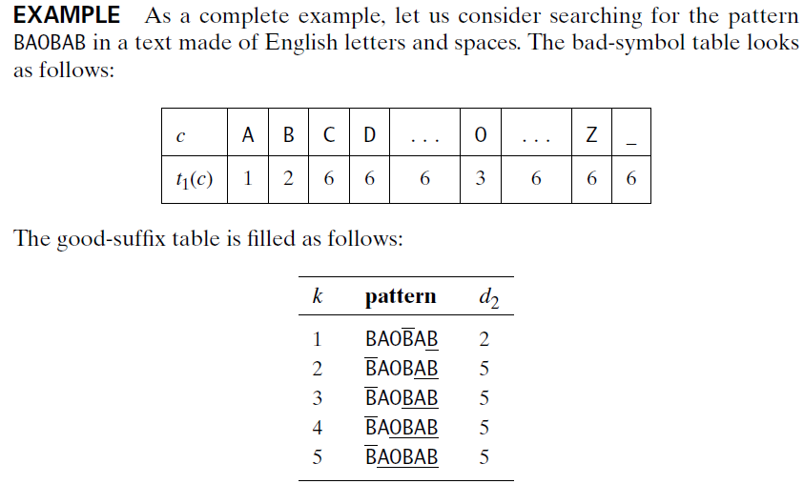
Space and Time Trade-Offs
Boyer-Moore Algorithm

Slide 137
Space and Time Trade-Offs
Boyer-Moore Algorithm
The actual search for this pattern in the text given in Figure 7.3 proceeds as follows.
After the last B of the pattern fails to match its counterpart K in the text, the algorithm retrieves t1(K) = 6 from the bad-symbol table and shifts the pattern by d1 = max{t1(K) − 0, 1} = 6 positions to the right.
The new try successfully matches two pairs of characters. After the failure of the third comparison on the space character in the text, the algorithm retrieves t1( ) = 6 from the bad-symbol table and d2 = 5 from the good-suffix table to shift the pattern by max{d1, d2} = max{6 − 2, 5} = 5.
Note that on this iteration it is the good-suffix rule that leads to a farther shift of the pattern.

Slide 138

Space and Time Trade-Offs
Boyer-Moore Algorithm

Slide 139
Space and Time Trade-Offs
Boyer-Moore Algorithm
The next try successfully matches just one pair of B’s. After the failure of the next comparison on the space character in the text, the algorithm retrieves t1( ) = 6 from the bad-symbol table and d2 = 2 from the good-suffix table to shift the pattern by max{d1,d2} = max{6 − 1, 2} = 5.
Note that on this iteration it is the bad-symbol rule that leads to a farther shift of the pattern.
The next try finds a matching substring in the text after successfully matching all six characters of the pattern with their counterparts in the text.

Slide 140
Space and Time Trade-Offs
Boyer-Moore Algorithm
When searching for the first occurrence of the pattern, the worst-case efficiency of the Boyer-Moore algorithm is known to be linear.
Though this algorithm runs very fast, especially on large alphabets (relative to the length of the pattern), many people prefer its simplified versions, such as Horspool’s algorithm, when dealing with natural-language–like strings.

Slide 141


Questions for practice

Slide 142
End of Module 3

