Slide 1
Analysis & Design of Algorithms
BCS401

Slide 2
Module-4
DYNAMIC PROGRAMMING, THE GREEDY METHOD

Slide 3
DYNAMIC PROGRAMMING
Dynamic programming is a technique for solving problems with overlapping sub problems.
These subproblems arise from a recurrence relating a given problem’s solution to solutions of its smaller subproblems.
Rather than solving overlapping subproblems again and again, dynamic programming suggests solving each of the smaller subproblems only once and recording the results in a table from which a solution to the original problem can then be obtained.
This technique can be illustrated by revisiting the Fibonacci numbers discussed in Section 2.5.

Slide 4
DYNAMIC PROGRAMMING
The Fibonacci numbers are the elements of the sequence
0, 1, 1, 2, 3, 5, 8, 13, 21, 34, . . . ,
which can be defined by the simple recurrence
F(n) = F(n − 1) + F(n − 2) for n > 1 (8.1)
and two initial conditions
F(0) = 0, F(1) = 1. (8.2)
If we try to use recurrence (8.1) directly to compute the nth Fibonacci number
F(n), we would have to recompute the same values of this function many times

Slide 5
DYNAMIC PROGRAMMING
Note that the problem of computing F(n) is expressed in terms of its smaller and overlapping subproblems of computing F(n − 1) and F(n − 2).
We can simply fill elements of a one-dimensional array with the n + 1 consecutive values of F(n) by starting, in view of initial conditions (8.2), with 0 and 1 and using equation (8.1) as the rule for producing all the other elements.
Obviously, the last element of this array will contain F(n).
Note that we can avoid using an extra array to accomplish this task by recording the values of just the last two elements of the Fibonacci sequence.

Slide 6
DYNAMIC PROGRAMMING
Thus, although a straightforward application of dynamic programming can be interpreted as a special variety of space-for-time trade-off, a dynamic programming algorithm can sometimes be refined to avoid using extra space.
Certain algorithms compute the nth Fibonacci number without computing all the preceding elements of this sequence.
It is typical of an algorithm based on the classic bottom-up dynamic programming approach, however, to solve all smaller subproblems of a given problem.
One variation of the dynamic programming approach seeks to avoid solving unnecessary subproblems.

Slide 7
DYNAMIC PROGRAMMING
This technique, illustrated in Section 8.2, exploits so-called memory functions and can be considered a top-down variation of dynamic programming.
Whether one uses the classical bottom-up version of dynamic programming or its top-down variation, the crucial step in designing such an algorithm remains the same: deriving a recurrence relating a solution to the problem to solutions to its smaller subproblems.
The immediate availability of equation (8.1) for computing the nth Fibonacci number is one of the few exceptions to this rule.

Slide 8
DYNAMIC PROGRAMMING
Three Basic Examples
The goal of this section is to introduce dynamic programming via three typical examples.
EXAMPLE 1 Coin-row problem
There is a row of n coins whose values are some positive integers c₁, c₂, . . . , c_{n}, not necessarily distinct.
The goal is to pick up the maximum amount of money subject to the constraint that no two coins adjacent in the initial row can be picked up.

Slide 9
DYNAMIC PROGRAMMING
EXAMPLE 1 Coin-row problem
Let F(n) be the maximum amount that can be picked up from the row of n coins.
To derive a recurrence for F(n), we partition all the allowed coin selections into two groups: those that include the last coin and those without it.
The largest amount we can get from the first group is equal to c_{n} + F(n − 2)—the value of the nth coin plus the maximum amount we can pick up from the first n − 2 coins.
The maximum amount we can get from the second group is equal to F(n − 1) by the definition of F(n).

Slide 10
DYNAMIC PROGRAMMING
EXAMPLE 1 Coin-row problem
Thus, we have the following recurrence subject to the obvious initial conditions:
We can compute F(n) by filling the one-row table left to right in the manner similar to the way it was done for the nth Fibonacci number by Algorithm Fib(n).

Slide 11
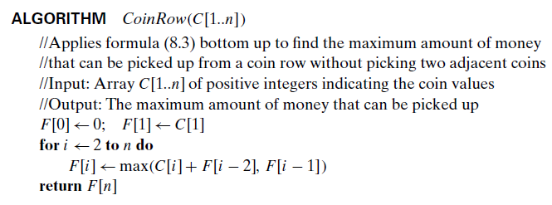
DYNAMIC PROGRAMMING
EXAMPLE 1 Coin-row problem

Slide 12
DYNAMIC PROGRAMMING
EXAMPLE 1 Coin-row problem
The application of the algorithm to the coin row of denominations 5, 1, 2, 10,6, 2 is shown in Figure 8.1.
It yields the maximum amount of 17. It is worth pointing out that, in fact, we also solved the problem for the first i coins in the row given for every 1≤ i ≤ 6.
For example, for i = 3, the maximum amount is F(3) = 7.
To find the coins with the maximum total value found, we need to backtrace the computations to see which of the two possibilities—c_{n} + F(n − 2) or F(n − 1)—produced the maxima in formula (8.3).

Slide 13
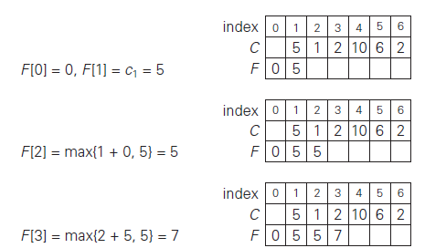
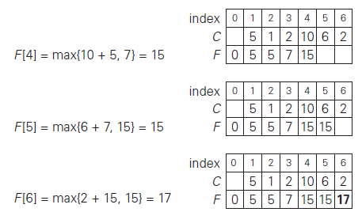
DYNAMIC PROGRAMMING
EXAMPLE 1 Coin-row problem

Slide 14
DYNAMIC PROGRAMMING
EXAMPLE 1 Coin-row problem
In the last application of the formula, it was the sum c6 + F(4), which means that the coin c₆ = 2 is a part of an optimal solution.
Moving to computing F(4), the maximum was produced by the sum c₄ + F(2), which means that the coin c₄ = 10 is a part of an optimal solution as well.
Finally, the maximum in computing F(2) was produced by F(1), implying that the coin c₂ is not the part of an optimal solution and the coin c₁= 5 is.
Thus, the optimal solution is {c1, c4, c6}.

Slide 15
DYNAMIC PROGRAMMING
EXAMPLE 1 Coin-row problem
To avoid repeating the same computations during the backtracing, the information about which of the two terms in (8.3) was larger can be recorded in an extra array when the values of F are computed.
Using the CoinRow to find F(n), the largest amount of money that can be picked up, as well as the coins composing an optimal set, clearly takes (n) time and(n) space.
This is by far superior to the alternatives: the straightforward top-down application of recurrence (8.3) and solving the problem by exhaustive search.
Consider the general instance of the following well-known problem. Give change for amount n using the minimum number of coins of denominations d1<d2 < . . .<dm.

Slide 16
DYNAMIC PROGRAMMING
EXAMPLE 2 Change-making problem
For the coin denominations used in the United States, as for those used in most if not all other countries, there is a very simple and efficient algorithm discussed in the next chapter.
Here, we consider a dynamic programming algorithm for the general case, assuming availability of unlimited quantities of coins for each of the m denominations d1< d2 < . . . < dm where d1 = 1.
Therefore, we can consider all such denominations and select the one minimizing F(n − dj ) + 1.
Since 1 is a constant, we can, of course, find the smallest F(n − dj ) first and then add 1 to it.
Hence, we have the following recurrence for F(n):

Slide 17

DYNAMIC PROGRAMMING
EXAMPLE 2 Change-making problem
Let F(n) be the minimum number of coins whose values add up to n; it is convenient to define F(0) = 0.
The amount n can only be obtained by adding one coin of denomination dj to the amount n − dj for j = 1, 2, . . . , m such that n ≥ dj .
We can compute F(n) by filling a one-row table left to right in the manner similar to the way it was done above for the coin-row problem, but computing a table entry here requires finding the minimum of up to m numbers.

Slide 18
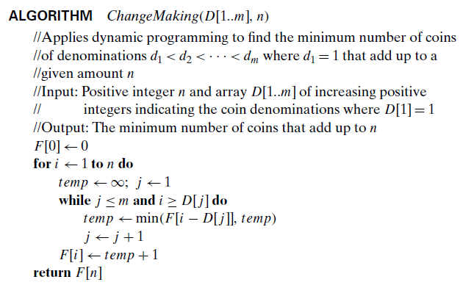
DYNAMIC PROGRAMMING
EXAMPLE 2 Change-making problem

Slide 19
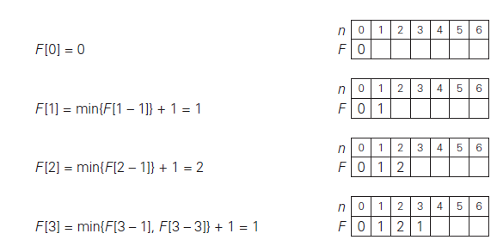
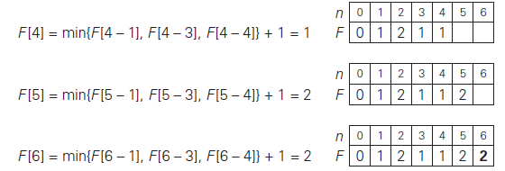
DYNAMIC PROGRAMMING
EXAMPLE 2 Change-making problem
The application of the algorithm to amount n = 6 and denominations 1, 3,4 is shown in Figure 8.2.
The answer it yields is two coins. The time and space efficiencies of the algorithm are obviously O(nm) and O(n), respectively.

Slide 20
DYNAMIC PROGRAMMING
EXAMPLE 2 Change-making problem
To find the coins of an optimal solution, we need to backtrace the computations to see which of the denominations produced the minima in formula (8.4).
For the instance considered, the last application of the formula (for n = 6), the minimum was produced by d2 = 3.
The second minimum (for n = 6 − 3) was also produced for a coin of that denomination.
Thus, the minimum-coin set for n = 6 is two 3’s.

Slide 21
DYNAMIC PROGRAMMING
EXAMPLE 3 Coin-collecting problem
Several coins are placed in cells of an n × m board, no more than one coin per cell.
Arobot, located in the upper left cell of the board, needs to collect as many of the coins as possible and bring them to the bottom right cell.
On each step, the robot can move either one cell to the right or one cell down from its current location.
When the robot visits a cell with a coin, it always picks up that coin.
Design an algorithm to find the maximum number of coins the robot can collect and a path it needs to follow to do this.

Slide 22
DYNAMIC PROGRAMMING
EXAMPLE 3 Coin-collecting problem
Let F(i, j) be the largest number of coins the robot can collect and bring to the cell (i, j ) in the ith row and jth column of the board.
It can reach this cell either from the adjacent cell (i − 1, j) above it or from the adjacent cell (i, j − 1) to the left of it.
The largest numbers of coins that can be brought to these cells are F(i − 1, j) and F(i, j − 1), respectively.
Of course, there are no adjacent cells above the cells in the first row, and there are no adjacent cells to the left of the cells in the first column.
For those cells, we assume that F(i − 1, j) and F(i, j − 1) are equal to 0 for their nonexistent neighbors.

Slide 23

DYNAMIC PROGRAMMING
EXAMPLE 3 Coin-collecting problem
Therefore, the largest number of coins the robot can bring to cell (i, j ) is the maximum of these two numbers plus one possible coin at cell (i, j ) itself. In other words, we have the following formula for F(i, j):
where cij = 1 if there is a coin in cell (i, j ), and cij = 0 otherwise.
Using these formulas, we can fill in the n × mtable of F(i, j) values either row by row or column by column, as is typical for dynamic programming algorithms involving two-dimensional tables.

Slide 24
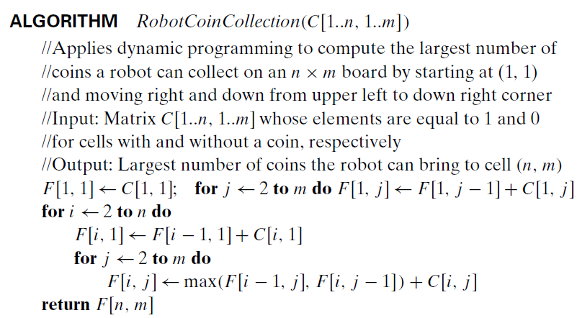
DYNAMIC PROGRAMMING
EXAMPLE 3 Coin-collecting problem

Slide 25
DYNAMIC PROGRAMMING
EXAMPLE 3 Coin-collecting problem
The algorithm is illustrated in Figure 8.3b for the coin setup in Figure 8.3a.
Since computing the value of F(i, j) by formula (8.5) for each cell of the table takes constant time, the time efficiency of the algorithm is
Its space efficiency is, obviously, also
Tracing the computations backward makes it possible to get an optimal path:
if F(i − 1, j) > F(i, j − 1), an optimal path to cell (i, j ) must come down from the adjacent cell above it; if F(i − 1, j) < F(i, j − 1), an optimal path to cell (i, j ) must come from the adjacent cell on the left; and if F(i − 1, j) = F(i, j − 1), it can reach cell (i, j ) from either direction.
This yields two optimal paths for the instance in Figure 8.3a, which are shown in Figure 8.3c.

Slide 26
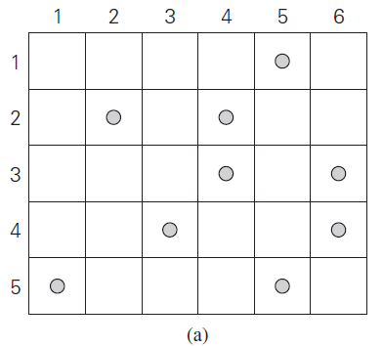
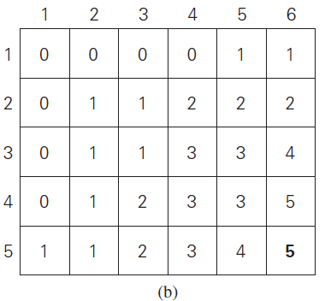
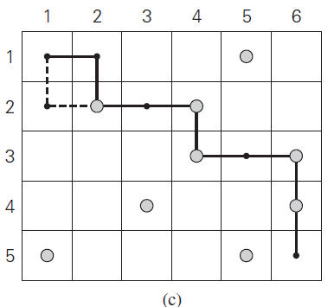
DYNAMIC PROGRAMMING
EXAMPLE 3 Coin-collecting problem
If ties are ignored, one optimal path can be obtained in time.

Slide 27
DYNAMIC PROGRAMMING
The Knapsack Problem and Memory Functions
We start this section with designing a dynamic programming algorithm for the knapsack problem: given n items of known weights w1, . . . , wn and values v1, . . . , vn and a knapsack of capacity W, find the most valuable subset of the items that fit into the knapsack.
We assume here that all the weights and the knapsack capacity are positive integers; the item values do not have to be integers.
To design a dynamic programming algorithm, we need to derive a recurrence relation that expresses a solution to an instance of the knapsack problem in terms of solutions to its smaller sub instances.

Slide 28
DYNAMIC PROGRAMMING
The Knapsack Problem and Memory Functions
Let us consider an instance defined by the first i items, 1≤ i ≤ n, with weights w1, . . . , wi, values v1, . . . , vi , and knapsack capacity j, 1 ≤ j ≤ W.
Let F(i, j) be the value of an optimal solution to this instance, i.e., the value of the most valuable subset of the first i items that fit into the knapsack of capacity j.
We can divide all the subsets of the first i items that fit the knapsack of capacity j into two categories: those that do not include the ith item and those that do. Note the following:
Among the subsets that do not include the ith item, the value of an optimal subset is, by definition, F(i − 1, j).

Slide 29
DYNAMIC PROGRAMMING
The Knapsack Problem and Memory Functions
Among the subsets that do include the ith item (hence, j − wi ≥ 0), an optimal subset is made up of this item and an optimal subset of the first i − 1 items that fits into the knapsack of capacity j − wi .
The value of such an optimal subset is vi + F(i − 1, j − wi).
Thus, the value of an optimal solution among all feasible subsets of the first I items is the maximum of these two values.
Of course, if the ith item does not fit into the knapsack, the value of an optimal subset selected from the first i items is the same as the value of an optimal subset selected from the first i − 1 items.

Slide 30
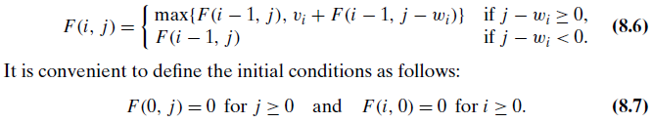
DYNAMIC PROGRAMMING
The Knapsack Problem and Memory Functions
These observations lead to the following recurrence:
Our goal is to find F(n, W), the maximal value of a subset of the n given items that fit into the knapsack of capacity W, and an optimal subset itself.
Figure 8.4 illustrates the values involved in equations (8.6) and (8.7).

Slide 31
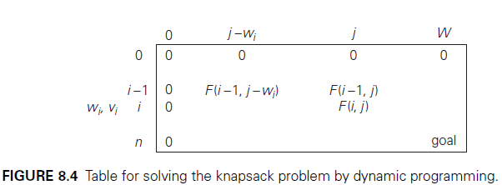
DYNAMIC PROGRAMMING
The Knapsack Problem and Memory Functions
For i, j > 0, to compute the entry in the ith row and the jth column, F(i, j), we compute the maximum of the entry in the previous row and the same column and the sum of vi and the entry in the previous row and wi columns to the left.
The table can be filled either row by row or column by column.

Slide 32
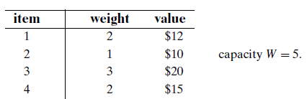
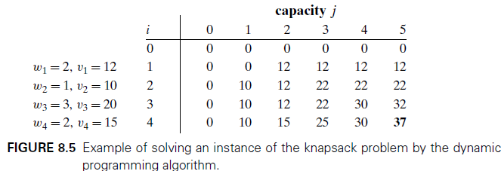
DYNAMIC PROGRAMMING
The Knapsack Problem and Memory Functions
EXAMPLE 1 Let us consider the instance given by the following data:
The dynamic programming table, filled by applying formulas (8.6) and (8.7),is shown in Figure 8.5.

Slide 33
DYNAMIC PROGRAMMING
The Knapsack Problem and Memory Functions
Thus, the maximal value is F(4, 5) = $37.
We can find the composition of an optimal subset by backtracking the computations of this entry in the table.
Since F(4, 5) > F(3, 5), item 4 has to be included in an optimal solution along with an optimal subset for filling 5 − 2 = 3 remaining units of the knapsack capacity.
The value of the latter is F(3, 3).
Since F(3, 3) = F(2, 3), item 3 need not be in an optimal subset. Since F(2, 3) > F(1, 3), item 2 is a part of an optimal selection, which leaves element F(1, 3 − 1) to specify its remaining composition.

Slide 34
DYNAMIC PROGRAMMING
The Knapsack Problem and Memory Functions
Similarly, since F(1, 2) > F(0, 2), item 1 is the final part of the optimal solution {item 1,item 2, item 4}.
The time efficiency and space efficiency of this algorithm are both in .
The time needed to find the composition of an optimal solution is in O(n). You are asked to prove these assertions in the exercises.

Slide 35
DYNAMIC PROGRAMMING
Memory Functions
As we discussed at the beginning of this chapter and illustrated in subsequent sections, dynamic programming deals with problems whose solutions satisfy a recurrence relation with overlapping subproblems.
The direct top-down approach to finding a solution to such a recurrence leads to an algorithm that solves common subproblems more than once and hence is very inefficient (typically, exponential or worse).
The classic dynamic programming approach, on the other hand, works bottom up: it fills a table with solutions to all smaller subproblems, but each of them is solved only once.

Slide 36
DYNAMIC PROGRAMMING
Memory Functions
An unsatisfying aspect of this approach is that solutions to some of these smaller subproblems are often not necessary for getting a solution to the problem given.
Since this drawback is not present in the top-down approach, it is natural to try to combine the strengths of the top-down and bottom-up approaches.
The goal is to get a method that solves only subproblems that are necessary and does so only once.
Such a method exists; it is based on using memory functions.
This method solves a given problem in the top-down manner but, in addition, maintains a table of the kind that would have been used by a bottom-up dynamic programming algorithm.

Slide 37
DYNAMIC PROGRAMMING
Memory Functions
Initially, all the table’s entries are initialized with a special “null” symbol to indicate that they have not yet been calculated.
Thereafter, whenever a new value needs to be calculated, the method checks the corresponding entry in the table first: if this entry is not “null,” it is simply retrieved from the table; otherwise, it is computed by the recursive call whose result is then recorded in the table.
The following algorithm implements this idea for the knapsack problem. After initializing the table, the recursive function needs to be called with i = n (the number of items) and j = W (the knapsack capacity).

Slide 38
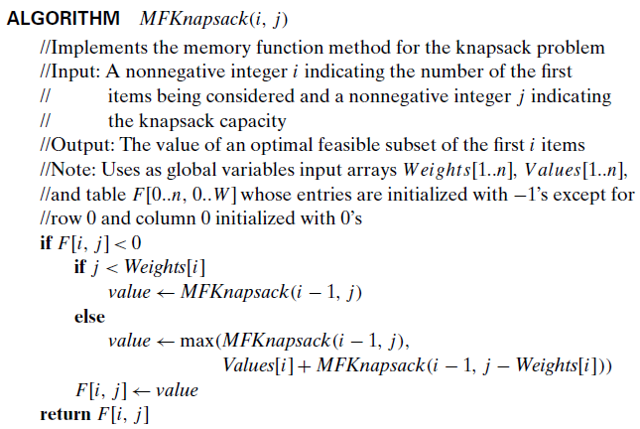
DYNAMIC PROGRAMMING
Memory Functions

Slide 39
DYNAMIC PROGRAMMING
Memory Functions
EXAMPLE 2 Let us apply the memory function method to the instance considered in Example 1.
The table in Figure 8.6 gives the results. Only 11 out of 20 nontrivial values (i.e., not those in row 0 or in column 0) have been computed.
Just one nontrivial entry, V (1, 2), is retrieved rather than being recomputed.
For larger instances, the proportion of such entries can be significantly larger.

Slide 40
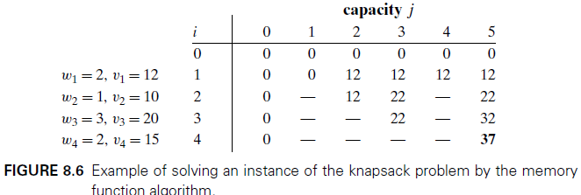
DYNAMIC PROGRAMMING

Slide 41
DYNAMIC PROGRAMMING
Memory Functions
In general, we cannot expect more than a constant-factor gain in using the memory function method for the knapsack problem, because its time efficiency class is the same as that of the bottom-up algorithm (why?).
A more significant improvement can be expected for dynamic programming algorithms in which a computation of one value takes more than constant time.
You should also keep in mind that a memory function algorithm may be less space-efficient than a space efficient version of a bottom-up algorithm.

Slide 42
Module-4
Warshall’s Algorithm

Slide 43
DYNAMIC PROGRAMMING
Warshall’s Algorithm
Recall that the adjacency matrixA = {a_{ij}} of a directed graph is the Boolean matrix that has 1 in its i^{th} row and j^{th} column if and only if there is a directed edge from the ith vertex to the jth vertex.
We may also be interested in a matrix containing the information about the existence of directed paths of arbitrary lengths between vertices of a given graph.
Such a matrix, called the transitive closure of the digraph, would allow us to determine in constant time whether the jth vertex is reachable from the ith vertex.

Slide 44
DYNAMIC PROGRAMMING
Warshall’s Algorithm
Few application examples:
When a value in a spreadsheet cell is changed, the spreadsheet software must know all the other cells affected by the change.
If the spreadsheet is modeled by a digraph whose vertices represent the spreadsheet cells and edges indicate cell dependencies, the transitive closure will provide such information.
In software engineering, transitive closure can be used for investigating data flow and control flow dependencies as well as for inheritance testing of object-oriented software.

Slide 45
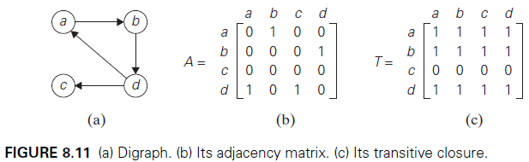
DYNAMIC PROGRAMMING
Warshall’s Algorithm
DEFINITION: The transitive closure of a directed graph with n vertices can be defined as the n × n boolean matrix T = {t_{ij}}, in which the element in the ith row and the jth column is 1 if there exists a nontrivial path (i.e., directed path of a positive length) from the ith vertex to the jth vertex; otherwise, t_{ij} is 0.
An example of a digraph, its adjacency matrix, and its transitive closure is given in Figure 8.11

Slide 46
DYNAMIC PROGRAMMING
Warshall’s Algorithm
We can generate the transitive closure of a digraph with the help of depth first search or breadth-first search.
Performing either traversal starting at the ith vertex gives the information about the vertices reachable from it and hence the columns that contain 1’s in the ith row of the transitive closure.
Thus, doing such a traversal for every vertex as a starting point yields the transitive closure in its entirety.
Since this method traverses the same digraph several times, we should hope that a better algorithm can be found. Indeed, such an algorithm exists.
It is called Warshall’s algorithm after Stephen Warshall.

Slide 47
DYNAMIC PROGRAMMING
Warshall’s Algorithm
It is convenient to assume that the digraph’s vertices and hence the rows and columns of the adjacency matrix are numbered from 1 to n.
Warshall’s algorithm constructs the transitive closure through a series of n × n boolean matrices:
The central point of the algorithm is that we can compute all the elements of each matrix R^{(k)} from its immediate predecessor R^{(k−1)} in series (8.9).
Let r^{(k)} _{ij} , the element in the ith row and jth column of matrix R^{(k)}, be equal to 1.
This means that there exists a path from the ith vertex v_{i} to the jth vertex vj with each intermediate vertex numbered not higher than k: v_{i}, a list of intermediate vertices each numbered not higher than k, v_{j} . (8.10)

Slide 48

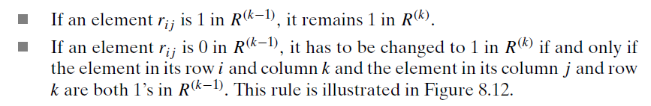
DYNAMIC PROGRAMMING
Warshall’s Algorithm
The formula for generating the elements of matrix from the elements of matrix
Formula (8.11) is at the heart of Warshall’s algorithm.
This formula implies the following rule for generating elements of matrix from elements of matrix , which is particularly convenient for applying Warshall’s algorithm by hand:

Slide 49
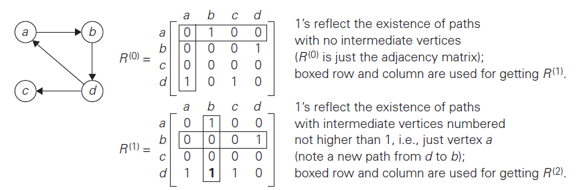
DYNAMIC PROGRAMMING
Warshall’s Algorithm
As an example, the application of Warshall’s algorithm to the digraph in Figure 8.11 is shown in Figure 8.13.

Slide 50
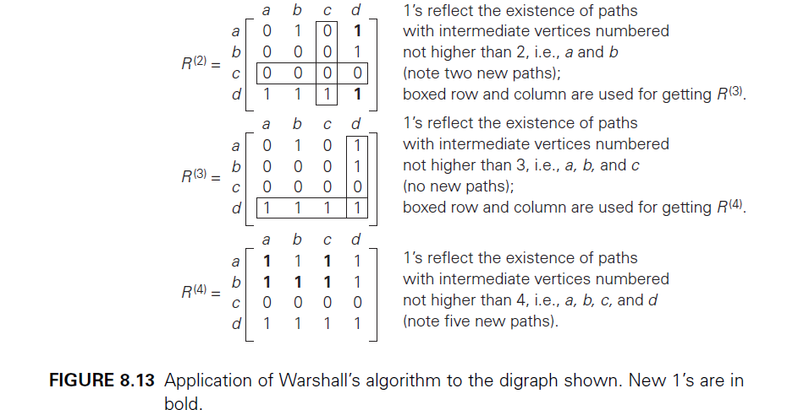
DYNAMIC PROGRAMMING
Warshall’s Algorithm

Slide 51
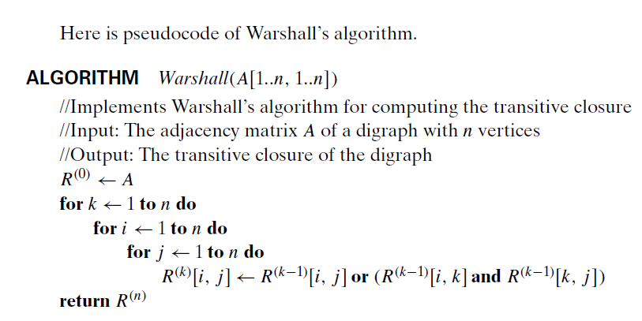
DYNAMIC PROGRAMMING
Warshall’s Algorithm

Slide 52
DYNAMIC PROGRAMMING
Warshall’s Algorithm
First, it is remarkably succinct, and its time efficiency is only .
We can speed up the above implementation of Warshall’s algorithm for some inputs by restructuring its innermost loop.
Another way to make the algorithm run faster is to treat matrix rows as bit strings and employ the bitwise or operation available in most modern computer languages.

Slide 53
Module-4
Floyd’s Algorithm

Slide 54
DYNAMIC PROGRAMMING
Floyd’s Algorithm for the All-Pairs Shortest-Paths Problem
Given a weighted connected graph (undirected or directed), the all-pairs shortest paths problem asks to find the distances—i.e., the lengths of the shortest paths— from each vertex to all other vertices.
This is one of several variations of the problem involving shortest paths in graphs. Because of its important applications to communications, transportation networks, and operations research, it has been thoroughly studied over the years.
Among recent applications of the all-pairs shortest-path problem is precomputing distances for motion planning in computer games.

Slide 55
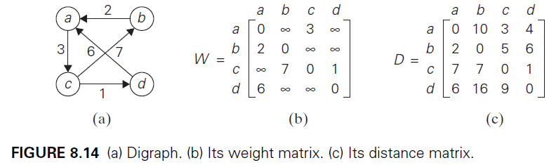
DYNAMIC PROGRAMMING
Floyd’s Algorithm for the All-Pairs Shortest-Paths Problem
It is convenient to record the lengths of shortest paths in an n × n matrix D called the distance matrix: the element dij in the ith row and the jth column of this matrix indicates the length of the shortest path from the ith vertex to the jth vertex.
For an example, see Figure 8.14.

Slide 56
DYNAMIC PROGRAMMING
Floyd’s Algorithm for the All-Pairs Shortest-Paths Problem
We can generate the distance matrix with an algorithm that is very similar to Warshall’s algorithm.
It is called Floyd’s algorithm after its co-inventor RobertW. Floyd.
It is applicable to both undirected and directed weighted graphs provided that they do not contain a cycle of a negative length.
The algorithm can be enhanced to find not only the lengths of the shortest paths for all vertex pairs but also the shortest paths themselves.
Floyd’s algorithm computes the distance matrix of a weighted graph with n vertices through a series of n × n matrices:

Slide 57
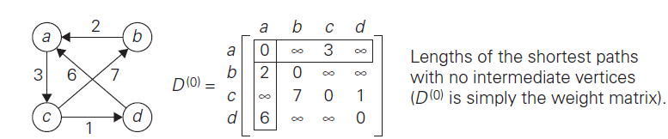
DYNAMIC PROGRAMMING
Floyd’s Algorithm for the All-Pairs Shortest-Paths Problem
The application of Floyd’s algorithm to the graph in Figure 8.14 is illustrated in Figure 8.16.

Slide 58
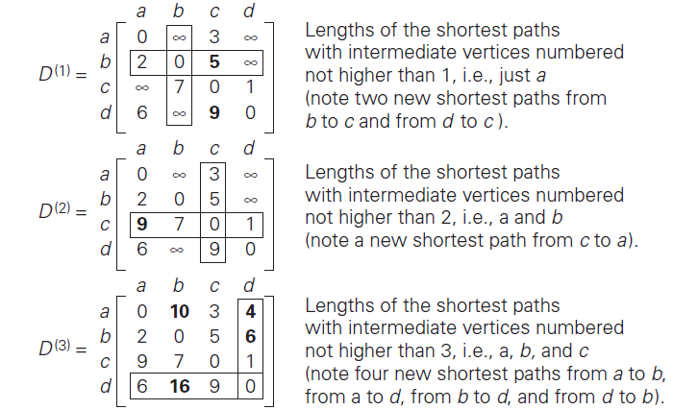
DYNAMIC PROGRAMMING
Floyd’s Algorithm for the All-Pairs Shortest-Paths Problem

Slide 59
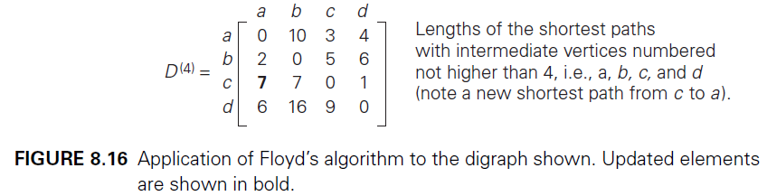
DYNAMIC PROGRAMMING
Floyd’s Algorithm for the All-Pairs Shortest-Paths Problem
Here is pseudocode of Floyd’s algorithm.

Slide 60
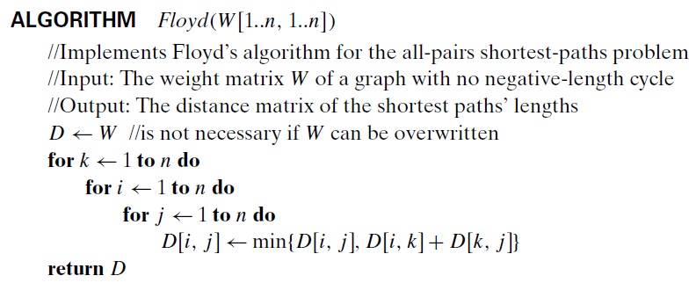
DYNAMIC PROGRAMMING
Floyd’s Algorithm for the All-Pairs Shortest-Paths Problem
The time efficiency of Floyd’s algorithm is cubic—as is the time efficiency of Warshall’s algorithm.

Slide 61
Module-4
THE GREEDY METHOD

Slide 62
Greedy Technique
The greedy approach suggests constructing a solution through a sequence of steps, each expanding a partially constructed solution obtained so far, until a complete solution to the problem is reached.
On each step—and this is the central point of this technique—the choice made must be:
feasible, i.e., it has to satisfy the problem’s constraints
locally optimal, i.e., it has to be the best local choice among all feasible choices available on that step
irrevocable, i.e., once made, it cannot be changed on subsequent steps of the algorithm

Slide 63
Module-4
Prim’s Algorithm

Slide 64
Greedy Technique
Prim’s Algorithm
DEFINITION: A spanning tree of an undirected connected graph is its connected acyclic subgraph (i.e., a tree) that contains all the vertices of the graph.
If such a graph has weights assigned to its edges, a minimum spanning tree is its spanning tree of the smallest weight, where the weight of a tree is defined as the sum of the weights on all its edges.
The minimum spanning tree problem is the problem of finding a minimum spanning tree for a given weighted connected graph.
Figure 9.2 presents a simple example illustrating these notions.

Slide 65
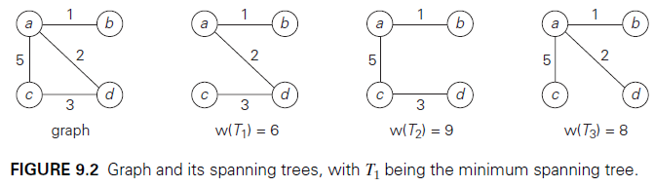
Greedy Technique
Prim’s Algorithm
If we were to try constructing a minimum spanning tree by exhaustive search, we would face two serious obstacles.
First, the number of spanning trees grows exponentially with the graph size (at least for dense graphs).

Slide 66
Greedy Technique
Prim’s Algorithm
Second, generating all spanning trees for a given graph is not easy; in fact, it is more difficult than finding a minimum spanning tree for a weighted graph by using one of several efficient algorithms available for this problem.
Prim’s algorithm constructs a minimum spanning tree through a sequence of expanding subtrees.
The initial subtree in such a sequence consists of a single vertex selected arbitrarily from the set V of the graph’s vertices.

Slide 67
Greedy Technique
Prim’s Algorithm
On each iteration, the algorithm expands the current tree in the greedy manner by simply attaching to it the nearest vertex not in that tree.
The algorithm stops after all the graph’s vertices have been included in the tree being constructed.
Since the algorithm expands a tree by exactly one vertex on each of its iterations, the total number of such iterations is n − 1, where n is the number of vertices in the graph.
The tree generated by the algorithm is obtained as the set of edges used for the tree expansions.

Slide 68
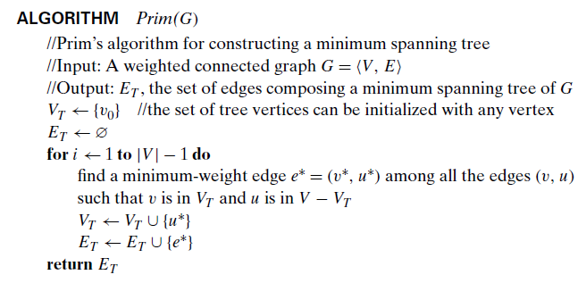
Greedy Technique
Prim’s Algorithm
Here is pseudocode of this algorithm.

Slide 69
Greedy Technique
Prim’s Algorithm
The nature of Prim’s algorithm makes it necessary to provide each vertex not in the current tree with the information about the shortest edge connecting the vertex to a tree vertex.
We can provide such information by attaching two labels to a vertex: the name of the nearest tree vertex and the length (the weight) of the corresponding edge.
Vertices that are not adjacent to any of the tree vertices can be given the ∞ label indicating their “infinite” distance to the tree vertices and a null label for the name of the nearest tree vertex.

Slide 70
Greedy Technique
Prim’s Algorithm
With such labels, finding the next vertex to be added to the current tree T = { V_{T}, E_{T} } becomes a simple task of finding a vertex with the smallest distance label in the set V − V_{T} . Ties can be broken arbitrarily.
After we have identified a vertex u ∗ to be added to the tree, we need to perform two operations:
Move u ∗ from the set V − V_{T} to the set of tree vertices V_{T} .
For each remaining vertex u in V − V_{T} that is connected to u ∗ by a shorter edge than the u’s current distance label, update its labels by u ∗ and the weight of the edge between u ∗ and u, respectively.

Slide 71
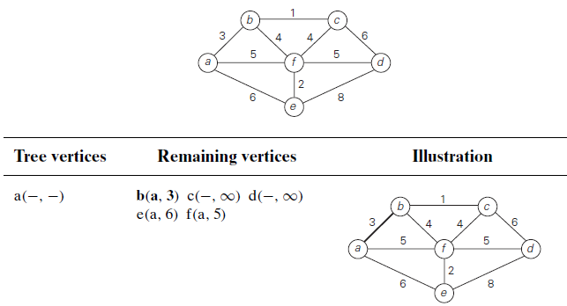
Greedy Technique
Prim’s Algorithm
Figure 9.3 demonstrates the application of Prim’s algorithm to a specific graph.

Slide 72
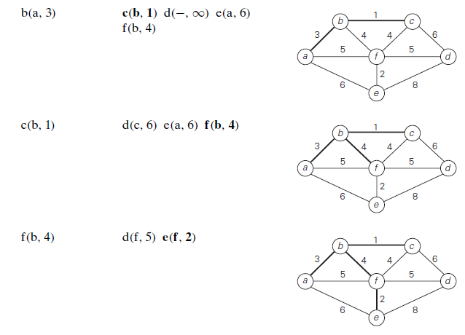
Greedy Technique
Prim’s Algorithm

Slide 73
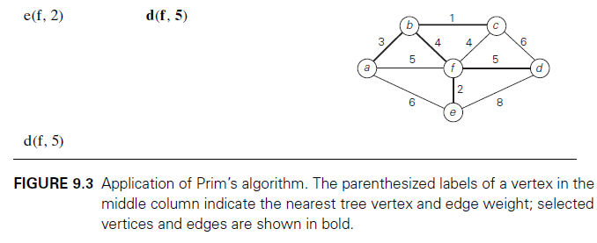
Greedy Technique
Prim’s Algorithm
How efficient is Prim’s algorithm? The answer depends on the data structures chosen for the graph itself and for the priority queue of the set V − V_{T} whose vertex priorities are the distances to the nearest tree vertices.

Slide 74
Greedy Technique
Prim’s Algorithm
In particular, if a graph is represented by its weight matrix and the priority queue is implemented as an unordered array, the algorithm’s running time will be in
Indeed, on each of the |V| − 1 iterations, the array implementing the priority queue is traversed to find and delete the minimum and then to update, if necessary, the priorities of the remaining vertices.
We can also implement the priority queue as a min-heap.
Namely, a min-heap is a complete binary tree in which every element is less than or equal to its children.

Slide 75
Greedy Technique
Prim’s Algorithm
All the principal properties of heaps remain valid for min-heaps, with some obvious modifications.
For example, the root of a min-heap contains the smallest rather than the largest element.
Deletion of the smallest element from and insertion of a new element into a min-heap of size n are O(log n) operations, and so is the operation of changing an element’s priority.
If a graph is represented by its adjacency lists and the priority queue is implemented as a min-heap, the running time of the algorithm is in O(|E| log |V |).

Slide 76
Greedy Technique
Prim’s Algorithm
This is because the algorithm performs |V| − 1 deletions of the smallest element and makes |E| verifications and, possibly, changes of an element’s priority in a min-heap of size not exceeding |V |.
Each of these operations, as noted earlier, is a O(log |V |) operation.
Hence, the running time of this implementation of Prim’s algorithm is in
because, in a connected graph, |V| − 1≤ |E|.

Slide 77
Greedy Technique
Kruskal’s Algorithm
Kruskal’s algorithm looks at a minimum spanning tree of a weighted connected graph G = V, E as an acyclic subgraph with |V| − 1 edges for which the sum of the edge weights is the smallest.
Consequently, the algorithm constructs a minimum spanning tree as an expanding sequence of subgraphs that are always acyclic but are not necessarily connected on the intermediate stages of the algorithm.
The algorithm begins by sorting the graph’s edges in nondecreasing order of their weights.
Then, starting with the empty subgraph, it scans this sorted list, adding the next edge on the list to the current subgraph if such an inclusion does not create a cycle and simply skipping the edge otherwise.

Slide 78
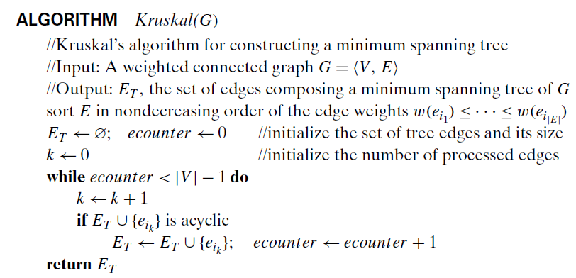
Greedy Technique
Kruskal’s Algorithm

Slide 79
Greedy Technique
Kruskal’s Algorithm
The correctness of Kruskal’s algorithm can be proved by repeating the essential steps of the proof of Prim’s algorithm given in the previous section.
The fact that ET is actually a tree in Prim’s algorithm but generally just an acyclic subgraph in Kruskal’s algorithm turns out to be an obstacle that can be overcome.
Figure 9.5 demonstrates the application of Kruskal’s algorithm to the same graph we used for illustrating Prim’s algorithm in Section 9.1.
As you trace the algorithm’s operations, note the disconnectedness of some of the intermediate subgraphs.

Slide 80
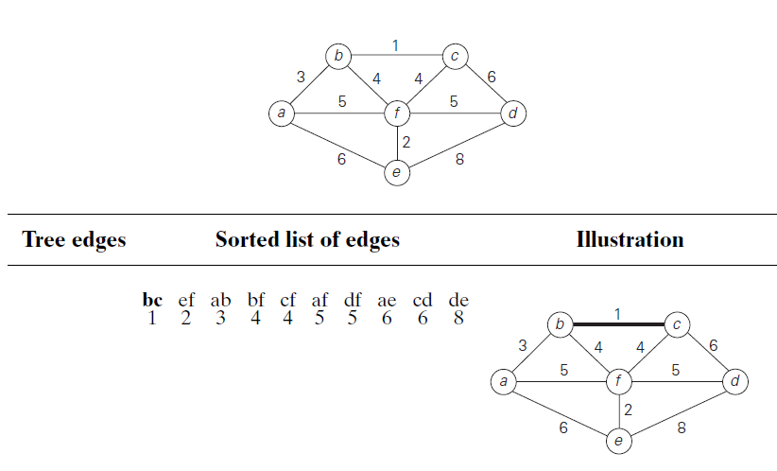
Greedy Technique
Kruskal’s Algorithm

Slide 81
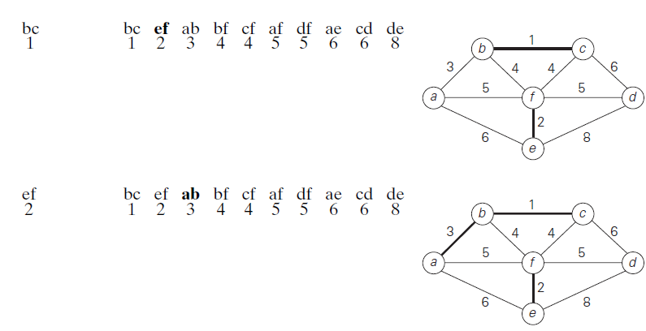
Greedy Technique
Kruskal’s Algorithm

Slide 82
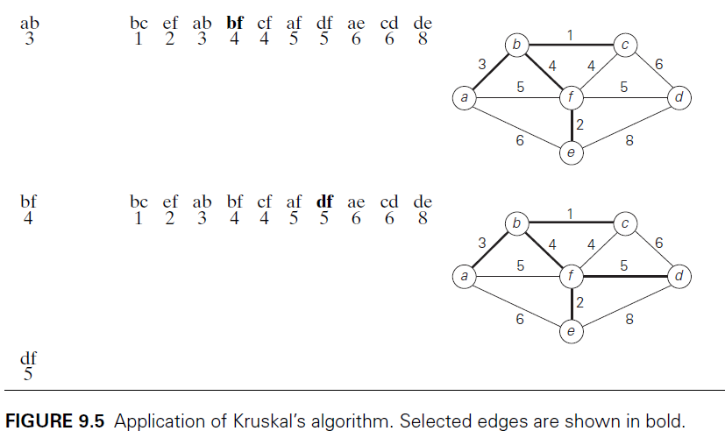
Greedy Technique
Kruskal’s Algorithm

Slide 83
Greedy Technique
Kruskal’s Algorithm
Applying Prim’s and Kruskal’s algorithms to the same small graph by hand may create the impression that the latter is simpler than the former.
This impression is wrong because, on each of its iterations, Kruskal’s algorithm has to check whether the addition of the next edge to the edges already selected would create a cycle.
In view of these observations, it is convenient to use a slightly different interpretation of Kruskal’s algorithm.
We can consider the algorithm’s operations as a progression through a series of forests containing all the vertices of a given graph and some of its edges.

Slide 84
Greedy Technique
Kruskal’s Algorithm
The initial forest consists of |V | trivial trees, each comprising a single vertex of the graph. The final forest consists of a single tree, which is a minimum spanning tree of the graph.
On each iteration, the algorithm takes the next edge (u, v) from the sorted list of the graph’s edges, finds the trees containing the vertices u and v, and, if these trees are not the same, unites them in a larger tree by adding the edge (u, v).
Fortunately, there are efficient algorithms for doing so, including the crucial check for whether two vertices belong to the same tree.
They are called union find algorithms.

Slide 85
Greedy Technique
Kruskal’s Algorithm ( Disjoint Subsets and Union-Find Algorithms )
With an efficient union-find algorithm, the running time of Kruskal’s algorithm will be dominated by the time needed for sorting the edge weights of a given graph.
Hence, with an efficient sorting algorithm, the time efficiency of Kruskal’s algorithm will be in O(|E| log |E|).
Kruskal’s algorithm is one of a number of applications that require a dynamic partition of some n element set S into a collection of disjoint subsets S₁, S₂, . . . , S_{k}.
After being initialized as a collection of n one-element subsets, each containing a different element of S, the collection is subjected to a sequence of intermixed union and find operations.

Slide 86
Greedy Technique
Kruskal’s Algorithm ( Disjoint Subsets and Union-Find Algorithms )
Note that the number of union operations in any such sequence must be bounded above by n − 1 because each union increases a subset’s size at least by 1 and there are only n elements in the entire set S.
Thus, we are dealing here with an abstract data type of a collection of disjoint subsets of a finite set with the following operations:
makeset(x) creates a one-element set {x}. It is assumed that this operation can be applied to each of the elements of set S only once.
find(x) returns a subset containing x.
union(x, y) constructs the union of the disjoint subsets S_{x} and S_{y} containing x and y, respectively, and adds it to the collection to replace S_{x} and S_{y}, which are deleted from it.

Slide 87
Greedy Technique
Kruskal’s Algorithm ( Disjoint Subsets and Union-Find Algorithms )
For example, let S = {1, 2, 3, 4, 5, 6}. Then makeset(i) creates the set {i} and applying this operation six times initializes the structure to the collection of six singleton sets:
{1}, {2}, {3}, {4}, {5}, {6}.
Performing union(1, 4) and union(5, 2) yields
{1, 4}, {5, 2}, {3}, {6},
and, if followed by union(4, 5) and then by union(3, 6), we end up with the disjoint subsets
{1, 4, 5, 2}, {3, 6}.

Slide 88
Greedy Technique
Kruskal’s Algorithm ( Disjoint Subsets and Union-Find Algorithms )
There are two principal alternatives for implementing this data structure.
The first one, called the quick find, optimizes the time efficiency of the find operation; the second one, called the quick union, optimizes the union operation.
The quick find uses an array indexed by the elements of the underlying set S; the array’s values indicate the representatives of the subsets containing those elements.
Each subset is implemented as a linked list whose header contains the pointers to the first and last elements of the list along with the number of elements in the list.
See Figure 9.7 for an example.

Slide 89
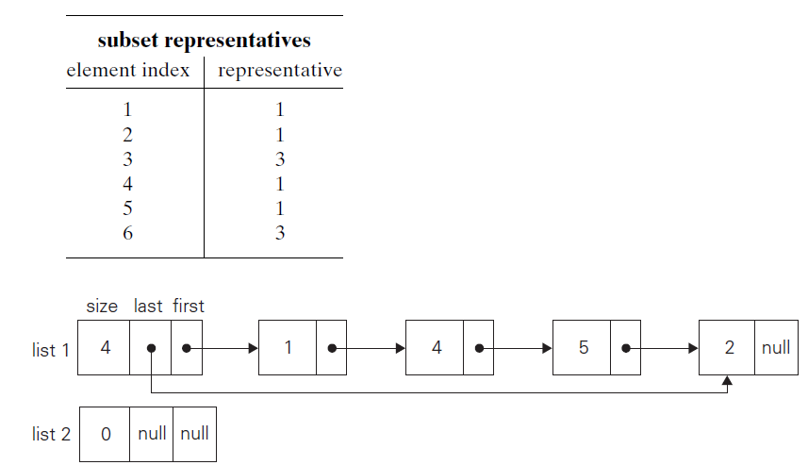
Greedy Technique
Kruskal’s Algorithm ( Disjoint Subsets and Union-Find Algorithms )

Slide 90
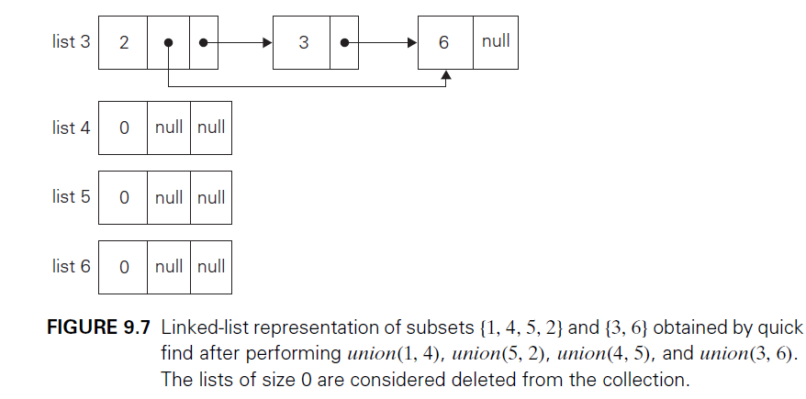
Greedy Technique
Kruskal’s Algorithm ( Disjoint Subsets and Union-Find Algorithms )

Slide 91

Greedy Technique
Kruskal’s Algorithm ( Disjoint Subsets and Union-Find Algorithms )
Under this scheme, the implementation of makeset(x) requires assigning the corresponding element in the representative array to x and initializing the corresponding linked list to a single node with the x value.
The time efficiency of this operation is obviously in , and hence the initialization of n singleton subsets is in .
The efficiency of find(x) is also in : all we need to do is to retrieve the x’s representative in the representative array. Executing union(x, y) takes longer.

Slide 92

Greedy Technique
Kruskal’s Algorithm ( Disjoint Subsets and Union-Find Algorithms )
A straightforward solution would simply append the y’s list to the end of the x’s list, update the information about their representative for all the elements in the y list, and then delete the y’s list from the collection.
It is easy to verify, however, that with this algorithm the sequence of union operations
A simple way to improve the overall efficiency of a sequence of union operations is to always append the shorter of the two lists to the longer one, with ties broken arbitrarily.

Slide 93
Kruskal’s Algorithm ( Disjoint Subsets and Union-Find Algorithms )
The size of each list is assumed to be available by, say, storing the number of elements in the list’s header.
This modification is called the union by size.
Though it does not improve the worst-case efficiency of a single application of the union operation the worst-case running time of any legitimate sequence of union-by-size operations turns out to be in
Thus, for union by size, the time efficiency of a sequence of at most n − 1 unions and m finds is in O(n log n + m).

Slide 94
Greedy Technique
Kruskal’s Algorithm ( Disjoint Subsets and Union-Find Algorithms )
The quick union—the second principal alternative for implementing disjoint subsets—represents each subset by a rooted tree.
The nodes of the tree contain the subset’s elements (one per node), with the root’s element considered the subset’s representative; the tree’s edges are directed from children to their parents (Figure 9.8).
In addition, a mapping of the set elements to their tree nodes— implemented, say, as an array of pointers—is maintained.
This mapping is not shown in Figure 9.8 for the sake of simplicity.

Slide 95
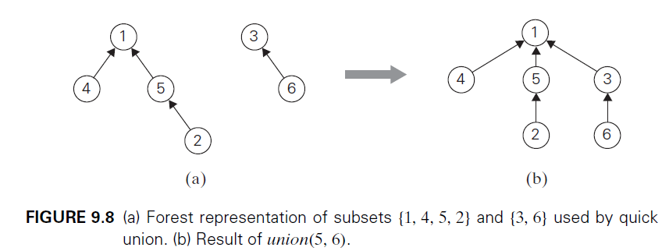
Greedy Technique
Greedy Technique
Kruskal’s Algorithm ( Disjoint Subsets and Union-Find Algorithms )
For this implementation, makeset(x) requires the creation of a single-node tree, which is a operation; hence, the initialization of n singleton subsets is in .

Slide 96
Greedy Technique
Kruskal’s Algorithm ( Disjoint Subsets and Union-Find Algorithms )
A union(x, y) is implemented by attaching the root of the y’s tree to the root of the x’s tree (and deleting the y’s tree from the collection by making the pointer to its root null).
The time efficiency of this operation is clearly .
A find(x) is performed by following the pointer chain from the node containing x to the tree’s root whose element is returned as the subset’s representative.
Accordingly, the time efficiency of a single find operation is in O(n) because a tree representing a subset can degenerate into a linked list with n nodes.

Slide 97
Greedy Technique
Greedy Technique
Kruskal’s Algorithm ( Disjoint Subsets and Union-Find Algorithms )
This time bound can be improved.
The straightforward way for doing so is to always perform a union operation by attaching a smaller tree to the root of a larger one, with ties broken arbitrarily.
The size of a tree can be measured either by the number of nodes (this version is called union by size) or by its height (this version is called union by rank).
Of course, these options require storing, for each node of the tree, either the number of node descendants or the height of the subtree rooted at that node, respectively.

Slide 98
Greedy Technique
Greedy Technique
Kruskal’s Algorithm ( Disjoint Subsets and Union-Find Algorithms )
One can easily prove that in either case the height of the tree will be logarithmic, making it possible to execute each find in O(log n) time.
Thus, for quick union, the time efficiency of a sequence of at most n − 1 unions and m finds is in O(n + m log n).
In fact, an even better efficiency can be obtained by combining either variety of quick union with path compression.
This modification makes every node encountered during the execution of a find operation point to the tree’s root (Figure 9.9).

Slide 99
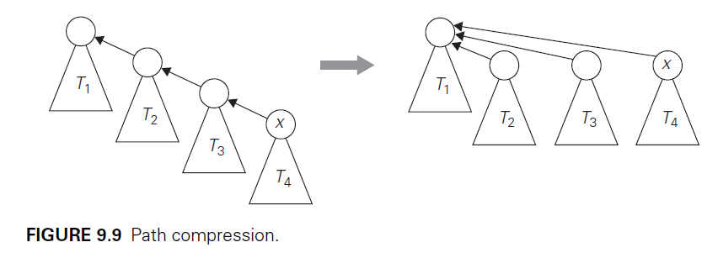
Greedy Technique
Greedy Technique
Kruskal’s Algorithm ( Disjoint Subsets and Union-Find Algorithms )
This and similar techniques improve the efficiency of a sequence of at most n − 1 unions and m finds to only slightly worse than linear.

Slide 100
Module-4
Huffman Trees and Codes

Slide 101
Greedy Technique
Huffman Trees and Codes
Suppose we have to encode a text that comprises symbols from some n-symbol alphabet by assigning to each of the text’s symbols some sequence of bits called the codeword.
For example, we can use a fixed-length encoding that assigns to each symbol a bit string of the same length m (m ≥ log2 n). This is exactly what the standard ASCII code does.
One way of getting a coding scheme that yields a shorter bit string on the average is based on the old idea of assigning shorter codewords to more frequent symbols and longer codewords to less frequent symbols.

Slide 102
Greedy Technique
Huffman Trees and Codes
Variable-length encoding, which assigns codewords of different lengths to different symbols, introduces a problem that fixed-length encoding does not have.
Namely, how can we tell how many bits of an encoded text represent the first symbol?
To avoid this complication, we can limit ourselves to the so-called prefix-free (or simply prefix) codes.
In a prefix code, no codeword is a prefix of a codeword of another symbol. Hence, with such an encoding, we can simply scan a bit string until we get the first group of bits that is a codeword for some symbol, replace these bits by this symbol, and repeat this operation until the bit string’s end is reached.

Slide 103
Greedy Technique
Huffman Trees and Codes
If we want to create a binary prefix code for some alphabet, it is natural to associate the alphabet’s symbols with leaves of a binary tree in which all the left edges are labeled by 0 and all the right edges are labeled by 1.
The codeword of a symbol can then be obtained by recording the labels on the simple path from the root to the symbol’s leaf.
Since there is no simple path to a leaf that continues to another leaf, no codeword can be a prefix of another codeword; hence, any such tree yields a prefix code.

Slide 104
Greedy Technique
Huffman Trees and Codes
Among the many trees that can be constructed in this manner for a given alphabet with known frequencies of the symbol occurrences, how can we construct a tree that would assign shorter bit strings to high-frequency symbols and longer ones to low-frequency symbols?
It can be done by the following greedy algorithm, invented by David Huffman while he was a graduate student at MIT [Huf52].

Slide 105
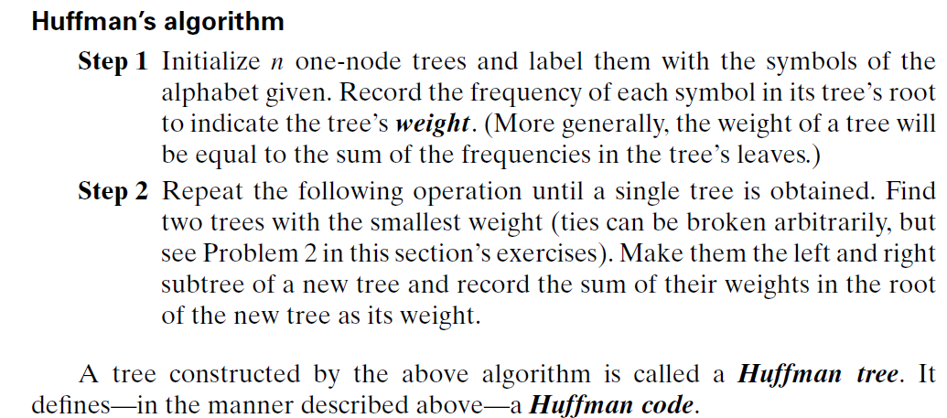
Greedy Technique
Huffman Trees and Codes

Slide 106
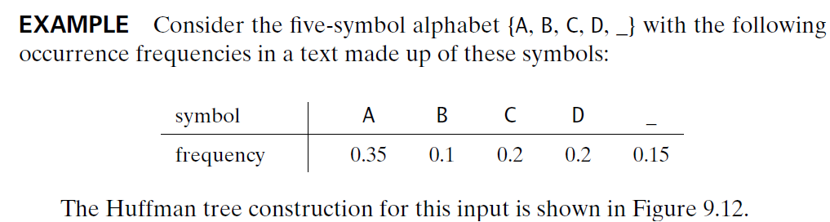
Greedy Technique
Huffman Trees and Codes

Slide 107
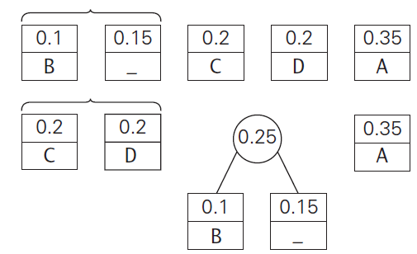
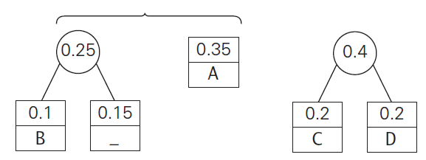
Greedy Technique
Huffman Trees and Codes

Slide 108
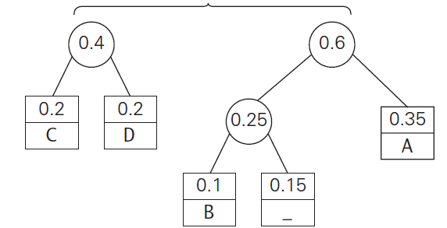
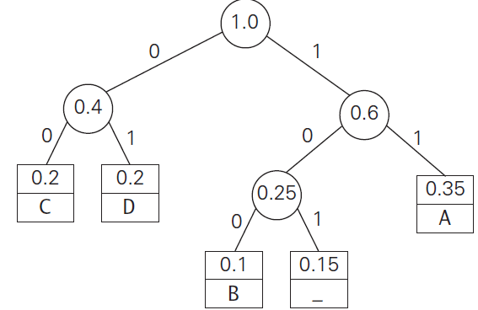
Greedy Technique
Huffman Trees and Codes

Slide 109
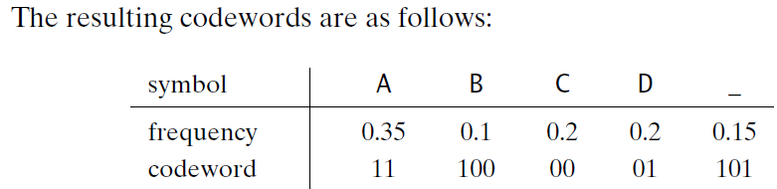
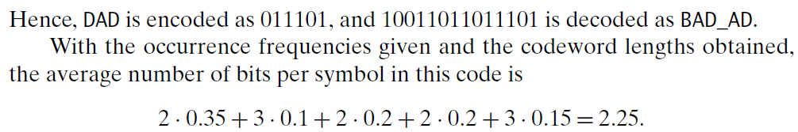
Greedy Technique
Huffman Trees and Codes

Slide 110
Greedy Technique
Huffman Trees and Codes
Had we used a fixed-length encoding for the same alphabet, we would have to use at least 3 bits per each symbol.
Thus, for this toy example, Huffman’s code achieves the compression ratio—a standard measure of a compression algorithm’s effectiveness—
of (3− 2.25)/3 100%= 25%.
In other words, Huffman’s encoding of the text will use 25% less memory than its fixed-length encoding.

Slide 111
Greedy Technique
Huffman Trees and Codes
Huffman’s encoding is one of the most important file-compression methods. In addition to its simplicity and versatility, it yields an optimal, i.e., minimal-length, encoding (provided the frequencies of symbol occurrences are independent and known in advance).
The simplest version of Huffman compression calls, in fact, for a preliminary scanning of a given text to count the frequencies of symbol occurrences in it.
Then these frequencies are used to construct a Huffman coding tree and encode the text as described above.
This scheme makes it necessary, however, to include the coding table into the encoded text to make its decoding possible.

Slide 112
Greedy Technique
Huffman Trees and Codes
This drawback can be overcome by using dynamic Huffman encoding, in which the coding tree is updated each time a new symbol is read from the source text.
It is important to note that applications of Huffman’s algorithm are not limited to data compression. Suppose we have n positive numbers w1, w2, . . . , wn that have to be assigned to n leaves of a binary tree, one per node.

Slide 113

Greedy Technique
Huffman Trees and Codes
If we define the weighted path length as the sum where li is the length of the simple path from the root to the ith leaf, how can we construct a binary tree with minimum weighted path length?
This problem arises in many situations involving decision making. Consider, for example, the game of guessing a chosen object from n possibilities (say, an integer between 1 and n) by asking questions answerable by yes or no.
Different strategies for playing this game can be modeled by decision trees such as those depicted in Figure 9.13 for n = 4.

Slide 114
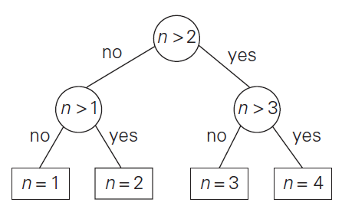
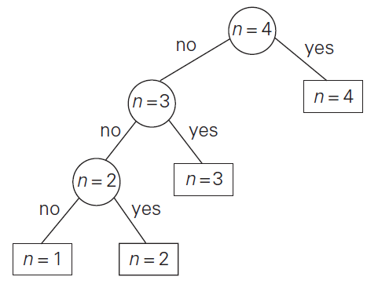
Greedy Technique
Huffman Trees and Codes

Slide 115
Greedy Technique
Huffman Trees and Codes
The length of the simple path from the root to a leaf in such a tree is equal to the number of questions needed to get to the chosen number represented by the leaf.
If number i is chosen with probability pi, the sum where l_{i} is the length of the path from the root to the i^{th} leaf, indicates the average number of questions needed to “guess” the chosen number with a game strategy represented by its decision tree.
If each of the numbers is chosen with the same probability of 1/n, the best strategy is to successively eliminate half (or almost half) the candidates as binary search does.
This may not be the case for arbitrary pi ’s, however.

Slide 116
Greedy Technique
Huffman Trees and Codes
For example, if n = 4 and p1 = 0.1, p2 = 0.2, p3 = 0.3, and p4 = 0.4, the minimum weighted path tree is the rightmost one in Figure 9.13.
Thus, we need Huffman’s algorithm to solve this problem in its general case.
Note that this is the second time we are encountering the problem of constructing an optimal binary tree.
In this section, given numbers are assigned just to leaves.
The latter problem turns out to be easier: it can be solved by the greedy algorithm, whereas the former is solved by the more complicated dynamic programming algorithm.

Slide 117
Module-4
Dijkstra’s Algorithm

Slide 118
Greedy Technique
Dijkstra’s Algorithms
We consider the single-source shortest-paths problem: for a given vertex called the source in a weighted connected graph, find shortest paths to all its other vertices.
It is important to stress that we are not interested here in a single shortest path that starts at the source and visits all the other vertices.
The single-source shortest-paths problem asks for a family of paths, each leading from the source to a different vertex in the graph, though some paths may, of course, have edges in common

Slide 119
Greedy Technique
Dijkstra’s Algorithms
The most widely used applications are transportation planning and packet routing in communication networks, including the Internet.
There are several well-known algorithms for finding shortest paths, including Floyd’s algorithm for the more general all-pairs shortest-paths problem
Here, we consider the best-known algorithm for the single-source shortest-paths problem, called Dijkstra’s algorithm.
This algorithm is applicable to undirected and directed graphs with nonnegative weights only

Slide 120
Greedy Technique
Dijkstra’s Algorithms
Dijkstra’s algorithm finds the shortest paths to a graph’s vertices in order of their distance from a given source.
First, it finds the shortest path from the source to a vertex nearest to it, then to a second nearest, and so on.
In general, before its ith iteration commences, the algorithm has already identified the shortest paths to i −1 other vertices nearest to the source.
These vertices, the source, and the edges of the shortest paths leading to them from the source form a subtree T_{i} of the given graph (Figure 9.10).

Slide 121
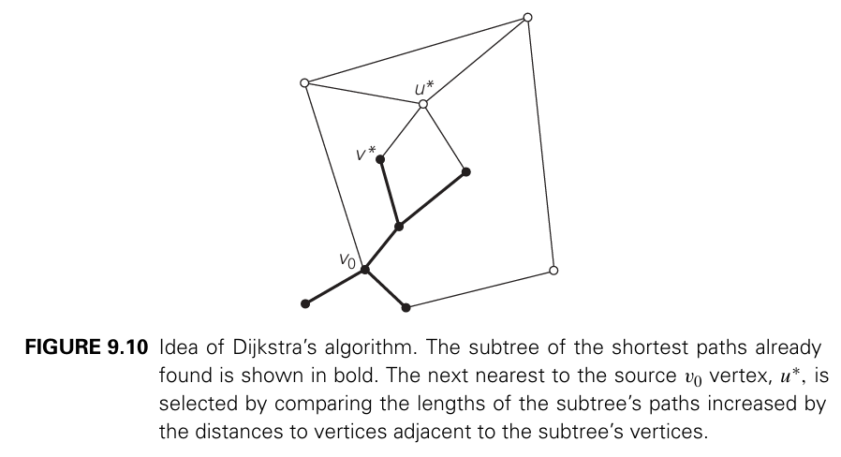
Greedy Technique

Slide 122

Greedy Technique

Slide 123
Greedy Technique
Dijkstra’s Algorithms
The time efficiency of Dijkstra’s algorithm depends on the data structures used for implementing the priority queue and for representing an input graph itself.

Slide 124



Slide 125
End of Module 4

