Slide 1

Splay-Tree

Slide 2
Splay tree is another variant of a binary search tree, Like AVL and Red-Black Trees, Splay tree is also self-balancing BST. The main idea of splay tree is to bring the recently accessed item to root of the tree, this makes the recently searched item to be accessible in O(1) time if accessed again. The idea is to use locality of reference (In a typical application, 80% of the access are to 20% of the items).

Slide 3
The search operation in Splay tree does the standard BST search, in addition to search, it also splays (move a node to the root). If the search is successful, then the node that is found is splayed and becomes the new root. Else the last node accessed prior to reaching the NULL is splayed and becomes the new root.

Slide 4
Splaying an element, is the process of bringing it to the root position by performing suitable rotation operations.
In a splay tree, splaying an element rearranges all the elements in the tree so that splayed element is placed at the root of the tree.

Slide 5
Rotations in Splay Tree
Zig rotation
Zag rotation
Zig-Zig rotation
Zig-Zag rotation
Zag-Zig rotation
Zag-Zag rotation

Slide 6

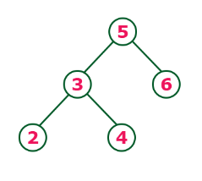
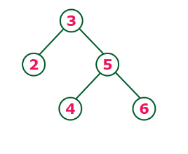
Zig and Zag rotations:
Zig (splay 3)
Single right rotation
Zag (splay 5)
Single left rotation

Slide 7
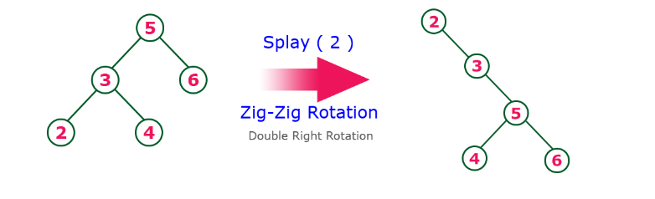
Zig-Zig rotation

Slide 8
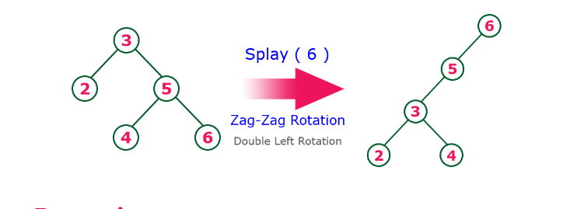
Zag-Zag Rotation:

Slide 9
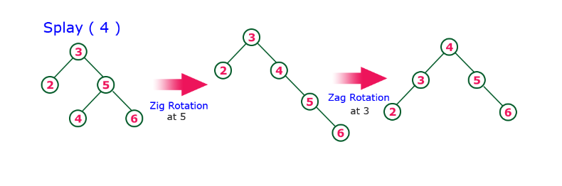
Zig-Zag rotation :

Slide 10
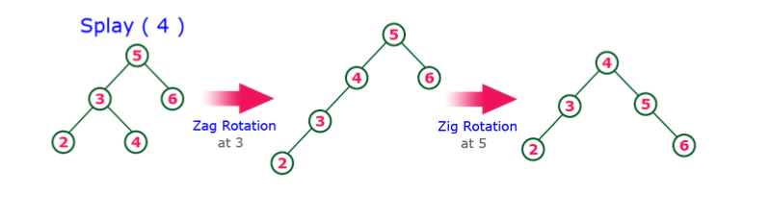
Zag-Zig rotation:

Slide 11
Insertion Operation in Splay-Tree :
Step 1 - Check whether tree is Empty.
Step 2 - If tree is Empty then insert the newNode as Root node and exit from the operation.
Step 3 - If tree is not Empty then insert the newNode as leaf node using Binary Search tree insertion logic.
Step 4 - After insertion, Splay the newNode

Slide 12
Deletion Operation in Splay-Tree :
The deletion operation in splay tree is similar to deletion operation in Binary Search Tree. But before deleting the element, we first need to splay that element and then delete it from the root position. Finally join the remaining tree using binary search tree logic.

Slide 13
Splay trees are typically used in the implementation of caches, memory allocators, garbage collectors, data compression, ropes (replacement of string used for long text strings), in Windows NT (in the virtual memory, networking, and file system code) etc

Slide 14
A good example is a network router. A network router receives network packets at a high rate from incoming connections and must quickly decide on which outgoing wire to send each packet, based on the IP address in the packet. The router needs a big table (a map) that can be used to look up an IP address and find out which outgoing connection to use. If an IP address has been used once, it is likely to be used again, perhaps many times. So we can bulid the look up table using splay tree. if we have look up for a ip address once it will come on top of tree, so next time that ip address come again ,we can find its entry on top and don’t have to go till bottom.

