Slide 1

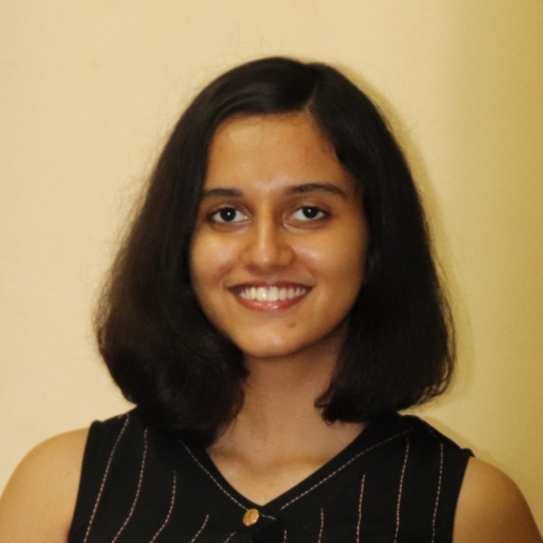
Name : Abha Nitin Barge
PROBLEM STATEMENT – 1
Technical Problem Statement:
Transforming Early Talent Engagement and Hiring through Advanced Analytics and AI
What if Unstop could provide an ‘unstoppable’ guarantee to recruiters ?
My solution aims to maintain an optional but powerful
‘unstoppable guarantee score’ for each user, this is based on factors like daily activity, participation rate, skills possessed.
This would achieve the following :
Increased user engagement
Increased trust from recruiters

Slide 2

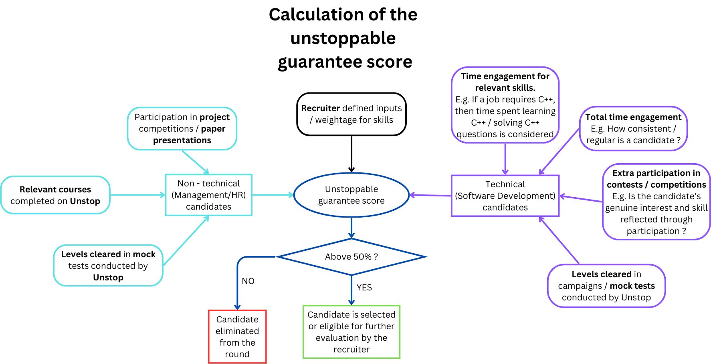
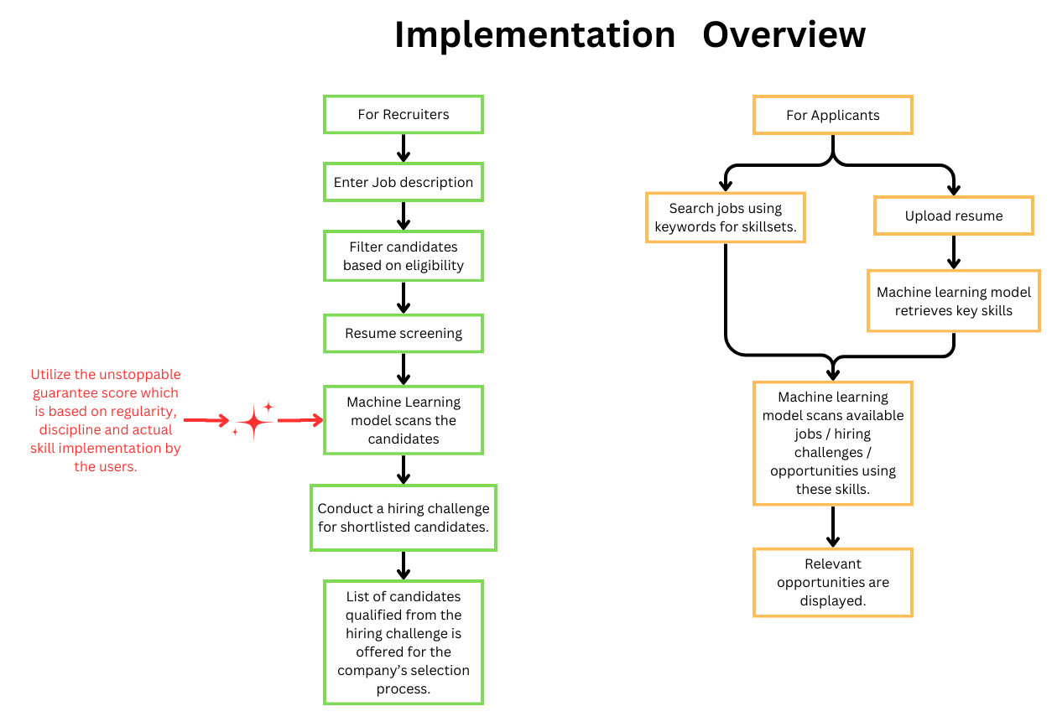
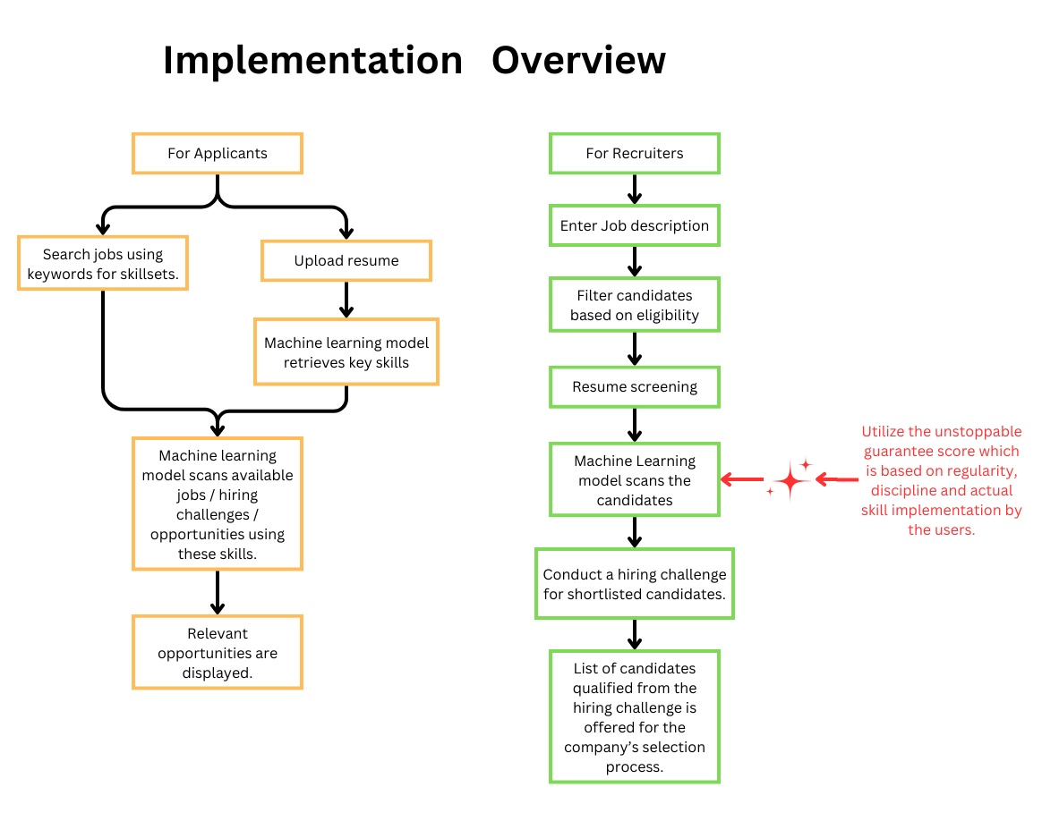
Why use the unstoppable guarantee score ?
Many candidates lie on their resume and write about skills that they do not possess. In the recruiting process, spanning over few months, the recruiters invest their time and resources by shortlisting such candidates, only to find out that they are not fit for the job, this is a prevalent problem.
The Unstoppable Guarantee Score considers the applicant’s regularity, true proficiency and
overall dedication towards the field in which they are applying for a job. This eliminates all
false applicants and saves the recruiter’s time and monetary investments.
Job-market perspective
Unstop can revolutionize the industry and amplify the trust of various recruiters, in Unstop if it can offer a fool-proof system for this, this is possible by using the ‘Unstoppable Guarantee Score’
This will take Unstop ahead of the competition, in terms of recruiters as well as good applicants who would prefer proper validation of their skills.
Over the time, it can be used to predict selection chances.
This will also encourage candidates to be truthful and regular in their practice, thereby resulting in an
increased user engagement.
Specific weightage is allocated to every feature, to reduce any bias.
E.g. Solving difficult questions will get a higher score than solving easy questions.
How to implement this ?
I will use a machine learning model that implements multiple machine learning algorithms to calculate the Unstoppable Guarantee score.
I will use Decision Trees for attribute selection to choose the features, dimensionality reduction techniques like Principal Component Analysis or Attribute Subset Selection are implemented.
For score calculation, I will use multiple regression or polynomial regression based on the features used and weightage provided to them.
In the future, I can use clustering algorithms like K-Means algorithm to cluster applicants with similar scores and Apriori algorithm to perform Market Basket Analysis and recommend targeted mock tests, preparation courses, etc. to specific applicants.
Unstop can also use this model to identify and recruit talented individuals for Unstop itself, by modifying the parameters.
Recurrent Neural Networks(RNN) can be used for Time Series Analysis, to show variation in the scores of every user over sometime, this can motivate them to engage more with the platform.
Generative Adversarial Networks(GAN) can be used to create personalised application guide-bots based on the Unstop Guarantee Score of an applicant.

