Slide 1





TANCAM’S
HACKATHON FOR WOMEN
IN ENGINEERING
THEME: Bio-Sanitation Station
TITLE: Enhancing the quality of treated water
VENUE: Kalaingarkarunanithi Institute of Technology
TEAM LEADER NAME: Suthi S K

Slide 2
PROBLEM STATEMENT :
The treated water from the bio sanitation station remains inefficient, containing high levels of pathogens even after treatment. Consequently, it fails to meet the standards required for public sector use in industrial, urban, and agricultural applications and is found harmful on discharging into water bodies.

Slide 3
OBJECTIVES OF THE WORK
To increase the efficiency of treated water from bio sanitation stations thereby improving its quality.
To arrive a sustainable solution by means of replacing energy requirement with a renewable resource.
To overcome the disadvantages of the existing disinfectant and filtration methods involved.
To lower the overall cost of water treatment in bio sanitation station.
To protect the public health and meeting the demands in applications treated water.

Slide 4
PROJECT DESCRIPTION:
Bio sanitation station generally involves a sequence of steps including Pretreatment, Primary, Secondary and Tertiary treatment.
Large debris is filtered in the Pretreatment whereas suspended solids are removed in the Primary treatment.
Secondary treatment involves microorganisms grown as biofilms through aeration which removes organic matter producing treated effluent.
Tertiary treatment is an advanced method involving filtration, nutrient removal, and disinfection thereby refining the wastewater quality.
Existing UV radiation and chlorination methods of disinfection proved to be harmful for the environment in multiple ways.

Slide 5
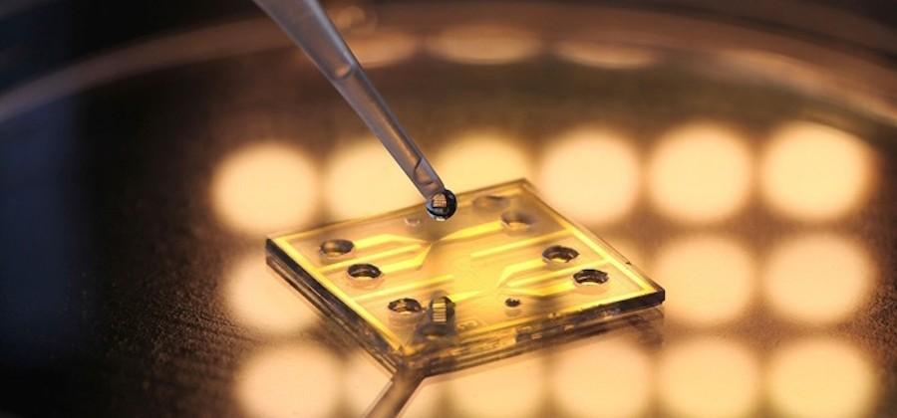
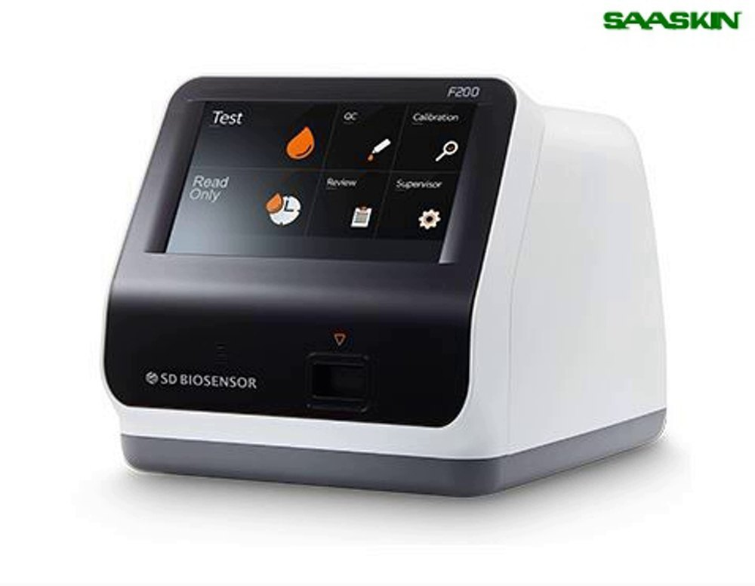
Our solution focuses on replacing the steps in tertiary treatment by monitoring the level of pathogens and applying bacteriophages in a proper level.
A sample of the water from secondary treatment is tested using DNA biosensor and produces a biological signal in response to DNA presence.
Electrochemical transducer present in this sensor converts the biological signal into an electrical signal (voltage or current).
The intensity of signal is proportional to the concentration of pathogens and the calibration curve is used to identify the levels of pathogen.
The dosage level of phage application is decided from the concentration values for effective usage of disinfectants.

Slide 6
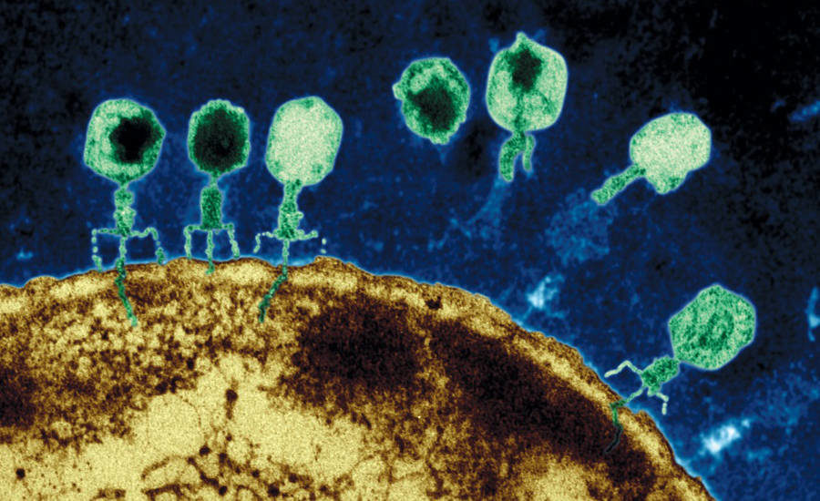
Our innovative solution involves usage of hybrid bacteriophages as disinfectants which has the ability to kill multiple bacterial strains in treated water.
Escherichia coli (E.coli)
Salmonella
Listeria monocytogens
Campylobacter
“PhageGuard and FOP (Foodborne Outbreak Pill)” – A commercial hybrid bacteriophage developed by Micreos for food industrial applications, that targets all the bacterial strains in treated water.
These hybrid bacteriophages are produced as a result of genetic engineering by combining the DNA of bacterial strains.

Slide 7
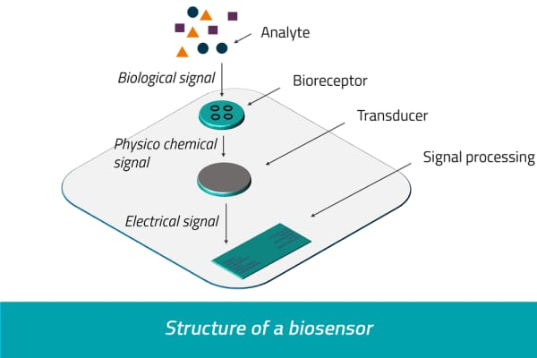
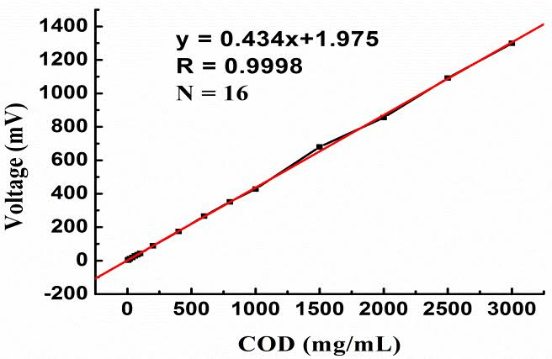
SOLUTION MODEL :
Calibration Curve

Slide 8
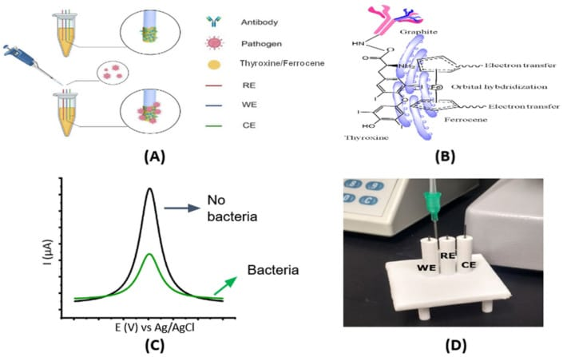
SOLUTION MODEL :
DETECTION OF THE PRESENCE OF PATHOGENS

Slide 9
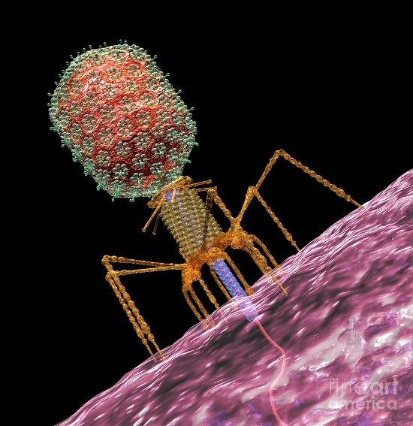
CONCLUSIONS:
Bacteriophages offer several advantages as disinfectants compared to traditional chemical methods.
Their specificity, safety, environmental sustainability, and potential for addressing antimicrobial resistance make them promising alternatives.
The use of bacteriophages is a sustainable solution that eliminates the energy requirements making the process eco friendly.

Slide 10
TEAM MEMBER DETAILS:
TEAM MEMBER 1 :
TEAM MEMBER 2 :
NAME: Vajika Shafreen K
SEMESTER: IV
YEAR: 2ND Year
DEPARTMENT: ECE
NAME: Suthi S K
SEMESTER: IV
YEAR: 2ND Year
DEPARTMENT: ECE

