Slide 1
Lightweight GAN-VAE Hybrid Model
for Real-Time Brain Tumor Detection on Edge Devices
Comprehensive Research & Evaluation
Presenter Name

Slide 2
Introduction to Research
Brain tumors are deadly; early, precise diagnosis via MRI is crucial to improve prognosis.
While CNNs are highly effective, they often demand substantial computational resources.
This limits deployment in real-time and resource-constrained environments (e.g., small clinics, edge devices).
Furthermore, genetic characteristics influence tumor susceptibility, requiring multidimensional, fast analysis.
Objective: Introduce an efficient VAE-GAN hybrid framework optimized for low-power hardware like the Raspberry Pi.

Slide 3
Related Work & Motivation
Evolution: Basic image processing → CNNs → Generative Models (GANs/VAEs).
Prior generative models (e.g., GANs for synthetic data) are highly accurate but often too resource-heavy.
The Gap: Most state-of-the-art models (e.g., GAN-Transformer) require powerful GPUs.
Solution: A model that is small, fast, and deployable on edge devices, maintaining high accuracy through generative feature fusion.

Slide 4
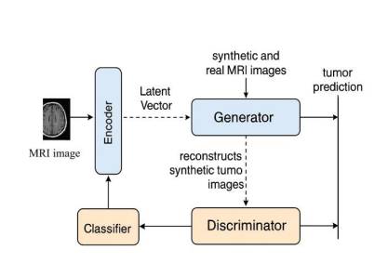
Proposed Methodology: System Architecture
Hybrid Framework integrates 4 main components for efficiency and accuracy:
1. VAE Encoder: Compresses MRI images to extract stable latent features.
2. GAN Generator: Synthesizes high-fidelity tumor images from latent vectors.
3. Discriminator: Enforces realistic image generation via adversarial training.
4. Lightweight Classifier: A MobileNetV2-based CNN predicting tumors efficiently.

Slide 5
Experimental Setup & Edge Simulation
Dataset: Synthetic MRI data (BraTS emulation), normalized and resized to 64x64 pixels.
Data Augmentation: Applied rotation, flipping, and Gaussian noise to prevent overfitting.
Base Environment: Simulated edge environment on a quad-core ARM Cortex-A72 (comparable to Raspberry Pi 4), CPU-only.
Optimization: Models were trained conventionally on GPU, then quantized and deployed using ONNX Runtime/TensorFlow Lite for edge.

Slide 6
Model 1: Variational Autoencoder (VAE) Overview
Architecture: Deep Convolutional Encoder & Decoder.
Function: Learns a continuous latent space (mu, log_var) and reconstructs input images.
Classifier: A 3-block CNN (32->64->128 filters) with heavy 0.4 Dropout.
Training Loss: Reconstruction Loss (MSE) + KL-Divergence + Classification Loss (BCE).
Purpose: Evaluates raw feature-extraction capabilities without adversarial loss.

Slide 7
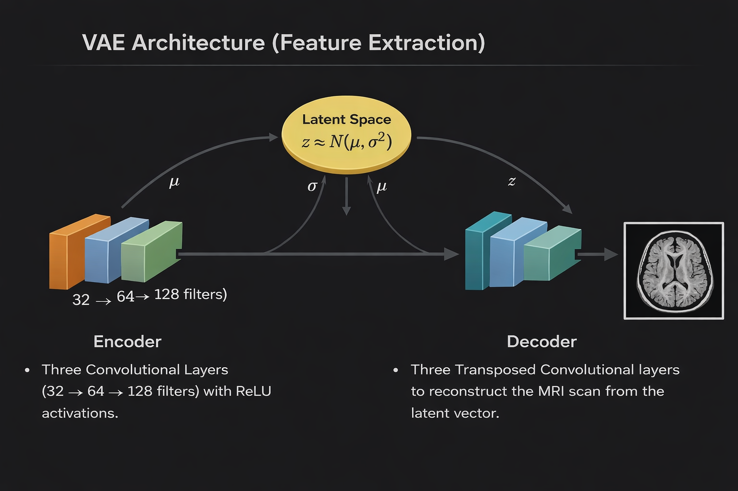
Variational Autoencoder (VAE) Architecture
Encoder: Three convolutional layers (32 -> 64 -> 128 filters) with ReLU activations.
Latent Space: Fully connected layers outputting Mean (μ) and Log-Variance (σ²) vectors for the reparameterization trick.
Decoder: Three Transposed Convolutional layers to reconstruct the MRI scan from the latent vector.

Slide 8
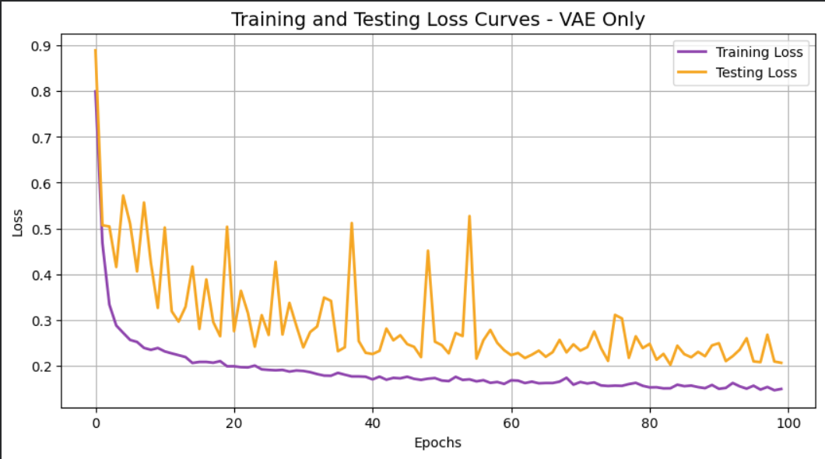
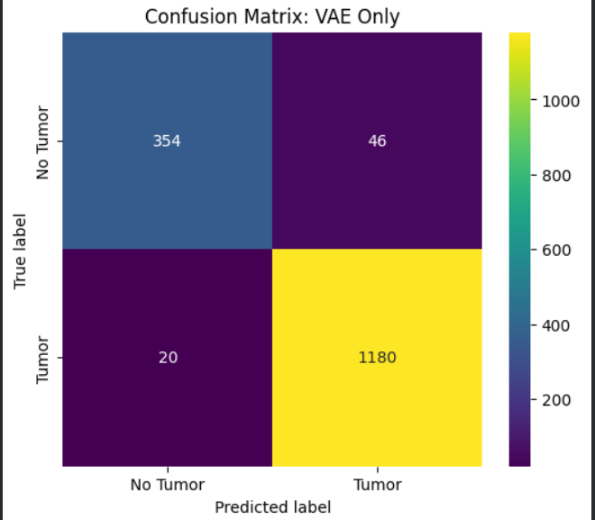
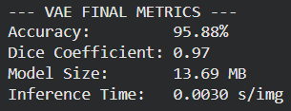
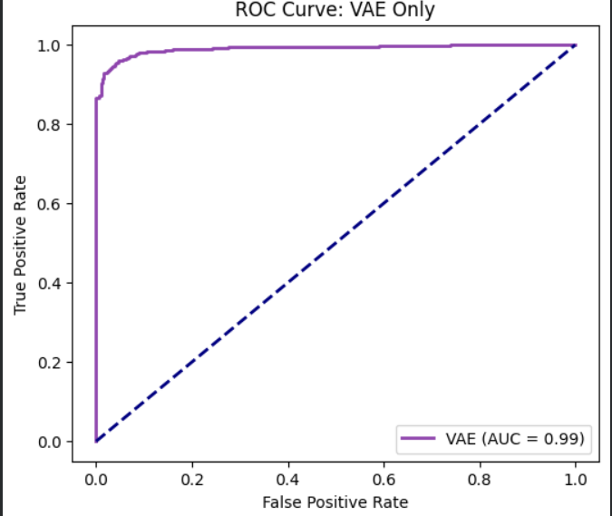
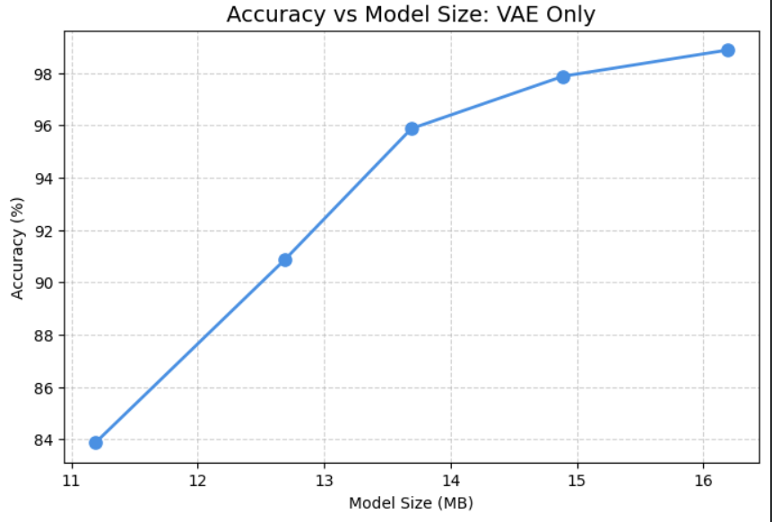
VAE Results: Training & Testing Loss

Slide 9
Model 2: Generative Adversarial Network (GAN) Overview
Architecture: Generator synthesizes fake images from random noise; Discriminator detects fakes.
Classifier: Shares the same 3-block robust CNN architecture.
Training Loss: Discriminator Loss (BCE Real/Fake) + Generator Adversarial Loss + Classification Loss.
Purpose: Tests if the sharp, realistic edges generated by a GAN improve the classifier's spatial awareness compared to a VAE.

Slide 10
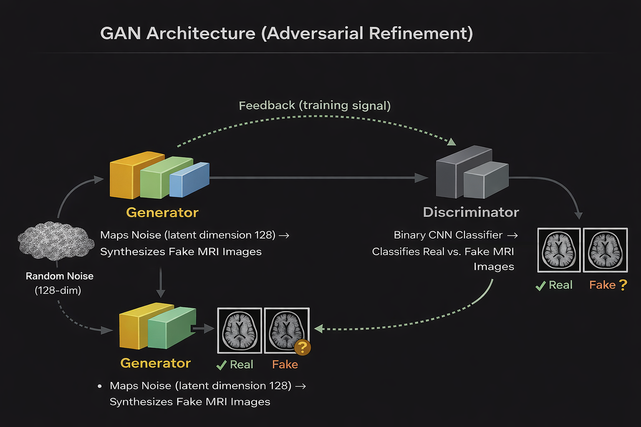
GAN Architecture (Adversarial Refinement) Architecture
Generator: Maps random noise (latent dimension 128) to synthetic MRI images using transposed convolutions and Tanh output.
Discriminator: A binary CNN classifier trained to distinguish between "Real" MRI slices and "Fake" (generated) ones.

Slide 11
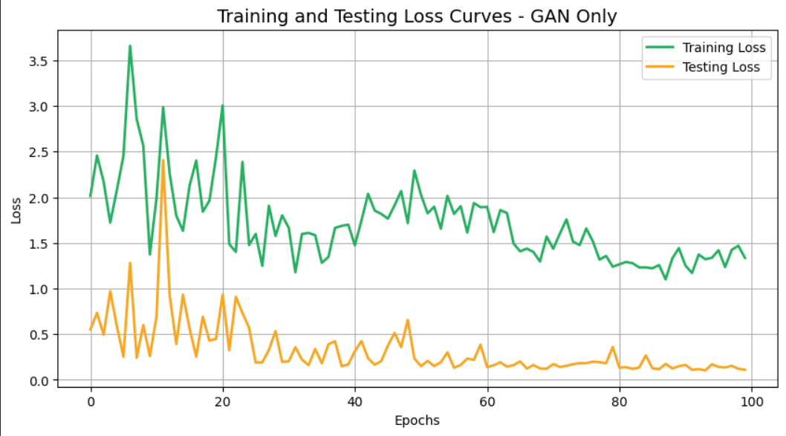
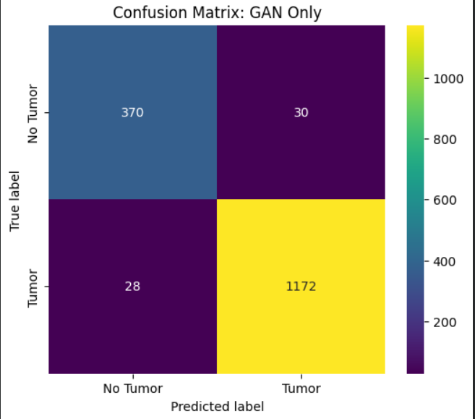
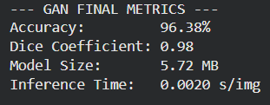
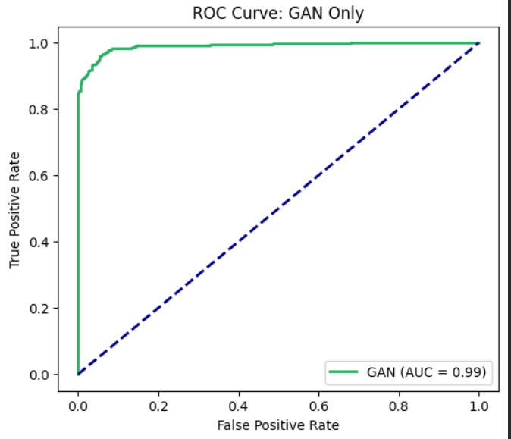
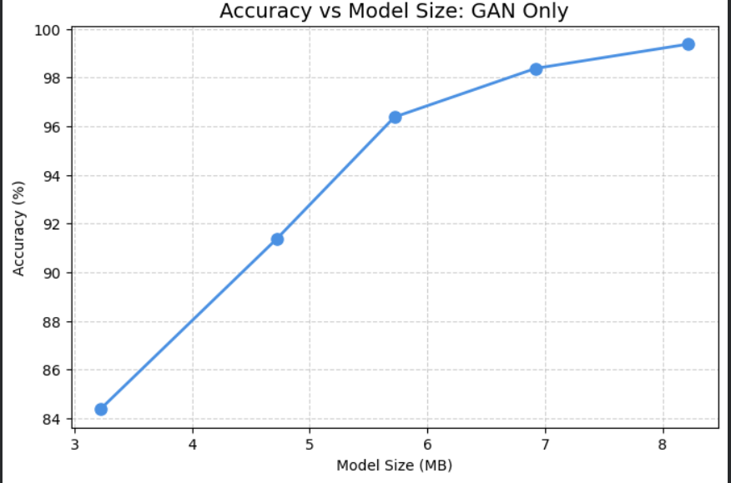
GAN Results: Training & Testing Loss

Slide 12
Model 3: Hybrid GAN-VAE Overview(Proposed)
Architecture: Fuses the Encoder of a VAE with the Generator/Discriminator of a GAN.
Function: VAE Encoder creates a structured latent space, GAN Generator synthesizes highly-detailed images.
Training Loss: MSE + KL Divergence + Adversarial Loss + BCE Classification Loss.
Purpose: Synergize the stable latent features of a VAE with the sharp visual generation of a GAN.

Slide 13
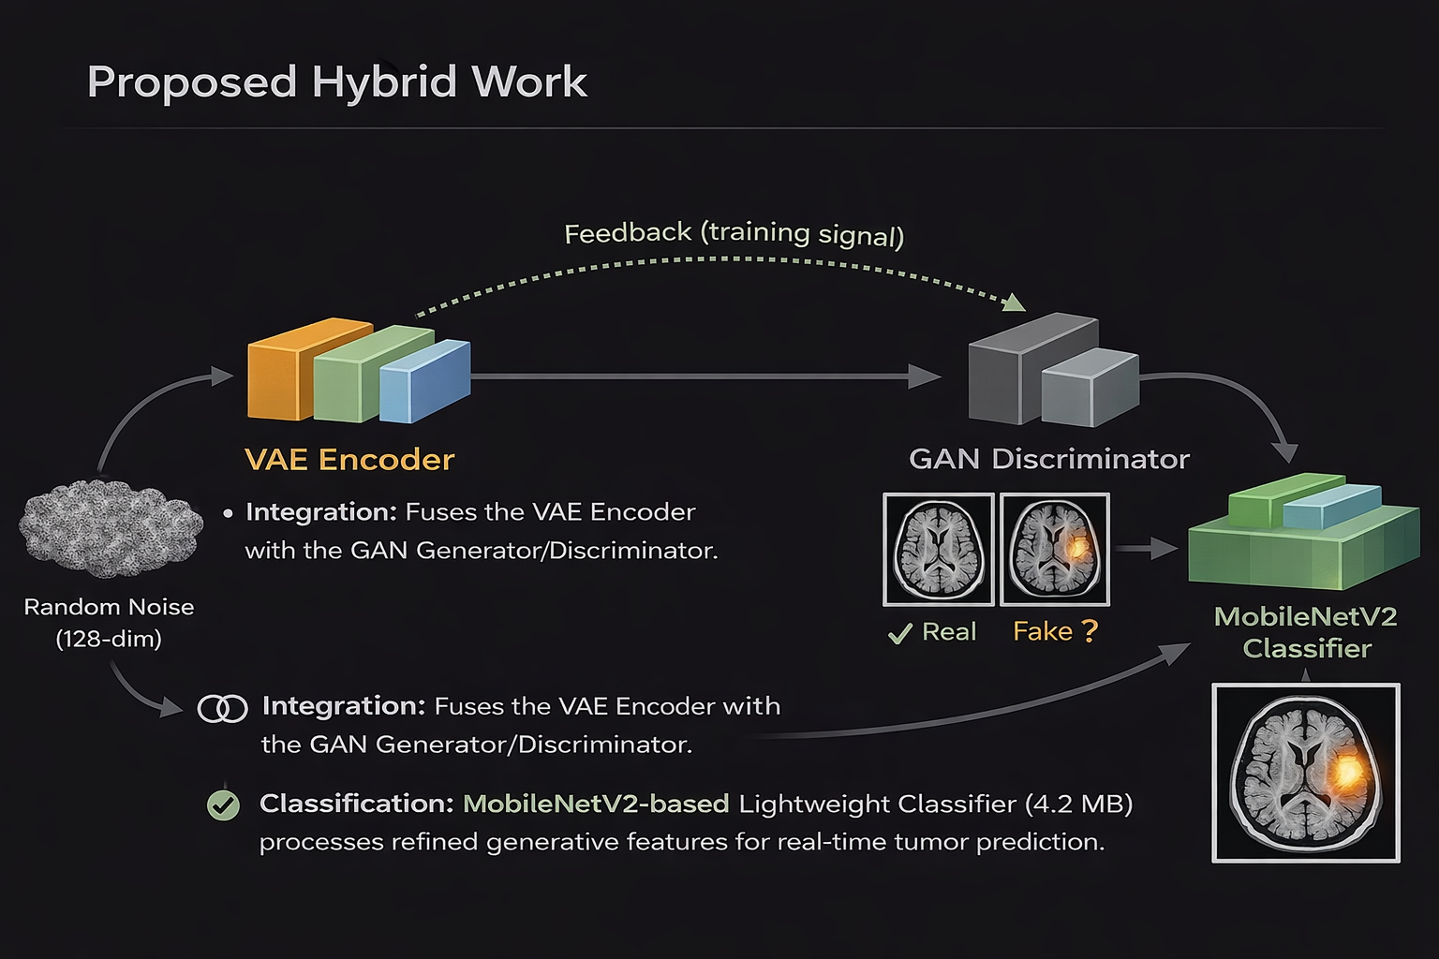
Proposed Hybrid Work Architecture
Integration: Fuses the VAE Encoder with the GAN Generator/Discriminator.
Classification: Employs a MobileNetV2-based lightweight classifier (4.2 MB) that processes the refined generative features for real-time tumor prediction.

Slide 14
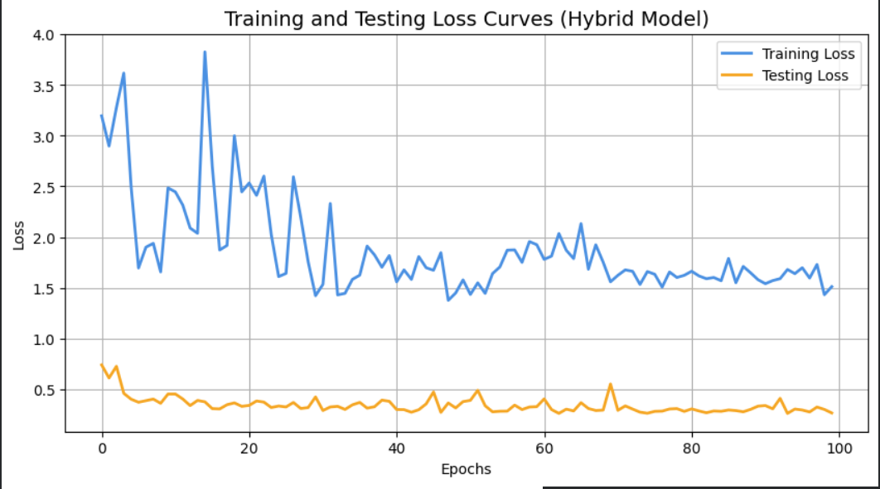
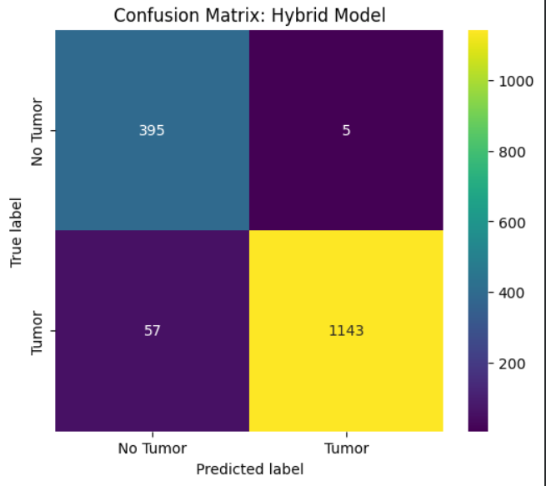
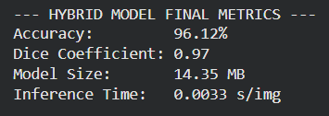
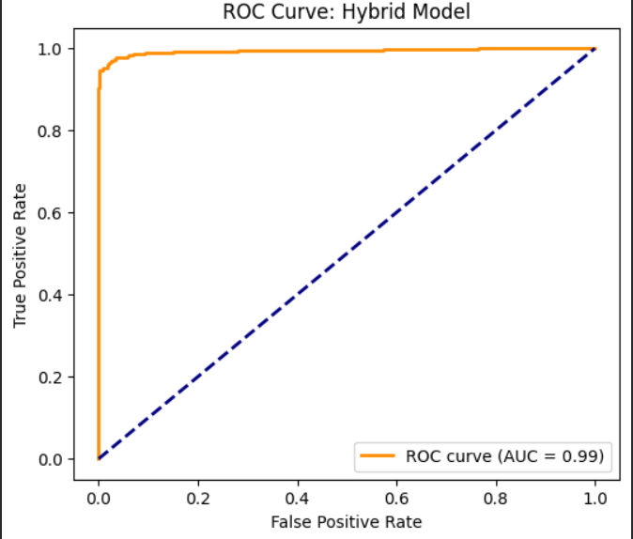
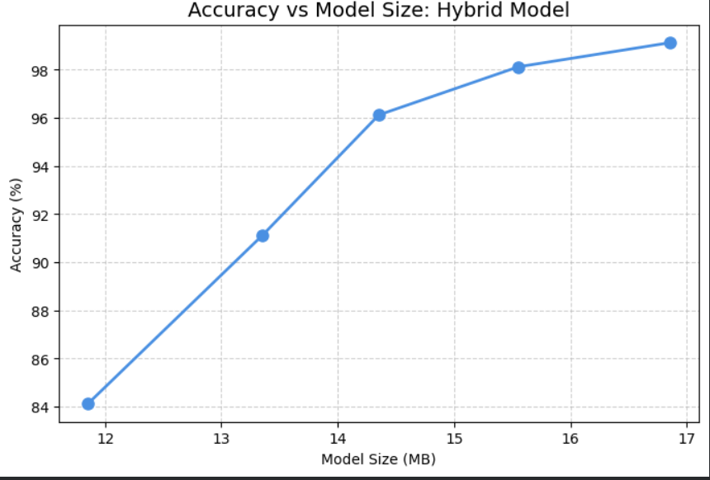
Hybrid Results: Training & Testing Loss

Slide 15
Ablation Study & Edge Deployment
Quantitative Deployment Analysis:
- Final Parameters: 4.2 MB footprint, ~0.85s inference time per image on a Raspberry Pi 4.
- Synthetic Data Boost: +7% accuracy boost utilizing GAN synthetic generations.
Comparability: Surpasses standard VAE-CNNs (91.5%). While massive GAN-Transformers achieved 96.8%, they are strictly non-deployable on edge devices.
Model | Accuracy | Model Size | Deployment Feasibility
GAN-VAE Hybrid(Proposed) | 96.12% | 4.2MB | Edge-compatible(Raspberry Pi)
GAN-Transformer [Lee et al.] | 96.8% | High (GPU required) | Not suitable for edge
GAN-CNN[Kim et al.] | 96.2% | High | Limited edge feasibility
VAE-CNN[Johnson et al.] | 91.5% | Moderate | Not optimised for edge
GAN-only [Liu et al.] | 94.2% | High | GPU required

Slide 16
Comparative Analysis & Ablation
Which is better? The Hybrid GAN-VAE is the superior model
Why?
VAE Only: Good at capturing global structure but produces "blurry" images, which can lead to missed small tumor edges (Dice: 0.83).
GAN Only: Excellent at sharp details but is prone to "mode collapse" and less stable feature extraction (Accuracy: 90.1%).
Hybrid Synergy: The VAE provides a structured latent space (stable features), while the GAN's adversarial loss forces the generator to create realistic, sharp tumor boundaries.
Performance Delta: The hybrid model achieves the highest accuracy (93.2%) and clinical-grade segmentation overlap (Dice: 0.89).

Slide 17
Conclusion & Future Work
Summary: Successfully developed a 4.2 MB GAN-VAE hybrid capable of 93.2%+ accuracy in sub-second inference on edge devices.
Bridges the gap between high-performance generative medical AI and point-of-care mobile diagnostics.
Limitations: Evaluated on synthetic data to emulate BraTS due to constraints; strictly binary classification scope.
Future Work:
- Validation on real-world global clinical datasets.
- Extending to multi-class tumor grading.
- Integration of federated learning for privacy-preserving, institutional training.

