Slide 1
Let’s React

Slide 2
React Component

Slide 3
//app.js
import React from ‘react’;
export default class App extends React.Component {
render() {
return (
<div>
Hello World!!
</div>
);
}
}
//index.js
import React from ‘react’;
import ReactDom from ‘react-dom’;
import App from ‘./components/app.js’;
ReactDom.render(<App />, document.getElementById('app'));

Slide 4
import React from ‘react’;
Import ReactDom from ‘react-dom’;
class App extends React.Component {
render () {
return (
<h1> Hello World again !! </h1>
);
}
}
ReactDom.render(
<App />,
document.getElementById(‘container’)
);
Component
Element

Slide 5
React Elements
An element is a plain object describing a component instance (or DOM node) and its desired properties.
Elements describe the Tree.
<App>
<EmployeeList>
<Employee />
<Employee />
</ EmployeeList>
</ App>
https://facebook.github.io/react/blog/2015/12/18/react-components-elements-and-instances.html

Slide 6
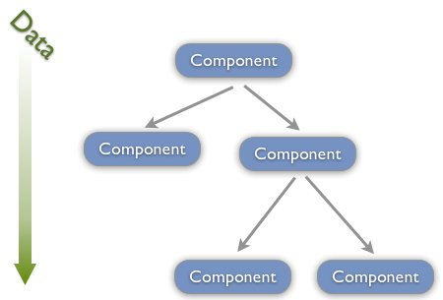
Data Flow
State :
Own State of a component
props :
Properties passed by owner

Slide 7
Props
State
The way data is passed by owner to child components
Defines behaviour - how owner wants a child to behave
Treat it as immutable
Unlike props, state represents dynamic data - maintained by component itself.
Good use-case is data changed by user interaction

Slide 8
React Component Life Cycle

Slide 9
Mounting : when an instance of a component is being created and inserted into the DOM :
constructor()
componentWillMount()
render()
componentDidMount()
Updating : when a component is being re-rendered:
componentWillReceiveProps()
shouldComponentUpdate()
componentWillUpdate()
render()
componentDidUpdate()
Unmounting : when a component is being removed from the DOM:
componentWillUnmount()

Slide 10
render
return UI
pure
required
class EmployeeList extends React.Component {
render() {
return (
<div>
<h4> List of Employees </h4>
{this.getEmployeeList()}
</div>
);
}
getEmployeeList() {....}
}

Slide 11
Constructor
initialize state
bind event handlers

Slide 12
componentWillMount
componentDidMount
Server side rendering
DOM node initialization
Load data
setState - trigger re-rendering

Slide 13
componentDidMount
class SortableList extends React.Component {
componentDidMount() {
this.$list = $(this.refs.sortable);
this.$list.sortable();
}
render() {
return (
<ul ref="sortable"></ul>
);
}
};

Slide 14
componentDidMount
componentDidMount() {
getEmployees().then(data => {
this.setState({
employees: data
})
});
}

Slide 15
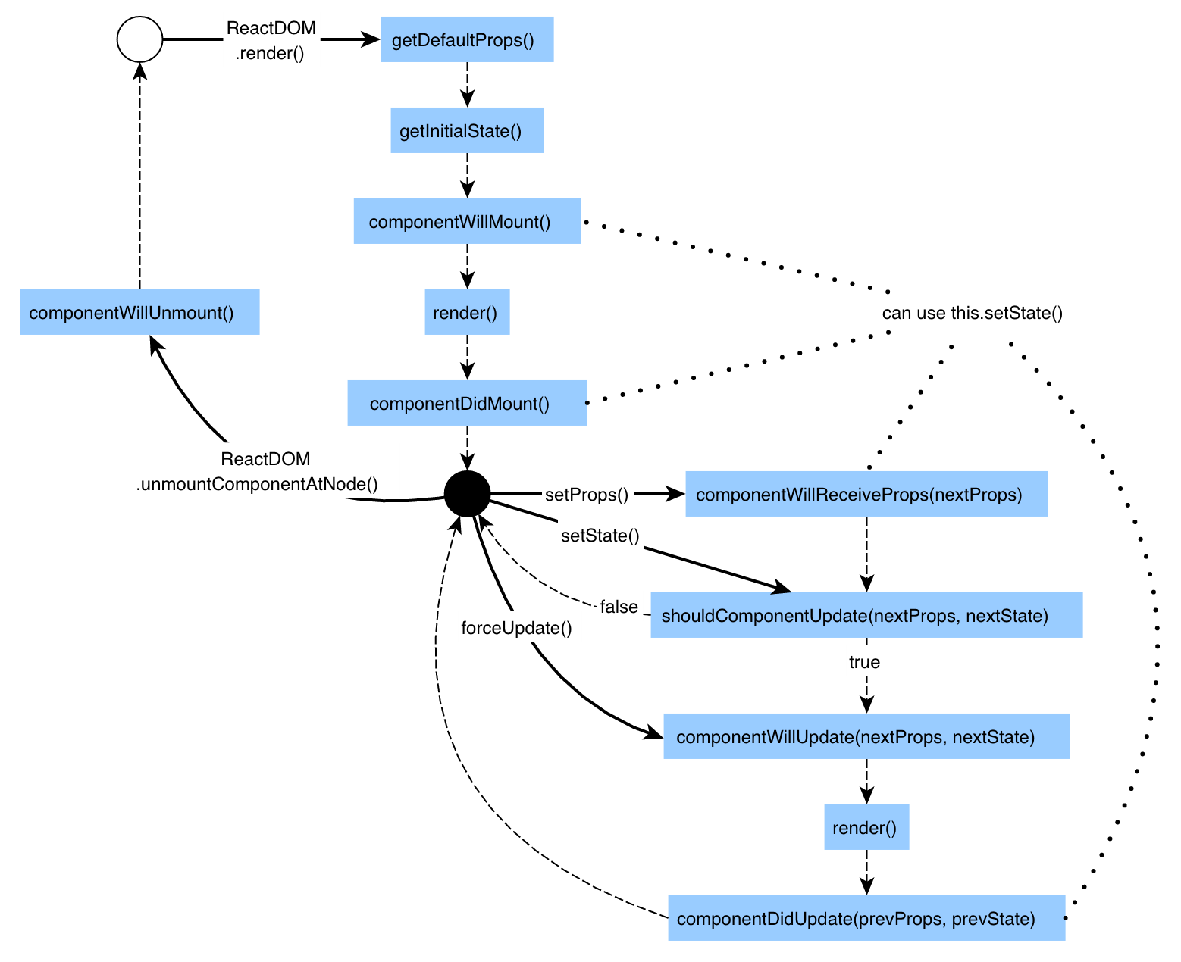

Slide 16
componentWillReceiveProps
Invoked when a component is receiving new props. (A => B) !=> (B => A)
not called for the initial render
set state according to new props
componentWillReceiveProps: function(nextProps) {
this.setState({
likesIncreasing : nextProps.likeCount > this.props.likeCount
});
}

Slide 17
shouldComponentUpdate
Called when new props or state are being received
Opportunity to deny rendering
Performance
shouldComponentUpdate: function(nextProps, nextState) {
return nextProps.likeCount !== this.props.likeCount;
}

Slide 18
componentWillUpdate
Called before rendering
Notify parent/animate
componentWillUpdate(nextProps, nextState) {
if (nextState.open == true && this.state.open == false) {
this.props.onWillOpen();
}
}

Slide 19
componentDidUpdate
After rendering
DOM changes
componentDidUpdate(prevProps, prevState) {
//if height is greater than limit, scroll to bottom
}

Slide 20
componentWillUnmount
Before instance is unmounted and destroyed
Clean-up tasks like destroying jquery elements

Slide 21
setState
Way to tell react - update the state of component and re-render it
Shallow merge
may be batched for performance
Consider it as Async - don’t access the state just after setting it assuming that it would be updated
this.setState({
disable: false
});

Slide 23
propTypes
Describes what kind of data component expects
Gives warning in case of mismatch
Useful for maintenance

Slide 24
defaultProps
Props which can have some default value e.g. checked, disabled

Slide 25
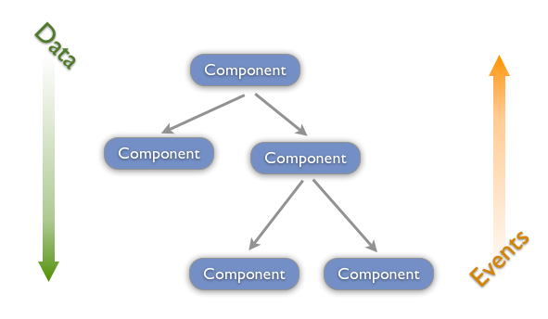
Flow of events

Slide 26
Design
What are the components here? Which piece of UI would be a component?
Which can be owner and child components?
Data flow
  State design - which component should own which data as state?
  Props - which data should be passed as props

Slide 27
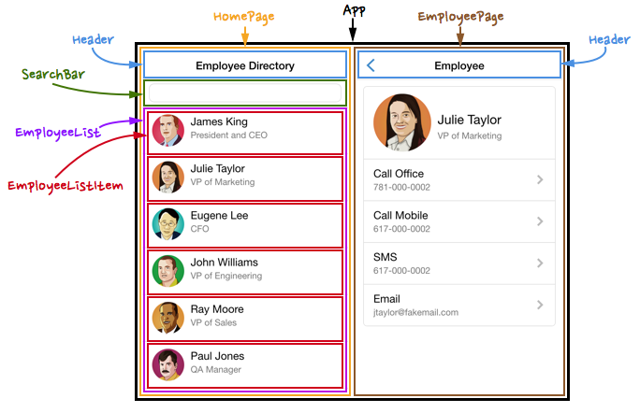

Slide 28
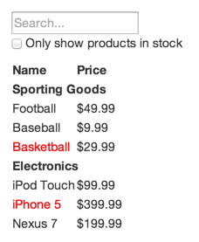
Use case
products = [
{category: "Sporting Goods", price: "$49.99", stocked: true, name: "Football"},
{category: "Sporting Goods", price: "$9.99", stocked: true, name: "Baseball"},
{category: "Sporting Goods", price: "$29.99", stocked: false, name: "Basketball"},
{category: "Electronics", price: "$99.99", stocked: true, name: "iPod Touch"},
{category: "Electronics", price: "$399.99", stocked: false, name: "iPhone 5"},
{category: "Electronics", price: "$199.99", stocked: true, name: "Nexus 7"}
];
Source https://facebook.github.io/react/docs/thinking-in-react.html

Slide 29
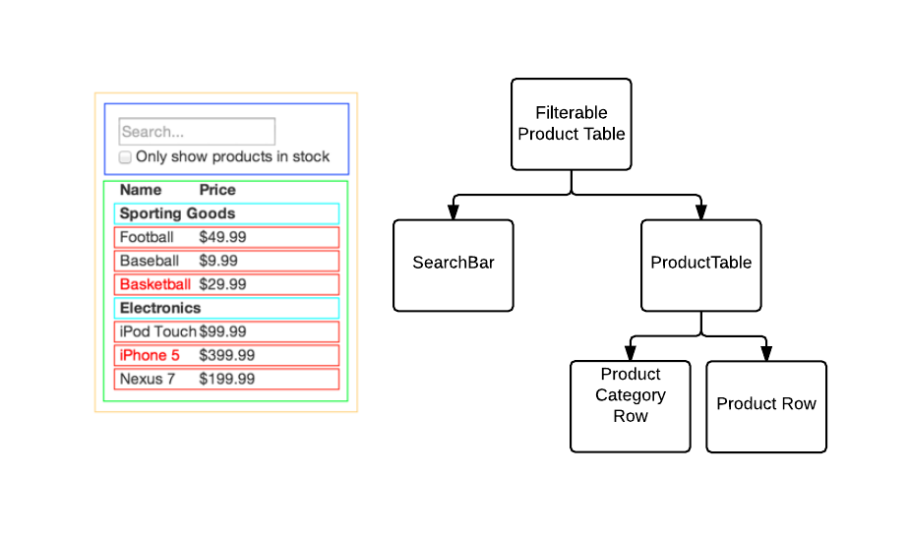
How many components should I have?

Slide 30

what‘s our data here?
Products List
Search Text
Only in stock flag
Static
User Defined
Dynamic

Slide 31
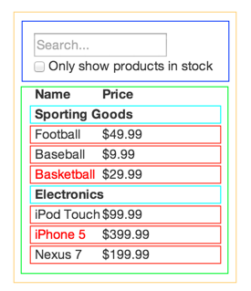
Static data flow - props - product List
Filterable Product table
Props
Product table - show all category and products
Props
Product category - show single category text
Product Row - show single product object

Slide 32
<FilterProductTable products = { data } >
FilterProductTable -
<div>
<ProductTable products={this.props.products}>
</div>
ProductTable -
<div>
//for every change in category
<ProductCategory category={category} />
//for every product
<Product product={product} />
</div>

Slide 33
dynamic data - search Text and only in stock
- state
User changes filter
Props to
ProductTable should contain filter
notify
Product Table

Slide 34

Change in state of a component should render
only to itself and it’s children
NOT owner

Slide 35
dynamic data - search Text and only in stock - state
Filterable Product table state
notify
Filter, Props
Search bar
Product table - filtered data
Props
Product category - show single category text
Product Row - show single product object

Slide 36
FilterProductTable -
<div>
<SerachBar
onSearchText={this.OnsearchTextChange.bind(this)}
onStockOnlyChange={fn} />
<ProductTable products={this.props.products, this.state.filter}>
</div>
OnsearchTextChange (event) {
this.setState({
filter: {
searchText : event.target.value,
isStockOnly: this.state.isStockOnly
}
})
}
In SearchBar
Input - onChange={onSearchText}

Slide 37
High order & functional/stateless components

Slide 38
High Order Components
High order functions use other components to create UI
These components typically takes props from outside, maintain state and pass data to functional components
Example -
class RequiredTextInput extends React.Component {
render() {
return <input required={true} type='text' {...this.props}/>
}
}

Slide 39
Functional / Stateless Components
Functional components don’t maintain state.
These components take data as props and give out UI
No instance is created
E.g. const Emp = (props) => {
return <div>
<div>id - { props.id }</div>
<div>name - { props.name }</div>
</div>
}

Slide 40
refs

Slide 41
Way to access underlying DOM element
Useful for direct DOM manipulation or accessing DOM node properties
<input
type="text"
ref={input => this.textInput = input} />
Or
<input type="text" ref="textInput" />
Use callback instead of string

Slide 42
Component refs
ref can be used with custom component as well
It gives mounted instance
Cannot be used with functional component
class App extends React.Component {
render() {
return <TextInput ref={node => this.input = node} />
}
componentDidMount() {
this.input.someCustomMethod();
}
}

Slide 43
Controlled/Uncontrolled components

Slide 44
Controlled Component
Controlled by component state
We set value as some state property
We assign onChange event and set component state on it
<input name='name'
value={this.state.name}
onChange={this.onNameChange}
/>

Slide 45
Uncontrolled Components
We don’t specify value attribute
We use ref to access DOM node values
defaultValue can be used to pass initial value
<input name='type'
defaultvalue='Permanent'
ref={node => this.typeEle = node}
/>

