Slide 1

React.js

Slide 2
React.js

Slide 3
Name : Soham Sanjay Bhosale Class : S.Y B.Tech Branch : Computer Science

Slide 4
What is React.js ?
React is a JavaScript library created for building fast and interactive user interfaces for web and mobile applications. It is an open-source, component-based, front-end library responsible only for the application’s view layer.

Slide 5
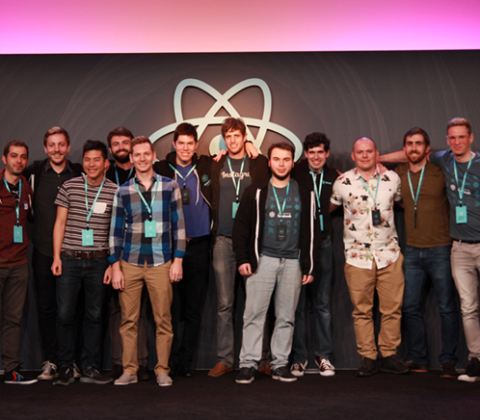
History
React was created by Jordan Walke, a software engineer at Facebook, who released an early prototype of React called "FaxJS".
It was open-sourced at JSConf US in May 2013.
Latest Stable Release - 17.0.2 / 22 March 2021

Slide 6
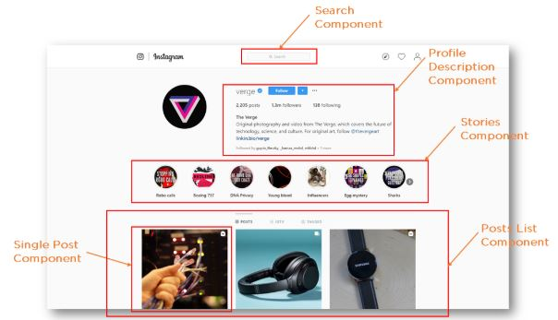
Let’s take a look at an Instagram webpage example, entirely built using React, to get a better understanding of how React works. As the illustration shows, React divides the UI into multiple components, which makes the code easier to debug. This way, each component has its property and function.

Slide 7
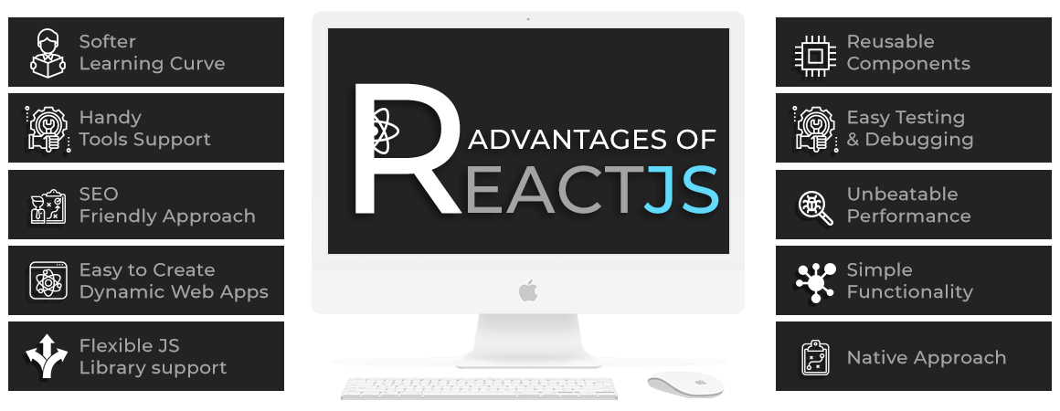
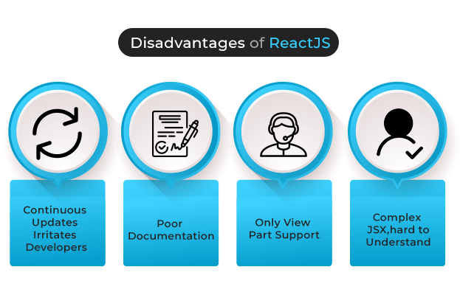
👈Advantages
Disadvantages👉

Slide 8
👈Advantages
Disadvantages👉

Slide 9
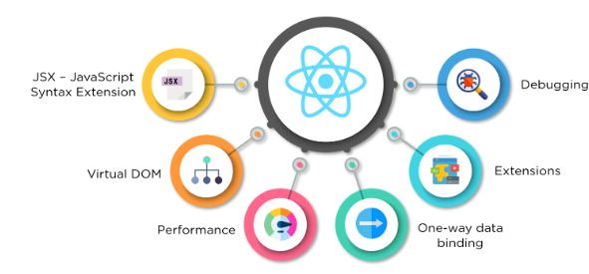
Features Of React!!

Slide 10
React.js is taking over the front-end development. It abstracts away the Document Object Model from you, providing a simpler programming model and better performance. ·Code maintainability: React is fundamentally about self-contained components. This readability and maintainability is truly the best when it comes to out-of-the-box frameworks. ·Fast prototyping: As a designer, fast prototypes not only give you more feedback opportunities, but engage clients and customers. ·Component over pages: React is fundamentally different than other front-end frameworks as each asset is made up of many isolated components. Its main methodology is to use the same tools and stack for different systems

Slide 11
Thank You.

