Slide 1


Major Project
Title:
Retail Pulse - A Multi-Source Pipeline for E-Commerce Business Intelligence
Presented by:
Akash Chauhan — 500123838 Suryansh Chauhan — 500121527 Himanshu Bhaker — 500123230 Abhay Chaudhary — 500122710
Guided by: Dr Amit Panwar

Slide 2


Content
Introduction
Problem Statement
Abstract
Literature Review
Objective
References
Pert Chart
Conclusion
Methodology

Slide 3

1. Abstract
E-commerce data is generated continuously from databases, APIs and customer interactions.
Retail Pulse integrates these heterogeneous sources into a scalable and automated data pipeline.
Data is cleaned, validated and assigned a Data Trust Score before entering the warehouse.
ML models provide demand forecasting, inventory prediction and anomaly detection.
An AI Business Analyst converts analytical data into explainable, evidence-based insights.
Dashboards combine business KPIs, ML predictions, anomalies, security and pipeline health.

Slide 4
2. Introduction
Modern e-commerce systems generate large volumes of transactional, inventory and behavioural data.
Data is often distributed across multiple systems, creating quality, integration and trust issues.
Traditional BI mainly reports what happened, but businesses also need to know what may happen and why.
RetailPulse combines ETL, data trust, ML analytics and AI-powered business intelligence.
The system aims to transform raw e-commerce data into secure, explainable and decision-oriented insights.
"From collecting data to helping businesses make better decisions"

Slide 5
3.Literature Review
Study / Area | Methodology | Key Finding
ETL & Real-Time Data Warehousing (Allwell et al., 2025) | Qualitative literature review on ETL optimization's effect on latency and throughput | Speed gains often compromise data integrity/scalability; quality checks must be embedded, not bolted on
Multi-Source Integration & Data Quality (Luján-Mora & Palomar) | Clustering algorithm using 4 string-similarity measures to merge inconsistent values across sources | Achieved ~89–90% precision, near-zero error in reconciling inconsistent multi-source data
Machine Learning for Business Analytics (Hobor et al., 2026) | Benchmarked tree ensembles (XGBoost, LightGBM) vs. deep learning on real retail sales data | XGBoost gave the best accuracy and speed; tree-based models beat neural nets on sparse retail demand
Data Trust, Security & Anomaly Detection (Bayram, Ahmed & Hallin, 2024) | Adaptive ML scoring framework with drift-detection-triggered retraining, tested on industrial sensor data | Cut processing time by 88% vs. standard scoring while keeping high predictive accuracy (R² up to 0.978)

Slide 6
4. Problem Statement
How can scattered e-commerce data be converted into trusted, secure and actionable business intelligence through one automated pipeline?
Data exists in different formats and systems.
Manual processing is time-consuming.
Poor data quality can lead to unreliable insights.
A reliable and automated pipeline is required for unified analytics.

Slide 7
5. Objectives
Scalable Multi-Source Data Pipeline
Automated Data Cleaning, Validation & Trust Assessment
ML-Based Demand Forecasting, Inventory Prediction & Anomaly Detection
AI Business Analyst for Explainable, Evidence-Based Insights
Security Mechanisms & AI Guardrails
Interactive Dashboards & Decision-Support Features

Slide 8








6.Methodology
Data Ingestion
Data Cleaning & Validation
Data Trust & Security
Data Warehouse
ML Analytics
Business & Security Dashboard
AI Security Guardrails
AI Business Analyst

Slide 9
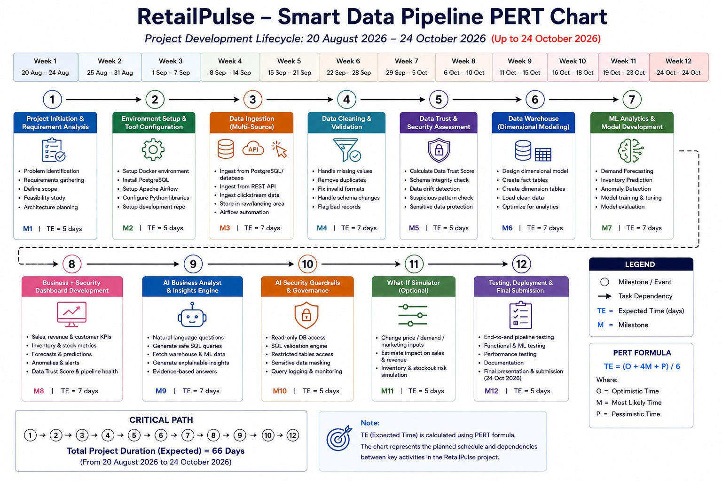
7. PERT Chart

Slide 10

8. Conclusion
RetailPulse integrates multi-source e-commerce data into a unified pipeline.
Automated validation and Data Trust Assessment improve reliability.
ML models enable forecasting, inventory prediction and anomaly detection.
An AI Business Analyst provides explainable, evidence-based insights.
Security guardrails ensure safer interaction between AI and business data.
The final system supports analytics, prediction and decision-making in one platform.

Slide 11
9. References
Allwell, Bestman & Uwadiegwu (2025) — Optimizing ETL Processes for Real-Time Data Warehousing
Luján-Mora & Palomar — Reducing Inconsistency in Integrating Data From Different Sources
Hobor, Brčić, Polutnik & Kapetanović (2026) — Comparative Analysis of Modern ML Models for Retail Sales Forecasting
Bayram, Ahmed & Hallin (2024) — Adaptive Data Quality Scoring Operations Framework using Drift-Aware Mechanism

Slide 12
Thank You

