Slide 1





EVALUATING THE INFLUENCE OF VEHICLE LATERAL DEVIATION ON CURVED WIDENING REQUIREMENT FOR TWO LANE UNDIVIDED ROADS
By Abhay Singh
Indian Institute of Technology Jammu

Slide 2
CONTEXT AND BACKGROUND
Horizontal curve design is a critical component in highway geometry, particularly on two-lane undivided roads common in developing nations like India.
Conventional road design guidelines (e.g., IRC:73-1980, AASHTO) provide empirical or formula-based widening standards, assuming ideal conditions such as fixed vehicle size and spee, central lane-following and uniform driver response.
Real-world driving behavior deviates from codal assumptions due to lateral deviation, steering fluctuations influence of vehicle type, curve geometry, and kinematic characteristics of vehicle.
Mixed traffic conditions, evasive maneuvers, increased driver workload at sharp curvature and non-lane-based movements challenge existing extra-widening provisions on horizontal curve.
Most design standards and previous studies overlook steering angle variation, lateral acceleration, and geometric parameters of the road such as gradients, curvature change rate, super-elevation, overlapping length of horizontal and vertical curve and vertical curvature.
This leads to under-designed curves, increasing risks of lane encroachment, use of shoulders and run-off-road incidents

Slide 3
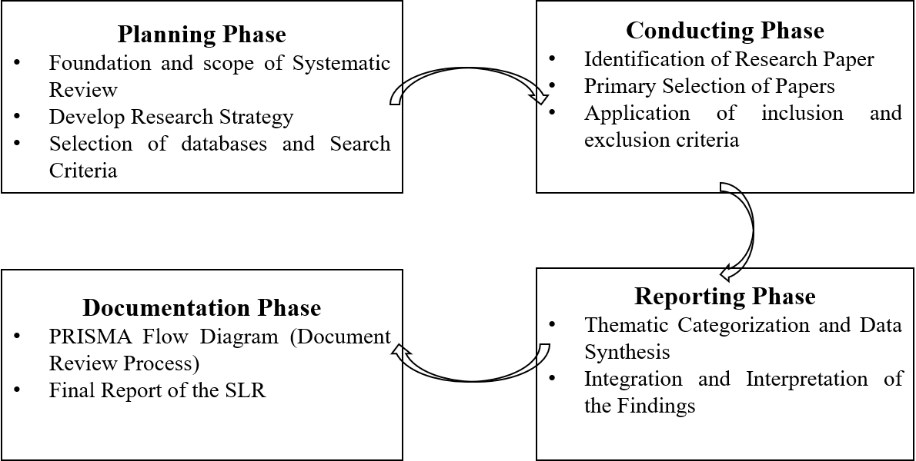
Systematic Literature Review Following PRISMA 2020 Guidelines
Fig. 1 Methodological Framework for PRISMA-Guided Systematic Literature Review

Slide 4
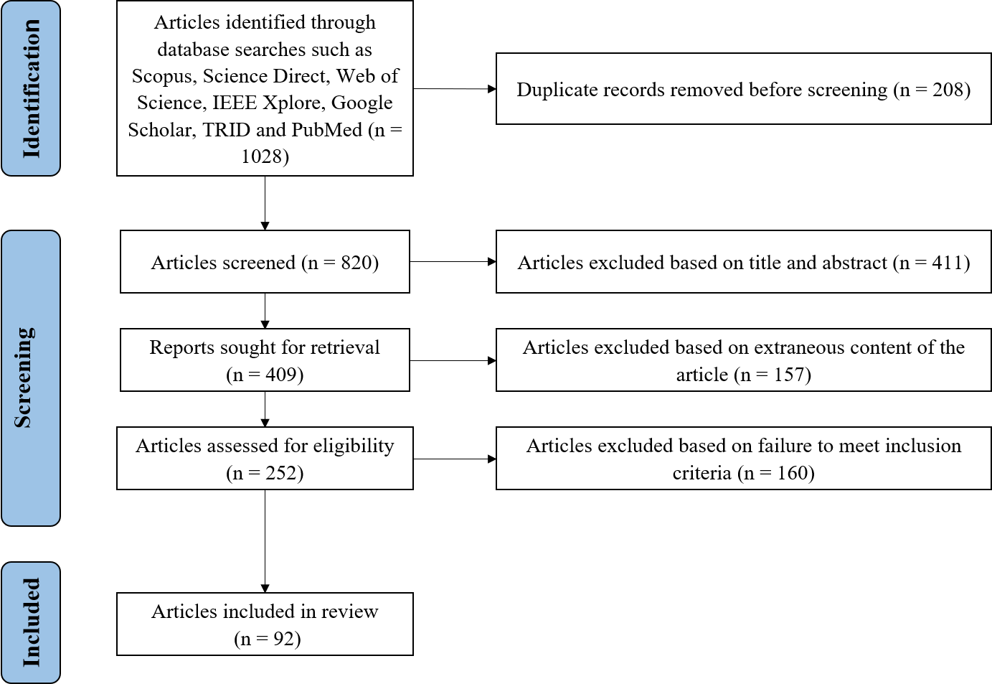
PRISMA Flow Diagram: Documentation of the Review Process
Fig. 2 PRISMA Flow Diagram illustrating the systematic literature identification, screening, and inclusion process.

Slide 5
Comparative Evaluation of Codal Provisions for Horizontal Curve Widening
Aspect | IRC:73-1980 | AASHTO (USA) | Austroads (Australia) | UK DMRB | China JTG D20-2017 | FHWA (USA) | Motorways (2018)
Approach | Formula-based | Formula + Tabular | Performance-based (Swept Path) | Swept Path Simulation | Tabular (Based on class & geometry) | Simulation + Tabular | Swept Path + Design Templates
Assumptions | Ideal driving, centered lane tracking | Uniform driver behavior, fixed speed | Disciplined traffic, standard dynamics | Predictable movement, ideal behavior | Fixed vehicle config, ideal tracking | Ideal lane-following, no drift | Structured lanes, long vehicles
Methods Adopted | Empirical formula | Formula-based, tabular aids | Swept path + empirical formula | Simulation-based | Tabular based on terrain & speed | Simulation + predefined templates | Simulation + standard geometry
Design Vehicle | Single 6m truck | SU-30 / WB-67 | B-double, A-double, A-triple | HGVs (Articulated) | Articulated (14.3 m) | WB-62 / WB-67 trucks | WB-20 semi-trailers
Kinematic Parameters | Design speed only | Design speed only | Speed + turning radius | Speed + swept path analysis | Design speed focused | Deterministic vehicle speed | Deterministic speed & turning radius
Geometric Parameters | R < 300m, lane width, no. of lanes | R < 500m, lane width, no. of lanes | R < 1600m, deflection angle, etc. | R < 500m, lane width | R < 300m, terrain, road class | R < 300m, road class, shoulder width | R < 300m, shoulder, transition length
Limitations | Ignores real behavior, mixed traffic | No behavior modeling, ideal assumptions | No two-wheeler/driver variability data | Lacks adaptability to heterogeneity | Static design, no trajectory input | No behavior input, lacks flexibility | Not suitable for informal traffic
Future Scope | Trajectory-based modeling needed | Include lateral drift, driver variation | Integrate real-time path data | Empirical validation, mixed traffic | Real-world data + behavior modeling | Adaptive design from trajectory data | Include steering & deviation tracking

Slide 6
Studies on Influence of Kinematic Parameters on Vehicle Lateral Deviation
Author and Year | Kinematic Parameter | Observation | Conclusion
Aryal (2020) | Steering angle, Heading angle | Identified that heading drift increases with reduced curve radii and mixed traffic | Heading variation significantly affects trajectory and widening demand
Singh & Das (2021) | Lateral deviation, Steering correction | Field trajectory analysis on curved roads showed increased deviation under evasive actions | Driver steering correction patterns are crucial for accurate widening models
Cao et al. (2024) | Vehicle speed, Curve radius | Lateral deviation found to increase with speed and tighter curves, especially for large vehicles | Conventional designs underestimate space needed for high-speed curved travel
Hossain et al. (2024) | Trajectory envelope, Deviation envelope | Drone-based trajectory mapping showed real paths exceeded codal assumptions | Trajectory envelopes justify need for dynamic, behavior-driven widening standards
Zhou et al. (2021) | Yaw rate, Lateral deviation | Used simulation data to link high yaw rate changes with unstable lateral movements | Yaw variability is a predictor of unsafe curve negotiation in real-time models
Gupta et al. (2022) | Mixed vehicle paths, Steering angle | In heterogeneous traffic, deviation varied widely based on vehicle type and maneuvering | Standard designs fail to accommodate two-wheelers and non-lane-based movement
Rahman et al. (2023) | Vehicle class, Curve negotiation behavior | Class-based trajectory analysis showed significant variation in lateral space usage | Supports need for class-specific widening estimates
Zhang & Wang (2022) | Steering angle, Acceleration | Found strong correlation between lateral deviation spikes and abrupt steering inputs | Behavior-driven deviations must be integrated into widening design models

Slide 7
Studies on Influence of Vehicle Parameters on Vehicle Lateral Deviation
Author and Year | Vehicle Parameter | Observation | Conclusion
Aryal (2020) | Vehicle length, Wheelbase | Longer vehicles showed higher off-tracking and wider lateral deviation envelopes | Vehicle size significantly increases the need for extra widening on curves
Singh & Das (2021) | Vehicle type, Turning radius | Multi-class vehicle analysis showed that turning radius and size influence deviation behavior | Different vehicle types require different widening standards
Cao et al. (2024) | Vehicle type (Trucks vs. Cars) | Trucks exhibited up to 16 cm more lateral deviation than smaller vehicles on sharp curves | Heavy vehicles demand significantly higher lateral clearance on curves
Gupta et al. (2022) | Vehicle class, Speed | Smaller vehicles maneuvered laterally more to avoid larger vehicles under mixed traffic | Vehicle interaction plays a major role in determining lateral deviation
Zhang & Wang (2022) | Vehicle width, Axle spacing | Lateral shift and path tracking varied significantly with axle configuration | Vehicle geometry directly affects path deviation across horizontal curves
Rahman et al. (2023) | Vehicle type, Road curvature | Observed that buses and trailers struggled with tight curves, needing larger envelopes | Vehicle-specific curve responses must guide widening provisions
Zhou et al. (2021) | Vehicle center of gravity, Turning behavior | Higher center-of-gravity vehicles deviated more during curve entry/exit transitions | Vehicle dynamics (e.g., C.G.) are crucial in lateral behavior modeling
Liu et al. (2021) | Wheelbase variation, Axle load | Longer wheelbase and higher axle loads resulted in sharper off-tracking patterns | Wheelbase and axle configurations directly influence design trajectory
Bhargava et al. (2020) | Vehicle category, Lane discipline | In Indian traffic, weak lane discipline caused excessive lateral spread, especially in buses | Lack of disciplined path following must be accounted for in curve design

Slide 8
Studies on Influence of Geometric Design Variables on Vehicle Lateral Deviation
Author and Year | Geometric Design Variable | Observation | Conclusion
Aryal (2020) | Curve Radius | Smaller curve radii led to increased heading angle drift and trajectory expansion | Tight curves require greater widening due to increased lateral deviation
Singh & Das (2021) | Superelevation | Insufficient or inconsistent superelevation caused outward lateral drift | Proper superelevation can mitigate lateral deviation and steering instability
Cao et al. (2024) | Lane Width | Narrow lanes on curves resulted in frequent encroachment by larger vehicles | Lane width must reflect vehicle type and lateral envelope during curves
Hossain et al. (2024) | Combined Curvature and Superelevation | Field data showed misaligned curve geometry with low superelevation increases deviation | Integrated geometric optimization is necessary for safer curve design
Gupta et al. (2022) | Transition Length | Short or abrupt transitions between tangents and curves led to sharp steering adjustments | Gradual transitions reduce sudden lateral shifts and improve path stability
Zhou et al. (2021) | Deflection Angle | Large deflection angles resulted in abrupt path changes and lateral drift | Deflection angle control is critical to avoid erratic vehicle trajectories
Rahman et al. (2023) | Combined Horizontal and Vertical Curves | Compound curves caused higher lateral deviation, especially at high speeds | Design standards should treat compound curvature as a risk factor
Zhang & Wang (2022) | Shoulder Width | Narrow shoulders led to reduced recovery space and increased off-road incidents | Adequate shoulder width helps manage lateral deviation during loss of control
Bhargava et al. (2020) | Gradient & Curve Overlap | Overlap of vertical and horizontal curves intensified deviation, especially for loaded vehicles | Gradient-curve interaction must be evaluated in geometric safety assessments
Liu et al. (2021) | Widening Provisions | Codal widening underestimated actual path width needed under mixed traffic | Behavior-based models outperform static code recommendations in dynamic scenarios

Slide 9
OBJECTIVE AND SCOPE
To investigate the influence of vehicle characteristics, kinematic variables, and geometric design elements on lateral movement behavior, particularly lateral deviation and heading angle variation during the negotiation of horizontal curves on two-lane undivided highways.
The objective emphasizes understanding the dynamic interaction between vehicle motion and roadway geometry under real-world, mixed-traffic conditions.
To develop a behaviorally responsive model for estimating the required curve widening by integrating dynamic vehicle behavior with geometric design elements, thereby facilitating context-sensitive curve.
To evaluate the safety and adequacy of horizontal curves by quantifying the safety margin defined as difference between estimated and provided widening (IRC:73-1980, IRC:52-2019, MoRTH etc.) through reliability analysis and surrogate safety measures, particularly Anticipated Collision Time (ACT).
By correlating widening deficites with reductions in ROR_ACT values, the study aims to identify curve segments with elevated risk of lane encroachment, vehicle instability, or conflict under heterogeneous traffic conditions.

Slide 10
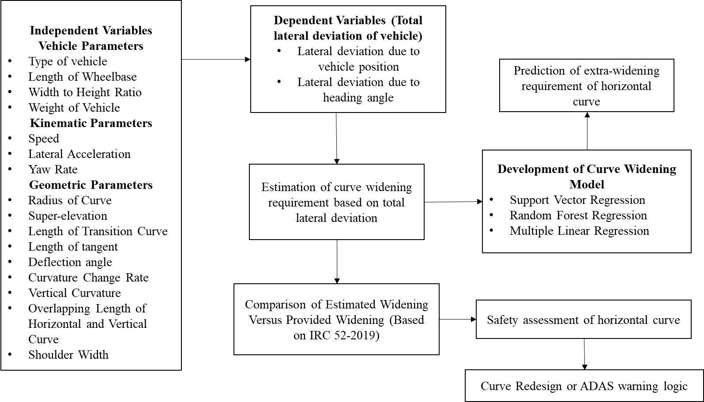
METHODOLOGY

Slide 11
RESULTS AND ANALYSIS
Curve no. | Extra widening based on IRC-73-1980 | Estimated extra widening requirement
 |  | Mean | Max | Std | cv
127 | 0.886 | 0.713 | 2.494 | 0.454 | 0.637
179 | 0.552 | 0.685 | 2.172 | 0.421 | 0.616
183 | 1.038 | 0.710 | 2.262 | 0.456 | 0.642
171 | 0.954 | 0.571 | 2.318 | 0.392 | 0.686
189 | 0.886 | 0.664 | 2.494 | 0.452 | 0.681
245 | 0.669 | 0.644 | 2.527 | 0.411 | 0.638
221 | 1.038 | 1.034 | 1.948 | 0.568 | 0.549
227 | 0.921 | 0.592 | 2.428 | 0.391 | 0.660

Slide 12
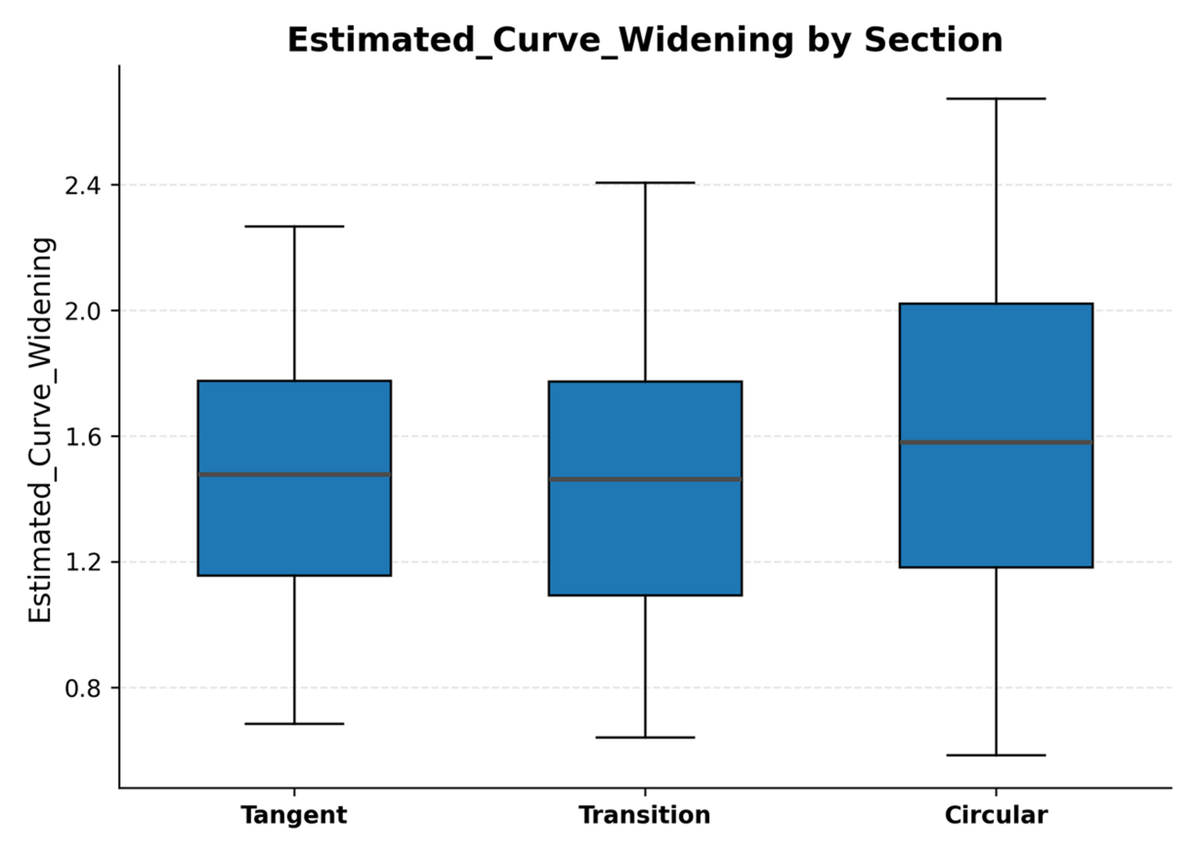
RESULTS AND ANALYSIS

Slide 13
RESULTS AND ANALYSIS-Estimated Curve Widening for Trucks
Metric | Value | Insight
Average Widening | 0.89 m | Indicates high lateral space demand for trucks.
Maximum Widening | 2.53 m | E xceeds IRC 73:1980 range; reflects large off-tracking under real-time vehicle motion on curves.
Standard Deviation | 0.48 m | Reveals inconsistent path-following across trucks and curve conditions.
CV (Coefficient of Variation) | > 0.5 | Suggests significant behavioral variability, supports design of extra-widening of curves based on real time trajectory data.

Slide 14
CONCLUSION
This study on estimated curve widening requirements for trucks reveals significant deviations between observed vehicle behavior and codal assumptions. The average estimated widening was found to be 0.89 meters, with a maximum value of 2.53 meters, indicating that the lateral space demand for trucks often exceeds the IRC:73-1980 recommended range (0.5–1.0 meters).
The presence of high standard deviation (~0.48 m) and a coefficient of variation greater than 0.5 highlights the inconsistent lane-following behavior exhibited by trucks, especially in curved sections under mixed traffic. This variability underscores the necessity for flexible and context-sensitive design strategies.
It is evident that static codal designs are insufficient for accurately capturing the dynamic interactions of heavy vehicles with horizontal curves. Therefore, there is a pressing need to incorporate behavioral, vehicle dynamic, and trajectory-based data into highway geometric design practices to ensure safety and operational efficiency.

