Slide 1
Infoमित्र:Classifying Real vs. Fake
Recognize truth, Eliminate Fake
AI-Powered Balanced News Analyzer
Presented by: Semicolon
Tanushree
Preeti Gupta
Harshal Tamrakar
Atharv Pathak
Abhay Bhattacharya

Slide 2



Problem Statement: The Spread of Misinformation
Social media is a breeding ground for fake news.
In today's digital age, misinformation spreads rapidly. Critical thinking skills are declining globally, leading to echo chambers.
Rapid Spread
Verification
Automation
Fake news spread quickly online.
75% don’t verify facts before sharing
Automated tools are needed.

Slide 3



Objective: Tweet Verification System
Perspective Bot analyzes news and identifies different viewpoints. It presents a balanced summary from
credible sources. Empowering users to form informed opinions.
Achieve high accuracy and reliability in classification for real-time misinformation detection.
AI Analysis
Viewpoints
Credible Sources

Slide 4
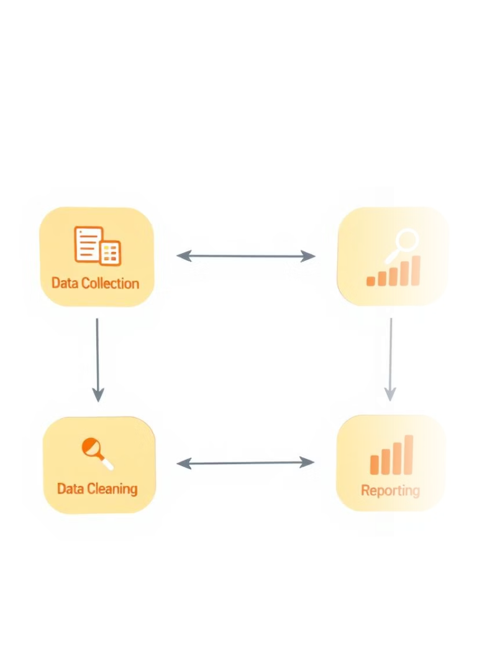




Workflow: From Input to Insight
Perspective Bot takes user input, analyzes it, and delivers a balanced summary. The entire process is streamlined for quick understanding.
User Upload
Upload news or text.
Text Analysis
Analyze with NLP.
Viewpoint Search
Search the web.
Balanced Summary
Generate summary + links.

Slide 5




Tech Stack
Perspective Bot uses a combination of cutting-edge technologies. NLP, APIs, sentiment analysis, React, and Python power this powerful tool.
NLP
News APIs
Sentiment
React/Python
Text analysis
Source aggregation
Algorithms
Interface & server

Slide 6
Why This Project Stands Out
Tackles real-world misinformation and bias.
Blends NLP, summarization, and sentiment analysis in a creative way.
Encourages critical thinking instead of passive consumption.
Scalable and adaptable to different domains (e.g., health, politics, finance).

Slide 7
Applications: Real-World Impact
Automated fake news detection on social media platforms.
Potential use in election monitoring and public health campaigns, reducing the spread of misinformation.
Fake News Detection
Real-Time Verification
Protects Democratic Processes
Builds Public Trust

Slide 8
Future Work and Conclusion
Add image analysis to the classification pipeline and incorporate user credibility scores.
1
Add image analysis
2
Incorporate user data
3
Multilingual support `
4
Upside and Downsides

Slide 9
Thank You

