Slide 1

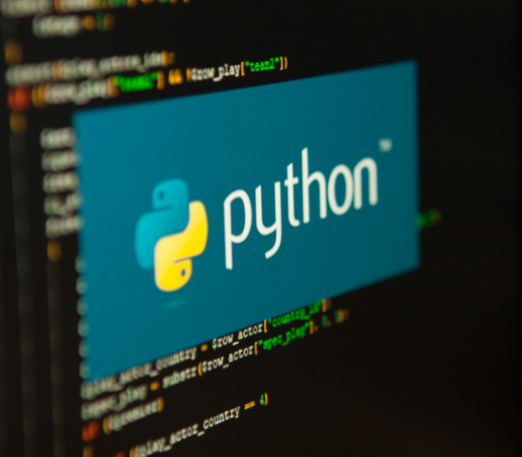

Python…… Explore to Data World
https://www.anaconda.com/download

Slide 2
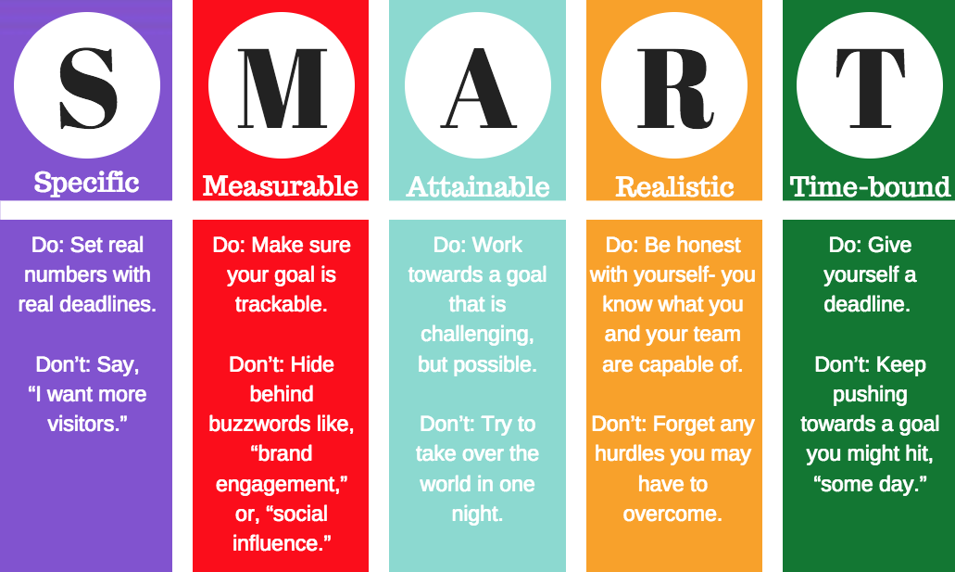
Learning Objectives:
Introduction to Python
Functions
Iterables and Conditional Statement
Modules
Python Strings
Python Dates and Times
Math
File Processing
Exception Handling
OOPS in Python
Playing with Data
NumPy, Pandas, Matplotlib,Seaborn
Data Analysis Using Statistical Models
https://www.anaconda.com/download

Slide 3

Learning Outcomes:
Upon successful completion of this training, participants will be able to:
Write Basic Python Programs
Manipulate Data Structures
Implement Control Flow Logic
Solve Problems with Functions
Handle Errors and Exceptions
Work with Files
Develop Confidence in Writing Python Code
Collaborate with Other Developers
Prepare for Intermediate Python Topics: Lay the foundation for exploring
more advanced topics such as object-oriented programming, libraries, and frameworks used in Python.
https://www.anaconda.com/download

Slide 4
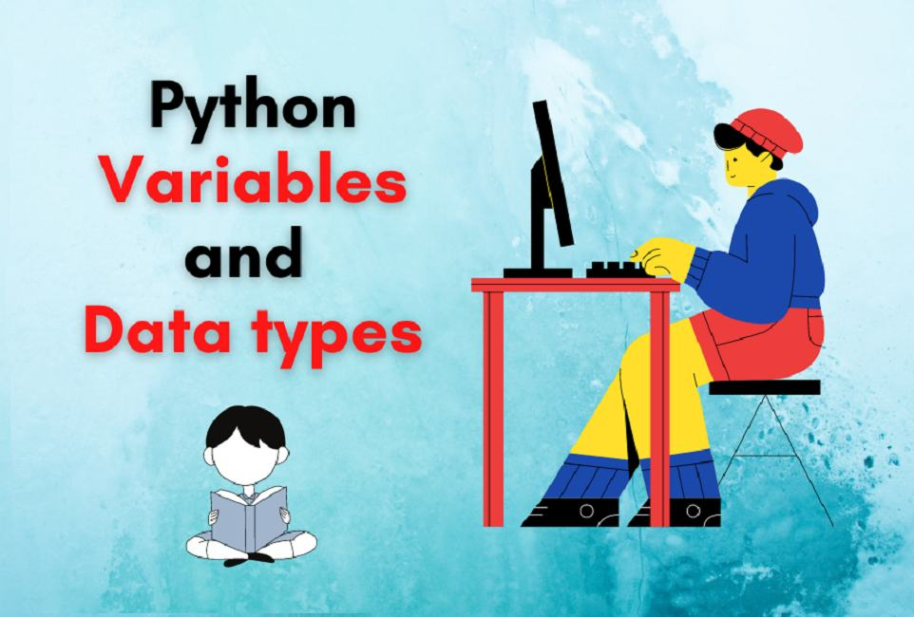

Slide 5
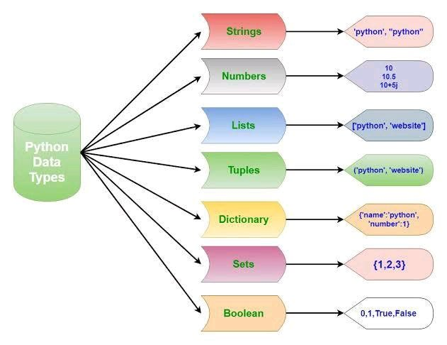
Variable and Data Structures
In other programming languages like C, C++ and Java, you will need to declare the type of variables but in Python you don’t need to do that. Just type in the variable and when values will be given to it, then it will automatically know whether the value given would be a int, float or char or even a String.
# Python program to declare variables
myNumber = 3
print(myNumber)
myNumber2 = 4.5
print(myNumber2)
myNumber ="helloworld"
print(myNumber)

Slide 6
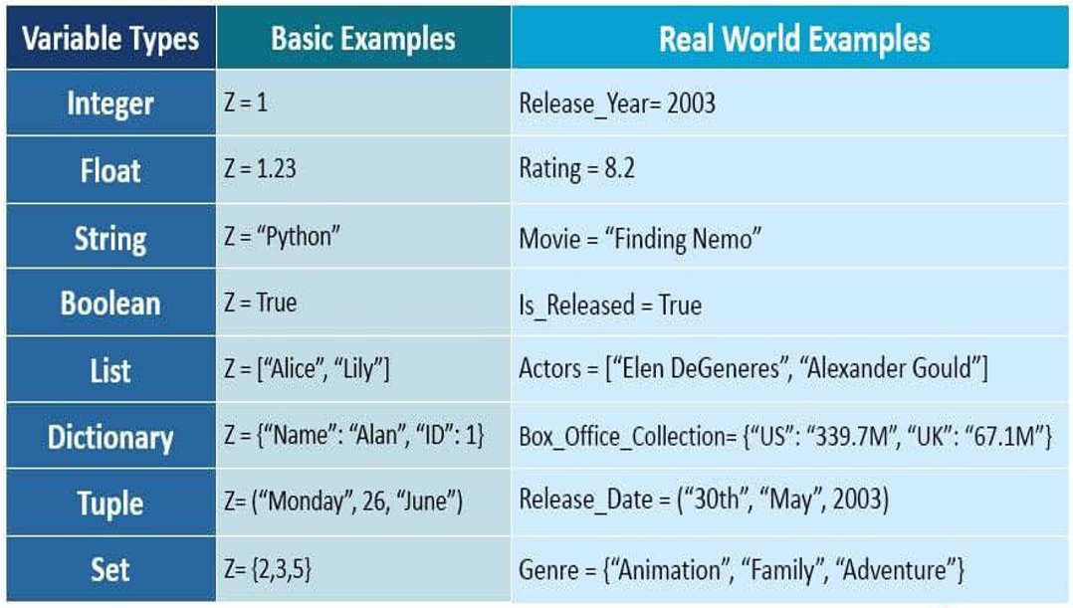

Slide 7
Input and Output
In this section, we will learn how to take input from the user and hence manipulate it or simply display it. input() function is used to take input from the user.
# Python program to illustrate
# getting input from user
name = input("Enter your name: ")
# user entered the name ‘Siddhant'
print("hello", name)
# Python3 program to get input from user
# accepting integer from the user
num1 = int(input("Enter num1: "))
num2 = int(input("Enter num2: "))
num3 = num1 * num2
print("Product is: ", num3)

Slide 8
Variable Declaration and Naming
In Python, variables are used to store data, and data types define the kind of data a variable can hold. Python is dynamically typed, so you don't need to explicitly declare the type of a variable. Below is an explanation of variables and common data types in Python, with examples.
Variables in Python
A variable is a name that refers to a value stored in memory.
Assign a value to a variable using the = operator.
Variable names:
Must start with a letter (a-z, A-Z) or an underscore _.
Can contain letters, numbers, or underscores.
Are case-sensitive (age and Age are different).
Cannot be Python keywords (e.g., if, for, while).
name = "Alice" # String
age = 25 # Integer
height = 5.6 # Float
is_student = True # Boolean

Slide 9
Common Data Types in Python
Here are the primary data types in Python, with examples:
1. Numeric Types
int: Integer (whole numbers, no decimal point).
float: Floating-point number (numbers with decimal points).
complex: Complex numbers (with real and imaginary parts).
# Integer
count = 10
negative = -5
# Float
price = 19.99
temperature = -2.5
# Complex
complex_num = 3 + 4j
print(count, type(count))
print(price, type(price))
print(complex_num, type(complex_num))

Slide 10
2. String
A sequence of characters enclosed in single (') or double (") quotes.
Used for text data.
Strings are immutable (cannot be changed after creation).
name = "John Doe"
greeting = 'Hello, World!'
multiline = """This is a
multi-line string."""
print(name, type(name))
print(greeting)
print(multiline)
3. Boolean
Represents True or False.
Used for logical operations and conditions.
is_active = True
has_license = False
print(is_active, type(is_active))
print(has_license, type(has_license))

Slide 11
4. Type Checking and Conversion
Use type() to check the data type of a variable.
Use functions like int(), float(), str(), etc., to convert between types.
x = "123"
y = int(x) # Convert string to integer
z = float(x) # Convert string to float
print(y, type(y))
print(z, type(z))
Key Points
Python automatically determines the data type based on the assigned value.
Variables can change type through reassignment (dynamic typing).
.

Slide 12
Checking Data Types
# Using type() function
value = 42
print(type(value))
# Using isinstance() function
print(isinstance(value, int))
print(isinstance(value, (int, float)))
Dynamic Typing Python is dynamically typed, meaning variable types are determined at runtime:
# A variable can change type
variable = 10
print(type(variable))
variable = "hello"
print(type(variable))
variable = [1, 2, 3]
print(type(variable))

Slide 13
Variable Assignment
# Multiple assignment
a, b, c = 1, 2, 3
# Swap variables
x, y = 10, 20
x, y = y, x
# Unpacking
numbers = [1, 2, 3]
first, second, third = numbers

Slide 14


Slide 15
1. Which of the following is a valid variable name in Python?
A) 1value B) value_1 C) value-1 D) value one
Answer: B Explanation: Variable names cannot start with a digit, cannot contain - or spaces. Only letters, digits, and underscores are allowed.

Slide 16
2. What is the output of the following code?
x = "5"
y = 5
print(x * y)
A) 25 B) 55555 C) Error D) 55
Answer: B Explanation: "5" is a string. "5" * 5 → "55555".

Slide 17
3. Which of the following is not a valid data type in Python?
A) int B) float C) real D) complex
Answer: C Explanation: real is not a built-in type. Python has int, float, complex.

Slide 18
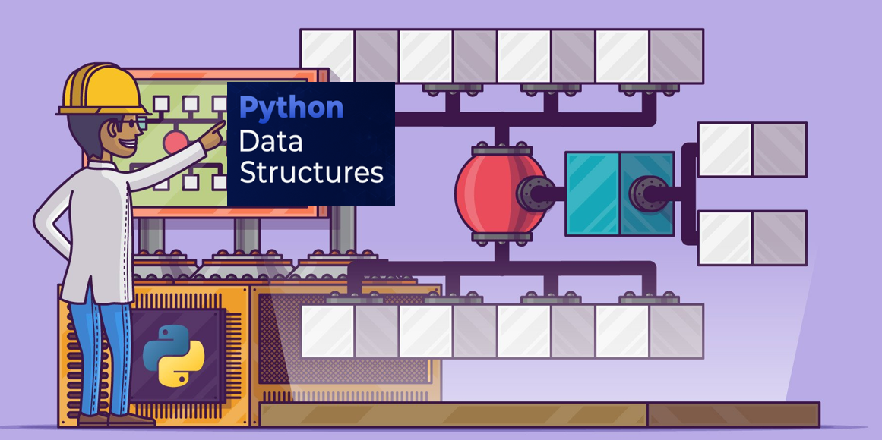

Slide 19
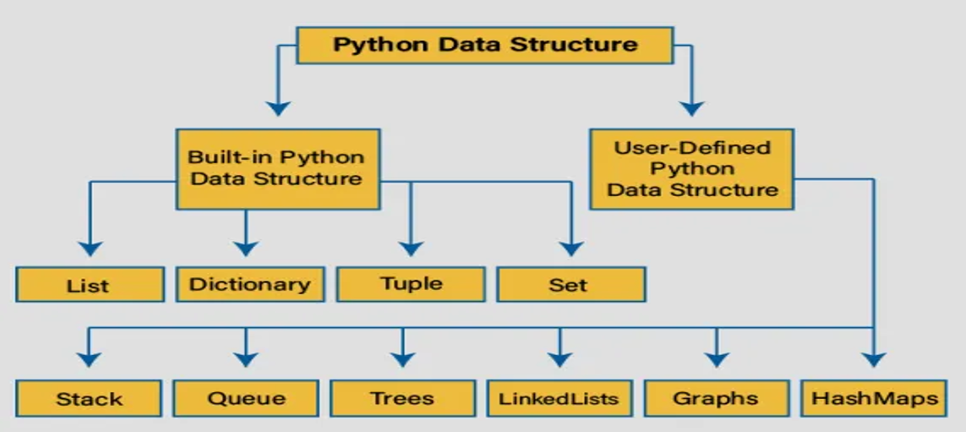

Slide 20
Data Structure …
Python have 4 types of built in Data Structures namely
List,
Dictionary
Tuple
and Set.
In Python, a list is a versatile, ordered, mutable collection of items that can store elements of different data types (e.g., integers, strings, floats, or even other lists).
Lists are defined using square brackets [], and items are separated by commas. They are widely used for storing and manipulating sequences of data.
Key Characteristics of Lists
Ordered: Items maintain their order (accessible by index, starting from 0).
Mutable: You can change, add, or remove elements after creation.
Allows Duplicates: Lists can contain identical elements.
Dynamic: Lists can grow or shrink as needed.
Heterogeneous: Can store mixed data types.

Slide 21
1. Creating a List : Lists are created by enclosing items in square brackets [].
Example: Creating Lists
# Empty list
empty_list = []
# List with integers
scores = [85, 90, 78, 92]
# List with mixed data types
student = ["Alice", 20, 3.8, True]
# List with another list (nested list)
matrix = [[1, 2, 3], [4, 5, 6], [7, 8, 9]]
print(scores)
print(student)
print(matrix)
2. Accessing List Elements: Access elements using their index (0-based) or slicing to get a subset of the list.
Example: Accessing Elements
fruits = ["apple", "banana", "orange", "grape"]
# Access by index
print(fruits[0])
print(fruits[-1])
# Slicing
print(fruits[1:3])
print(fruits[:2])
print(fruits[2:])

Slide 22
3. Modifying Lists
Since lists are mutable, you can change elements, add new ones, or remove them.
Example: Modifying a Shopping List
shopping_list = ["milk", "bread", "eggs"]
# Change an element
shopping_list[1] = "butter"
print(shopping_list)
# Add an element (append)
shopping_list.append("cheese")
print(shopping_list)
# Insert at specific index
shopping_list.insert(1, "apples")
print(shopping_list)
# Remove an element
shopping_list.remove("eggs")
print(shopping_list)
# Remove by index and return it
item = shopping_list.pop(2)
print(item)
print(shopping_list)

Slide 23
4. List Methods
Python lists have built-in methods for common operations. Here are some widely used ones with an example.
Example: Managing a Task List
tasks = ["Study Python", "Attend meeting", "Buy groceries"]
# Add multiple items
tasks.extend(["Exercise", "Read book"])
print(tasks)
# Sort the list
tasks.sort()
print(tasks)
# Reverse the list
tasks.reverse()
print(tasks)
# Count occurrences
tasks.append("Study Python")
print(tasks.count("Study Python"))
# Clear the list
tasks.clear()
print(tasks)

Slide 24
5. List Comprehension
List comprehensions provide a concise way to create or modify lists.
# Create a list of squares for numbers 1 to 5
squares = [x**2 for x in range(1, 6)]
print(squares)
# Filter even numbers from a list
numbers = [1, 2, 3, 4, 5, 6]
evens = [num for num in numbers if num % 2 == 0]
print(evens)

Slide 26
1. Which of the following creates a list in Python?
A) list = {1, 2, 3} B) list = (1, 2, 3) C) list = [1, 2, 3] D) list = <1, 2, 3>
Answer: C Explanation: Lists are created using square brackets [ ].

Slide 27
2. What will be the output?
mylist = [1, 2, 3, 4]
print(mylist[2])
A) 1 B) 2 C) 3 D) 4
Answer: C Explanation: Lists are zero-indexed. mylist[2] → 3.

Slide 28
3. Which method is used to add an element at the end of a list?
A) insert() B) append() C) extend() D) add()
Answer: B Explanation: append() adds a single element to the end of a list.

Slide 29
4. What is the output?
mylist = [100, 200, 300]
print(len(mylist))
A) 2 B) 3 C) 4 D) Error
Answer: B Explanation: The list has 3 elements, so len(mylist) = 3.

Slide 30
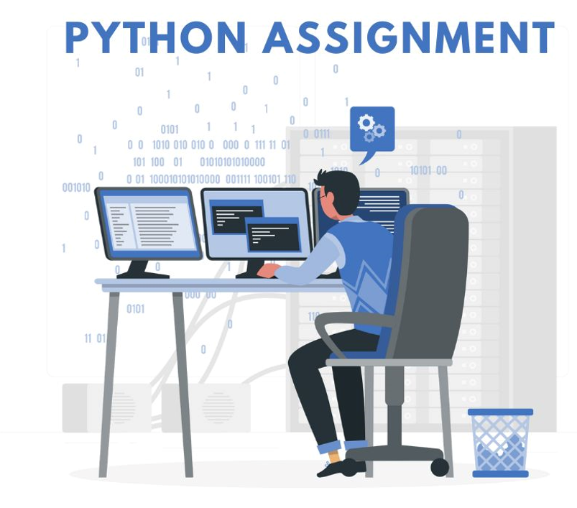

Slide 31
Assignment: Student Gradebook
Combines list operations to manage a list of
student scores
calculate averages and
filter passing grades.

