Slide 1
Introduction to React
Ankush IT-16, Abhay IT-02, Anurag IT-18

Slide 2

What is React?
• React is a JavaScript Library
• Used for front end web development
• Created and used by Facebook
• Famous for implementing a virtual DOM

Slide 3

Timeline of front-end JavaScript frameworks
jQuery* AngularJS React Vue Angular
(2006) (2010) (2013) (2014) (2014)
* jQuery is more often considered a library than a framework

Slide 4
Fundamentals of React
1. JavaScript and HTML in the same file (JSX)
2. Embrace functional programming
3. Components everywhere

Slide 5


JavaScript and HTML in the same file
HTML CSS JS
JSX CSS or JSS
Traditional
approach
React
approach

Slide 6
JSX: the React programming language
const first = "Aaron"; const last = "Smith";
const name = <span>{first} {last}</span>;
const list = ( | const listWithTitle = (
<ul> | <>
<li>Dr. David Stotts</li> | <h1>COMP 523</h1>
<li>{name}</li> | <ul>
</ul> | <li>Dr. David Stotts</li>
); | <li>{name}</li> </ul> </> );

Slide 7
"React is just JavaScript"

Slide 8
Functional programming
1. Functions are "first class citizens"
2. Variables are immutable
3. Functions have no side effects

Slide 10
Functional programming
This means functions can be...
1- Saved as variables
2. Passed as arguments
3. Returned from functions
Functions are "first class citizens"
let add = function() {
console.log('Now adding numbers'); const five = 3 + 2;
};
function foo() { return function() {
console.log('What gets printed?');
};
}
foo
foo();
foo()();
function performTask(task) { task();
console.log('Task performed!');
}
performTask(add);

Slide 11
Functional programming
Variables are immutable
let a = 4;
a = 2; // Mutates 'a'
let b = [1, 2, 3];
b.push(4); // Mutates 'b'
let c = [...b, 4]; // Does not mutate 'b

Slide 12
Tip: Use const instead of let to declare variables!
v_/

Slide 13
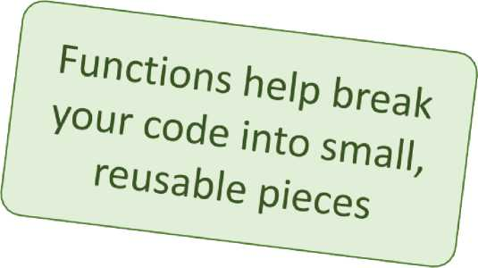
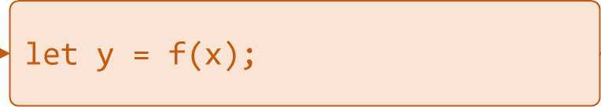
Components
Components are functions for user interfaces
Input x
Output number
Math function:
Input x
Output HTML
Component function:
let y = <FancyDiv value={x} />;

Slide 14

Anatomy of a React component
The component is just Inputs are passed through a
a function single argument called "props"
export default function MyComponent(props) {
return <div>Hello, world! My name is {props.name}</div>;
} A
const html = <MyComponent name="aaron" />;
The function outputs HTML
The function is executed as if it was an HTML tag
Parameters are passed in as HTML attributes

Slide 15
Component rendering
• When a component function executes, we say it "renders"
• Assume components may re-render at any time
Our job is to ensure that every time the component re-renders, the correct output is produced

Slide 16
Creating a new React app
"In React, everything is a component"

Slide 17
Creating a new React app
Creating a new React app is simple!
1. Install Node.js
2. Run: npx create-react-app app-name
3. New app created in folder: ./app-name
PS C:\Users\ankus\OneDrive\Desktop\DELTA\practke\REST_CLASS\demo> npx create-react-app counter
Creating a new React app in C:\Users\ankus\OneDrive\Desktop\DELTA\practice\REST_CLASS\demo\counter.
Installing packages. This might take a couple of minutes.
Installing react, react-dom, and react-scripts with era-template...

Slide 18
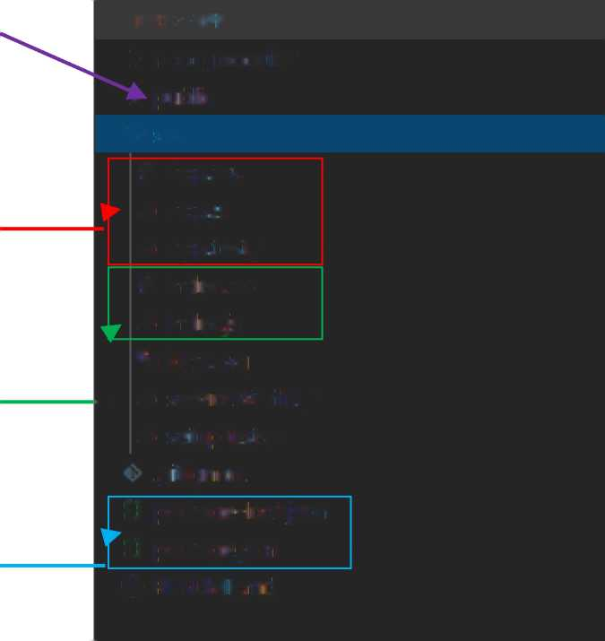
Anatomy of a new React app
public holds the initial html document and other static assets
v TODO-APP
> node_modules r public v src
# App.css JS Appjs
JS App.testjs
# irdex.css JS indexjs *u logo.wg
- JS serviceWorker.js JS setupTests.js .gitignore
(l package-lotk.j&on 0 package json ® README.md
App is a boilerplate starter component
index.js binds React to the DOM
package.json configures npm dependencies

Slide 19
Counter APP
App
< > G https://4x5mo.csb.app/ +⁺ # 0 d?
0
Increment
Decrement

Slide 20
import React. { useState } from "react"; import "./styles.css";
export default function AppQ {
const [count.. setCount] = useState(0); /
function increment() {
//setCount(prevCount => prevCount+=1); setCount(function (pnevCount) { retunn (prevCount += 1);
});
}
function decrement() {
setCount(function (pnevCount) { if (pnevCount > 0) {
return (prevCount -= 1);
} else {
return ;prevCount = 0);
}
});
}
return (
<div classMame="App">
<hl>{count}</hl>
cbutton onClick={ increment} * Increment-;/button > Cbutton onClick=(decrenent} 'Decrement-;/button>
</div>
);
}

Slide 21
What are hooks?
Hooks: Special functions that allow developers to hook into state and lifecycle of React components.
State: One or more data values
associated with a React component instance.
Lifecycle: The events associated with a React component instance (create, render, destroy, etc).

Slide 22
Built-in hooks:
useState
useEffect
useReducer
useMemo
useRef
useCallback

Slide 23
First React hook: useState
Purpose:
1. Remember values internally when the component re-renders
2. Tell React to re-render the component when the value changes
Syntax:
+
const [val, setVal] = useState(100);
The current value A setter function to The initial
change the value value to use

Slide 24
• React-Router
• Redux
• Material-UI
• Bootstrap
Font-Awesome

Slide 25
THANK YOU!

