Slide 1
TV Shows Analysis
By
Abhay Rawat

Slide 2
Introduction: -
We all love to spend our free time watching TV shows. Therefore, I have decided to explore a dataset of TV shows on the basis of various platforms such as Netflix, Prime Video, Disney+, Hulu, etc. This dataset contains a large number of TV shows from the mentioned platforms. After understanding this dataset, we will clean it by removing duplicate values and handling missing values. Then, I will analyze the data using statistical and analytical techniques. After that, I will visualize this data based on online platforms, Age , TV Show counts, IMDb ratings, etc.

Slide 3
WORKFLOW :-
I divide my workflow into 3 steps.
Data Collection
and
Understanding
Data Cleaning
and
Manipulation
Exploratory Data
Analysis(EDA)

Slide 4
Data Collection and Understanding
Data collection and understanding are very important . So I have TV Shows data that I get from “ git-hub ” website . It contains 5611rows and 11 columns. Let’s understand the columns.
Data Descriptions:
Title: it contains TV Shows.
Year: It contains Year.
Age+: Age of the target audience.
IMDB: It shows IMDB Ratings.
Streaming platforms like Netflix, Prime Video, Hulu, and Disney+ use values to indicate the presence of TV shows: a value of 1 means it contains TV shows, while a value of 0 means it does not contain any TV shows.

Slide 5
Data Cleaning and Manipulating
Given Data has 13% missing values.
These are the few columns in this dataset that have missing values: Age, IMDB, and Rotten Tomatoes.
There are 43% missing values in the Age column, 20% in the IMDB column, and 80% in the Rotten Tomatoes column.
I removed the Rotten Tomatoes column because it had 80% missing values.
I dropped two more columns, 'Unnamed: 0' and 'type', because they contained unwanted data.
I arranged the data types of a column in a structured format.
I replaced the missing values in the Age and IMDB columns with the mean values of those respective columns."
I created a new column named ‘ OTT _ Platforms ' using a user-defined function. It counts the total shows across different streaming platforms and provides the names of those platforms.

Slide 6
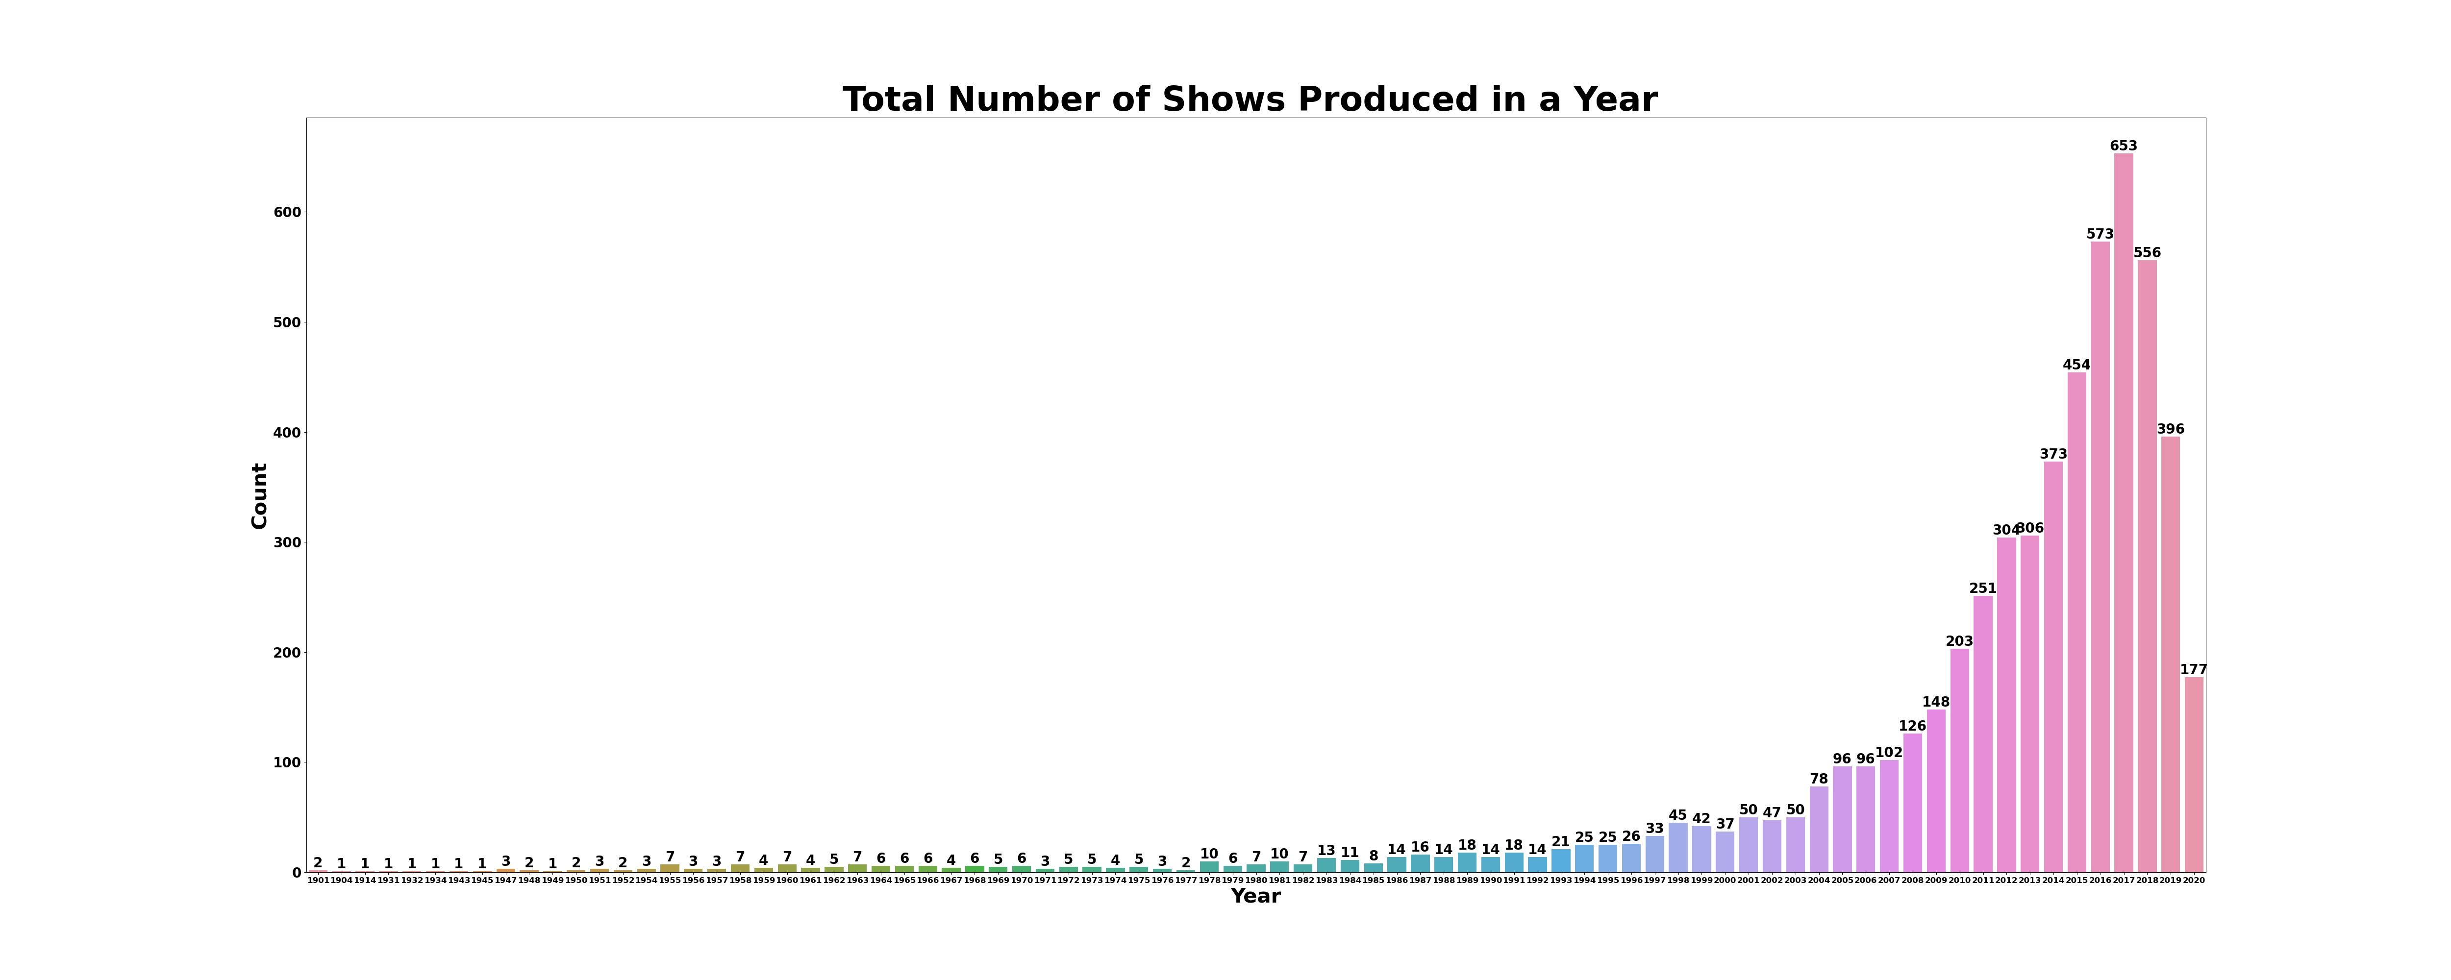
Conclusions: 1-The period between 2010 and 2020 saw the highest number of TV shows produced. This suggests that TV show production significantly increased over this decade. 2- In 2017, there were 653 TV shows produced. This is a specific data point indicating that this year saw a particularly high volume of TV show productions.
Exploratory Data Analysis:-

Slide 7
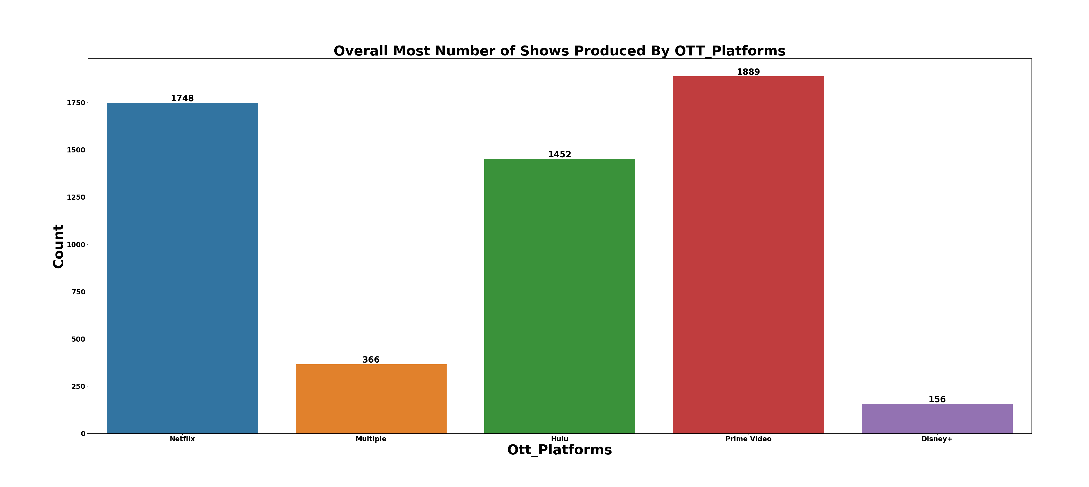
Conclusions:
1- Prime Video led the production of TV shows between 2010 and 2020 with 1,889 shows, indicating a strong presence in the TV show market.
2- Netflix followed closely with 1,748 shows, showing its substantial contribution to TV production as well.
3- Disney+ had the fewest productions among these platforms, with only 156 shows, which might reflect its relatively newer entry into the market or a different focus in its content strategy.

Slide 8
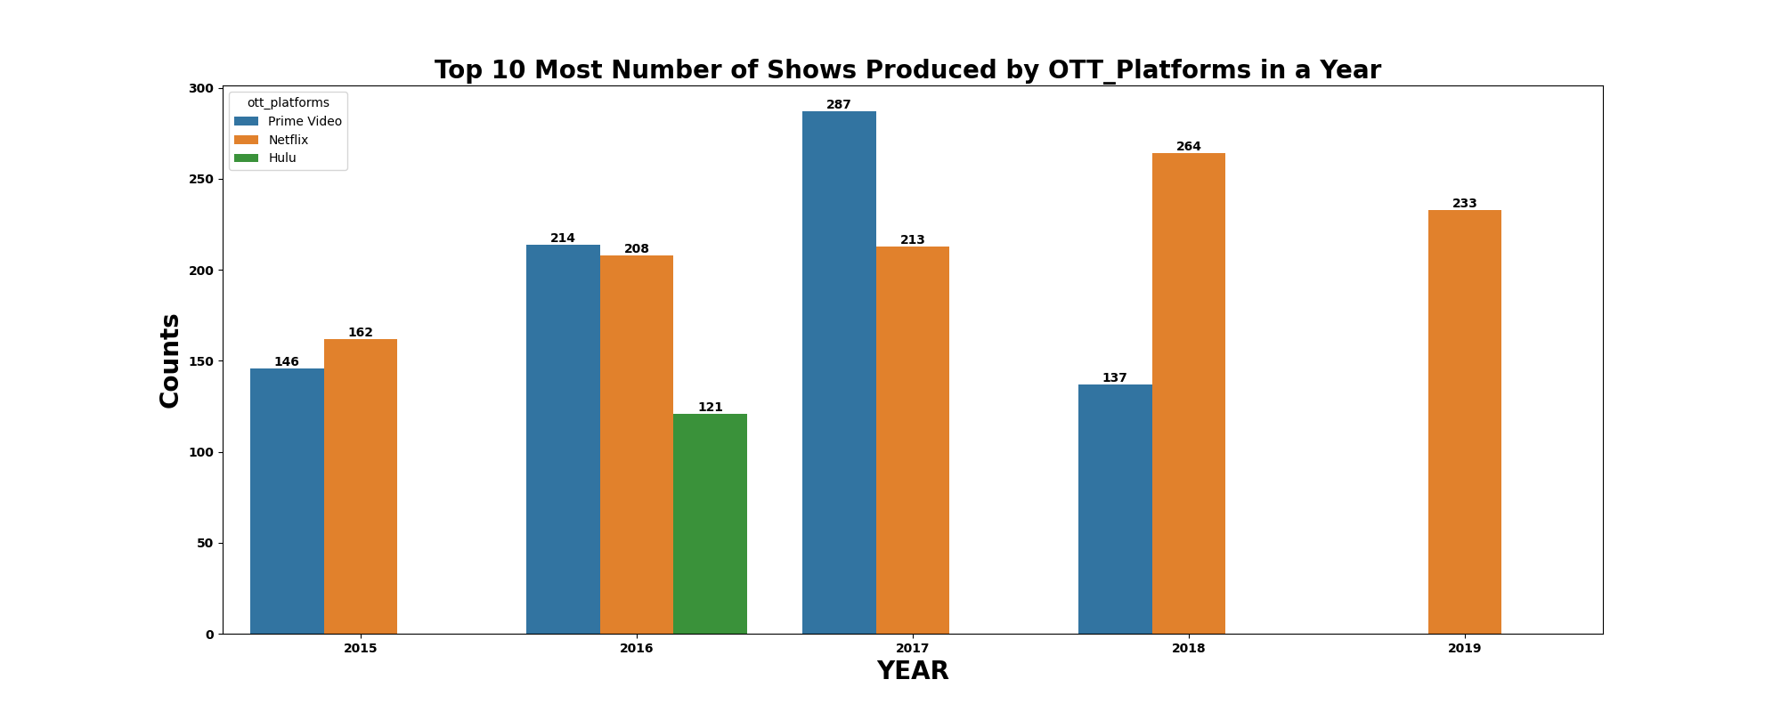
Conclusions:
1- 2017 was a significant year for TV show production, with Prime Video producing 287 shows and Netflix producing 213 shows.
2- These numbers indicate that both platforms were highly active in 2017, contributing to a large portion of the TV show content that year.

Slide 9
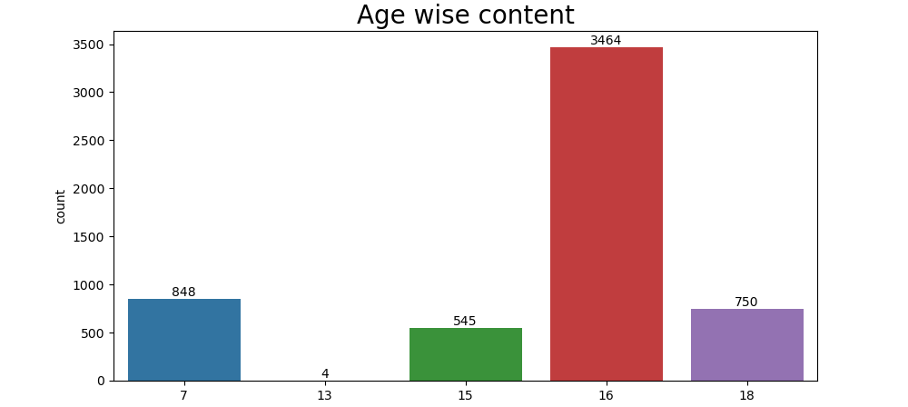
Conclusions:
1-The maximum number of TV shows produced for an audience aged 16 and older is around 3,464.
2-This indicates that a significant portion of TV show content is targeted at young adults and older teenagers, suggesting a strong focus on this demographic by the producers

Slide 10
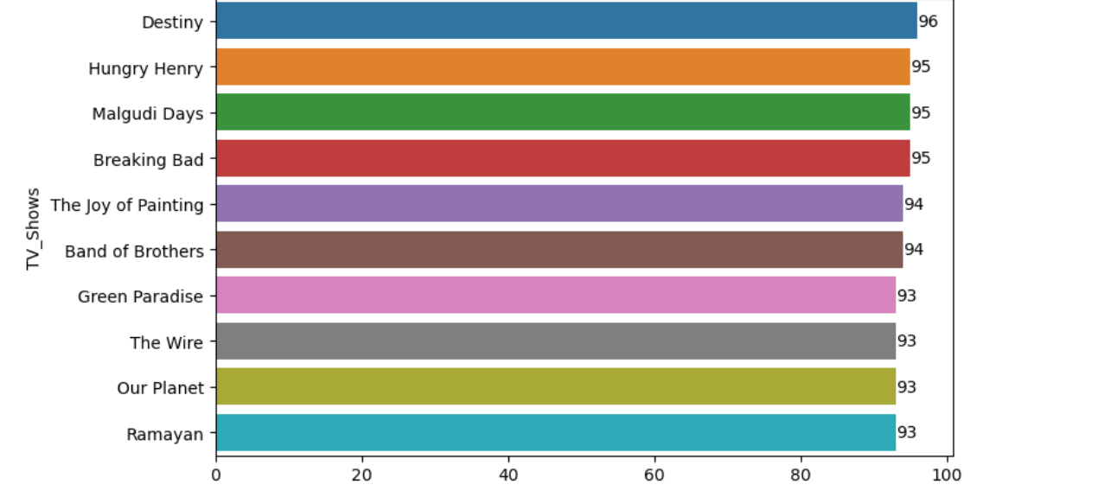
Conclusions:
Top 10 Shows BY IMDB Ratings
1-Destiny is the top-rated TV show with a rating of 96 out of 100.
2- Hungry Henry , Malgudi Days , and Breaking Bad all have high ratings of 95 out of 100, making them the next highest-rated shows.
3. The high ratings of these TV shows indicate their strong popularity among viewers. This suggests that they are particularly appealing to the **16+** demographic, which includes young adults and older teenagers.

Slide 11
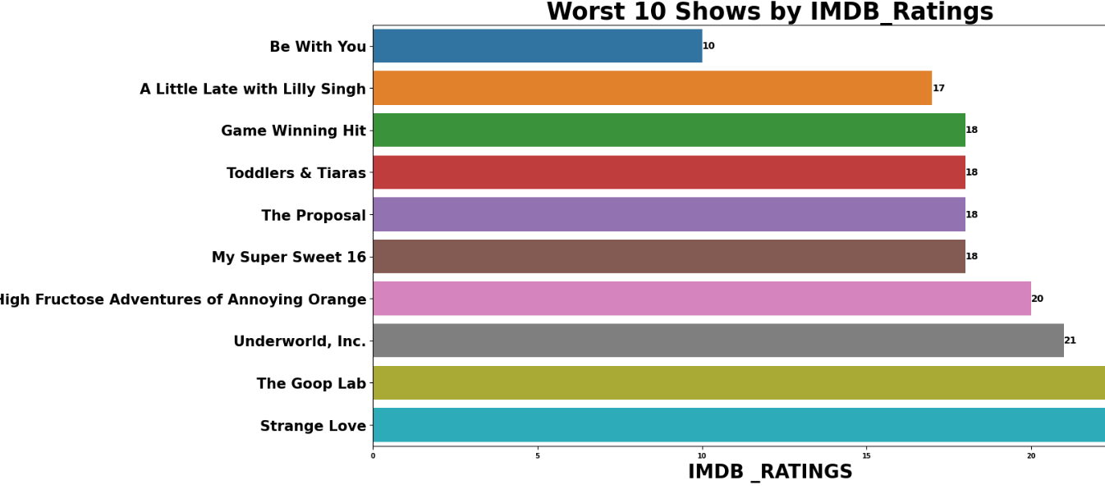
Conclusions:
Most Worst Shows are:
1- Be with You" is considered one of the worst shows based on its low IMDb rating, receiving only 10 out of 100.
2- A Little Late with Lilly Singh” follows with a similarly low rating of 17 out of 100.

