Slide 1

FINAL SUBMISSION
DiabeatIT
One calm place for medicines, readings, doctor visits and family — AI drafts, the patient confirms
Live MVP https://diabeatit.onrender.com Code github.com/AbhayBhandarkar/DiabeatIt
TEAM NAME [Team name]
TEAM CODE [Team code]
HEALTH-A-THON 2026 • TITLE

Slide 2
Team Overview & Background
Member | Role in DiabeatIT | Relevant expertise | Contribution
Abhay Bhandarkar | Product lead · full-stack and AI engineering | Software engineering, applied ML, HCI | Architecture, web app, API, AI layer, deployment, evaluation
[Team member] | On-device AI | Small vision + text models on phones | Phone-side models plugged into the AI adapter (same prompts + checks)
[Doctor partner, specialty] | Clinical advisor | [Years in practice / setting] | Workflow review, safety boundaries, content review, pilot site
[Team member] | [Role] | [Expertise] | [Contribution]
Why this team
Organisation
• Built and shipped a working, deployed product — not a mock-up
• Engineering + clinical input in one loop: every AI output is checked against a fixed schema
• Designed with and for families who manage a parent’s diabetes
[Organisation / college / startup name and one line about it]
Fields in [brackets] are for the team to complete before submission.
HEALTH-A-THON 2026 • FINAL SUBMISSION

Slide 3
Problem Statement and Supporting Evidence
101 million
~50%
~2 min
people in India live with diabetes, and 136 million more have prediabetes
average adherence to long-term therapies for chronic disease
average primary-care consultation in India — little time to reconstruct history
ICMR–INDIAB, Lancet Diabetes & Endocrinology, 2023
WHO, Adherence to Long-Term Therapies, 2003
Irving et al., BMJ Open, 2017
The gap we address
• Fragmented care. Older adults see a diabetologist, a cardiologist and a GP; each writes a separate paper prescription.
• Hidden duplicates. Two products can share an ingredient (e.g. paracetamol in a cold tablet and in Dolo 650) without anyone noticing.
• Lost history. Readings, missed doses and symptoms live on scraps of paper, so visits start from memory.
• Misinformation. “Karela juice can replace tablets” travels faster than guidance from the doctor.
• Family carers lack access. Children help from another city with no safe, permissioned view.
• Existing apps log numbers but do not connect prescriptions, visits and family into one story a doctor can use.
A real-world example DiabeatIT catches
A GP prescribes Dolo 650 (paracetamol 650 mg) for knee pain. Days later the patient buys a cold-and-flu tablet that also contains paracetamol. Nothing on either strip warns her. DiabeatIT flags the shared ingredient on her Medicines page and in her doctor’s view, with the official label one tap away.
HEALTH-A-THON 2026 • FINAL SUBMISSION

Slide 4
Target Users and Use Case
Patient · primary user
Family carer
Doctor
Sunita, 58, Pune — type 2 diabetes, hypertension, six medicines from three doctors. Uses a phone for WhatsApp and UPI.
Priya, 31, Bengaluru — manages her mother’s refills and appointments remotely.
Dr Mehta, diabetologist, outpatient clinic — sees 40+ patients a day.
• Sees the next dose and records it in one tap
• Scans a new prescription instead of typing it
• Checks a forwarded health claim before acting on it
• Gets only the record types Sunita shares
• Can log doses or questions if allowed
• Every action is in Sunita’s audit history
• Scans the patient’s QR, no account needed
• Reads a cited 30-second briefing and trends
• Link expires; the patient can withdraw it
Setting Home (daily routine on the phone) and the outpatient visit (doctor view on any screen).
Use case Keep a multi-doctor medicine routine safe and visible, and turn months of records into a one-minute, source-linked visit briefing.
1
Photo of the
prescription
2
Patient confirms
the schedule
3
One-tap dose
records at home
4
Timeline + QR
shared with doctor
5
Cited briefing
at the visit
→
→
→
→
HEALTH-A-THON 2026 • FINAL SUBMISSION

Slide 5
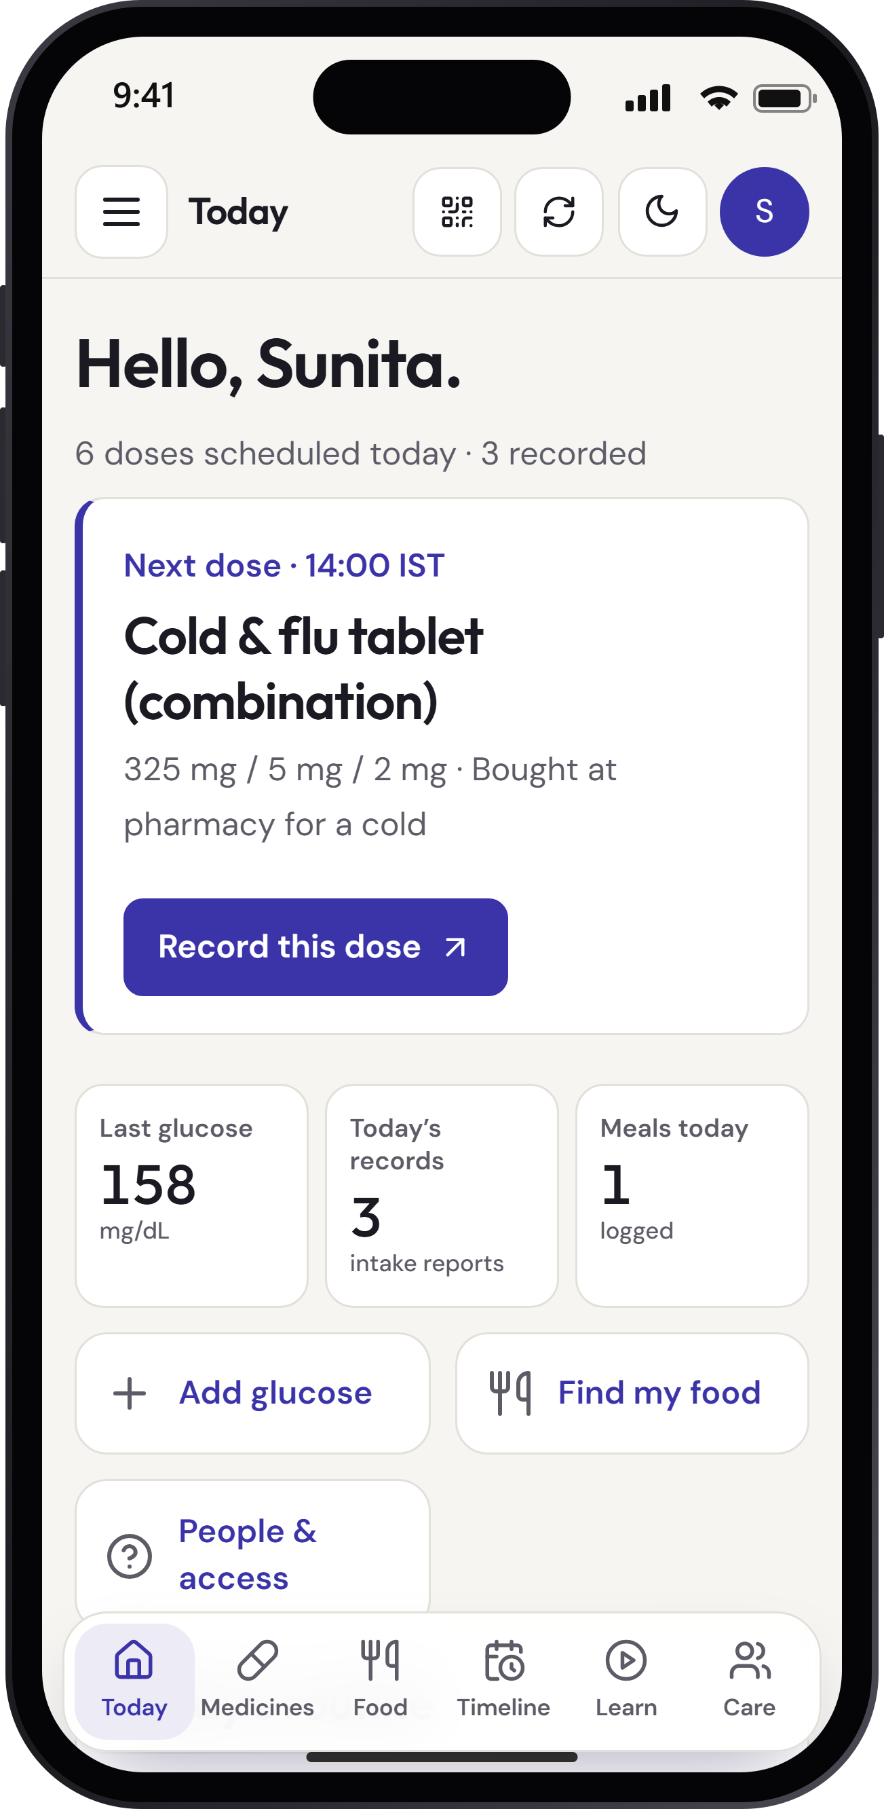
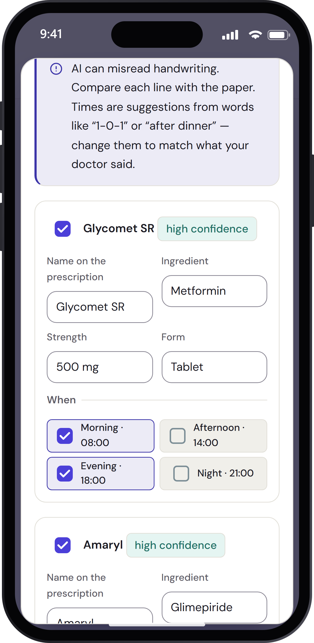
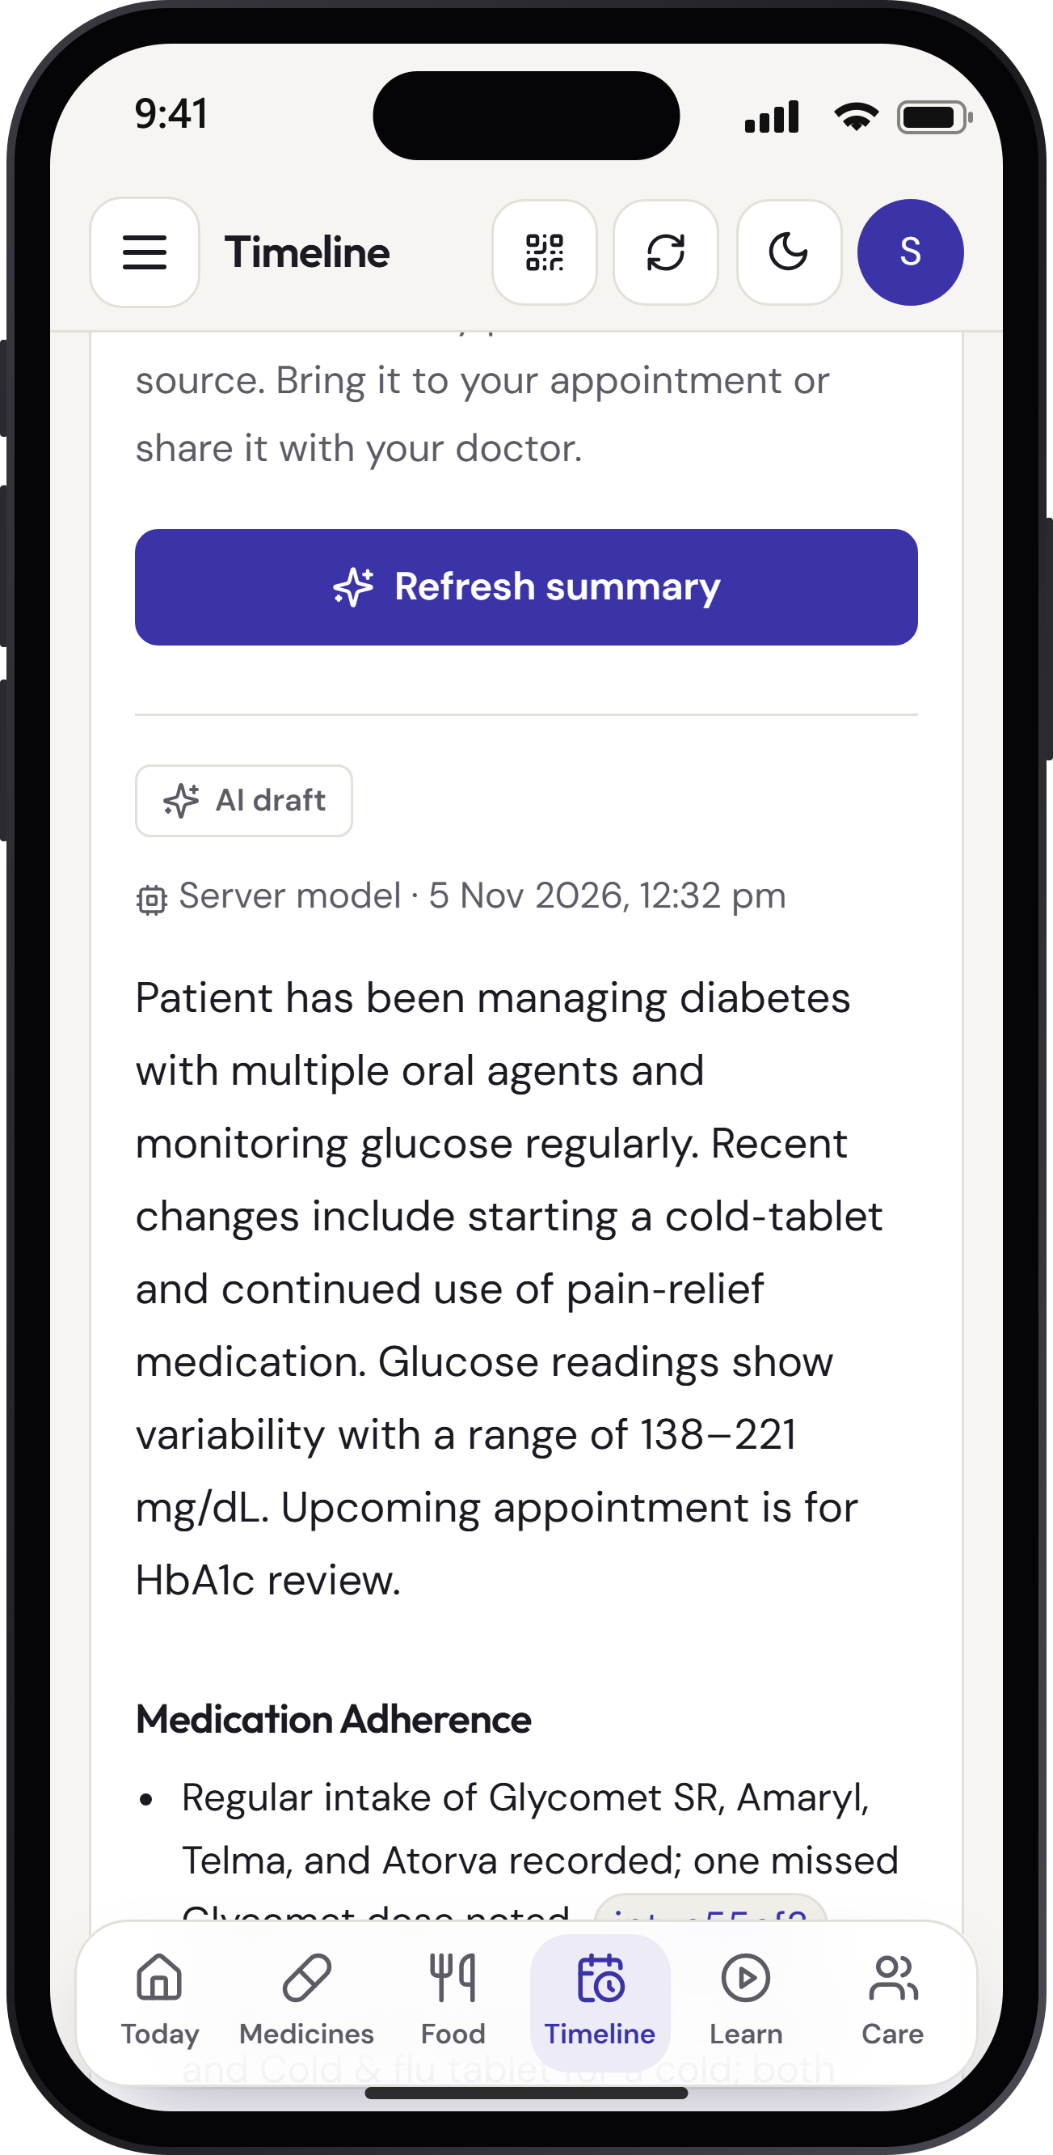
Solution Overview, Key Features & Impact
• Prescription scan photo → AI reads names, strengths, timings → patient confirms each line → daily schedule
• Next-dose home today’s doses in India time; taken / missed / unsure recorded honestly
• Care timeline visits, lab results, medicine changes, glucose, symptoms on one line
• Doctor link QR, read-only, 1–30 days, revocable, each view logged; AI briefing with citations
• Ingredient overlap flags the same ingredient in two products, with official label text
• Myth check + lessons claims checked only against NIDDK / NCCIH / MedlinePlus cards; narrated videos
• Family circle per-record read/write permissions for carers
• Phone-as-key sign-in scan a QR on a shared PC and tap the matching number
Next dose
Scanned prescription
Cited AI summary
Journey photo of prescription → confirmed schedule → daily one-tap records → timeline → QR to doctor → cited briefing at the visit.
Expected impact fewer duplicate-ingredient and missed-dose surprises; visits that start from facts; families who can help safely.
HEALTH-A-THON 2026 • FINAL SUBMISSION

Slide 6
Technology, Tools and AI Approach
Phone / desktop
React 19 PWA
light + dark, iPhone install
Express API
Node 24 · Zod validation
helmet CSP · rate limits
PostgreSQL
Neon (Singapore)
audit trail, versioned records
AI job | Output (checked)
Read prescription | medicines, timing, confidence
Identify meal | foods + rough grams only
Timeline summary | points citing record IDs
Myth check | verdict + known sources
Label in simple words | summary, pharmacist Qs
→
→
AI layer (one contract, swappable engines)
Server: Groq · Qwen 3.8 27B (vision + text), fallback gpt-oss-20b, OpenAI-compatible so any model server can plug in.
Phone: partner’s on-device small vision/text models via window adapter — same prompts, same schema checks; records can stay on the phone.
Trusted data sources
DailyMed + openFDA labels · Open Food Facts · USDA FoodData Central · NIDDK / NCCIH / MedlinePlus for education
• Draft, never decide: AI output is shown as a draft; nothing is saved until the patient confirms.
• Grounded: summaries may only cite supplied records; unknown citations are removed. Myth answers may only cite curated cards.
• Robust: strict JSON schemas, length normalisation, 30-min cache, automatic retry and model fallback; graceful “AI busy” message.
HEALTH-A-THON 2026 • FINAL SUBMISSION

Slide 7
Build Sprint Journey and Progress
Four sprints, each ending in a working, tested release
Sprint 1 Foundations
Sprint 2 Real accounts & records
Sprint 3 Knowledge & learning
Sprint 4 AI, doctor loop, launch
• Data model
• Synthetic patient journeys
• Clickable prototype
• Safety boundaries
• Accounts
• Recovery codes
• 13 record types
• Versioning
• Audit log
• Family sharing
• DailyMed/openFDA/OFF/USDA search
• Ingredient overlap
• 4 narrated Manim lessons
• HCI revision
• AI layer + eval
• Timeline
• Doctor links
• QR sign-in
• Redesign
• Website
• Deploy
Delivered
Live MVP on Render + Neon · 40+ API endpoints · 5 AI features behind one provider-neutral contract · 175 automated unit/API tests and 29 browser tests (desktop, 390 px and 320 px, light/dark, axe WCAG A/AA) · README with full API and on-device integration guide.
Hardest problems solved: grounding AI citations, safe multi-doctor schedules in India time, and sign-in across devices without passwords.
HEALTH-A-THON 2026 • FINAL SUBMISSION

Slide 8
Evaluation and User Validation
AI evaluation (Groq · Qwen 3.8 27B, 5 Nov 2026)
Software quality
Task | Test set | Result
Myth check | 13 claims (9 myths, 3 true, 1 off-topic) | 13/13 correct · 13/13 valid citations · median 0.67 s
Prescription scan | Synthetic printed Rx, 4 medicines | 4/4 names · 4/4 strengths · 3/4 timings · 0 invented
Timeline summary | Synthetic 5-month record (~85 records) | All citations resolve to real records (unknown IDs removed)
Meal photo | 1 thali photo | No items returned → fallback to search; prompt fix queued
• 175 unit/API tests: auth, permissions, concurrency, AI schemas, QR sign-in, doctor links
• 29 browser tests on 3 screen sizes, light + dark, automated WCAG A/AA (axe) checks
• Security: hashed tokens, SameSite cookies, CSP, rate limits, number-matching QR approval
• Live provider checks: DailyMed, openFDA, Open Food Facts, USDA
User validation
Improvements made from testing
Formal testing with patients and doctors has not yet been done. We report only technical results above.
[Add any feedback from your doctor partner or test users here: who, how many, what changed.]
• Paracetamol ↔ acetaminophen alias after label search failed for Indian names
• Calmer, flatter UI and “next dose” home after review of first design
• Output normaliser + fallback model after AI replies broke strict schemas
HEALTH-A-THON 2026 • FINAL SUBMISSION

Slide 9
Safety and Responsible AI
Risk | What we do
AI misreads a prescription | Draft only; each line shows confidence; patient edits and confirms; nothing auto-saved
AI invents facts in a summary | Records-only prompt; every point must cite record IDs; unknown IDs dropped; “verify before clinical use” banner
Medical advice from AI | Prompts forbid diagnosis, doses and glucose prediction; no free-text chat; myth answers limited to curated sources
Wrong person sees data | Owner-only sharing with scopes; doctor links expire + revocable; QR sign-in needs number match on phone
Health data exposure | Photos never stored; tokens hashed; HttpOnly cookies; CSP; no PHI in logs; export + delete account
Emergencies | Not a monitoring service: 112 shown in Help; low-glucose education links to NIDDK guidance
Human in the loop and known limits
The patient confirms every AI draft; the doctor sees sources for every AI statement; the doctor partner reviews content. Overlap detection compares entered ingredients — it is not a licensed interaction database. Labels are US (DailyMed/openFDA). Pilot uses test data only; free-tier AI is not used for real patient records; DPDP Act 2023 consent and on-device AI are the path to real data.
HEALTH-A-THON 2026 • FINAL SUBMISSION

Slide 10
Deployment, Cost and Sustainability Plan
Item | Today (MVP) | Clinic pilot (est.)
Web hosting | Render free | Render Starter ≈ ₹620/mo
Database | Neon free | Neon Launch ≈ ₹1,300/mo
AI (server) | Groq free tier | ≈ ₹0.15 per AI summary*
On-device AI | — | ₹0 per use (runs on phone)
Domain + email | — | ≈ ₹1,000/yr (one-time)
Total | ₹0 | ≈ ₹2,000–3,000/mo for ~500 users
Pilot requirements
• One outpatient clinic + its patients; consent forms
• Hosting in India region; DPDP Act 2023 privacy notice
• Doctor partner signs off content and AI prompts
• Regulatory check: records/education tool, no diagnosis (SaMD advice before any decision support)
*Estimate from token counts (~4k in / 0.8k out) at Qwen-class prices; USD at ≈ ₹88.
Scales horizontally: stateless API, sessions in Postgres.
Who pays (proposed)
Patient | Family Plus | Clinic
Free: tracking, timeline, doctor links, learning, fair-use AI | ₹99/month: unlimited AI scans + summaries, up to 5 carers | ₹1,499/doctor/month: briefing inbox, printable summaries, staff seats
Break-even ≈ 25 Family Plus subscribers (₹2,475) or 2 clinic seats (₹2,998) cover the monthly pilot infrastructure.
HEALTH-A-THON 2026 • FINAL SUBMISSION

Slide 11
What Next? Plans to take initiative forward (if any)
0–1 month
Pilot with doctor partner’s clinic: 20 patients, consent, weekly feedback; Hindi + Marathi UI
1–3 months
On-device AI as default (records stay on phone); WhatsApp reminders; refill alerts from stock counts
3–6 months
Indian drug database for brand → ingredient; glucometer/CGM import; pharmacist review queue
6–12 months
Clinic plan with 3–5 clinics; outcome study (missed doses, HbA1c change, visit time)
Publicly available? Yes — the MVP is live at https://diabeatit.onrender.com (pilot: test records only). Code: github.com/AbhayBhandarkar/DiabeatIt
Funding & partners [Planned grants, incubators or partners]
Ask Introductions to diabetologists and clinics willing to run a 3-month pilot.
HEALTH-A-THON 2026 • FINAL SUBMISSION

Slide 12
Thank you
[Team name] • [Team code]
[Contact email] | diabeatit.onrender.com | github.com/AbhayBhandarkar/DiabeatIt
Demo video: diabeatit.onrender.com/demo/DiabeatIT-demo.webm
Showcase login (synthetic data): sunita.sharma@example.com / Showcase-Sunita-2026!
Health-a-thon 2026
HEALTH-A-THON 2026

