Slide 1

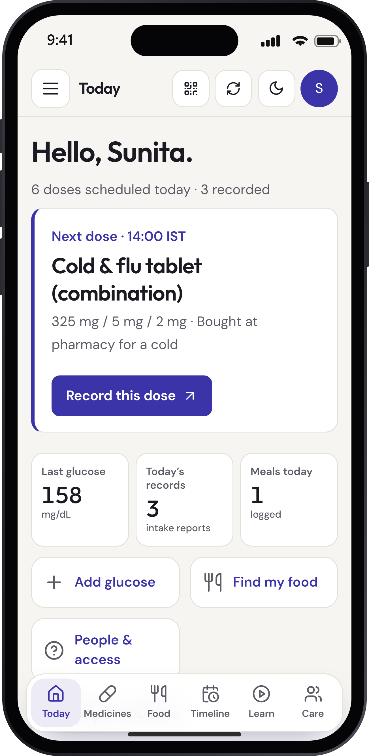
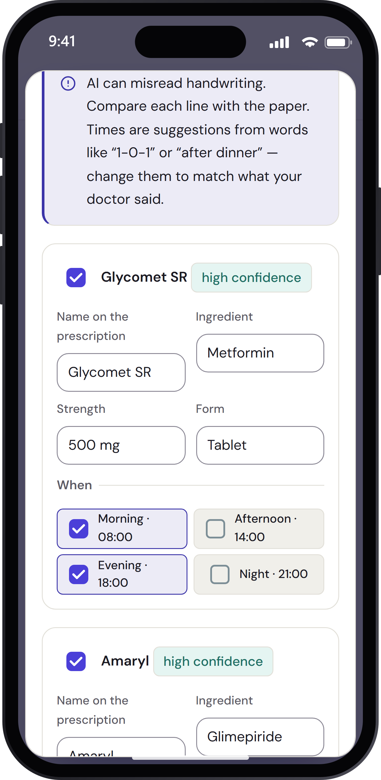
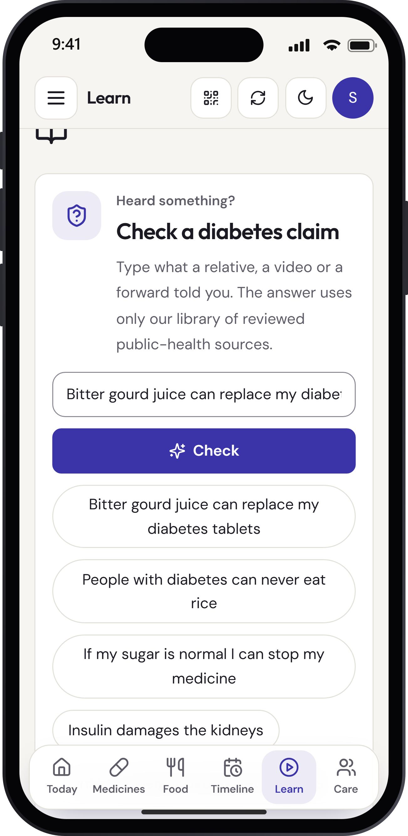

[Team name] |DiabeatIT
About the Team / Organisation
A. Team. Abhay Bhandarkar — product lead, full-stack and AI engineering. [Team member] — on-device AI (small vision + text models). [Organisation].
B. Doctor partner. [Name, specialty, years of practice] — reviews workflows, AI prompts and patient content; hosts the first clinic pilot.
Problem Statement (use case specific)
India has 101 million adults with diabetes and 136 million with prediabetes (ICMR–INDIAB, 2023). Adults aged 40–65 often take medicines from several doctors, written on separate paper prescriptions.
Duplicated ingredients (e.g. paracetamol in a cold tablet and Dolo 650), missed doses and lost readings go unnoticed; WHO estimates long-term adherence averages ~50%.
Consultations are short (~2 minutes in Indian primary care, BMJ Open 2017), so visits start from memory. Families want to help but have no safe shared view, and health myths spread faster than guidance.
Users: patients at home, family carers, and outpatient doctors.
AI Solution Description
DiabeatIT is a phone-first web app that keeps one calm, shared record of medicines, readings, visits and lab results. AI turns photos and long histories into drafts the patient confirms: a prescription becomes a daily schedule; months of records become a one-minute doctor briefing in which every statement links to its source record. A doctor opens it by scanning a QR code — read-only, time-limited and revocable.
Technology and Tools Used
React 19 PWA · Node/Express API · PostgreSQL (Neon) · Render hosting.
AI: Qwen 3.8 27B (vision + text) on Groq with gpt-oss-20b fallback; OpenAI-compatible contract so the partner’s on-device small models run the same prompts and schema checks on the phone.
Data: DailyMed, openFDA, Open Food Facts, USDA FoodData Central; education grounded in NIDDK, NCCIH, MedlinePlus.
Key Features of the solution
1. Prescription scan → confirmed schedule; next-dose home with one-tap records.
2. Care timeline + doctor link with cited AI briefing.
3. Same-ingredient overlap alerts with official label text in simple words.
4. Myth check against curated sources + narrated video lessons.
5. Family care circle with per-record permissions; phone-as-key QR sign-in.
Scan to open the live app
diabeatit.onrender.com
Showcase login (synthetic data): sunita.sharma@example.com / Showcase-Sunita-2026!

Slide 2
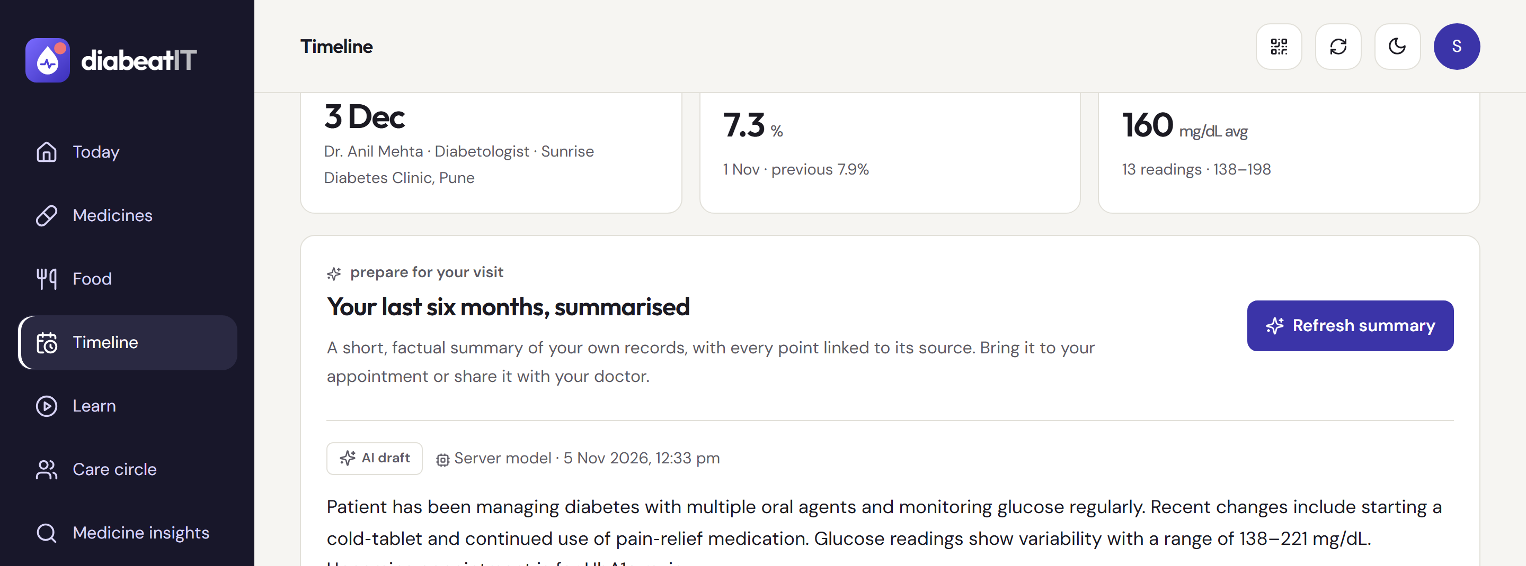
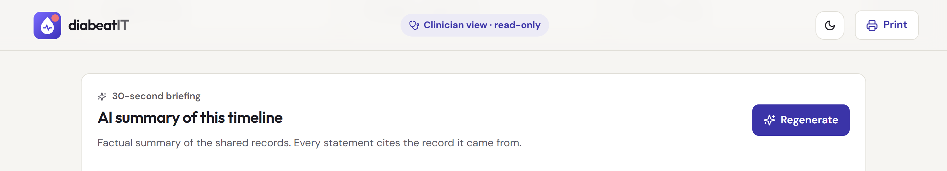
[Team name] |DiabeatIT
Build Sprint Progress
Four sprints: data model and prototype → real accounts, 13 record types, audit and family sharing → medicine/food knowledge search, ingredient overlap and four narrated lessons → AI layer, timeline, doctor links, QR sign-in, redesign and deployment.
Delivered: live MVP, 40+ API endpoints, 5 AI features behind one provider-neutral contract, full README and integration guide.
User Validation and AI Evaluation
Myth check: 13/13 correct verdicts, 13/13 valid citations, median 0.67 s. Prescription scan (synthetic): 4/4 names, 4/4 strengths, 3/4 timings, 0 invented medicines. Summaries: all citations resolve to real records. Meal photo: 1 failure → search fallback.
175 unit/API tests + 29 browser tests (3 screen sizes, light/dark, WCAG A/AA checks).
Patient and doctor testing not yet done; [add partner/user feedback here].
Safety and Responsible AI
AI produces drafts only; nothing is saved until the patient confirms. Prompts forbid diagnosis, dosing and glucose prediction; outputs must pass strict schemas; summary citations to unknown records are removed; myth answers may only cite curated sources.
Sharing is owner-controlled with scopes; doctor links expire, are revocable and every view is audited; QR sign-in needs number matching. Photos are not stored; tokens are hashed; CSP and rate limits; no health data in logs.
Limits: overlap uses entered ingredients (not a licensed interaction database); US label data; test records only on free-tier AI.
Deployment and Sustainability
Live today at ₹0 on free tiers (Render, Neon, Groq). Clinic pilot ≈ ₹2,000–3,000/month for ~500 users; on-device AI removes per-use AI cost.
Model: free for patients; Family Plus ₹99/month; Clinic ₹1,499/doctor/month. Next: 20-patient clinic pilot, Hindi/Marathi, DPDP-compliant consent.
Supporting Links
MVP: diabeatit.onrender.com · website diabeatit.onrender.com/about
Demo video: diabeatit.onrender.com/demo/DiabeatIT-demo.webm
Code: github.com/AbhayBhandarkar/DiabeatIt

