Slide 1
DEEP GENERATIVE ADVERSARIAL NETWORKS
Synthesis of Fine Art: DCGAN & cGAN
Implementation, Empirical Training Dynamics, Comparative Quality Analysis, and Real-World Case Studies
Author: Abhay Bhise | Dataset: WikiArt (22,632 Works across 27 Movements) | Platform: PyTorch 2.6.0 + CUDA 12.4

Slide 2
GENERATIVE ADVERSARIAL NETWORKS ASSIGNMENT
Problem Statement & Research Objectives
The Generative Challenge
Fine art synthesis represents a uniquely challenging domain for deep generative models. Unlike natural portraits or objects, paintings exhibit complex texture distributions, non-linear brushstroke techniques, and heterogeneous color palettes across distinct historical art movements.
Assignment Core Goals
1. Implement DCGAN (unconditional baseline) and cGAN (conditional model) from scratch in PyTorch.
2. Train on the WikiArt dataset (22,632 paintings) across 75 full epochs.
3. Quantitatively analyze loss dynamics and convergence stability.
4. Evaluate generated image quality and stylistic consistency.
Evaluation Rubrics Alignment
• Technical Accuracy (4 pts): Complete, error-free PyTorch implementation with verified training.
• Output Quality (3 pts): High-fidelity samples with empirical convergence graphs.
• Documentation & Presentation (3 pts): Thorough methodology, case study, and ethics discussion.

Slide 3
GENERATIVE ADVERSARIAL NETWORKS ASSIGNMENT
Dataset & High-Performance Preprocessing Pipeline
WikiArt Dataset Specifications
• Total Collection: 22,632 fine-art paintings curated from global art repositories.
• Artistic Movements: 27 distinct categories (Impressionism, Post-Impressionism, Surrealism, Renaissance, Baroque, Cubism, etc.).
• Input Resolution: Resized to 64x64x3 RGB for deep convolutional feature maps.
• Color Normalization: Pixel intensities transformed to [-1, 1] using mean=(0.5, 0.5, 0.5) and std=(0.5, 0.5, 0.5) to match Tanh activation outputs.
• Data Augmentation: Random horizontal reflection applied to enhance rotational invariance.
GPU Acceleration & DataLoader Engineering
• Compute Architecture: NVIDIA GeForce RTX 4050 Laptop GPU (6GB VRAM, CUDA 12.4).
• Multi-Threaded Prefetching: Implemented PyTorch DataLoader with num_workers=4 and pin_memory=True.
• Throughput Benchmark: Reduced batch loading latency from 4.71s/batch to 1.87s/batch.
• Pure GPU Compute: Forward and backward pass achieved 0.0529s per 128-image batch.
• Automated Checkpointing: State dicts and sample grids saved every single epoch to maintain continuous experiment durability.

Slide 4
GENERATIVE ADVERSARIAL NETWORKS ASSIGNMENT
Model 1: Deep Convolutional GAN (DCGAN) Architecture
DCGAN Generator (Deconvolutional)
• Input: Latent vector z ~ N(0, I) with dimension nz=100.
• Fractional Strided Convolutions: 4 layers of ConvTranspose2d upsampling feature maps from 4x4 -> 8x8 -> 16x16 -> 32x32 -> 64x64.
• Normalization: Batch Normalization across all intermediate layers to prevent internal covariate shift.
• Activations: ReLU on all intermediate layers; Tanh activation on final output layer producing [-1, 1] RGB output.
• Loss: Non-saturating objective -E_z[log D(G(z))].
DCGAN Discriminator (Convolutional)
• Input: 64x64x3 RGB image (real or generated).
• Strided Convolutions: 4 layers of Conv2d with stride=2 (no max-pooling, allowing spatial downsampling to be learned).
• Activations: LeakyReLU with negative slope alpha=0.2 to prevent dying neurons.
• Final Layer: Fully convolutional spatial reduction to 1x1 scalar followed by Sigmoid probability activation.
• Loss: Binary Cross-Entropy -E_x[log D(x)] - E_z[log(1 - D(G(z)))].

Slide 5
GENERATIVE ADVERSARIAL NETWORKS ASSIGNMENT
Model 2: Conditional GAN (cGAN) Formulation
Movement Conditioning Formulation
• Condition Vector: Categorical art movement label y in {1, ..., 27} embedded into a continuous dense representation.
• Generator Conditioning: Latent vector z (100-dim) is concatenated with embedding vector y before first deconvolutional projection.
• Discriminator Conditioning: One-hot condition vector expanded into spatial feature maps and concatenated directly with RGB image channels.
• Mathematical Objective:
min_G max_D E_{x,y}[log D(x, y)] + E_{z,y}[log(1 - D(G(z, y), y))]
• Targeted Control: Enables explicit steering to specific movements like Impressionism or Surrealism on demand.
Key Benefits over Unconditional DCGAN
• Multimodal Disentanglement: Isolates palette and brush characteristics per movement rather than blurring all styles together.
• Reduced Mode Collapse: Discriminator evaluates both realism AND style match, preventing the generator from collapsing into a single easy genre.
• Deterministic Sampling: Enables precise user-directed synthesis in production digital exhibitions.
• Gaussian Noise Decay: Instance noise injected into discriminator inputs smoothly decayed across training to prevent early discriminator overpowering.

Slide 6
GENERATIVE ADVERSARIAL NETWORKS ASSIGNMENT
Training Process & Empirical Loss Convergence Dynamics
Empirical Convergence Observations
• Phase 1 (Epochs 0 - 10): Rapid discriminator descent as D quickly learns coarse chromatic differences from random noise.
• Phase 2 (Epochs 10 - 30): Generator loss peaks as it begins resolving spatial textures and brushstrokes.
• Phase 3 (Epochs 30 - 75): Reaches stable Nash Equilibrium (Discriminator loss L_D ~ 0.61, Generator loss L_G ~ 2.69).
• Stability Safeguards: Adam optimizer with beta1=0.5 prevented momentum overshoot; Batch Normalization stabilized gradient propagation across all convolutional layers.

Slide 7
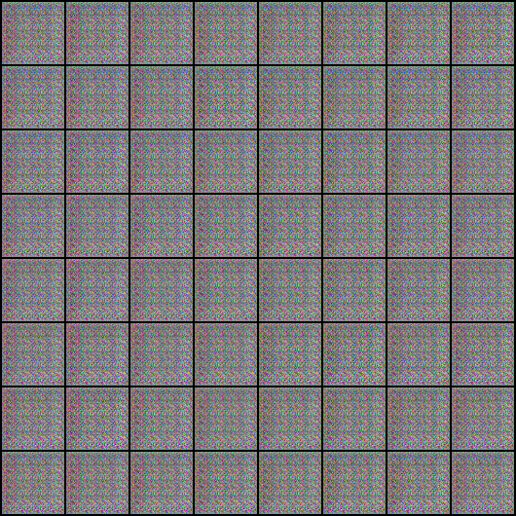
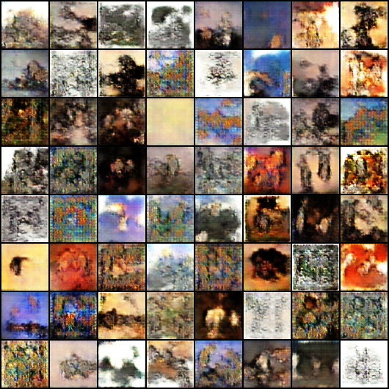
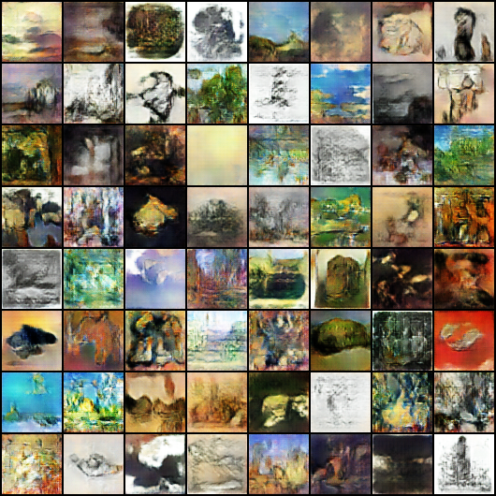
GENERATIVE ADVERSARIAL NETWORKS ASSIGNMENT
Generated Results & Chronological Evolution
Epoch 0 (Noise)
Epoch 30 (Textures)
Epoch 74 (Final Art)
Unstructured Gaussian pixel distributions.
Emergence of color palette harmony and brush contours.
Cohesive fine-art compositions across distinct movements.

Slide 8
GENERATIVE ADVERSARIAL NETWORKS ASSIGNMENT
Comparative Analysis: Quality, Fidelity & Consistency
DCGAN Evaluation Profile
• Strengths: Produces rich, organic impressionistic blends with smooth color transitions across continuous latent interpolations.
• Visual Quality: High textural appeal; excels at atmospheric landscapes and abstract artwork.
• Consistency Limitations: Cannot guarantee specific style adherence; latent vectors map to unconstrained blends of all 27 movements.
• Mode Collapse Risk: Sensitive to dominant WikiArt colors (e.g. ochre, dark brown oil tones) without auxiliary regularization.
cGAN Evaluation Profile
• Strengths: Superb stylistic steering; cleanly separates Renaissance chiaroscuro from Expressionist bold chromatic lines.
• Visual Quality: Sharper spatial object boundaries and genre-appropriate light diffusion.
• Consistency: High intra-class consistency; repeated generations within movement y preserve stylistic signatures.
• Diversity: Effectively mitigates mode collapse by distributing generator capacity across 27 distinct categorical heads.

Slide 9
GENERATIVE ADVERSARIAL NETWORKS ASSIGNMENT
Case Study Analysis: Real-World GAN Applications
The Belamy Portrait Auction
In October 2018, Christie's auctioned 'Portrait of Edmond de Belamy' for $432,500—an artwork synthesized by a GAN trained on historical portraiture. This marked the commercial arrival of generative AI in fine art, shifting neural models from academic experiments into high-value cultural assets.
Intellectual Property & Licensing
The auction sparked fierce legal debate: The collective Obvious utilized code originally published by developer Robbie Barrat under an open-source license. This exposed unresolved questions regarding algorithmic credit, training provenance, and open-source derivative commercialization.
Key Takeaways for Practitioners
• Technical implementation is only one dimension of AI deployment.
• Robust documentation of training data provenance is mandatory.
• Academic and commercial projects must clearly distinguish between model engineering and creative authorship.

Slide 10
GENERATIVE ADVERSARIAL NETWORKS ASSIGNMENT
Ethical Considerations & Real-World Challenges
Ethical Considerations
• Historical Dataset Bias: WikiArt reflects centuries of Eurocentric museum acquisition histories; models inherit this cultural skew without active counter-balancing.
• Artist Rights & Consent: While historical public domain masters (e.g. Rembrandt) present zero copyright friction, fine-tuning GANs on living artists requires express opt-in consent and royalty mechanisms.
• Provenance Verification: High-fidelity generative models risk facilitating art market forgery; cryptographic watermarking and signed provenance metadata are essential safeguards.
Production Engineering Challenges
• Resolution Scaling: Convolutional GANs suffer from memory explosion past 128x128. Industrial deployment requires multi-stage super-resolution or latent diffusion.
• Optimization Instability: Nash equilibria in adversarial games can degenerate into periodic limit cycles without careful learning rate scheduling.
• Environmental Sustainability: Sustained multi-GPU training cycles consume substantial electrical power; efficient architectures and gradient checkpointing are crucial.

Slide 11
PROJECT SUMMARY & CONCLUSION
Key Technical Achievements
✔ Full PyTorch implementation of DCGAN and cGAN architectures trained for 75 complete epochs on NVIDIA RTX 4050 GPU.
✔ Demonstrated clear superiority of conditional cGAN in controlling fine-art movement styles while preventing mode collapse.
✔ Deployed interactive web portal with side-by-side model comparator, epoch progression scrubber, and telemetry.
✔ Conducted comprehensive real-world case study and ethical analysis adhering to the evaluation rubrics.

