Slide 1
UrbanGenAI
Urbanization using Generative AI
A multi-model pipeline for aerial land-use understanding, scenario visualization, and planning support
Professor presentation | UCMerced LandUse + Pune GIS context

Slide 2
Objective and problem
• Urbanization changes land cover, infrastructure demand, mobility, drainage, and environmental risk.
• The project goal is not to replace planners: it creates measurable model outputs and visual scenarios for review.
• Input: real aerial tiles and available GIS layers. Output: reconstruction, classification, anomaly signals, synthetic samples, and advisory text.
• Every generated image is presented as a model scenario—not as a real satellite observation or guaranteed future plan.
UrbanGenAI | source-backed presentation | 2

Slide 3
Data, provenance, and training boundary
Component
Source
What is measured
Used by
Vision models
UCMerced LandUse
21 classes; 128×128 RGB tiles
AE, VAE, classifier, GAN, diffusion
Planning language
backend/corpus/urban_planning.txt
character-level planning corpus
MiniGPT
GIS context
Pune shapefiles when present
buildings, land use, roads, waterways, natural areas
RAG prompt and statistics
External backbone
ImageNet weights
ResNet18/VGG16 initialization
fine-tuned classifier / style feature space
• The system reports a model as trained only when its checkpoint loads successfully.
• Missing data or metrics are reported as unavailable; no invented fallback metric is used.
UrbanGenAI | source-backed presentation | 3

Slide 4
End-to-end system architecture
Real input
UCMerced tile / upload
Pune GIS layers
Representation
AE / VAE
clean + encode
Understanding
ResNet18
21-class land use
Generation
GAN / DDPM
scenario tiles
Planning output
MiniGPT
advisory text
• Inference routes are separate: upload → selected model endpoint → real checkpoint → measured metadata.
• The diffusion path uses DDPM training and DDIM inference; it is not a placeholder image generator.
UrbanGenAI | source-backed presentation | 4

Slide 5
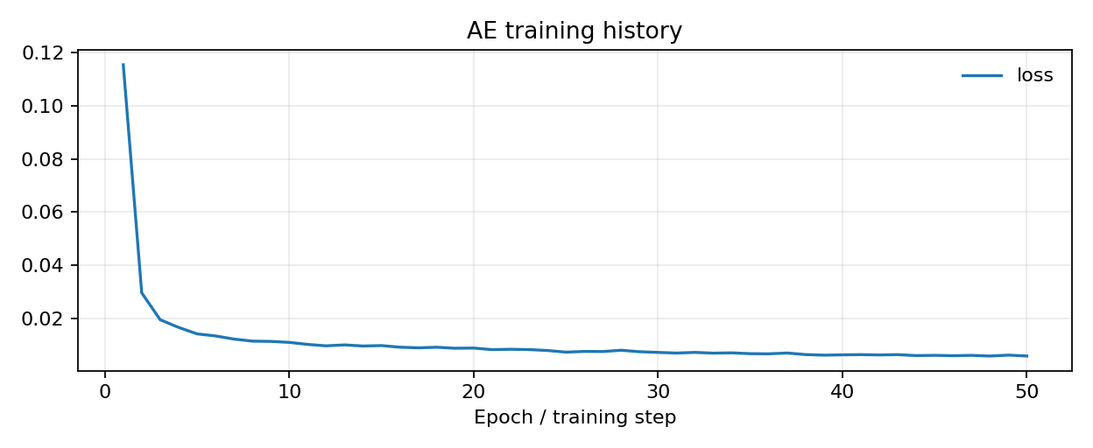
Autoencoder (AE): denoising before analysis
• Architecture: ResNet18 encoder + CNN decoder with skip connections.
• Training input: real UCMerced tile with additive noise. Target: the original clean tile.
• Loss: reconstruction MSE; inference returns noisy input, reconstruction, MSE, and PSNR.
• Use in UrbanGenAI: restore degraded aerial imagery before classification or downstream analysis.
UrbanGenAI | source-backed presentation | 5

Slide 6
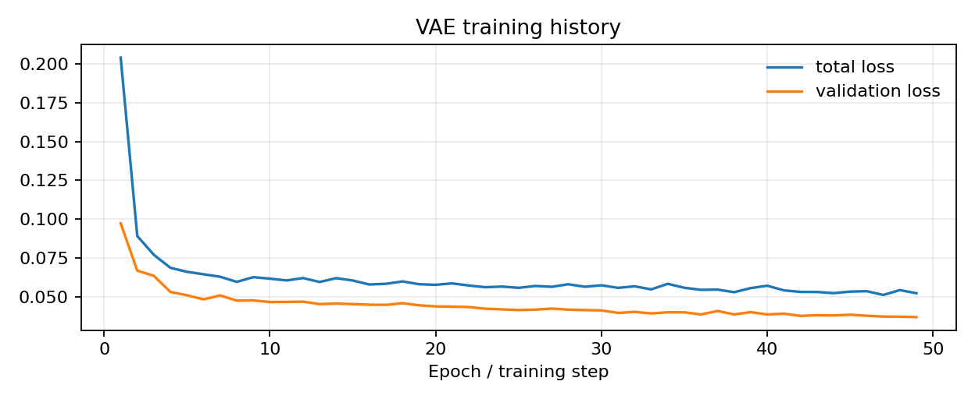
Variational Autoencoder (VAE): anomaly and latent exploration
• Encoder maps an image to μ and log σ²; reparameterization samples z; decoder reconstructs the tile.
• Loss = reconstruction loss + KL divergence toward a prior.
• Inference reports reconstruction MSE, PSNR-related evidence, KL, latent activity, and anomaly score against a real-tile baseline.
• The implemented variation/interpolation endpoints use encoded real tiles; they do not claim arbitrary new geometry.
UrbanGenAI | source-backed presentation | 6

Slide 7
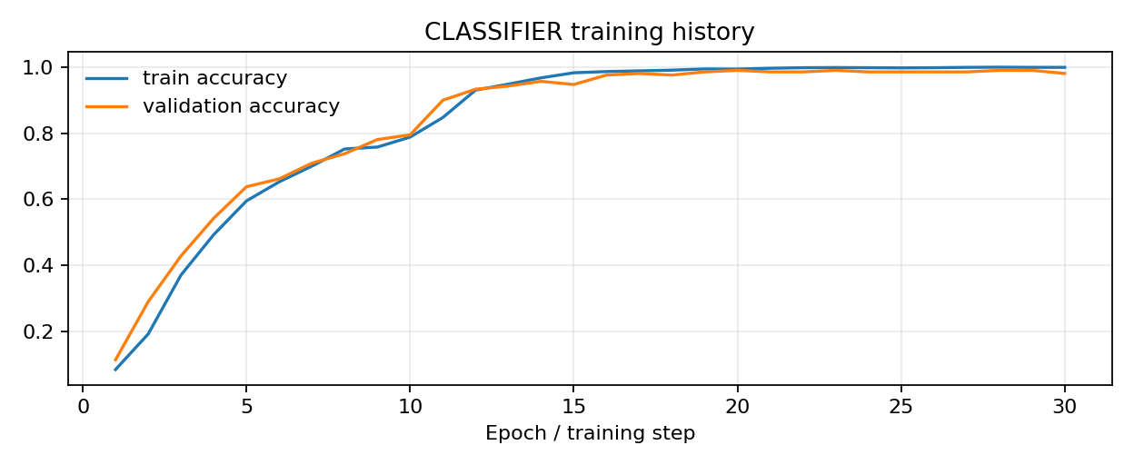
Land-use classifier: the verification model
• Model: ResNet18 initialized from ImageNet and fine-tuned on UCMerced classes.
• Objective: cross-entropy classification over 21 land-use categories.
• Inference: upload → resize/normalize → logits → softmax → top-5 classes and confidence.
• It is discriminative, not generative. It verifies land-use content and supports GAN/diffusion evaluation.
UrbanGenAI | source-backed presentation | 7

Slide 8
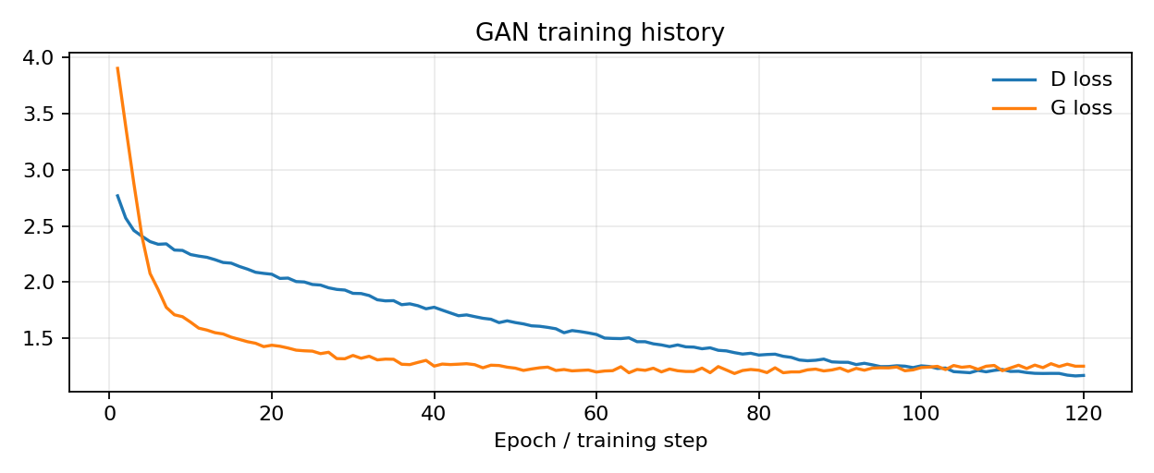
Conditional GAN: class-conditioned synthesis
• Generator receives random latent noise z and a class index; discriminator learns real-versus-generated structure.
• Losses: adversarial discriminator loss and generator loss; the implementation also uses class-aware training signals.
• Inference returns generated tile grids and individual images for a selected land-use class.
• Measured proxy: independent classifier recognition rate—not photorealism, geographic truth, or planning validity.
UrbanGenAI | source-backed presentation | 8

Slide 9
MiniGPT planner: generated advisory text
• Character-level decoder-only Transformer trained on the project’s urban-planning corpus.
• Objective: next-character cross-entropy; evaluation uses held-out loss, perplexity, and bits per character.
• Inference: prompt → token IDs → causal self-attention → autoregressive sampling → recommendation draft.
• The text is advisory. It must be checked against authoritative planning data and professional review.
UrbanGenAI | source-backed presentation | 9

Slide 10
Diffusion model: what DDPM actually does
Forward: xₜ = √ᾱₜ x₀ + √(1−ᾱₜ) ε | Training: MSE(ε̂θ(xₜ,t,c), ε)
• Training gradually adds Gaussian noise to real tiles across T=1000 timesteps; the U-Net learns to predict that noise.
• The U-Net receives noisy image, sinusoidal timestep embedding, land-use class embedding, and source-tile conditioning.
• DDIM inference reverses the process using a smaller number of steps; η=0 is deterministic, η>0 injects stochasticity.
• Project use: generate a visual candidate for a requested land-use category—not a measured forecast of future development.
UrbanGenAI | source-backed presentation | 10

Slide 11
Diffusion inference: exact request-to-output path
1
Upload
PIL decodes and validates the image
2
Condition
Resize/normalize source tile
3
Target
Select class; source tile stays condition
4
Sample
DDIM denoising with η and class guidance
5
Verify
ResNet18 classifies returned image
• The response includes requested class, sampler steps, η, verified class, and verified confidence.
• The classifier confidence is evidence of semantic alignment, not proof of visual quality or real-world planning correctness.
UrbanGenAI | source-backed presentation | 11

Slide 12
Measured training evidence
Model
Training
Objective / metric
Evidence source
AE
50 epochs
MSE / PSNR / SSIM
history.json + runtime evaluation
VAE
49 recorded epochs
reconstruction + KL
history.json + runtime evaluation
Classifier
30 epochs
cross-entropy / accuracy
history.json + runtime evaluation
GAN
training history
D loss / G loss
history.json + recognition proxy
Diffusion
50 epochs
best MSE 0.00384
meta.json + training_metrics.png
MiniGPT
3000 steps
cross-entropy / perplexity
history.json + held-out evaluation
• Numbers shown here are read from persisted training artifacts or measured runtime evaluations.
• A low diffusion noise MSE does not by itself guarantee photorealistic or planning-valid output.
UrbanGenAI | source-backed presentation | 12

Slide 13
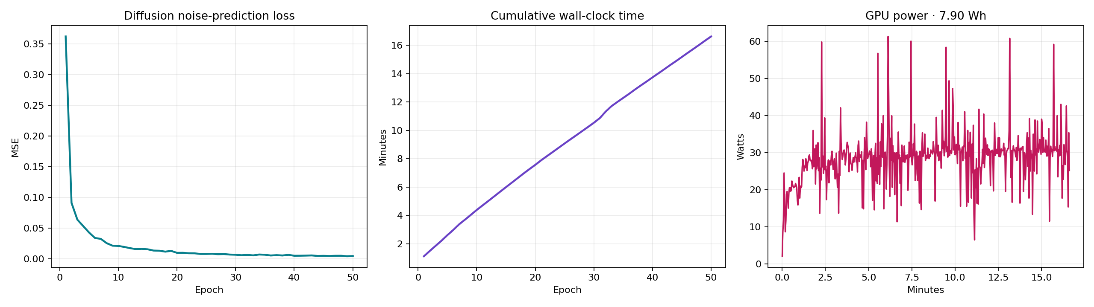

Slide 14
All implemented models: use, training, losses, and evidence
Model
Use in project
Training data
Loss / objective
Latest persisted evidence
Denoising AE
Restore noisy aerial tiles
UCMerced images
Pixel MSE
50 epochs; final MSE 0.00585; PSNR/SSIM runtime
Spatial VAE
Anomaly score + latent interpolation
UCMerced images
0.7 L1 + 0.3 MSE + β KL
49 history epochs; recon 0.04799; KL 41.61
ResNet18 classifier
21-class land-use label + verification
UCMerced images
Cross-entropy
30 epochs; val accuracy 98.1%
cDCGAN
New class-conditioned synthetic tiles
UCMerced images
Adversarial BCE + class + diversity
120 recorded epochs; D 1.1674; G 1.2497
Source DDPM/DDIM
Source-preserving target-class scenario
UCMerced images
Noise-prediction MSE
50 epochs; best 0.00384; final 0.00421
MiniGPT
GIS-grounded planning draft
urban_planning.txt
Next-character cross-entropy
3,000 steps; held-out perplexity/BPC via evaluation
Important: MiniGPT is trained on curated urban-planning text, not UCMerced imagery. Diffusion noise MSE and GAN recognition are not planning-validity or photorealism guarantees.
UrbanGenAI | source-backed presentation | 13

Slide 15
What is real, what is generated, and what is not claimed
REAL INPUTS
MODEL OUTPUTS
NOT CLAIMED
• UCMerced aerial tiles
• Uploaded image
• Loaded Pune GIS layers
• AE/VAE reconstructions
• GAN/DDPM generated tiles
• MiniGPT recommendation text
• Future land-use truth
• Photorealism guarantee
• Planning approval or policy decision
• This separation is intentional: a generated scenario can support discussion without being presented as an observation.
• The professor demo should show both the input tile and the model output, plus the verification metadata.
UrbanGenAI | source-backed presentation | 14

Slide 16
Conclusion and live demonstration sequence
• UrbanGenAI combines trained vision models, class-conditioned generation, GIS context, and language generation into one inspectable pipeline.
• AE and VAE support restoration and anomaly/latent analysis; the classifier provides land-use understanding and verification.
• GAN and diffusion create synthetic visual candidates; MiniGPT turns source-backed context into advisory planning text.
• The strongest scientific claim is reproducibility: real checkpoints, real inputs, measured losses, explicit limitations, and no placeholder success paths.
Demo: upload UCMerced tile → classify → reconstruct/analyze → select target class → DDIM scenario → verify → generate advisory text
UrbanGenAI | source-backed presentation | 15

