Slide 1
GENERATIVE AI CAPSTONE · MIT ACADEMY OF ENGINEERING · 2304422
UrbanGenAI
A Multi-Model Generative AI System for Urban-Planning Decision Support
Case study: Pune (PMC area) — 516 km2, 7.4 million residents

Slide 2
Problem Statement
City planners have to weigh many things at once — new housing, traffic, flooding, green cover, heat — and today the tools for this are split apart.
• Data is scattered. Satellite images, land-cover maps, road networks, terrain and population all sit in different software and formats.
• Tools give one fixed answer. Normal GIS produces a single map. Planners cannot easily see and compare alternative options.
• AI chat tools guess. Language models suggest ideas but are not connected to real ground data, so they can be wrong about a place.
• No single workspace. There is no one place that goes from raw data to generated options to a written recommendation a planner can act on.
Study area: Pune Municipal Corporation, India.

Slide 3
Objectives
Build one connected pipeline where four generative AI models each do a clear, useful job.
• Classify land use — label an aerial tile into one of 21 zoning categories (ResNet18 CNN).
• Clean the imagery — use a Denoising Autoencoder to remove noise before analysis.
• Flag unusual parcels — use a Variational Autoencoder to score how far a parcel is from normal.
• Create training data — use a class-conditional GAN to generate synthetic tiles per class.
• Draft the recommendation — use a from-scratch Transformer (MiniGPT) seeded with real Pune statistics.
• Prove every claim — train each model ourselves, commit the weights, and show live measured metrics.

Slide 4
Expected Outcome
A working, verifiable web application that a planner can actually use.
• A single dashboard — landing page, one page per model with architecture and instructions, and a live Evaluation page.
• Four trained models — checkpoints committed to the repository, not downloaded.
• Honest evaluation — real numbers for every model, plus a clear list of current limitations.
• Reproducible — full retrain takes about 1 hour on a laptop GPU (about 0.08 kg CO2).
• Syllabus coverage — autoencoder, VAE, GAN and Transformer all demonstrated with working demos, loss maths and an ethics discussion.

Slide 5
Literature Review (IEEE journals / magazines) — 1 of 2
Sr. | Year | Publisher (IEEE journal) | What the paper contains | How we use it
1 | 2016 | IEEE Geoscience & Remote Sensing Magazine | Tutorial on deep learning for remote-sensing data. | Covers autoencoders and CNNs for land-cover tasks; basis for our encoder choice.
2 | 2017 | Proceedings of the IEEE | Benchmark and review of remote-sensing scene classification. | Introduces standard datasets (incl. UC Merced) and CNN baselines we compare against.
3 | 2017 | IEEE Geoscience & Remote Sensing Magazine | Comprehensive review of deep learning in remote sensing. | Maps which DL methods suit classification, detection and generation.
4 | 2017 | IEEE Geoscience & Remote Sensing Letters | Deep learning classification of land cover and crop types. | Multi-level CNN for LULC; supports our 21-class classifier design.
5 | 2014 | IEEE J. Selected Topics in Applied Earth Obs. & Remote Sensing | Stacked autoencoders for hyperspectral image classification. | Early proof that autoencoder features help land classification.
6 | 2016 | IEEE Transactions on Geoscience and Remote Sensing | CNN-based deep feature extraction and classification of images. | Design guidance for the fine-tuned ResNet backbone we use.
7 | 2018 | IEEE Transactions on Geoscience and Remote Sensing | Discriminative CNNs (metric learning) for scene classification. | Motivates transfer learning on small remote-sensing datasets like ours.
8 | 2018 | IEEE Signal Processing Magazine | Overview of Generative Adversarial Networks. | Architectures and training tricks; guided our spectral-norm + EMA GAN.
All entries are IEEE journal or magazine articles — no conference papers.

Slide 6
Literature Review (IEEE journals / magazines) — 2 of 2
Sr. | Year | Publisher (IEEE journal) | What the paper contains | How we use it
9 | 2019 | IEEE Access | Survey of recent progress on GANs. | Catalogue of conditional-GAN variants; basis for our class-conditional design.
10 | 2019 | IEEE Transactions on Geoscience and Remote Sensing | Overview of deep learning for hyperspectral image classification. | Compares autoencoders, CNNs and GANs on the same task.
11 | 2021 | IEEE Transactions on Knowledge and Data Engineering | Review of GANs: algorithms, theory and applications. | Explains mode collapse and label smoothing, which we apply.
12 | 2021 | IEEE Transactions on Geoscience and Remote Sensing | Multimodal deep learning for remote-sensing classification. | Supports our multi-source City Stack idea (imagery + land cover + roads + terrain).
13 | 2021 | IEEE Access | Survey of digital twins from smart manufacturing to smart cities. | Frames UrbanGenAI as a decision-support digital twin.
14 | 2022 | IEEE Geoscience & Remote Sensing Magazine | Review of self-supervised learning in remote sensing. | Backs training our own encoders/decoders rather than only using labels.
15 | 2023 | IEEE Transactions on Pattern Analysis and Machine Intelligence | Survey on Vision Transformers. | Background for the decoder-only Transformer (MiniGPT) we build from scratch.
Verify each DOI against IEEE Xplore before final submission.

Slide 7
System Architecture (end-to-end pipeline)
Aerial tile
+ Pune GIS
128x128x3
Land-Use
Classifier (CNN)
-> 1 of 21 classes
Denoising
Autoencoder
clean tile
Variational
Autoencoder
anomaly score
Conditional
GAN
synthetic tiles
MiniGPT
Transformer
plan text
Planner
dashboard
decision support
One shared pipeline. The classifier says what a parcel is; the AE cleans the image; the VAE flags parcels that do not look normal for their zone; the GAN creates extra training data; MiniGPT turns the numbers into a written recommendation grounded in real Pune statistics.

Slide 8
Architecture detail — layers, epochs, dimensions at each stage
Model | Structure (layers) | Key dimensions | Epochs | Loss
Denoising AE | ResNet18 encoder + 4 ConvTranspose decoder with U-Net skips | input 128x128x3 -> 8x8x256 bottleneck -> 128x128x3 | 50 | MSE(recon, clean), noise sigma 0.15
Spatial VAE | ResNet18 encoder + two 1x1 conv heads + 4 ConvTranspose decoder | 8x8x256 -> mu / log-var 8x8x64 -> z (4,096) -> 128x128x3 | 50 | 0.7 L1 + 0.3 MSE + beta KL (beta ~ 1e-4)
Conditional GAN | G: Linear->8x8x512 + 5 ConvTranspose; D: 5 spectral-norm Conv | z 128 + class embed 64 -> 128x128x3 | 100 | non-saturating BCE, label smoothing 0.9/0.1, EMA 0.999
MiniGPT | 4 pre-norm Transformer blocks, 4 attention heads, causal mask, weight-tied head | context 192 chars, n_embd 256, vocab 64, 3.23M params | 3,000 steps | next-character cross-entropy
Classifier | ResNet18 backbone + Linear(512 -> 21) | 224x224x3 -> 512-d -> 21 logits | 30 | cross-entropy
Encoders start from ImageNet weights and are fine-tuned; all decoders, the GAN and MiniGPT are trained from scratch.

Slide 9
Implementation Result — modules, losses & evaluation matrix
Module | Objective / loss function | Final training loss | Evaluation metric (sample) | Measured result | Reading
Denoising AE | MSE(recon, clean tile); input corrupted with Gaussian noise sigma = 0.15 | 0.01977 MSE (from 0.1830 at epoch 1) | PSNR / SSIM / MSE — 105 held-out tiles | 29.7 dB / 0.865 / 0.0045 | Near-lossless
Spatial VAE | 0.7 L1 + 0.3 MSE + beta KL(q(z|x) || N(0,I)), beta ~ 1e-4 | recon 0.07524 · KL 103.25 nats | PSNR / SSIM / KL / active latent dims | 19.5 dB / 0.43 / 106 nats / 63 of 64 | Soft by design; latent healthy
Conditional GAN | Non-saturating BCE + label smoothing 0.9 / 0.1; EMA generator 0.999 | adversarial min-max — no single value | Classifier-recognition rate — 168 generated tiles | ~ 15 % overall | Texture OK; geometry immature
MiniGPT Transformer | Next-character cross-entropy (causal LM) | train 0.087 · held-out 0.083 | Perplexity / bits-per-char — 23,616 chars | 1.09 / 0.12 bpc (vs 6.0 random) | Learns corpus; generalises
Land-Use Classifier | Cross-entropy over 21 classes | 0.1032 validation loss | Top-1 accuracy + 21x21 confusion matrix | 98.1 % validation accuracy | Reliable; feeds VAE + GPT
All values are read live from committed checkpoints / training logs and served at /evaluate/<module>.

Slide 10
Evaluation parameters — what each one means
Parameter | What it measures | Better is | Used for
PSNR (dB) | Pixel closeness of the reconstruction to the target image | higher | AE, VAE
SSIM (0-1) | Structural similarity (edges, texture) to the target | higher (-> 1) | AE, VAE
MSE | Mean squared pixel error | lower | AE, VAE
KL divergence (nats) | How far the learned latent is from a standard Normal prior | balanced — not 0, not huge | VAE
Active latent dims | Latent channels that carry real information (out of 64) | higher | VAE
Classifier-recognition rate | Share of generated tiles the classifier recognises as their class | higher | GAN
Perplexity | Effective number of choices per character (1 = perfect) | lower (-> 1) | MiniGPT
Bits per character | Information per character vs 6.0 bits for a random guess | lower | MiniGPT
Top-1 accuracy | Share of tiles given the correct land-use label | higher | Classifier
Each model is scored with the metric that model is actually judged by — not one metric forced onto all.

Slide 11
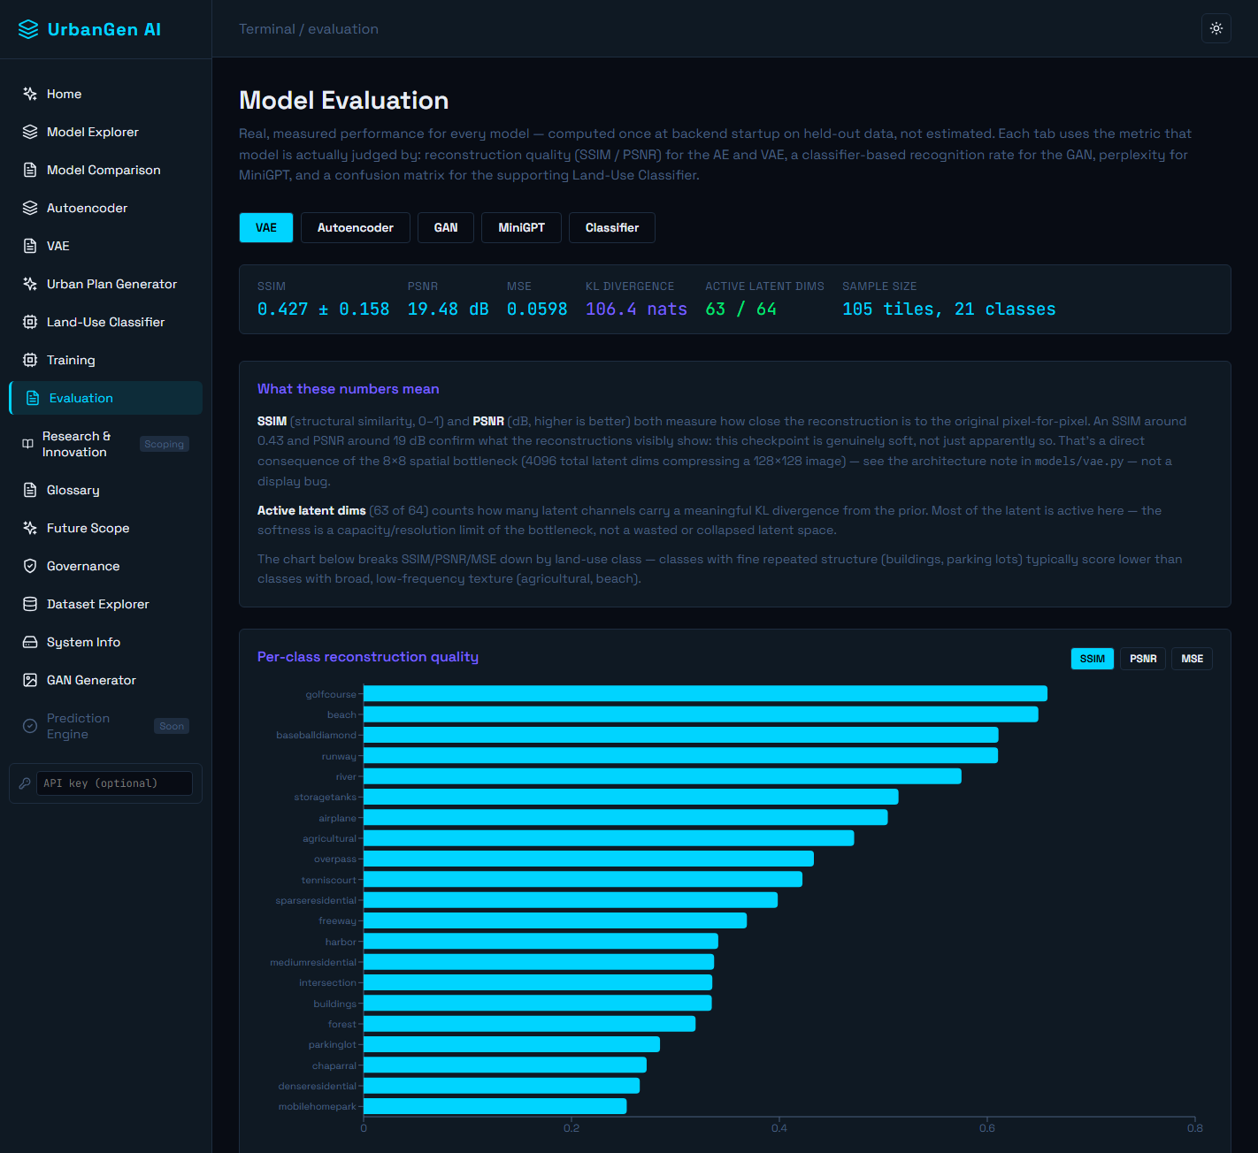
Implementation Result — live Evaluation dashboard
Evaluation page: one tab per module, each showing the metric it is judged by, computed on held-out data.

Slide 12
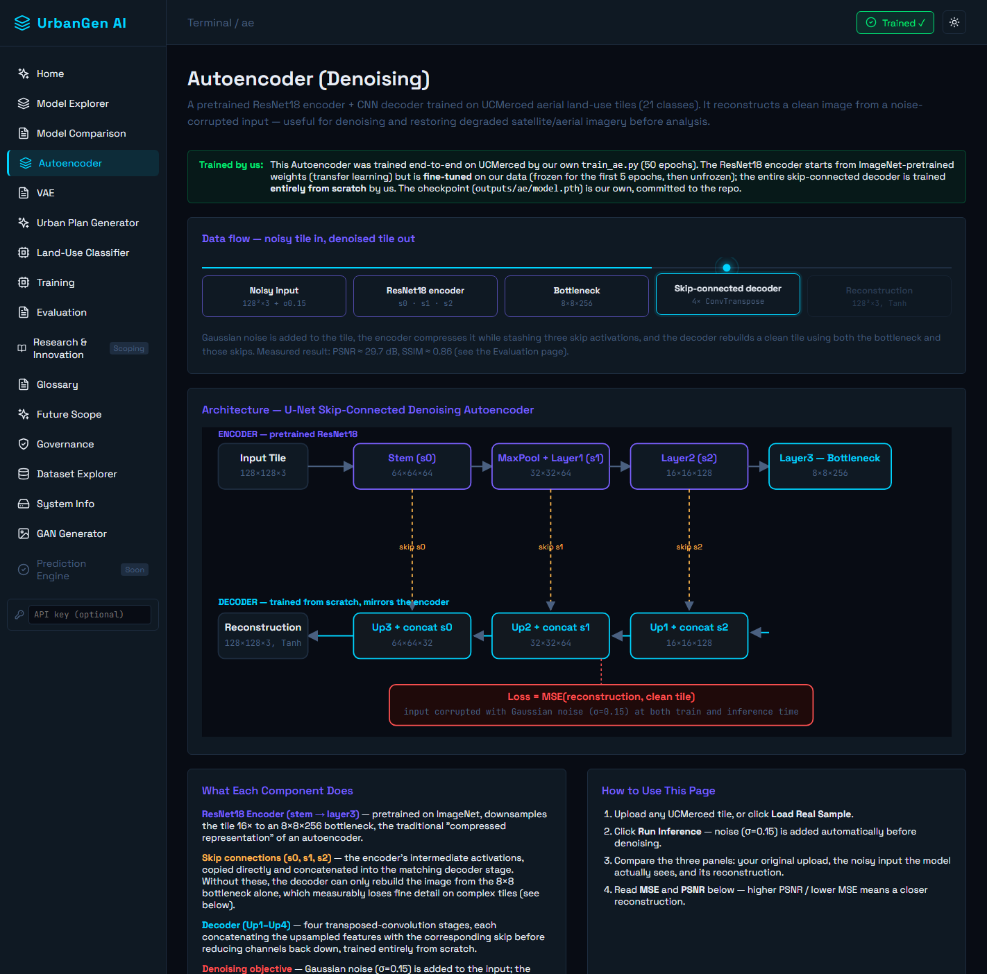
Output — a model page (Autoencoder)
Each model has its own page: animated input-to-output flow, labelled architecture diagram, how-to-use steps, and how it fits the project.

Slide 13
Output — input and result for each module
Module | Input | Output shown to the planner
Land-Use Classifier | One aerial tile (224x224) | Predicted zone (e.g. 'dense residential') + confidence + full 21-class bar
Denoising AE | Aerial tile + added noise | Three panels: original | noisy input | cleaned reconstruction (+ PSNR / SSIM)
Spatial VAE | One aerial tile | Anomaly banner — Typical / Unusual / Highly Anomalous — with a % and a plain reason; plus latent interpolation between two tiles
Conditional GAN | A chosen class (1 of 21) + random noise | A grid of freshly generated 128x128 tiles for that class
MiniGPT Transformer | Real Pune ward statistics (built-up %, road length, waterways) | A short written recommendation: setbacks, permeable surface, flood buffer, transit parking cap
Every output is on its own model page in the app, with an animated input-to-output flow above it.

Slide 14
Conclusion
UrbanGenAI shows four generative models working together on one urban-planning task.
• It works end to end — from an aerial tile and GIS data to a written, grounded recommendation.
• It is honest — every number is measured live; limitations (GAN geometry, VAE softness) are stated with evidence, not hidden.
• It is ours — the VAE decoder, the GAN and MiniGPT are trained fully from scratch; checkpoints are committed.
• It is responsible — only public data, planner stays in the loop, outputs are candidates that still need statutory and engineering checks.
• Next steps — full 5-source City Stack, a diffusion model for photoreal renders, and surrogate models for traffic, air quality and flood risk (see the Future Scope page).
Live demo order: Landing -> Model Explorer -> each model page -> Evaluation -> Future Scope.

